Slide 1
Ecology of diseases
Lecture 6
UNIT-2 (VETERINARY EPIDEMIOLOGY) (Credit Hours 3+1=4)
Dr. Anjay
Assistant Professor
Department of Veterinary Public Health & Epidemiology
Bihar Veterinary College
Bihar Animal Sciences University
Patna

Slide 2
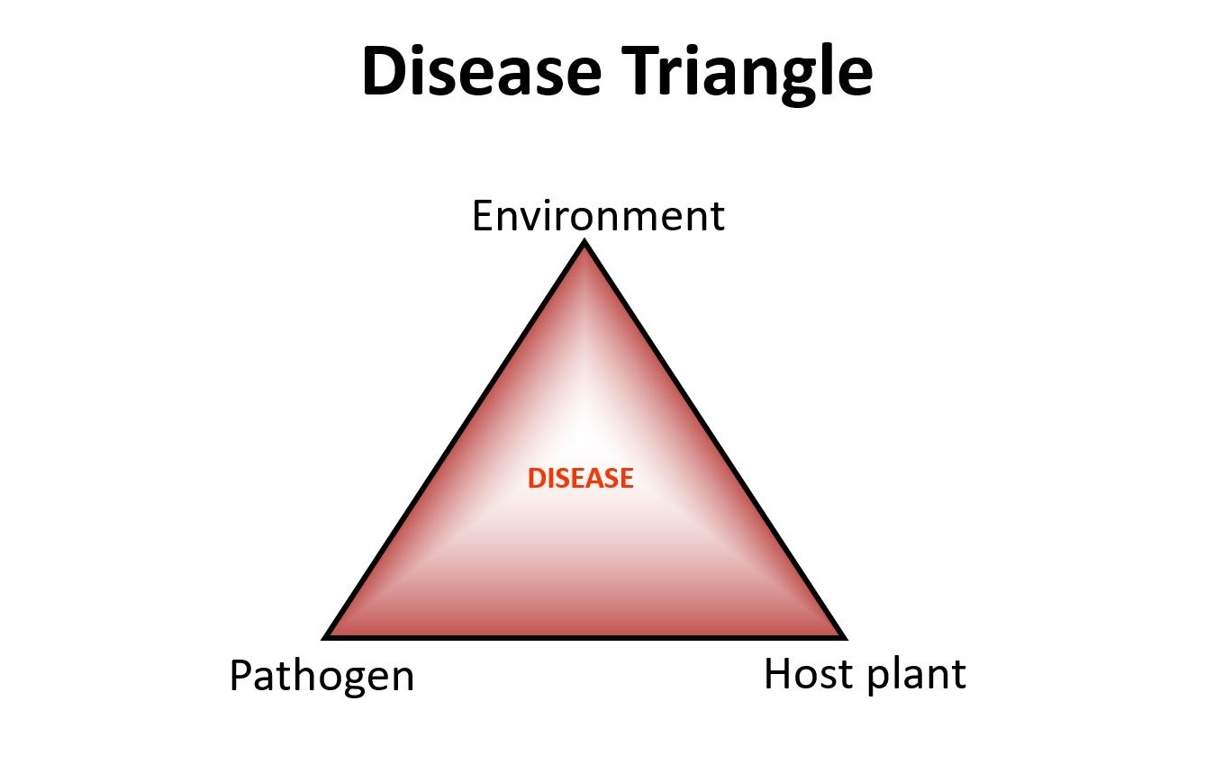
Ecology of diseases

Slide 3
What is ecology??
Ecology (Greek: oikos= house; logo- = discoursing)
The study of animals and plants in relation to their habits and habitation (habitat) is ecology
The study of a disease's ecology (also termed its natural history) is frequently a part of epidemiological investigations

Slide 4
Objectives of ecology
1. An increase in the understanding of the pathogenesis, maintenance and, for infectious agents, transmission of disease
2. The use of knowledge of a disease's ecology to predict when and where a disease may occur, to enable the development of suitable control techniques

Slide 5
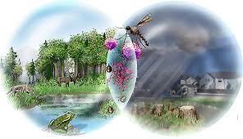
Basic ecological concepts
Factors: Determine the occurrence of disease
Distribution of animal populations
Distribution of suitable food
Distribution of suitable food
Distribution of suitable food
Size of animal populations
Availability of food,
Availability of mates & the species'
Breeding potential
Regulation of population size
The balance of nature
Vegetation zone
Tundra
Savannah
Desert
Control of population size by competition
Dispersal
Predation
Biomes
Home range
Territoriality
Social dominance

Slide 6
Factors effecting the disease spread
The distribution of host
Home range:
if home range increase: increase disease
3. Other behavioral activities of host:
ex. Rabies in foxes in Europe
Dump rabies: solitary existence
Furious rabies: approach other animals

Slide 7
The Niche
Competition: Intra species competition
Inter species competition
Coexistence of two strongly competing species is impossible
This led to the principle of competitive exclusion: that competition will exclude all but one Species from a particular position defined by an animal's feeding habits, physiology, mechanical abilities and behavior. This position is an animal’s niche.
Competitive exclusion has been used as a means of disease control
(Ex. The snail Biompholaria glabrata (I/H of Schistosomiasis)
Marisa cornuarietis (more competitive snail)
One Species one Niche

Slide 8
The Niche
Example of niche related diseases:
Louse infestation: Host specific so avoid competition
Intracellular parasitism: Occupy niche in cell
All viruses
Some bacteria (Mycobacterium, Rickettsiae, Brucella spp.)
Some protozoa (Babesia spp.)

Slide 9
Epidemiological interference
One type of respiratory adenovirus prevents infection with other types, even though the latter are common in surrounding community
Can effect the time of occurrence of disease:
Ex. altering age specific incidence rate (Human respiratory infections)
2. Alters the rate of natural immunization:
Ex. Interference by other enterovirus delays natural poliovirus immunization in man

Slide 10
The relationships between the different types of plant and animals
Food chain:
Simplistic view of the relationship between an animal and its food

Slide 11
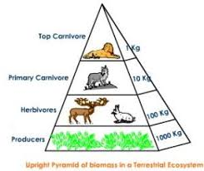
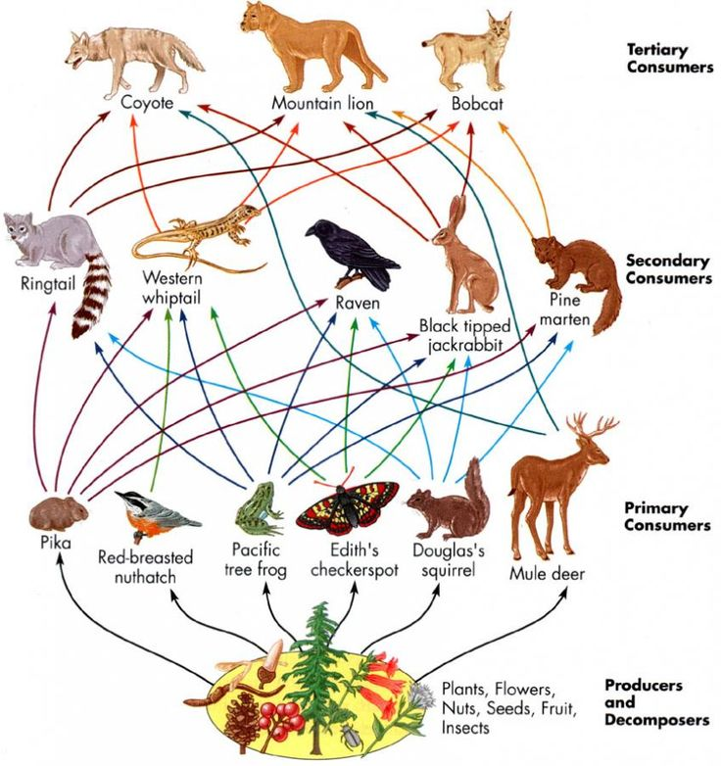
The relationships between the different types of plant and animals
Food webs and size of animals:

Slide 12
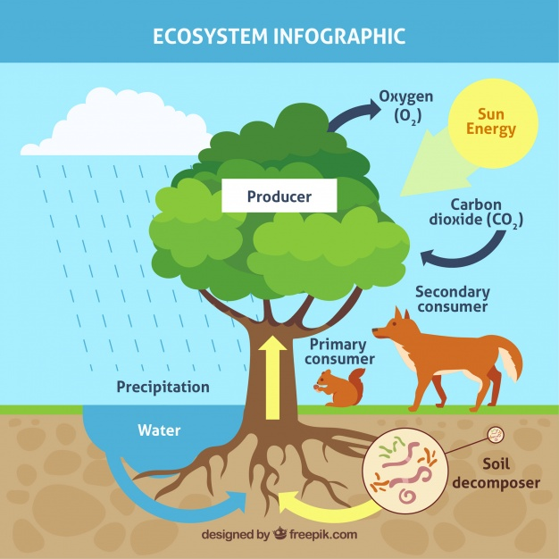
Ecosystem
Animals and plants that occupy them, and by their physical and climatic features. This unique interacting complex is called an ecosystem (An association of a biocenosis with the physical environment including soil or An association of living beings & their habitat).
Types: According to their origin
Autochthonous ecosystems
Anthropurgic ecosystems
Synanthropic ecosystems

Slide 13
Ecosystem
Autochthonous ecosystems
Greek word: autos: itself
chthon: the earth or the land
ous: deriving
Ex. Tropical rain forest, desert
Anthropurgic ecosystems
Greek word: anthropos: man
rooterg: to creat, to produce
Ex. Cultivated Pasteur & town
Synanthropic ecosystems
Greek word: syn: along with
anthropos: man
Ex. An example is a rubbish tip, harboring a variety ofvermin
(Leptosirosis)

Slide 14
Ecosystem
Biotope:
A biotope is the smallest spatial unit providing uniform conditions for life
An organism's biotope therefore describes its location
A biotope can vary in size
Ex. Caeca of a chicken for coccidia,
an area of poorly drained land for Fasciola hepatica infection of cattle
Different from niche which describes the functional position of an organism
Biocenosis
A biocenosis is the collection of living organisms in a biotope
The organisms include plants, animals and the microorganisms in the biotope
Biotic community: Large biocenosis.
Major biotic communities are biomes.

Slide 15
Ecosystem
An ecological climax
An ecological climax traditionally is said to have occurred when plants, animals, microbes, soil and macroclimate have evolved to a stable, balanced relationship
Infection is there & stable too: Endemic infection
The balance between host and parasite: In-apparent infection
If balance break: Epidemic infection
Ex. Bluetongue, in-apperent infection in indigenous sheep in South Africa due to ecological climax. The importation of exotic sheep (European breed) represented a disturbance of the stable climax

Slide 16
Ecosystem
Ecological interfaces
An ecological interface is a junction of two ecosystems
Infectious diseases can be transmitted across these interfaces
Ex: Transmission of yellow fever
The virus is maintained in apes in Africa in an autochthonous forest
ecosystem
Virgin forest cycle: Aedes africanus: transmits the virus between apes
Plantation cycle: A. simpsoni: bridges the interface between the autochthonous forest ecosystem & the anthropurgic cultivated savannahs.
Town cycle:A. aegypti: Between man.

Slide 17
Ecosystem
Ecological mosaics
An ecological mosaic is a modified patch of vegetation, created by man, within a biome that has reached a climax
Infection may spread from wild animals to man
Ex. The helminth infection loiasis is transmitted by arthropods between man, living in small forest clearing, and canopy-dwelling monkeys.
Ex. Clearing of the forest canopy encourages a close cover of weeds on the ground, creating conditions that are favourable for the incursion of field rats with mites infected with scrub typhus, which form mites infected with scrub typhus, which form mite islands and the resulting local areas of endemic scrub typhus

Slide 18
Landscape epidemiology
The study of diseases in relation to the ecosystems in which they are found is landscape epidemiology
Similar terms: Medical ecology
Horizontal epidemiology
Medical geography
Investigations are: qualitative in nature
Involves the study of ecological factors that effects the occurrence, maintenance, and transmission of disease

Slide 19
Landscape epidemiology
Nidality:
foci were natural homes of these diseases & were called nidi (Latin: nidus = nest)
Many arthropod transmitted infections present in the steppes were also limited to distinct geographical areas
The presence of a nidus depends on its limitation to particular ecosystem
An area that has ecological, social, & environmental conditions that can support a disease is a nosogenic territory
Nosoarea: is a nosogenic territory in which a particular disease is present

Slide 20
Landscape epidemiology
Objectives:
Prediction about the occurrence of disease
Facilitates the development of appropriate control strategies
Ex. Leptospirosis
Tularemia
Kyasanur Forest disease

Slide 21
THANKS
FOR
KIND ATTENTION

