Slide 1
Mating Systems - I
Jay Prakash Gupta
Associate Professor & Head,
Department of Animal Genetics & Breeding
Bihar Veterinary College
Bihar Animal Sciences University (BASU)
Patna – 800014 (Bihar)

Slide 2
Introduction
Mating System can be defined as a set of rules for making mating decisions
Selection Decision
Which indiv. to become parent?
How many progeny they produce?
How long be the parents utilized?
Animal Breeder
Mating Decision
which ♂s to breed to which ♀s

Slide 3
Mating System Classification
Animal Performance
Pedigree Relationship
Two bases:
Random
Mating
Positive Assortative
Mating
Negative Assortative
Mating
First strategy is for making individual matings—mating of specific sires to specific dams.
We will begin with a strategy that is, in a sense, no strategy at all. It is random mating.
Inbreeding
Outbreeding
Wright (1921)

Slide 4
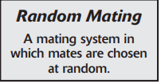
Random Mating
Random Number Table
Gate - Cutting
Random mating ≠ Random selection
Random mating can be either a lazy way to breed animals or a deliberate, carefully chosen technique.
Random mating is easy.
Requires no performance records or genetic predictions,
random mating is popular in commercial breeding programs where performance information is unavailable
Random mating relinquishes less control than we think, and the “mistakes” that result from random mating are often balanced by “pleasant surprises.”

Slide 5
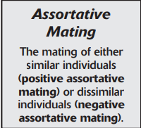
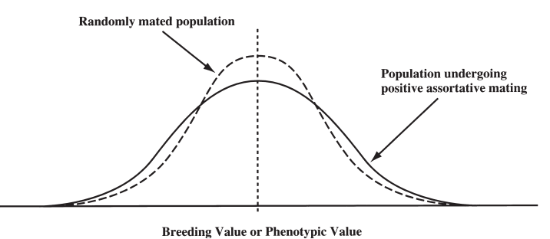
Assortative Mating
Positive and Negative Assortative mating
“Similar” means similar performance in a trait
Assortative mating Requires performance records, genetic predictions, or some other mating criterion
Positive Assortative Mating
Mating the biggest to the biggest, the smallest to the smallest, the fastest to the fastest, and so on.
Tends to create more genetic and phenotypi-c variation in the offspring generation than would be found in a comparable randomly mated population

Slide 6
Positive Assortative Mating
Mating the highest to the highest and the lowest to the lowest, tends to spread the distribution away from the center and toward the extremes.
Uniformity is usually valuable to breeders, so the increased phenotypic variation caused by positive assortative mating is normally considered a drawback of the strategy
However, increased genetic variation can be beneficial from a selection standpoint
Positive assortative mating therefore represents a way of speeding genetic change by increasing genetic variation.
Mostly breeders uses positive assortative mating to produce extreme individuals
Mating to produce extremes makes sense if the breeding goal is to change the mean performance of a population.
if an intermediate level of performance is optim-al and uniformity
about that optimum is
important, positive asso-rtative mating is inappr-opriate.

Slide 7
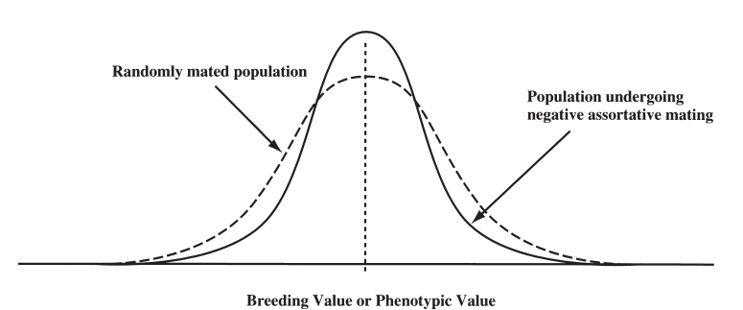
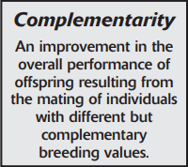
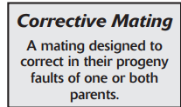
Negative Assortative Mating
Mating the biggest to the smallest, the smallest to the biggest, the fastest to the slowest, and so on.
Tends to decrease variation.
Mating extremes in one direction to animals that are extreme in the opposite direction tends to produce more intermediate types and reduce the number of extreme offspring
Reduced genetic variation decreases response to selection.
if our goal is to increase phenotypic uniformity about some interm-ediate optimum, this mating strategy can be beneficial.
Breeding for complementarity

Slide 8
Thanks!
Any questions?
You can find me at:
@JP_AAtrey
jp.prakash01@gmail.com

