Slide 1
Mating Systems – II (Based on Pedigree Relationship)
Associate Professor & Head,
Department of Animal Genetics & Breeding
Bihar Veterinary College
Bihar Animal Sciences University (BASU)
Patna – 800014 (Bihar)

Slide 2
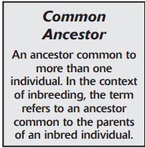
INBREEDING
Genetic Assortative Mating
is the mating of individuals more closely related than average for the population.
Individuals are considered to be closely related if they have common ancestor in the previous 4 to 6 generations
Types
Close inbreeding
Line Breeding

Slide 3
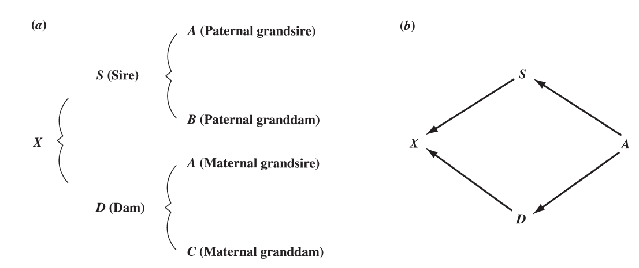
Assortative Mating
The main effect is increase in homozygosity
Effects of Inbreeding
Increase in the frequency of homozygous genotypes in an inbred population.
Increase in the number of homozygous loci in inbred individuals
Animal X is inbred because its parents (S and D) are
half sibs, having a common ancestor in individual A.
Because X could have inherited through its sire and dam
identical copies of an allele present in A, the inbred mating increases the likelihood that X is homozygous for that allele.

Slide 4
Prepotency: Effect of Inbreeding
The ability of an individual to produce progeny whose performance is especially like its own and(or) is especially uniform.
Inbred Genotype: AABbCCdd – Possible gametes: ABCd, AbCd
Non-inbred Genotype: AaBbCCDd - Possible gametes: ABCD, ABCd, AbCD, AbCd, aBCD,
aBCd, abCD, abCd
Inbred produces fewer unique gametes and therefore fewer unique zygotes than the noninbred.
An inbred individual is more likely to be prepotent if its homozygous loci contain chiefly dominant alleles.
Its offspring will then have at least one dominant
allele at each of these loci.
If dominance is complete
The effect of these loci in the
offspring will be the same as in the parent

Slide 5
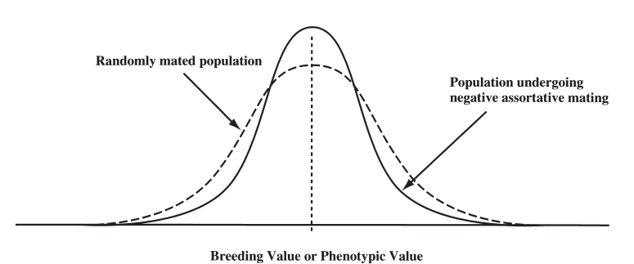
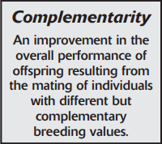
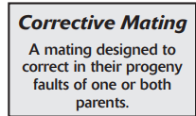
Negative Assortative Mating
Mating the biggest to the smallest, the smallest to the biggest, the fastest to the slowest, and so on.
Tends to decrease variation.
Mating extremes in one direction to animals that are extreme in the opposite direction tends to produce more intermediate types and reduce the number of extreme offspring
Reduced genetic variation decreases response to selection.
if our goal is to increase phenotypic uniformity about some interm-ediate optimum, this mating strategy can be beneficial.
Breeding for complementarity

Slide 6
Thanks!
Any questions?
You can find me at:
@JP_AAtrey
jp.prakash01@gmail.com

