Slide 1
Development of new breed for better productivity
Dr. Jay Prakash Gupta
Sardarkrushinagar Dantiwada Agricultural University
Animal Genetics & Breeding

Slide 2
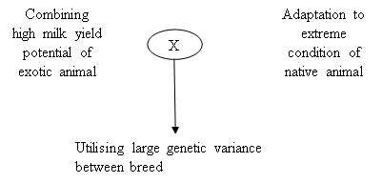
Objective

Slide 3
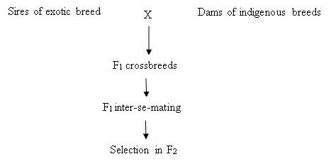
Plan

Slide 4
Choice of breed
Indigenous breed: (Foundation stock)
Considering the disease resistance, adaptation to local condition and hardiness
Exotic breed : Frozen semen technology has made it possible
They are mostly unrelated males free from any recessive inherited disease.
Should be selected on the basis of result of diallele crossing but it is costly to perform

Slide 5
So, general guideline is that Holstein-Frisian can be used in plains when fodder is available, Jersey can be used in hilly area where limited fodder is available
If motive of breed development is milk production, we may use Sahiwal, Red Sindhietc. with high lactation average and exhibited rapid genetic gain through selection
If we want to develop and breed for draught capacity in males, Hariana, Ongole, Kangayam can be used

Slide 6
if we want a locally adapted cattle breed, we may use non-descript cattle, but we will get undesirable types of F2 generation progenies, so progenies of Non-descript graded with good draught capacity is better.
If motive of breed development is milk production, we may use Sahiwal, Red Sindhietc. with high lactation average and exhibited rapid genetic gain through selection
If we want to develop and breed for draught capacity in males, Hariana, Ongole, Kangayam can be used
if we want a locally adapted cattle breed, we may use non-descript cattle, but we will get undesirable types of F2 generation progenies, so progenies of Non-descript graded with good draught capacity is better.

Slide 7
Level of exotic inheritance
Optimum exotic inheritance should be 50 to 62.5% for milk production
and it should be limited to 50% for adaptability, longevity as well as milk production.

Slide 8
Breeding plans
After obtaining crossbred progeny in F1 generation, we have to interbred or interse these progenies
Intensive selection should be performed from second generation onward by these considerations in mind
- for females lactation yield should be criteria
- Herd strength should be kept constant
- choice of intensity grades will depend on considering maximum genetic gain

Slide 9
Optimum number of females should be selected at different stages:
Retain 60% cows after first lactation
Cull 20% (1/5) cows after second lactation
Cull 12.5% (1/8) cows after third lactation
Cull all cows after fourth lactation except some outstanding ones

Slide 10
Thanks!
Any questions?
You can find me at:
@JP_AAtrey
jp.prakash01@gmail.com

