Slide 1
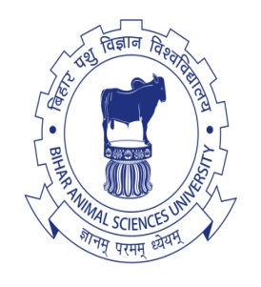
Recurrent selection in poultry
Dr. Jay Prakash Gupta
Associate Professor, Animal Genetics & Breeding
Bihar Veterinary College
BASU, Patna
Bihar - 800014

Slide 2
Recurrent Selection : Introduction
Recurrent selection was proposed by Jerkins (1940) for improving GCA in plant
It was further modified by Hull (1945) to utilize the specific combining ability
Definition:
Recurrent selection is defined as reselection generation after generation, with inter-mating of selected animals/ birds to produce the population for the next cycle of selection.

Slide 3
Recurrent Selection : Procedure
Here a highly inbred line is selected as tester “Tester line”
Large number of individuals of a source population are tested in crosses with this tester line, known to have good GCA.
There will be selection of male and female of the source population on the basis of their cross progeny of tester line performance.
Cross bred progeny are not used further for breeding

Slide 4
Recurrent Selection : Procedure
The selected individuals from source population are mated again and again among themselves to produce next generation of complementary stock of the tester inbred line.
This cycle is repeated several generations till maximum progress is achieved
By this method the GCA of only one line and SCA of cross are improved
Practical difficulty is to produce and maintain highly inbred tester line.

Slide 5
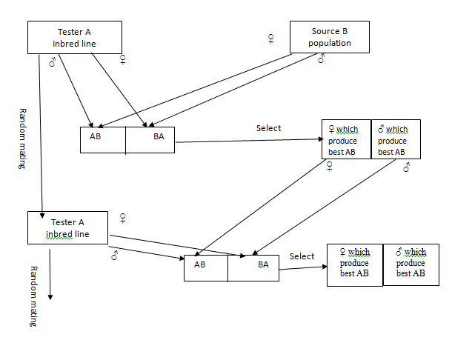
Recurrent Selection

Slide 6
Thanks!
Any questions?
You can find me at:
@JP_AAtrey
jp.prakash01@gmail.com

