Slide 1
Response to Selection
Dr. Jay Prakash Gupta
Associate Professor, Animal Genetics & Breeding
Bihar Veterinary College, Patna
BASU, Patna
Bihar - 800014

Slide 2
Introduction
Selected
Parent
Difference of mean is Selection Differential (S)
$$\overline{(P_{s})}$$
Selection
Population
$$\overline{(P_{0})}$$
Difference of mean is Response to selection (R)
Progeny
$$\overline{(P_{1})}$$

Slide 3
Response to Selection : Terms
Response to selection (R): it is the difference of mean phenotypic value between the offspring of the selected parents and the whole of the parental generation before selection.
Selection differential (S): It is the mean phenotypic value of individuals, selected as parents expressed as a deviation from the population mean, that is from the mean phenotypic value of all the individuals in the parental generation before selection was made.

Slide 4
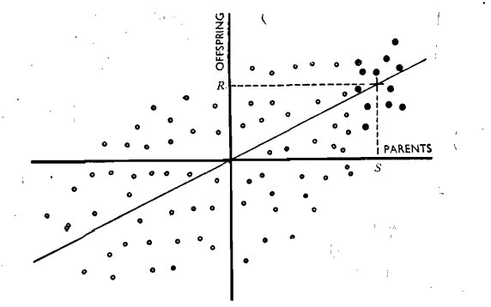
Connection between response and selection differential
$$\overline{(P_{s})}$$
Each Point = Pair of parents and their progeny
Horizontal axis = Mid parent value
Vertical axis = Mean value of progeny
Origin = Population mean same for both Gen.
$$\overline{(P_{0})}$$
S
Let R be the mean deviation of their offspring from the population μ.
Then S is the selection differential and R is the response
The cross-point represents the mean value of the selected parents and of their progeny, and it lies on the regression line.
The regression coefficient of offspring on parents is thus equal to R/S.

Slide 5
Response to selection
Therefore,
Regression of offspring on mid parent is equal to the heritability (h²)
Therefore, again
The heritability is equivalent to the regression of an individual's breeding value on its phenotypic value.
The deviation of the progeny from the population mean is, by definition, the breeding value of the parents, and so the response is equivalent to the breeding value of the parents.
Thus it follows that the expected value of the progeny is given by

Slide 6
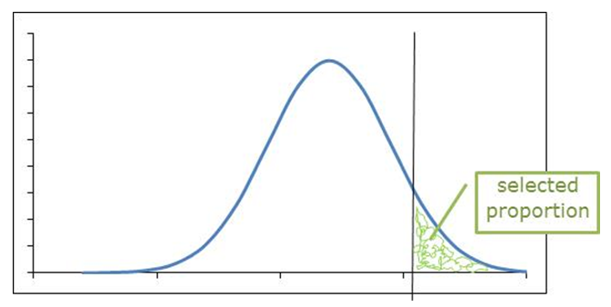
The selection differential
The change of the population mean brought about by selection i.e. the response depends on the heritability of the character and on the amount of selection applied as measured by the selection differential.
Frequency
Phenotypic value

Slide 7
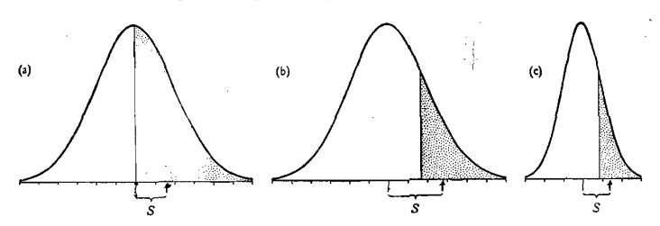
The selection differential
The magnitude of the selection differential depends on two factors: the proportion of the population included among the selected group, and the phenotypic standard deviation of the character.
Point of truncation (z)
Frequency
P
Phenotypic value
selection differential

Slide 8
The selection Intensity
The standard deviation, which measures the variability, is a property of the character and the population,
Selection intensity (i) is the number of phenotypic standard deviation (σp) units that selected parents are superior to the mean
Selection intensity (i) is obtained from normal distribution table, according to the proportion (P) of animals selected as parents

Slide 9
The selection Intensity
Note the relationship between proportion selected (P) and selection intensity (i)
Select few individuals low P and high (i)
Select many individuals high P and low (i)
Now, Selection differential standardized in terms of phenotypic standard deviation (σp) is known as Intensity of selection (i) i.e.
i = S/ σp

Slide 10
The selection differential
The standard deviation, which measures the variability, is a property of the character and the population,
The response to selection may be generalised if both R and S are expressed in terms of the phenotypic standard deviation (σp).
Then R /σ p is a generalised measure of the response, by means of which we can compare different characters and different populations; and

Slide 11
The selection differential
S / σ p is a generalised measure of the selection differential, by means of which we can compare different methods or procedures for carrying out the selection. The "standardised" selection differential, Sl σ p, will be called the intensity of selection, symbolised by i.
Summary,
R = i σp h²
R = i σp h x h
R = i σP(σA/ σP) h (since h = σA / σP), R = i σA h

Slide 12
Thanks!
Any questions?
You can find me at:
@JP_AAtrey
jp.prakash01@gmail.com

