Slide 1
Salmonellosis

Slide 2
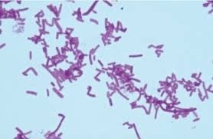
Introduction
Family: Enterobateriaceae
Named by: D.E. Salmon,
Isolated Salmonella Choleraesuis, from pigs in 1885 (Le Minor.,1994)
Morphology:
Rod-shaped (dia. 0.7 to 1.5 μm/ length 2 to 5 μm)
Gram-negative
Non-spore forming,
Predominantly motile (except S. Gallinarum and S. Pullorum)
Having peritrichous flagella
Recognized species: Two
S. enterica
S. bongori

Slide 3
Introduction
Number of serotypes: More than 2650
(According to the Kauffmann-White (KW) scheme)
Salmonella enterica (2639)
Salmonella bongori (20) (Ryan et al., 2017)
The basis of K-W serotyping includes
O (Heat-stabile somatic)
Vi (Heat-labile capsular)
H (Flagellar) antigens
(Nataro et al., 2011)
S. enterica subsp. Enterica: 1586 serotypes of which S. Typhimurium and S. Enteritidis are mainly responsible for human infections

Slide 4
Introduction
S. enterica subsp. salamae (522), subsp. arizonae (102), subsp. diarizonae (308), subsp. houtenae (76) and subsp. indica (13) serotypes
(Grimont and Weill., 2007)
S. bongori (V) composed of 22 serotypes
Mainly associated with cold-blooded animals
Role in human infections are very uncommon
May affect children of 1 month to 3 years of age
(Giammanco et al., 2002)
Nomenclature: The full taxonomic designation can be shortened by writing the genus name & name of serovar or serotype with First letter caps & without underline or italic
(Eg. Salmonella enterica subspecies enterica serotype Typhimurium as Salmonella Typhimurium)
(According to CDC & WHO)

Slide 5
Source of infection and mode of transmission
Isolated from: wide range of animals & their food products
(Poultry, bovine, ovine, porcine, fish, seafood & poikilotherms (cold-blooded animals) such as lizards & snakes
(Zajac et al., 2013: Nguyen et al., 2016; Flockhart et al., 2017)
Infection:
Non-typhoidal Salmonella
Ingestion of contaminated foods with bacteria: eggs, chicken, beef, pork, milk products, fruits, & vegetables
Direct person to person contact
Contact with infected animals farm or cats, dogs, rodents, reptiles, or amphibians
(Haeusler and Curtis., 2013)
Typhoidal Salmonella
Endemic: Developing world
Area with lack of clean water & adequate sanitation
Transmit through the fecal-oral route

Slide 6
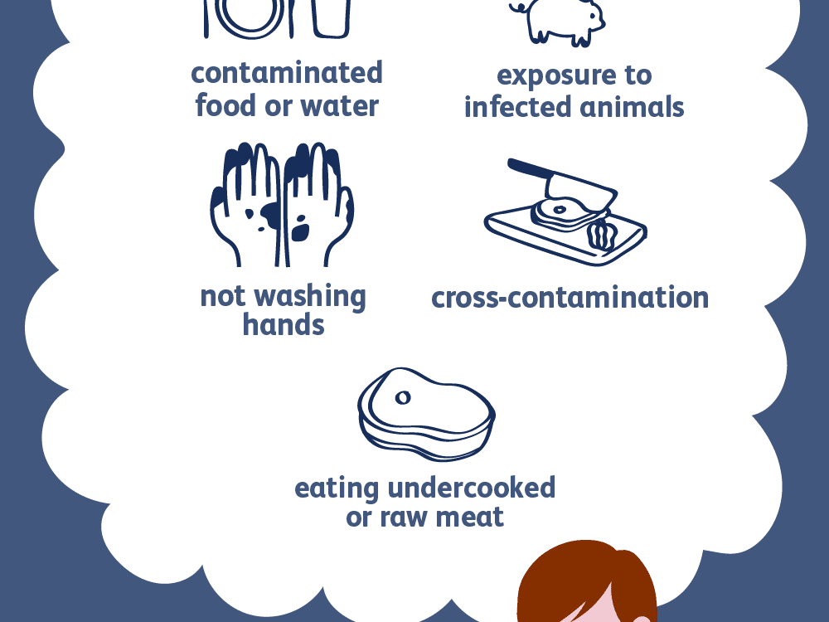
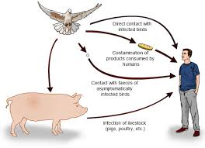

Slide 7
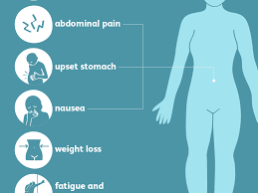
Disease in human
Typhoidal Salmonella serovars
Enteric fever -typhoid (Salmonella serovars serovar Typhi)
Paratyphoid fever (Salmonella serovars Paratyphi)
Incubation period: 14 day
Symptoms
Gradual onset of sustained fever (39–40°C),
Chills,
Abdominal pain,
Hepatosplenomegaly,
Rash (rose spots),
Nausea,
Anorexia,
Diarrhea or constipation,
Headache, & a dry cough

Slide 8
Disease in human
Non Typhoidal Salmonella (NTS) serovars
Cause self-limiting, acute gastroenteritis & watery diarrhea
Incubation Period: 6–12 h which lasts within 10 days
The most common symptoms
Diarrhoea
Nausea
Vomition,
Abdominal pain
Fever
In immunocompromised patient shows
Invasive infections
Symptoms similar to enteric fever characterized by high fever, hepatosplenomegaly & respiratory complications

Slide 9
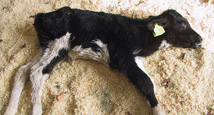
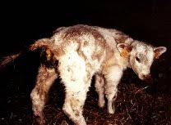
Disease in animals
Cattle:
Caused by : S. Dublin & S. Typhimurium
Clinical salmonellosis along with isolation of some other serotypes from infected animals
In adult
Source of infection: faeces & milk of an infected cow
Symptoms: High fever, abdominal pain, faeces with blood clots, followed by profuse diarrhoea & finally sub normal body temperature
In pregnant cattle : shows abortion
The outcome of disease: Death within a few days/ recovery /carrier
Calves
More susceptible high mortality
Caused septicaemia & death of new-born calves

Slide 10
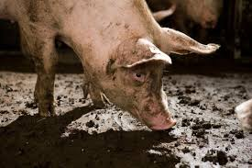
Disease in animals
Swine:
Principal reservoir of S. Choleraesuis
Other serotypes: S. Enteritidis, S. Typhimurium, & S. Dublin
Source of infections: The carrier animals & contaminated food
Causes: Swine paratyphoid or necrotic enteritis
Highly susceptible: in 2 to 4 months of age
Symptoms
Fever & diarrhoea
Invasive infections leads to septicaemia blood or any organ such as intestine & mesenteric lymph nodes

Slide 11
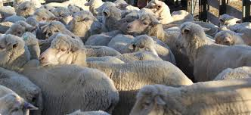
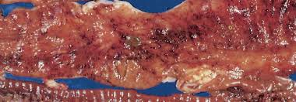
Disease in animals
Sheep and Goats:
S. Typhimurium & other serotypes: Gastroenteritis
S. Abortusovis:
Gastroenteritis,
Abortions in last two months of pregnancy,
Stillbirths in pregnant ewes
Mortality in neonates

Slide 12
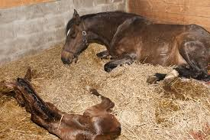
Disease in animals
Horses and Donkey:
S. Abortusequi
In mares & donkeys: Abortion (7-8 month of pregnancy)
Stallion:
Fever,
Edematous swelling of the prepuce,
Hydrocele,
epididymitis,
Orchitis,
Testicular atrophy and arthritis
Equines are also susceptible to other serotypes particularly S. Typhimurium

Slide 13
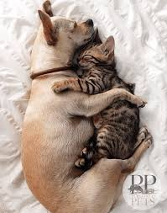
Disease in animals
Dogs and Cats:
infected by various serotypes of Salmonella and acts as asymptomatic carriers
They may get infection by consumption of faecal materials of other animals or man, and contaminated food and may suffer from gastroenteritis

Slide 14
Disease in animals
Fowl:
Caused disease by: S. Pullorum & S. Gallinarum
Host:
Mainly chickens & turkeys
Other birds: pheasants, quail, ducks, guinea-fowl & peafowl
Potent reservoirs: Domestic poultry
Disease
S. Pullorum: Pullorum disease (effect young bird: 2-4 month)
S. Gallinarum: fowl typhoid (adult bird)

Slide 15
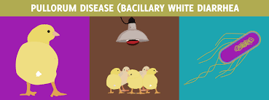
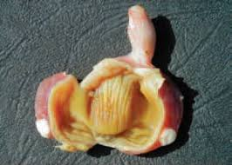
Disease in animals
Pullorum disease
Transmit vertically & horizontally
The birds may manifest
depression,
anorexia,
huddling,
droopy wings,
dehydration,
laboured breathing,
diarrhoea,
ruffled feathers,
weakness & adherence of faeces to the vent

Slide 16
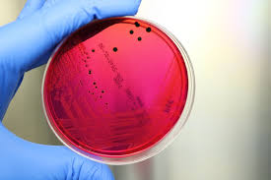
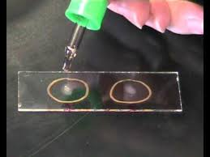
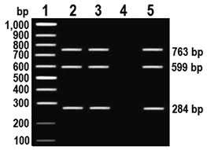
Diagnosis
Diagnosis of Salmonella serovars may be performed by
Cultural method
Serotyping
Molecular tools

Slide 17
Diagnosis
Cultural method
Gold standard
Samples: stool, blood, bone marrow, urine etc while faecal and food samples (NTS)
Pre-enrichment: Buffered peptone water
Enrichment: Selenite cystine broth or Tetrathionate broth
Selective/differential/chromogenic media:
MacConkey,
Hektoen enteric (HE),
Xylose-lysine-deoxycholate (XLD),
Salmonella-shigella (SS),
Bismuth sulfite agar (BSA)
Brilliant green & CHROM agar
(Gal-Mor., 2018)

Slide 18
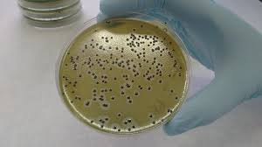
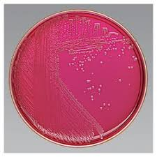
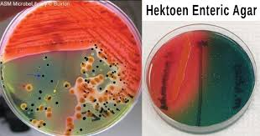
BSA
BGA
HE
XLD

Slide 19
Diagnosis
Biochemical characterization
Test | reaction
Indole | - ve
Methyl red | +ve
Voges-Proscauer | - ve
Citrate utilization | +ve
Urease test | - ve
TSI | Acidic butt and alkaline slant with blackening

Slide 20
Diagnosis
Serotyping
Carried out at central reference laboratories (K W scheme)
National Salmonella and Escherichia Centre (NSEC), Central Research Institute, Kasauli (H.P) – 173204 (India)
National Salmonella centre, ICAR-IVRI, Izatnagar, Bareilly (UP), 243122
Molecular Typing
Pulsed-field gel electrophoresis (PFGE),
Multilocus sequence typing (MLST),
Ribotyping,
Clustered regularly interspaced short palindromic repeat (CRISPR)
(Gal-Mor., 2018)

Slide 21
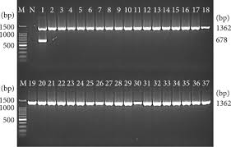
Diagnosis
Serological Diagnosis
Widal tube agglutination test
Dot blot enzyme-linked immunosorbent assay (ELISA)
Enzyme immunoassay (EIA)
Molecular and other method
PCR-based assays targeting invA, hisJ, hilA, fliC, viaB, ttrC-ttrA, 23S rRNA ratA etc.
Some other techniques
MALDI-TOF MS
Whole-genome sequencing

Slide 22
Prevention and control
In human
By reduction of its prevalence in food animals
Proper expert inspection/ supervision:
Meat, milk & egg production
Education:
Farmers, milkers, butchers & animal food handlers: about basic concept of food, slaughter, personal & environmental hygiene
Producers & consumers: Proper cooking & refrigeration practices
Epidemiological surveillance
To evaluate the magnitude of problem, origins of outbreaks & to design suitable measures to reduce the risks

Slide 23
Prevention and control
In animals
Elimination of carriers,
Immunization
Proper management of herds & poultry farms.

