Slide 1
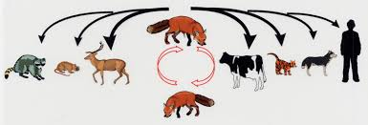
Training
on
“Zoonotic Diseases with special reference to Rabies, Bird flu, Swine flu etc..”
Emergence, Prevention & Control of rabies
Dr. Bhoomika
Assistant Professor cum Jr. Scientist
Department of Veterinary Public Health & Epidemiology,
Bihar Veterinary College
Bihar Animal Sciences University, Patna-14

Slide 2
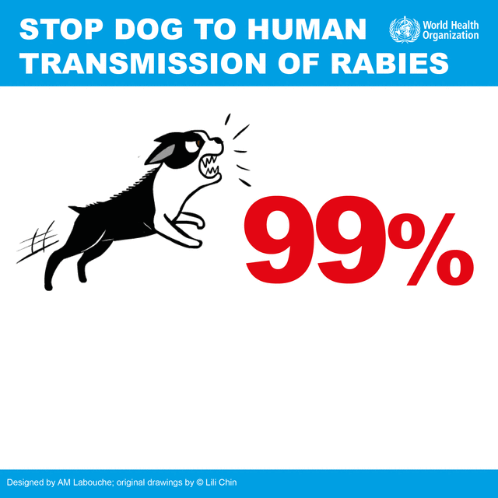
Rabies: Introduction
Rabies: a scourge that kills nearly 59,000 people a year
Effects the CNS of mammals (including humans)
The virus present: the saliva & brain of infected animals
It is transmitted via the saliva of an infected animal, most often a dog
Incubation period: several days to several months
Once symptoms are present, the disease is fatal for both animals and humans

Slide 3
Rabies: Fast facts
Occurs in more than 150 countries
Appx. 80% of human cases occur in rural areas
20, 000 human deaths occurring in India alone
10 of 1000 of deaths/ year mainly in Asia & Africa
40% of people bitten by suspect rabid animals are children under 15 years of age
Every year >29 M people worldwide receive a post-bite vaccination
Globally rabies causes an estimated cost of US$ 8.6 billion/ year

Slide 4
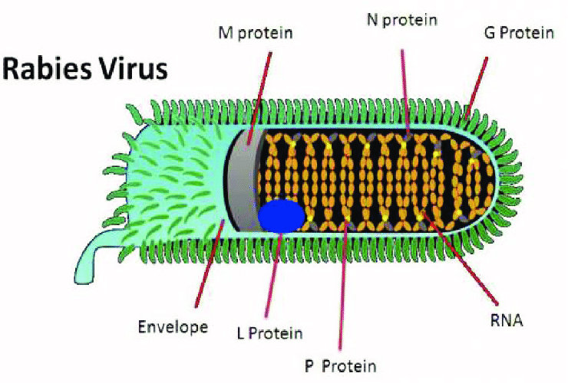
Etiology
Neurotropic RNA viruses
Family: Rhabdoviridae
Order: Mononegavirales
Genus: Lyssavirus
Species:
Classical rabies virus (RABV),
Lagos bat virus (LBV),
Mokola virus (MOKV),
Duvenhage virus (DUVV),
European bat lyssaviruses type-1 (EBLV-1) and type-2 (EBLV-2),
Australian bat lyssavirus (ABLV),
Aravan virus (ARAV),
Khujand virus (KHUV),
Irkut virus (IRKV),
West Caucasian bat virus (WCBV),
Shimoni bat virus (SHIBV)
Transmissible to all mammals
RABV is the most important one for public & animal health

Slide 5
Epidemiology
Infection is maintained in two epidemiological cycles: Urban & sylvatic
In the urban rabies cycle:
Dogs are the main reservoir host
Predominates in areas of Africa, Asia, & Central & South America
The sylvatic (or wildlife) cycle:
Predominant cycle in the northern hemisphere
It can also present simultaneously with the urban cycle in some parts of the world
Important social costs due to human mortality & high economic consequences
Vampire bat (Desmodus rotundus) in Latin America & a number of insectivorous bat species in North America

Slide 6
Epidemiology

Slide 7
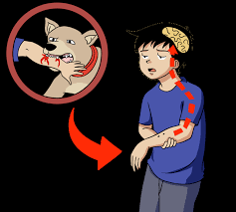
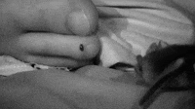
Sources & transmission
Primary reservoirs:
Foxes, bats, raccoons, skunks, dogs, cats & cattle
Main source: saliva & brain tissue
Transmission
From fresh saliva via bite, scratch or abrasion by an rabid animal
Rabid dogs shed virus in saliva 5-7 days before showing signs
Cat does so for only 3 days before signs
Contamination of skin wounds by fresh saliva from infected animals also a source of infection
Infection occurs primarily via bite wounds, or infected saliva entering an open cut or wound or mucous membrane, such as those in the mouth, nasal cavity or eyes
Occasional, albeit rare, transmission by inhalation of infected aerosol

Slide 10
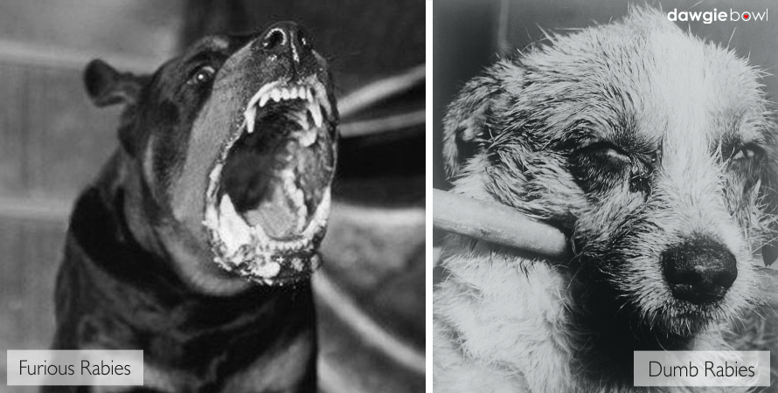
Clinical sign: animals
Central nervous system disturbances
The clinical course especially (in dogs)
Can be divided into 2 phases:
The excitative form
The paralytic form

Slide 11
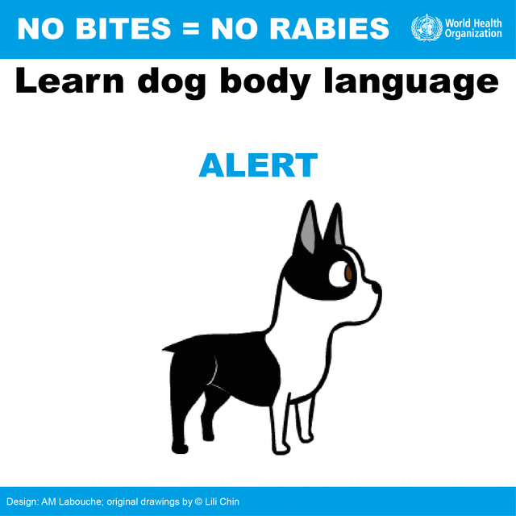
Clinical signs: animals
In dogs
1. Furious form (changes in behavior & stage of excitement)
Tendency to bite either inanimate/animate objects till death
Travel to long distance
Shows imaginary catching stance
Unable to drink water: paralysis of pharyngeal & laryngeal muscles
Drooling of saliva
Photophobia
Changes in barking: paralysis of vocal chords
Dropped jaw & protrude
tongue will drop down of head
Dump form or paralytic form:
Isolated themselves in dark places
Paralysis: lower jaw (dropped jaw ), tongue, larynx & hindquarters
Not capable to bite
In cats: furious form is more common
(Source: Text book ofElements of Veterinary Public Health)

Slide 12
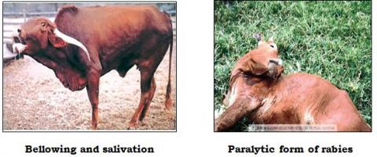
Clinical signs: animals
In cattle
Furious form is more common:
Violently attack other animals or
Attack to inanimate objects,
loud bellowing,
Incoordination of gait,
Excessive salivation,
Behavioral changes,
Muzzle tremor,
Aggression,
Sexual excitement,
Hyper excitability &
Pharyngeal paralysis
Paralytic form:
Knuckling of hind fetlock,
Sagging & swaying of hind quarter while walking
Deviation of tail to one side,
Drooling of saliva & yawing movement
(Source: Elements of Veterinary Public Health)

Slide 13
Clinical signs: animals
In sheep:
Hyperexcitability,
salivation,
vocalization,
recumbency,
vigorous wool plucking,
excessive bleating does not occur but continuous bleating is common & starring of eyes & twitching of lips
In horse:
Muscle tremors are frequent & common,
Pharyngeal paralysis,
Ataxia & lethargy,
Sudden onset of lameness in one limb followed by recumbency & violent head tossing
In pigs:
Twitching of nose,
excessive salivation,
chronic convulsion,
rapid chewing movement & may walk backwar
(Source: text book of Elements of Veterinary Public Health)

Slide 14
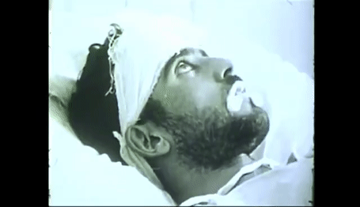
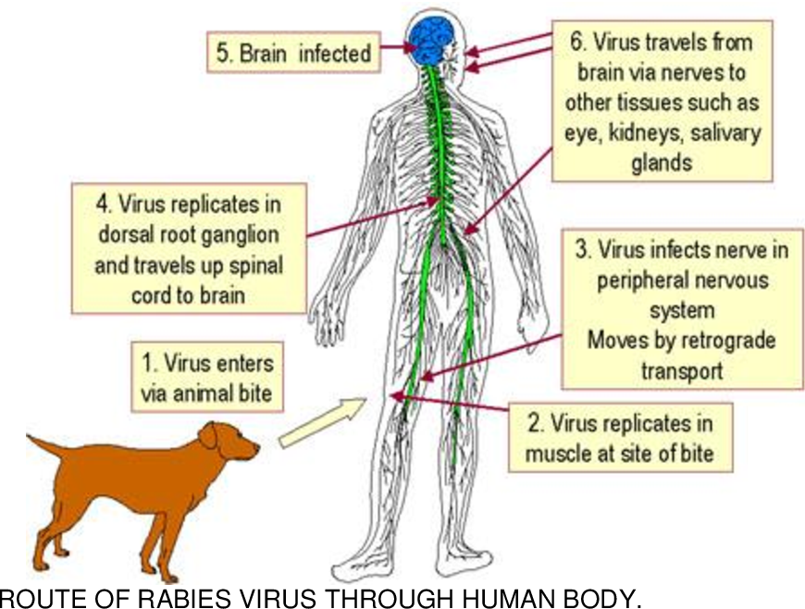
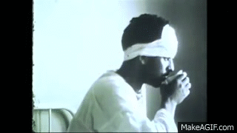
Clinical signs: humans
The incubation period: few months (usually 30 to 60 days)
The virus migrates along nerves to the spinal cord and brain at an estimated speed of 12–24 mm a day
Convulsions occur
Thick tenacious saliva
Increased lacrimation,
Frequent micturition
Increased perspiration
The initial symptoms of rabies are often mild fever & pain or paresthesia at the wound site
Furious rabies is rapidly fatal: hydrophobia or aerophobia, phobia towards sound, hyperactivity and fluctuating consciousness
Flaccid paralysis ascending with pain in the affected muscles & mild sensory disturbances will precede death from respiratory paralysis
Infection reaches to CNS symptoms begin to show
The infection is effectively untreatable & usually fatal within days
Death almost invariably results 2-10 days after first symptoms
Drinking cause extremely painful laryngeal spasm
Patient refuses to drink (hydrophobia-fear of water)
Muscle spasm, laryngospasm & extreme excitability are present
Depending on
The distance of bite
Severity of bite,
Amount of virus inoculated
Aggressive status of the rabid animal
(Source: Text book of Elements of Veterinary Public Health)

Slide 15
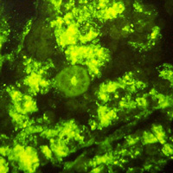
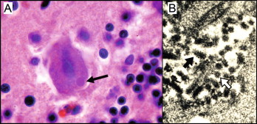
Diagnosis
Sign & symptoms
Fluorescent antibody test (FAT)
Corneal impression smear, as well as brain
Highly specific & rapid test (99.9%)
Detects different strains using monoclonal antibody
The identifiable strains correlate well with species & geographic distributions observed
3. Identification of Negribodies (intracytoplasmic inclusion bodies) in the brain impression smear by Seller's staining technique
4. Virus isolation from body fluid or brain tissue
5. Molecular techniques
Negri bodies
(Source: Text book of Elements of Veterinary Public Health)

Slide 16
Prevention & Control
Post-exposure immunization:
Upto 50% of human rabies immune globulin is infiltrated around the wound; the rest is administered IM
(ERIG or HRIG: anti-rabies antibody)
Human Diploid Cell Vaccine (HDCV):
5 injections IM at days 0, 3, 7, 14, & 28
Vaccination of domestic animals
Enforced animal control measures (Animal Birth Control and Anti-rabies vaccination programme: ABC-AR)
Controlling stray dog population
Proper immunization of household dogs (ABC-AR programme)
Vaccination of high risk personnel
Awareness programme among public
(Source: Text book of Elements of Veterinary Public Health)

Slide 17
Objectives:
Training of Health Care professionals on appropriate Animal bite management & Rabies Post Exposure Prophylaxis.
Advocacy for states to adopt and implement Interdermal route of Post exposure prophylaxis for Animal bite Victims and Pre exposure prophylaxis for high risk categories.
Strengthen Human Rabies Surveillance System.
Strengthening of Regional Laboratories under NRCP for Rabies Diagnosis.
Creating awareness in the community through Advocacy & Communication and Social Mobilization.
https://ncdc.gov.in/index1.php?lang=1&level=1&sublinkid=125&lid=150

Slide 18
Prevention & Control
Rabies vaccine for injectable use:
Live-attenuated vaccines: widely used for injection in domestic animals
(Documented to cause rabies in vaccinated animals)
The rabies virus glycoprotein biotechnology-derived vector vaccines are not live rabies virus vaccines
They are prepared by inserting non-infectious rabies virus nucleic acid coding for rabies virus glycoprotein into a vector such as avipox for injectable vaccine.
As these do not contain live rabies virus, animals vaccinated with rabies virus glycoprotein vaccines should not be restricted from entry into countries that have restrictions on entry of animals vaccinated with live rabies virus vaccines

Slide 19
Prevention & Control
Rabies vaccine for oral use
Vaccines for oral use are indicated for feral & wild animals
Oral vaccination programmes: live vaccines or biotechnology-derived vaccines
Safety and efficacy in target animals and safety in non-target species must be demonstrated.
Oral vaccination will request periodical monitoring of the impact of vaccination programme

Slide 20
Prevention & Control
(Rabies vaccines can be administered by two different routes: ID or IM)
ID route:
Sites: for all age groups
the deltoid region & either the anterolateral thigh or suprascapular regions
IM route:
Sites: for adults & children aged ≥2 years: the deltoid area of the arm,
for children aged ≤2 children years: the anterolateral area of the thigh
Pre-exposure prophylaxis
Three doses/three visits
IM or ID one dose each
on day 0, day 7, & day 21 or 28

Slide 21
Prevention & Control
Prevention & Control
Post-exposure prophylaxis (PEP)
appx. 15 minutes, with soap or detergent & copious amounts of water.
viricidal: iodine-containing, topical preparation
A series of rabies vaccine injections should be administered promptly after an exposure
*RIG: severe category III exposures
*If a repeat exposure occurs within 3 months of completion of PEP, only wound treatment is required, neither vaccine nor RIG are needed

Slide 22
Classification of exposure based involvement of risk
Class I-
(Slight or negligible risk)
Licks on healthy/ unbroken skin
Scratches without oozing of blood
Class II-
(Definite but moderate risk)
Licks on fresh cuts
Scratches with oozing of blood
All bites except on head, neck, face, palm and fingers
Minor wounds less than five in number
Class III-
(Severe/ grave risk)
Licks on mucosa
Bites on head, Neck, face, palm & fingers
Lacerated wounds on any part of the body
Bites from wild animals

Slide 23
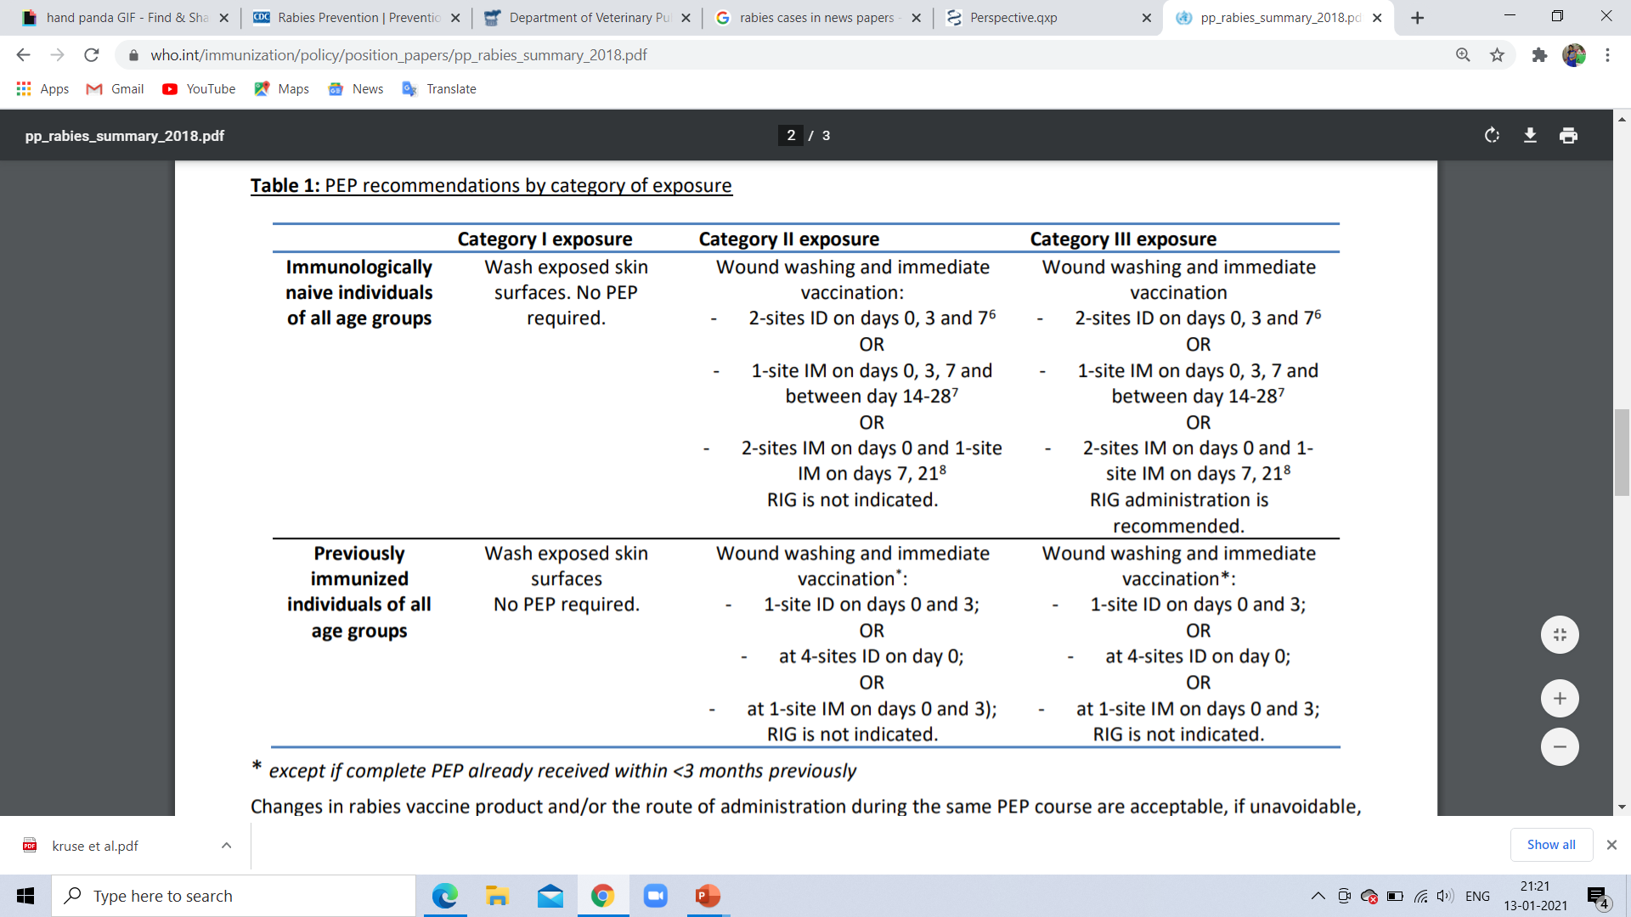
Prevention & Control
PEP recommendations by category of exposure

Slide 24
Prevention & Control
RIG dose:
The maximum dose is 20 IU (hRIG) and 40 IU (eRIG) per kg body weight
There is no minimum dose
Infiltrate as much as possible into the wound
Any remaining RIG, it should be given intramuscularly on the anterolateral region or deltoid region

Slide 25
Conclusion
Rabies is one of the oldest diseases known to humans & animals
It is a serious public threat in many countries in South-East Asia.
There is still no treatment available once a patient develops the symptoms of rabies
Prevention is always better than cure

