Slide 1
ANAPHYLAXIS
Unit- 1(General), Veterinary Medicine
Dr. Anil Kumar
Associate Professor
VMD, BVC (BASU), PATNA

Slide 2
Introduction
When an animal is exposed to an antigen, it produces a state of increased reactivity of the animal's tissues to that antigen, and a state of specific immune responsiveness is achieved which are defensive and beneficial most of the time.
But, on occasion, they can be detrimental to the host due to a state of hypersensitivity which is clinically recognizable as allergy.
When the reaction is sudden and clinically severe it is called anaphylaxis and if sufficiently severe it may result in anaphylactic shock.

Slide 3
There are 4 major mechanisms for the induction of a hypersensitivity response, and classified as types I- IV based on the immune mechanism that give rise to the disease state.
Types I-III are antibody-mediated responses to antigen whereas Type IV hypersensitivity is cell-mediated
Anaphylactic shock (type I)-Immediate hypersensitivity
Autoimmune hemolytic anemia (type II)- cytotoxic hypersensitivity
The local Arthus reaction (type III)
Type IV hypersensitivity (Delayed hypersensitivity): is caused by the induction of sensitized T lymphocytes and thus has a cell-mediated mechanism-

Slide 4
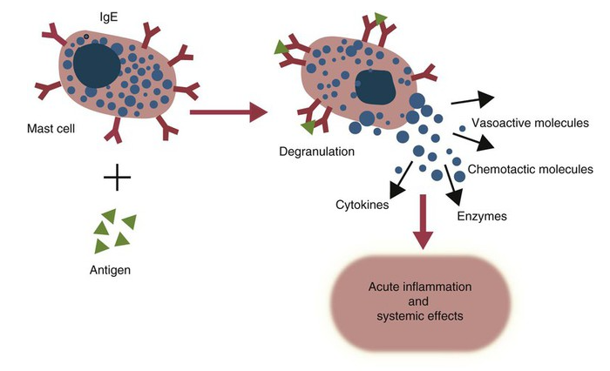
In TYPE I:
It is also called immediate hypersensitivity, are mediated by immunoglobulin E (IgE) attached to mast cells.
Disease is caused by the release of inflammatory molecules from mast cells following the binding of antigens to IgE.
The clinical signs of allergic disease depend in large part on the route by which antigens (allergens) enter the body.

Slide 5
Massive systemic release of inflammatory molecules by mast cells may give rise to allergic anaphylaxis. In this syndrome, animals may collapse and die rapidly as a result of the contraction of critical smooth muscles such as those lining the bronchi and increase capillary permeability
Animals commonly suffer from allergies to foods, inhaled antigens, vaccines, or drugs.
In many cases, especially in the dog, these allergies may manifest as intense pruritus.

Slide 6
IgE mediates immediate hypersensitivity reactions
This type of hypersensitivity reaction is also commonly called an allergy. Antigens that stimulate allergies may be called allergens.
If an immediate hypersensitivity reaction is systemic and life-threatening, it is called allergic anaphylaxis or anaphylactic shock.
Sometimes an animal may have a reaction that is similar to allergic anaphylaxis but is not immunologically mediated. This type of reaction is described as anaphylactoid.

Slide 7
TYPE II:
It is also called cytotoxic hypersensitivity, occurs when antibodies (and complement) destroy normal cells.
E.g.; hemolytic disease of the newborn.
Some vaccines may induce anti-MHC antibodies in cows. If ingested in mother’s colostrum, these antibodies may cause a lethal pancytopenia in their calves.
Some drugs may bind to blood cells and make them targets of antibodies in a type II hypersensitivity reaction.
Autoimmune reactions are uncommon in farm animals.
E.g.; Spermatic granulomas, Isoimmune hemolytic anemia and thrombocytopenic purpura

Slide 8
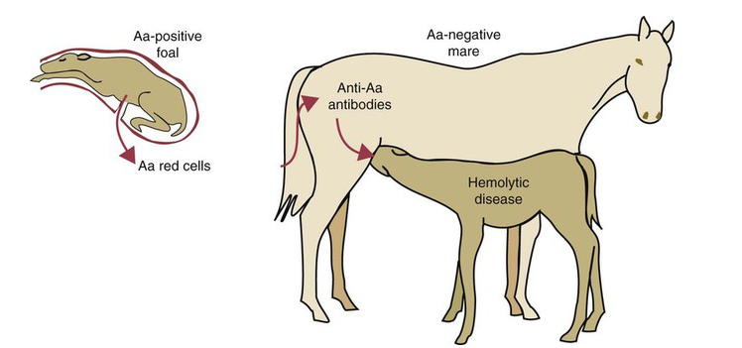
Fig: The pathogenesis of hemolytic disease of the newborn in foals. In the first stage, fetal lymphocytes leak into the mother’s circulation and sensitize her. In the second stage, these antibodies are concentrated in colostrum and are then ingested by the suckling foal. These ingested antibodies enter the foal’s circulation and cause red cell destruction.

Slide 9
TYPE III
It is also called Arthus-type reaction / the Arthus phenomenon.
There is the development of an inflammatory lesion, with induration, erythema, edema, hemorrhage and necrosis, a few hours after intradermal injection of antigen into a previously sensitized animal producing precipitating antibody
The formed precipitation of antigen-antibody complexes causes complement activation and the release of complement fragments that are chemotactic for neutrophils; large numbers of neutrophils infiltrate the site and cause tissue destruction by release of lysosomal enzymes
it is classed as a type III hypersensitivity reaction in the Gell and Coombs classification of immune responses.

Slide 10
TYPE IV:
Cell-mediated or delayed hypersensitivity is of importance in ' the tuberculin and other long-term skin sensitivity tests., but similar delayed reactions to topically applied antigens are not common in farm animals.
Queensland and sweet itch are probably examples.

Slide 11
Treatment: The treatment of allergic states:
functional antagonists which have opposing effects to those of the allergic mediators
the specific pharmacological antagonists (especially antihistamines and corticosteroids).
The functional antagonists include the sympathomimetic drugs, those related to epinephrine and, to a less extent, the anticholinergic drugs.
Of the sympathomimetic drugs there is a choice between those with an alpha-response (vasoconstriction and maintaining vascular permeability) and those with a beta response (bronchodilatory and cardiac stimulatory)

Slide 12
Of the pharmacological antagonists, antihistamines have very limited usefulness, being effective only when the allergic mediator is histamine,
The corticosteroids have very wide applicability
The NSAlDs (acetylsalicylic acid, phenylbutazone and meclofenarmic acid), all inhibit prostaglandin synthesis and reduce inflammation

Slide 13
ANAPHYLAXIS AND ANAPHYLACTIC SHOCK
Anaphylaxis is an acute disease caused by antigen-antibody reaction. If severe it may result in anaphylactic shock
In general the reaction is due to sensitization to a protein substance entering the bloodstream and a second exposure to the same substance
ETIOLOGY:
Parenteral administration of a drug or biological product-Most common in farm animals

Slide 14
Anaphylactic reactions can occur in the following circumstances:
Repeated intravenous injection of biological preparations such as glandular extracts
Repeated blood transfusions from the same donor
Repeated injections of vaccines, e.g. those against foot-and-mouth disease and rabies
A systemic reaction after Hypoderma spp. larvae are killed in their subcutaneous sites
PATHOGENESIS:
Antigen-antibody reactions occurring in contact with, or in close proximity to fixed tissue mast cells, basophils and neutrophil leukocytes
This result in the activation of these cells to release pharmacologically active substances/mediators that mediate the subsequent anaphylactic reaction

Slide 15
These mediators like biogenic amines such as histamine, serotonin and catecholamines; vasoactive polypeptides such as kinins, cationic proteins and anaphylatoxins; vasoactive lipids such as prostaglandins and slow reacting substance of anaphylaxis (SRS-A);and others
Histamine is of less importance as a mediator in farm animals than in other species and that prostaglandins and SRS-A are of greater importance
Bradykinin and 5-hydroxytryptamine (5-HT) are also known to act as mediators in cattle

Slide 16
Horse: 4 phases of anaphylactic response
I-acute hypotension combined with pulmonary arterial hypertension 2-3 minutes after the injection of the triggering agent; it coincides with histamine release
II-blood plasma 5-HT levels rise, and central venous blood pressure rises sharply at about 3 minutes and onward
III-sharp rise in blood pressure, and alternating apnea and dyspnea
IV-systemic hypotension due to prostaglandin and SRS-A influence

Slide 17
In cattle:
There is a similar diphasic systemic hypotension with marked pulmonary venous constriction and pulmonary artery hypertension
An increase in mesenteric venous pressure and mesenteric vascular resistance causes considerable pooling of blood on the venous side of the mesenteric vessels.
In both cattle and horses these reactions are accompanied by severe hemoconcentration, leukopenia, thrombocytopenia and hyperkalemia
In Sheep and pigs:pulmonary reaction

Slide 18
IN HORSES AND CATTLE:
there is marked changes in vascular tone coupled with increased capillary permeability, increased secretion of mucous glands and bronchospasm , and finally leading to the development of severe pulmonary congestion, edema and emphysema and edema of the gut wall.
Death is due to anoxia.

Slide 19
CLINICAL FINDINGS
Cattle:
Sudden onset of severe dyspnea, muscle shivering anxiety, and a rise in temperature to 40.5°C (105°F)
In some cases there is profuse salivation, in others moderate bloat and yet others diarrhea
After an incompatible blood transfusion:
first sign is often hiccough
Additional signs are urticaria, angioneurotic edema and rhinitis

Slide 20
Sheep and pigs:
Acute dyspnea is common
Laminitis also occurs rarely in ruminants
Horses:
severe dyspnea, distress, recumbency and convulsions
Laminitis and angioneurotic edema

Slide 21
TREATMENT:
Epinephrine administered IM(or one-fifth of the dose given IV) is the most effective treatment for anaphylaxis and anaphylactic shock
Corticosteroids potentiate the effect of epinephrine
Antihistamines
Atropine
Acetylsalicylic acid, sodium meclofenamate and diethyl carbamazine (NSAID)

