Slide 1
WELFARE OF ANIMALS
USED IN
EDUCATION AND RESEARCH
Dr. Ravi Shankar Kr Mandal
Assistant Professor
Veterinary Medicine
BVC, Patna

Slide 2
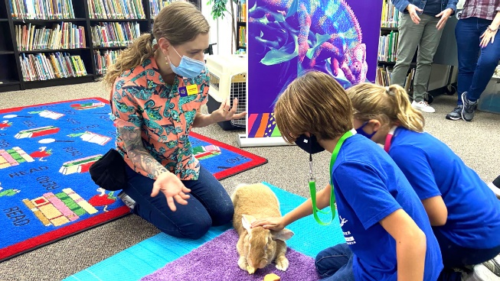
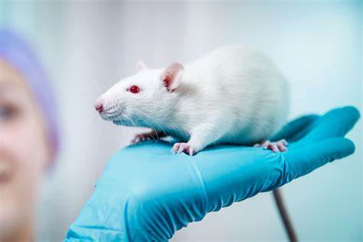
USE OF ANIMALS IN
EDUCATION AND RESEARCH
Animals have always played an important role in support of human discovery, even before their domestication
Hunting Techniques: Observing predators like wolves and big cats helped humans develop strategies for hunting.
Food Sources: Animals led humans to discover edible plants, water sources, and fertile land.
Early humans used animal sounds and movements as inspiration for communication, leading to the development of language and art.
Cave paintings depict animals not just as food but as spiritual symbols, demonstrating their deep influence on human culture and understanding.

Slide 3
Domestication and scientific advancements
Transport and exploration: horses, camels, and elephants enabled humans to explore and connect distant regions, spreading knowledge and ideas.
Medical insights: ancient societies observed healing practices through animals, such as dogs licking wounds, which inspired antiseptic research.
Agriculture: the use of animals in farming helped humans shift from nomadic lifestyles to settled agricultural societies, facilitating scientific and technological growth.

Slide 4
Modern Contributions of Animals in Research and Education
Biomedical Research
Disease Research: Animal models are used to study diseases such as cancer, Alzheimer’s, diabetes, and infectious diseases.
Vaccine Development: Animals have been essential in the creation of life-saving vaccines
Surgical Procedures: Testing on animals has helped refine surgical techniques, such as organ transplants and cardiac surgery, before application to humans.
Genetic Research: Genetically modified animals provide insights into the genetic basis of diseases and potential therapies.

Slide 5
Drug Development and Safety Testing
Animals are used to evaluate the safety and efficacy of new drugs before clinical trials on humans.
Toxicology studies on animals ensure that products like medications, cosmetics, and chemicals are safe for human use.
Environmental and Ecological Research
Wildlife Studies: Monitoring animal populations and behaviors informs conservation efforts and climate change studies.
Indicator Species: Certain animals, such as amphibians, serve as indicators of environmental health, revealing pollution or habitat degradation.
Ecosystem Restoration: Research on keystone species aids in restoring ecological balance.

Slide 6
WELFARE OF ANIMALS USED IN SCIENCE
Animal welfare” is widely used to refer to an animal’s quality of life.
Animals should be healthy, well fed, and housed in an environment that they might themselves choose
Animals should be relatively free from negative states, such as pain, fear and distress, and capable of enjoying life
Animals should be able to carry out behaviors and activities that they are strongly motivated to do

Slide 7
3 RS’ TENET
Replacement, Reduction, Refinement
Concept was introduced in 1959 as part of a revolutionary approach to improving the ethical treatment of animals in scientific research
After World War II, the rapid expansion of biomedical research led to increased use of animals in experiments
1959: Birth of the 3Rs
British scientists William Russell (a zoologist) and Rex Burch (a microbiologist) published their landmark book, The Principles of Humane Experimental Technique.
The book introduced the 3Rs concept as a framework for ethical and humane use of animals in scientific research.

Slide 8
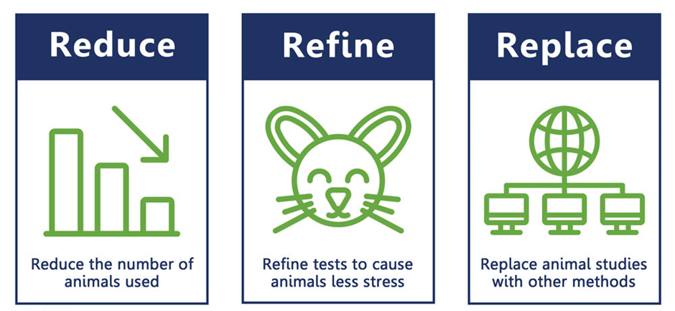
3 RS’ TENET
Replacement, Reduction, Refinement
Animals should be used only if a scientist’s best efforts to find a nonanimal alternative have failed, and that when animals are needed, only the most humane methods should be used on the smallest number of animals required to obtain valid information

Slide 9
REPLACEMENT
Use of methods utilizing cells, tissues or organs of animals (relative replacement), as well as those that do not require the use of animals to achieve the scientific aims (absolute replacement)

Slide 10
REDUCTION
Use of methods that enable researchers to obtain comparable levels of information from fewer animals or to obtain more information from the same number of animals
The principle of reduction has long been closely tied to good experimental design and proper use of statistical methods to determine sample sizes that provide the most scientifically meaningful results

Slide 11
REFINEMENT
Use of methods that prevent, alleviate or minimize pain, suffering, distress or lasting harm and/or enhance welfare for the animals used.
Refinement includes the appropriate selection of relevant species with a lesser degree of structural and functional complexity in their nervous systems and a lesser apparent capacity for experiences that derive from this complexity.
Opportunities for refinement should be considered and implemented throughout the lifetime of the animal and include, for example, housing and transportation as well as procedures and euthanasia

Slide 12
THE EXPERIMENTS ON ANIMALS
(CONTROL AND SUPERVISION) RULES,1968
Under section 17 of chapter IV of the PCA Act, 1960, the committee for the purpose of controlling and supervising Experiments on Animals
Section 3: Stocking of Animals
Animal houses- located in a quiet atmosphere
Animal cages- can live in comfort and overcrowding is avoided
Animal attendants- trained and experienced
Breeding of and Experiments on Animals (Control and Supervision) Rules, 1998

Slide 13
Section 4: Conduct of experiments
Experiments should be performed with due care and humanity
Experiments shall be performed in every case by or under the supervision of persons duly qualified, in a laboratory adequately equipped and staffed for the purpose and under the responsibility of the person performing the experiment.
Minimum number of animals shall be used in an experiment
Experiments involving operative procedure more severe than simple inoculation or superficial venesection shall be performed under the influence of anaesthetic of sufficient power to prevent the animal feeling pain and it shall remain so throughtout the experiment.
The experiment shall not be performed for the purpose of attaining or retaining manual skill

Slide 14
6. Experiment shall not be performed by way of an illustration of lecture in schools or colleges
7. Experiments shall not be performed as a public demonstration except for advancement of knowledge
8. The substance known as Urari or Curari or any such paralysant shall not be used or administered for the purpose of any experiment except in conjunction with anaesthetic of sufficient depth to produce loss of consciousness
9. No experiment the result of which is already conclusively known, shall be repeated without previous justification
10. There shall not be applied to the eye of an animal by way of experiment any chemical substance for the purpose of absorption through the conjunctival membrane or through the cornea calculated to only give pain

Slide 15
11. Dogs held for experimental purposes shall not be debarked.
12. Where experiments are performed in any institution, the responsibility therefor is placed on the person in charge of the institution and in cases where experiments are performed outside an institution by an individual qualified in that behalf, the-experiments, are performed on his responsibility
Records
Every, establishment/Institutional Animals Ethics Committee shall maintain a record of the animals under its control and custody in the specified format.

Slide 16
Contract animal experiments
No establishment shall contract or undertake to perform contract research or experiments on contract basis on behalf of any other establishment or research or educational Institution
This shall not apply to collaborative research between academic institutions.

Slide 17
COMMITTEE FOR THE PURPOSE OF CONTROL AND SUPERVISION OF EXPERIMENTS ON ANIMALS (CPCSEA)
A statutory committee, which is established under chapter 4, section 15(1) of the PCA act, 1960
Functions of CPCSEA
Registration of establishments conducting animal experimentation or breeding of animals for this purpose.
Selection and appointment of nominees in the Institutional Animal Ethics Committees (IAEC) of registered establishments.
Approval of Animal House Facilities on the basis of reports of inspections conducted by CPCSEA.
Permission for conducting experiments involving use of animals.
Recommendation for import of animals for use in experiments.
Action against establishments in case of violation of any legal norm/ stipulation.

Slide 18
CPCSEA GUIDELINES FOR THE CONDUCT OF ANIMAL EXPERIMENTS
Animals are maintained in a proper and healthy manner.
Animals are not subjected to unnecessary pain or suffering before, during and after performance of experiments on them
There is no unnecessary sacrifice of animals for the sake of science.
There should be no duplication of research.
Animals are kept in disease free condition to ensure proper data collection.
Animals are procured from registered breeders.
Experiments on large animals are to be avoided whenever it is possible to achieve the same results by experiments on small laboratory animals.

Slide 19
INSTITUTIONAL ANIMALS ETHICS COMMITTEE (IAEC)
A local body, approved by CPCSEA, which has been empowered to permit experiments on small animals through an amendment in rules for breeding and experiments on animals (control and supervision) in year 2006
Goal of IAEC
Review and approve research protocols
Prevent unnecessary suffering to animals during experimentation
Proper accommodation /veterinary care
Humane disposal after termination of the study
Mid-term termination if unnecessary to prevent suffering
Adequately skilled personnel to do the experiments

Slide 20
OBJECTIVES OF IAEC
Every experiment shall be performed by or under the supervision of a person duly qualified in that behalf, that is, degree holders in veterinary science or medicine or laboratory animal science of a university or an institution recognised by the government for the purpose and under the responsibility of the person performing the experiment
That experiments are performed with due care and humanity and as far as possible experiments involving operations are performed under the influence of some anaesthetic of sufficient power to prevent the animals from feeling pain
That animals who, in the course of experiments under the influence of anaesthetics, are so injured that their recovery would involve serious suffering, are medically allowed to death while still under influence of anaesthetic

Slide 21
That experiment on animals is avoided wherever it is possible to do so.
That experiments on larger animals are avoided when it is possible to achieve the same results by experiments on small laboratory animals like guinea-pigs, rabbits, mice, rats etc
That, as far as possible, experiments are not performed merely for the purpose of acquiring manual skill
That animals intended for the performance of experiments are properly looked after before, during and after experiments
Those suitable records are maintained with respect to experiments performed on animals.

Slide 22
FUNCTIONS OF IAEC
Work for achievement of the objectives as mentioned above (primary duty).
Focus mainly on ensuring ethical and methodical handling of animals during and after experiments, so that they have less suffering.
Review and approve all types of protocols for research involving small animal experimentation before the start of the study.
For approval of experimentation on large animals, the case is required to be forwarded to CPCSEA in prescribed manner with the recommendation of IAEC.

Slide 23
Monitor the research throughout the study and after completion of study
IAEC shall obtain the periodic reports on research development and shall ensure visit to animal house facility and laboratory where the experiments are conducted.
The committee has to ensure compliance with all regulatory requirements, applicable rules, guidelines and laws.

Slide 24
COMPOSITION OF INSTITUTIONAL ANIMALS ETHICS COMMITTEE
(IAEC)
From within Institute/establishment
Biological scientist | 1
Scientists from different biological disciplines | 2
Veterinarian involved in the care of animal | 1
Scientist-in-charge of animal facility | 1
From CPCSEA
A Scientists from outside the institute | 1
A non-scientific socially aware member | 1
A nominee of CPCSEA | 1
Duration 5 yrs
Minimum 6 members
A specialist may be co-opted of the relevant field while reviewing special project using hazardous agents such as radioactive substance and deadly microorganisms.

Slide 25
WELFARE MEASURES IN ANIMAL HOUSES
Housing: Location and space requirement, type of cages, material, environment.
Feed: Feeding schedule, type of diet.
Water: Clean sterile water, type of bottle, nozzle.
Exercise: Inside the cage if it is large enough –otherwise in open space, especially for large animals
Health: Diseases, health check-up records.
Handling: Whether personnel are trained?
Companionship: Do they provide companionship of compatible members of the same species? Solitary confinement is not recommended except in specific cases

Slide 26
Thank You

