Slide 1
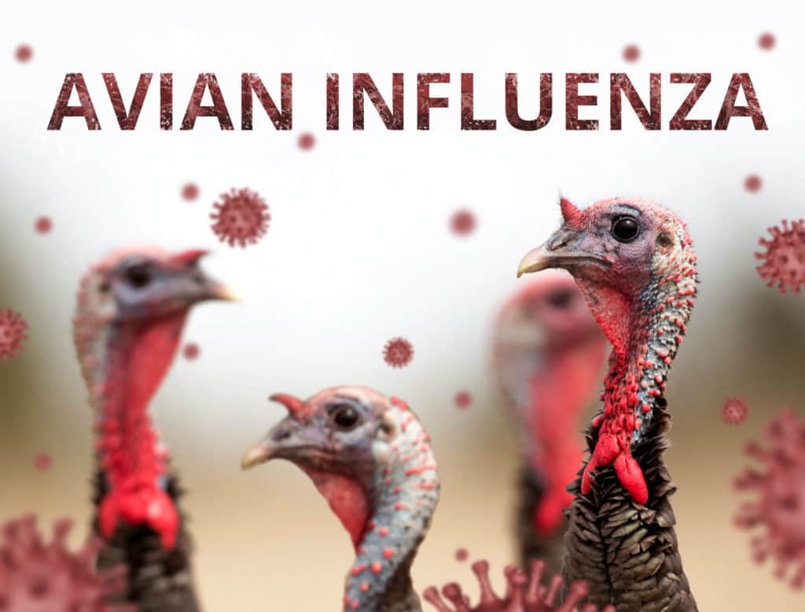
BIRD FLU/ AVIAN FLU/ FOWL PLAGUE
Dr. Ravi Shankar Kr Mandal
Assistant Professor
Veterinary Medicine
BVC, Patna

Slide 2
AVIAN INFLUENZA
Influenza is an infection or disease syndrome caused by type “A” influenza viruses, a member of the Orthomyxoviridae family
Avian influenza viruses are distributed throughout the world and infect domestic poultry as well as pet, zoo and wild birds
Domestic turkeys and chickens have experienced the most substantial disease problems due to influenza.
In 1878 a respiratory disease causing high mortality in poultry was first described as Fowl Plague.
In 1955 an influenza virus was isolated as the cause of Fowl Plague or avian influenza.

Slide 3
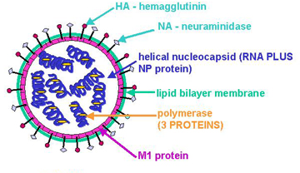
ETIOLOGY
Type A influenza RNA viruses in the family Orthomyxoviridae
Have 8 different gene segments that encode 10 different viral proteins
Two surface glycoproteins, the Hemagglutinin (HA) and Neuraminidase (NA) proteins, important in regard to virulence of the virus and the antibody response
The HA protein has 16 defined antigenic subtypes (H1-H16), and the NA has 9 antigenic subtypes (N1-N9), based on hemagglutinin inhibition and neuraminidase inhibition test respectively
All the outbreaks have been of either H5 or H7 subtype
Because of its broad host range, can represent a zoonotic risk.
It can cause a range of disease symptoms from subclinical infection to highly virulent with 100% mortality.

Slide 4
The virus can be generally divided into viruses that cause a localized infection, often primarily restricted to the respiratory or enteric tract, and viruses that cause systemic infections.
The viruses that cause localized infections are usually referred to as low pathogenic avian influenza (LP AI) viruses, and typically these viruses causes subclinical infection, respiratory disease, drop in egg production in domestic poultry.
The viruses that cause systemic infections usually cause high mortality and are referred to as highly pathogenic avian influenza (HP AI) viruses, or historically as fowl plague virus.

Slide 5
The LP AI viruses:
Mild to severe respiratory disease, that in conjunction with secondary pathogens can on rare occasions cause high mortality in a flock.
Most AI viruses are LP AI (H1-H16)
The HPAI viruses
Restricted to the H5 and H7 subtypes and generally they are low pathogenic, but some time they can mutate into the highly pathogenic forms of the virus and cause devastating epidemics
HPAI is not believed to be normally present in the natural wild bird reservoir.

Slide 6
Host Range:
Wide host range include humans, swine, horses, chickens, turkeys and wild birds
Aquatic birds are the natural reservoir for influenza virus
In the wild bird reservoir, it causes an asymptomatic infection and genetically stable in this group.
They are generally species specific, but this general rule of host adapted influenza viruses staying within a single species can be broken
Avian influenza viruses can present a public health threat as a zoonotic pathogen, although the risk is considered to be small

Slide 7
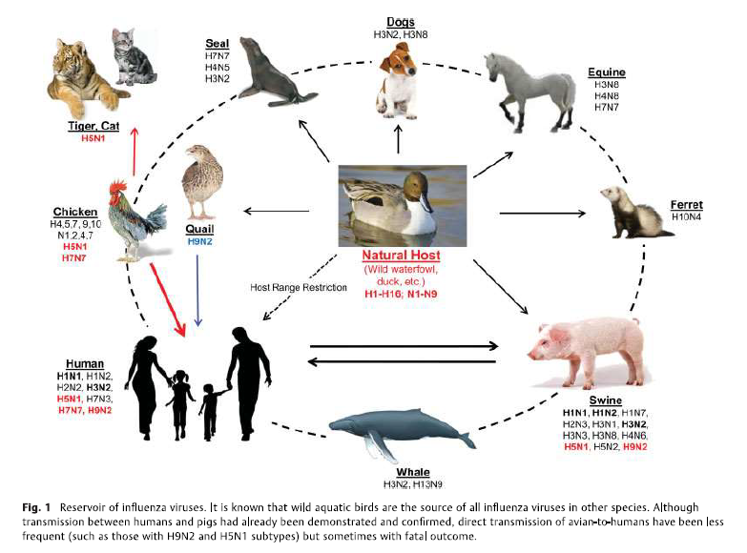
Transmission:
Airborne virus particles from the respiratory tract, droppings, and people-carrying virus on their clothing and equipment are the main routes of transmission

Slide 8
CLINICAL SIGNS
Extremely variable and depend on the:
species affected,
age
sex
concurrent infections
type of the virus
environmental factors

Slide 9
CLINICAL FINDINGS AND LESIONS
Low Pathogenicity Avian Influenza viruses
Typically produces respiratory signs: sneezing, coughing, ocular and nasal discharge, swollen infraorbital sinuses
Respiratory tract lesion: congestion and inflammation of trachea and lung
In layers and breeders: decrease in egg production or fertility and ova rupture (evident as yolk in abdominal cavity) or involution, mucosal edema, inflammatory exudates in lumen of oviduct
Acute renal failure and visceral urate depositon (visceral gout)
Low morbidity and mortality unless accompainied by secondary bacterial or viral infections, or environmental stress
Sporadic infecton

Slide 10
High Pathogenicity Avian Influenza viruses
The first sign of highly pathogenic avian influenza (HPAI)in chickens or turkeys is the sudden onset of high mortality, which may approach 100% within a few days
Peracute cases: clincal signs and gross lesion lacking before death
Acute cases:
Cyanosis and edema of head, comb, wattle, and snood (turkey)
Edema and red discolouration of the shanks and feet due to subcutaneous ecchymotic hemorrhages
Petechial hemorrhages on visceral organs and in muscles
Blood tinged oral and nasal discharge
Greenish diarrhoea in severely affected birds
Survivors of peracute infection may develop CNS involvement evident as torticolis, opisthotonos, incoordination, paralysis and dropping wings

Slide 11
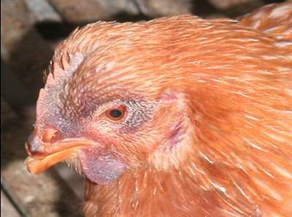
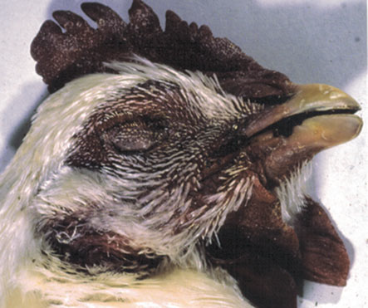
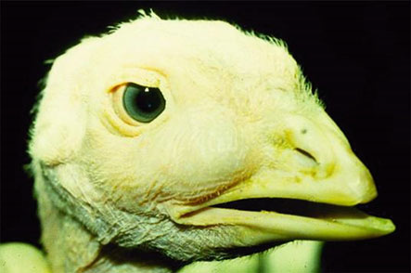
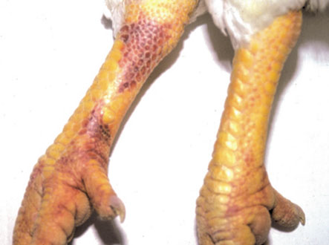
Congestion and cyanosis of the comb and wattles
Swelling of the infraorbital sinuses
Hemorrhages on the shank

Slide 12
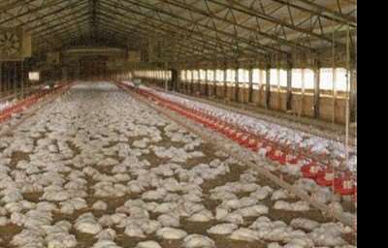
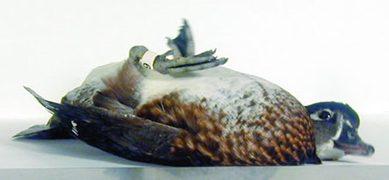
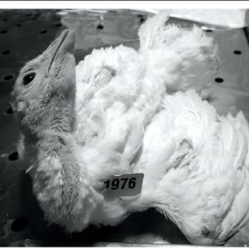
Mass mortality
Neurologic clinical signs

Slide 13
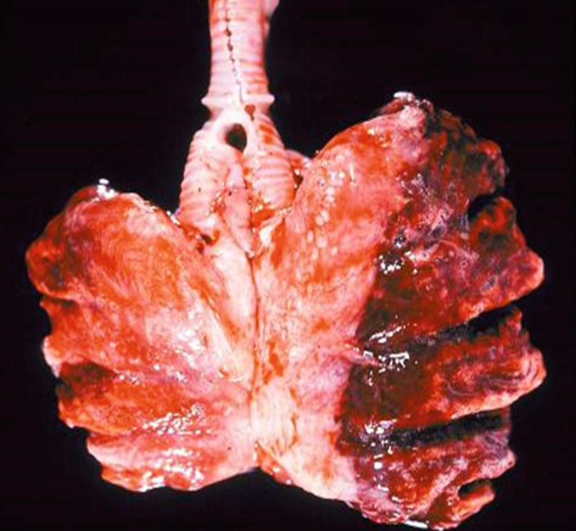
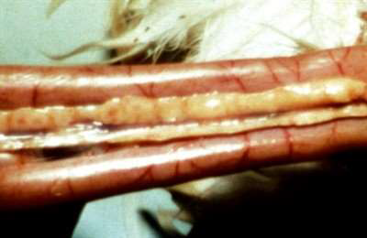
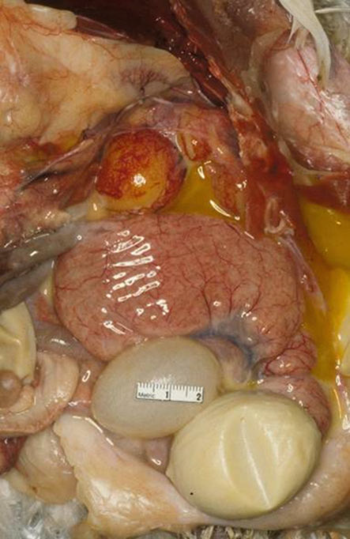
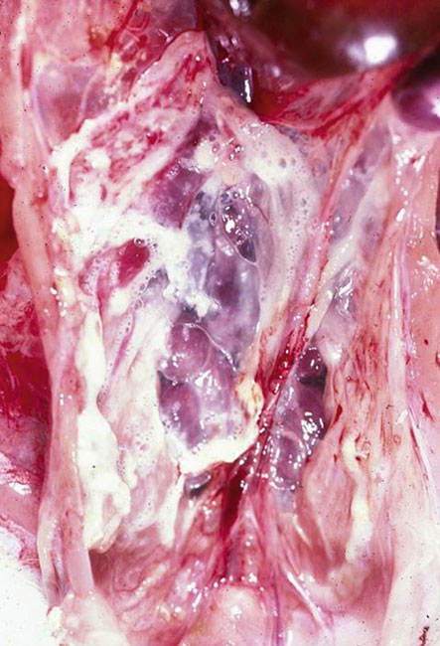
Lung with pneumonia from a turkey
naturally infected with H9N2 LPAI virus
Hemorrhage in pancreas
Air sac with caseous and foamy exudate in a turkey naturally infected with H9N2 LPAI virus
Egg-yolk peritonitis, oviduct edema and shell less eggs

Slide 14
DIAGNOSIS:
Virus isolation: oropharyngeal and cloacal swab, other organs swab
ELISA: detect only antibody to the nucleoprotein
Agar gel immune-diffusion test (AGID): detects antibody to both the nucleoprotein and matrix 1 (M1) proteins that are conserved for all type A influenza viruses.
.
DIFFERENTIAL DIAGNOSIS
LP AI
Acute to s/acute viral disease: IB, ILT, low virulent ND,
Bacterial disease : mycoplsamosis, Infectious Coryza, ornithobacteriosis, turkey coryza, fowl cholera (Respiratory form)
Fungal disesa: aspergillosis
HP AI
Virulent ND, peracute septicemic fowl cholera, heat exhaustion and severe water deprivation

Slide 15
PREVENTION & TREATMENT
Vaccnation
Prevent clinical signs and detah
Reduction of viral replication and shedding from respiratory and GIT in vaccinated birds
Two types of vaccines
Killed whole virus adjuvanted vaccine administered either intramuscularly or subcutaneously
Killed vaccine produces good humoral immunity, but no cellular immunity
Recombinant vaccines
Hemagglutinin gene from influenza virus is inserted in Fowl pox virus vaccine strain or the Herpes virus turkey (HVT) as a vector
Produces both cellular and humoral immunity & vaccinated birds can be distinguished from naturally infected birds since vaccinated birds will not have NA antibody because the vector only contains the hemagglutinin gene.

Slide 16
Complete eradication is not possible because of wildlife reservoirs
For outbreaks of HP AI, infected flocks are depopulated, often with disposal of the birds by burning or burial
Increased biosecurity by greatly restricting access of personnel and equipment to and from farms in the quarantine zone
Suspected outbreaks should be reported to appropriate regulatory authority
Increased surveillance on surrounding farms to monitor for evidence of spread of influenza infections
LP AI affected flocks
Quarantine zone around the infected flocks
Broadspectrum antibiotics to control 2° pathogens
Environmental management: increase house temp to reduce morbidity and mortality
Antiviral compounds – not approved or recommended

Slide 17
Thank You

