Slide 1
AVIAN SARCOMA, BIG LIVER DISEASE, VISCERAL LYMPHOID LEUKOSIS, LYMPHOMATOSIS
AVIAN LEUKOSIS
Dr. Ravi Shankar Kumar Mandal
Assistant Professor
Veterinary Medicine
BVC, Patna

Slide 2
AVIAN LEUKOSIS
Infection of chickens with avian leukosis virus (ALV) is the most common among avian leukosis/sarcoma virus (AL/SV) infections encountered in the field flocks
It causes neoplastic, non-neoplastic and subclinical infections, thereby significantly affects the economy of poultry industry throughout the world
Losses due to reduction in economic traits are tremendous, mainly due to non-neoplastic and subclinical infections of birds
ALV is considered one of the most common immunosuppressive viruses in chickens

Slide 3
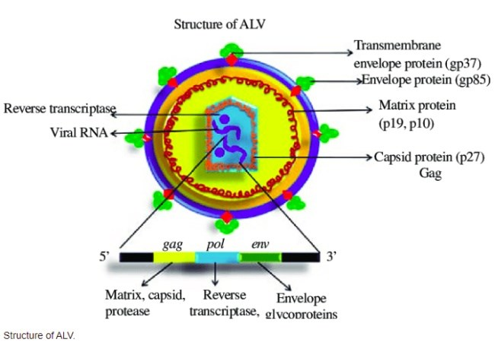
ETIOLOGY
Caused by certain members of the leukosis/sarcoma group of genus Alpharetrovirus subfamily Orthoretrovirinae of the family Retroviridae.
These viruses are commonly called avian leukosis viruses and belong to subgroups A, B, C, D, E, and J on the basis of differences in their viral envelope glycoproteins, interference patterns, host range in chicken cells of varying phenotypes and serum neutralization

Slide 4
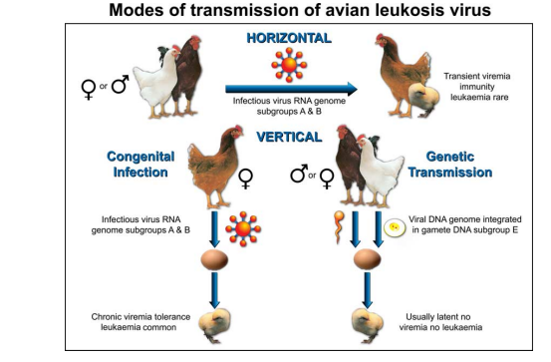
TRANSMISSION
Under natural conditions, ALVs spread in the flock by three modes
(i) Horizontal transmission, when the virus is passed from bird to bird by direct or indirect contact;
(ii) Vertical or congenital transmission, when the virus is passed from hen to offspring through egg albumen to embryo
(iii) Genetic transmission, when endogenous viral genome is transmitted from parents to offspring

Slide 5
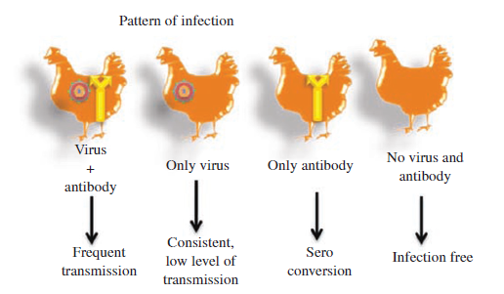
Pattern of infection has strong impact on mode of transmission. Depending on the presence or absence of viremia, antibodies, or both, birds can be classified into
i) Viremic, antibody-positive/ immune (V+A+)
ii) Viremic, antibody-negative/ non-immune (V+A-)
iii) Non-viremic, antibody-positive/ immune (V-A+)
iv) Non-viremic, antibody-negative/ non-immune (V-A-)
V-A- birds belong to ALV infection free flock or genetically resistant stock.

Slide 6
PATHOGENESIS
Lymphoid leukosis is a clonal malignancy of the bursal-dependent lymphoid system.
Transformation invariably occurs in the intact bursa, often as early as 4-8 wk after infection.
Tumors are often not detectable until 14 wk of age.
Death rarely occurs before 14 wk of age and is more frequent around the time of sexual maturity
The tumors are composed almost entirely of B lymphocytes that, in many instances, have IgM on their surfaces.
The induction of lymphoid leukosis tumors can be enhanced in chickens co-infected with serotype 2 Marek's disease virus
A subclinical disease syndrome characterzed by depressed egg production in the absence of tumor formation is more important economically than are deaths from lymphoid leukosis

Slide 7
CLINICAL FINDINGS & LESIONS
Inappetence, weakness, diarrhea, dehydration, and emaciation
Infected chickens become depressed before death
The comb may be pale shriveled and sometimes cyanotic
The abdomen is usually enlarged because of massive liver
Palpation often reveals an enlarged bursa and enlarged liver
Diffuse or nodular lymphoid tumors are common in the liver, spleen, and bursa and are found occasionally in the kidneys, gonads, and mesentery

Slide 8
DIAGNOSIS
Clinical findings and PM findings
Isolation of Virus
Molecular Assay : PCR, RT-PCR, qRT-PCR
Serological tests
FAT
Neutralization test
Complement fixation avian leucosis (COFAL) test
Precipitation test

Slide 9
PREVENTION
There is no vaccine available and eradication is the preferred method of control.
Since the viruses are primarily transmitted via the egg, virus infected breeders are detected by testing the egg albumin. Positive birds are eliminated.
Incubators should be clean and adequately disinfected.
Control blood-sucking parasites.

Slide 10
DIFFERENCE BETWEEN MAREK’S & LYMPHOID LEUKOSIS
FEATURE | MAREK’S DISEASE | LYMPHOID LEUKOSIS
Age | Any age. Usually 6 weeks or older | Not under 16 weeks
Signs | Frequently paralysis | Non-specific
Incidence | Frequently above 5% in unvaccinated flocks. Rare in vaccinated flocks | Rarely above 5%
MACROSCOPIC LESIONS
Neural involvement | Frequent | Absent
Bursa of Fabricius | Diffuse enlargement or atrophy | Nodular tumours
Tumours in skin, muscle and proventriculus, grey eye | May be present | Usually absent
MICROSCOPIC LESIONS
Neural involvement | Yes | No
Liver tumours | Often perivascular | Focal or diffuse

Slide 11
Spleen | Diffuse | Often focal
Bursa of Fabricius | Interfollicular tumour and/ or atrophy of follicles | Intrafollicular tumour
Central nervous system | Yes | No
Lymphoid proliferation in skin and feather follicle | Yes | No
Cytology of tumours | Pleomorphic lymphoid cells, Rarely Only lymphoblasts | Lymphoblasts
Category of neoplastic lymphoid cell | T cell | B cell

Slide 12
Thank You

