Slide 1


ACTS AND RULES RELATED TO ZOO AND WILD ANIMALS
Dr Mritunjay Kumar
Associate Professor
VMD, BVC, BASU, Patna

Slide 2
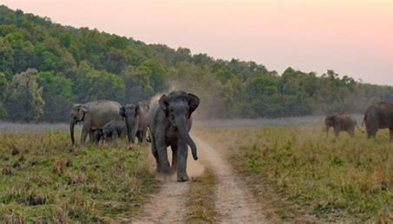
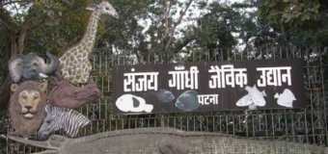
A wildlife sanctuary is an area where animal habitats and their surroundings are protected from any sort of disturbance
A zoo (zoological park) is a place where animals live in captivity and are put on display for people to view

Slide 3
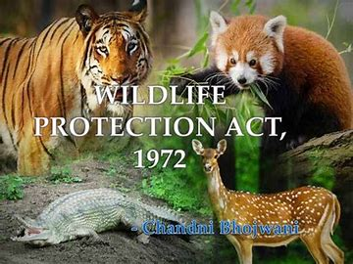
ACTS AND RULES RELATED TO ZOO AND WILD ANIMALS
The GOI enacted Wild Life (Protection) Act 1972 with the objective
Effectively protecting the wildlife and to control poaching, smuggling and illegal trade in wildlife and its derivatives
The Act was amended in January 2003 and punishment and penalty for offences under the Act have been made more stringent

Slide 4
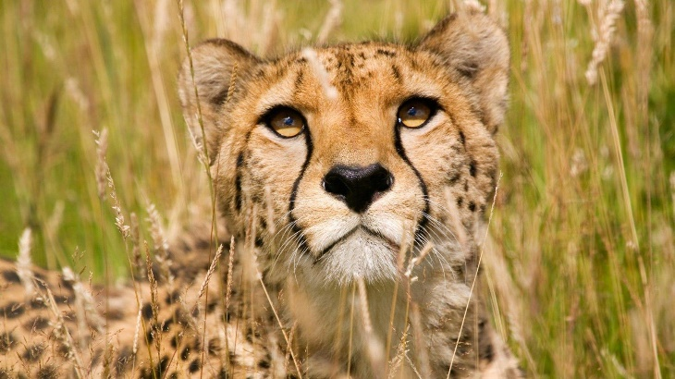
ACTS AND RULES RELATED TO ZOO AND WILD ANIMALS
1. Wildlife Protection Act, 1972
According to this act, “Wildlife” is defined as ‘Any animal, bee, butterflies, crustaceae, fish and moths and aquatic or land vegetation’
Wildlife is the term that embraces all life forms that are wild or care themselves

Slide 5
Important sections
Section 18
Declaration of Sanctuary
The State Government may by notification declare its intention to constitute any area or area comprised with any reserve forest or territorial waters as Sanctuary if it considers that such area is of adequate ecological faunal, floral, geo-morphological natural or zoological significance for the purpose of protecting, propagating or developing wildlife or its environment

Slide 6
Section -27
Restriction of entry in Sanctuary
No person other than
  A public servant on duty
  A person who has been permitted by the Chief Warden or the authorized officer to reside within limits of the sanctuary
  A person who has any right over immovable property within limits of the sanctuary
  A person passing through the sanctuary along a public highway

Slide 7
Section-28
Grant of permit
The Chief Wildlife Warden may on application grant to any person a permit to enter or reside in a sanctuary for all (or) any of the following purpose:
  Investigation or study of Wildlife and purposes of ancillary or incidental threats
  Photography
  Scientific research
  Tourism
  Transaction of any lawful business with any person residing in the sanctuary
A permit to enter or reside in a sanctuary shall be issued subject to such conditions and on payment of such fee as may be prescribed

Slide 8
Section 9
Hunting of wild animals is prohibited
Section 51 (Penalties)
Enforcement can be performed by agencies such as Forest Department, The Police, The Wild Life Crime Control Bureau (WCCB), the Customs and Central bureau of Investigation (CBI).
Charge sheet can be filed directly by Forest Department
2002 Amendment Act : Came into force in Jan., 2003 have made punishment and penalty for offences under the act more stringent

Slide 9
Offences related to wild animals or their parts and products included in Schedule I or part of Schedule II and those related to hunting or altering the boundaries of sanctuary or national park-
Minimum imprisonment of 3 years which may be extended to 7 years, with a minimum fine of 10,000
Subsequent offences-Minimum imprisonment of 3 years which may be extended to 7 years, with a minimum fine of 25,000
Offences not pertaining to hunting of endangered species- imprisonment upto 3 years and or fine upto 25,000/-

Slide 10
Section:33-A
Immunization of Livestock
The Chief Wildlife Warden shall take such measures in such manner as may be prescribed, for immunization against communicable diseases of livestock kept in or within 5 kms of the sanctuary
No person shall take or graze any livestock in a sanctuary without getting it immunized

Slide 11
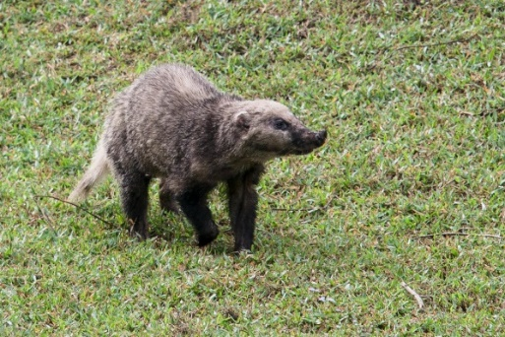
Schedules
Schedule I to VI are dealt by Wildlife Protection Act 1972 with amendments during 1986 and 1991.
Schedule I: Cover endangered species
Part I – Mammals
  Indian chinkara, Indian lion, Indian wild ass, Indian wolf, leopard, leopard cat, Clouded Leopard, Lion-tailed macaque, Loris, Gaur or Indian Bison, Cheetah, Indian gazelle, Dugong, Nilgiri Tahr, Niligiri langur, Musk deer, Sloth bear, Tiger, Wild Buffalo, Mouse deer, Hog badger, Hispid Hare, Chinese pangoling, Crab-eating macaque, Desert fox, Fishing cat, Four-horned antelope, Indian one-horned Rhinoceros, Rusty spotted cat, Serow, Swamp deer etc

Slide 12
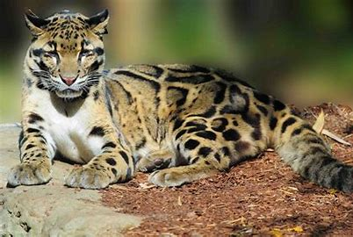
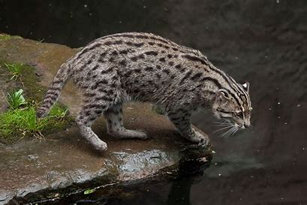
Schedule II
Part I – Bonnet macaque, Common langur, Wild dog, Chameleon, Spiny tailed lizard or Sanda.
Part II – Beetles
Schedule III
Chital, Barking deer or Muntjac, Gorals, Hog deer, Wild pig, Nilgai, Sponges
Schedule IV
Indian Hedgehogs, Indian porcupine, Mongooses, Polecats
Schedule V (Animals that are considered as Vermin and can be hunted)
Common crow, Fruit bats, Mice, Rats, Five striped palm squirrel, Black napped hare, Common Indian hare, Desert hare, Himalayan mouse hare.
Schedule VI (Cultivation of a specific plant/ birds)
Restrict possession, sale and transportation
Birds like Coots, Cranes, Cormorants, Flamingos, Ibises
Ladies slipper orchids, Red Vanda, Blue Vanda

Slide 13
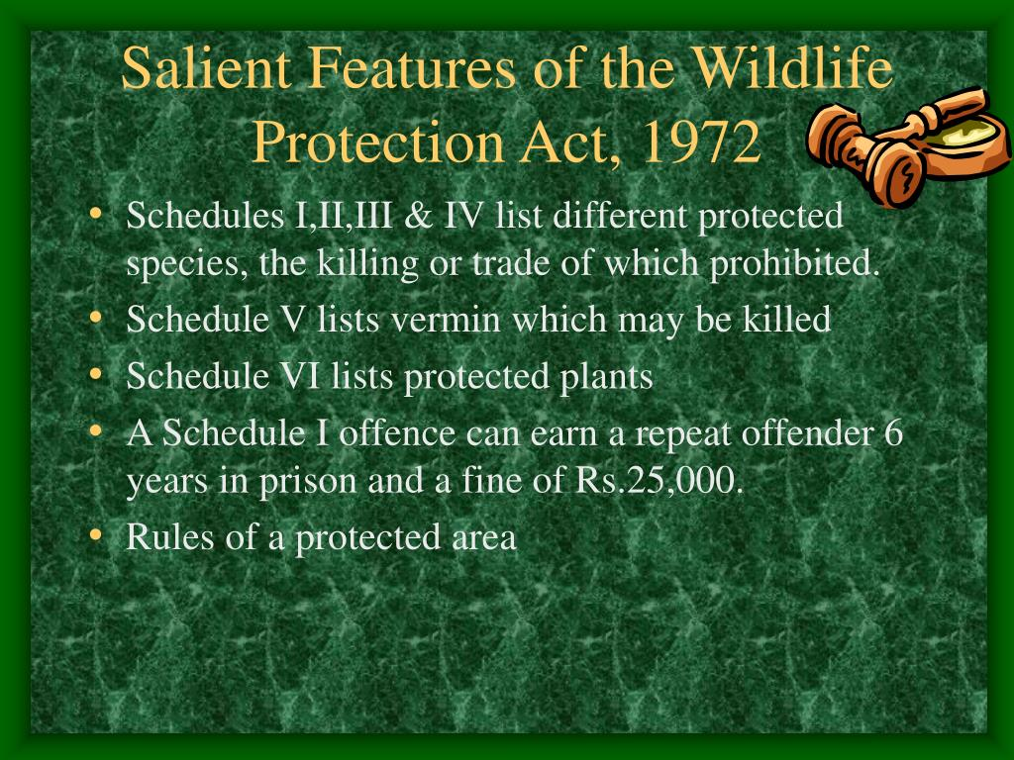
Part II – Amphibians and Reptiles (Animal protection with the prohibition on their trade)
  Pythons, Water lizard, Gharial, Estuarine (or) Salt water crocodile, Golden Gecko, Green sea turtle, Leathery turtle, Logger head turtle, Hawksbill turtle, Indian egg-eating snake, Himalayan black bear, Jackal, Sperm whale, Indian cobra, King cobra
Part II A – Fishes
  Whale shark, Shark, Ray, Sea horse, Giant grouper.
Part III – Birds (Hunting prohibited)
  Hornbills, Mountain quail, Peafowl, Andaman teal, Nicobar megapods, Nicobar pigeon, Bengal florican, Black-necked crane etc.
Part IV – Insects (Hunting Prohibites)
  Butterflies and Moths.
Part IV A – Coelentrates
  Fire coral, Sea fan, Roof building coral.
Part IV B – Mollusca
Part IV C – Echinodermata
Sea cucumber (all Holothurians)

Slide 14
2. Indian Biological diversity Act, 2002
This is act to provide for constitution of biological diversity, sustainable use of its components and fair and equitable sharing of the benefits arising out of the use of biological resources and knowledge
3. The Forest (conservation) Act, 1980
The Forest (Conservation) Act, 1980 an Act of the Parliament of India to provide for the conservation of forests and for matters connected therewith or ancillary or incidental thereto

Slide 15
The Indian Forest Act, 1927
The Indian Forest Act, 1927 to consolidate and reserve the areas having forest cover, or significant wildlife, to regulate movement and transit of forest produce, and duty leviable on timber and other forest produce
It defines what is a forest offence, what are the acts prohibited inside a Reserved Forest, and penalties leviable on violation of the provisions of the Act
5. The Indian Fisheries Act, 1897
Fisheries Act is a stock short title used for legislation in multiple countries relating to fisheries. The Bill for an Act with this short title will have been known as a Fisheries Bill during its passage through Parliament

Slide 16
6. The Cruelty against animals Act, 1960
The Prevention of Cruelty to Animals Act, 1960, authored by acclaimed dancer and animal lover, Rukmini Devi Arundale
It is an Act of the Parliament of India enacted in 1960 to prevent the infliction of unnecessary pain or suffering on animals and to amend the laws relating to the prevention of cruelty to animals
As per the provisions of the law the government of India formed the Animal Welfare Board of India.

Slide 17
Other acts and rules related to zoo and wild animals are:
  Elephant preservation Act, 1879
  Bengal Rhinoceros Act, 1932.
  Bombay Wild animal and wild birds Protection Act, 1951.

Slide 18
Thanks

