Slide 1
CHICKEN INFECTIOUS ANEMIA
(CIA)
Dr. Ravi Shankar Kr Mandal
Assistant Professor
Veterinary Medicine
BVC, Patna

Slide 2
CHICKEN INFECTIOUS ANEMIA (CIA)
CIA is a disease of young chickens caused by a virus.
First described in 1979 by Yausa et al. (1979) from contaminated vaccine in Japan and was called Chicken Anemia Agent(CAA)
when inoculated into 1-dayold specific-pathogen-free (SPF) chicks produces a severe aplastic anemia (Yuasa et al., 1979)
It has immunosuppressive property and invade by multiple secondary bacterial invaders
Commonly found in commercially produced chickens and has a worldwide distribution
The chicken appears to be the only recognized natural host

Slide 3
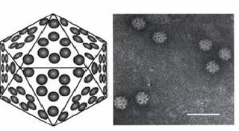
Etiology
Chicken anemia virus (CAV ) the only member of the Gyrovirus genus of the Circoviridae family.
17-25 nm, nonenveloped, icosalledral virus with a single-stranded, circular DNA
Virus is very stable and difficult to eradicate from the environment
resistant to treatment with organic solvents, several detergents, enzymes, commercial disinfectants and its infectivity remains after heat exposure at 60°C for an hour

Slide 4
Transmission
Horizontal transmission
fecal-oral route, perhaps by the respiratory route, and through infected feather follicle epithelium
Vertical transmission
Chicks hatched from the eggs of CAV infected hens, and CAV can rapidly spread horizontally from these chicks to susceptible, maternal antibody-negative hatchmates
Roosters shedding CAV in semen are another source of vertical transmission
Spread of infection by CAV-contaminated embryo- or cell-culture derived vaccines is possible

Slide 5
Pathogenesis
Entry of virus: viremia occurs within 24 hr
Principal sites of CAV replication
Hemocytoblasts in the bone marrow : Anemia
Precursor T cells in the cortex of the thymus
Dividing CD4 and CD8 cells in the spleen
Due to severe destruction of bone marrow stem cells chicks develop severe aplastic anemia.
Neutralizing antibodies are detectable 21 days after infection, and clinical, hematologic, and pathologic parameters return to normal ~35 days after infection.
In addition to T-cell defects, macrophage functions such as Fc-receptor expression, phagocytosis, and antimicrobial activity may be impaired.
Immunosuppression.

Slide 6
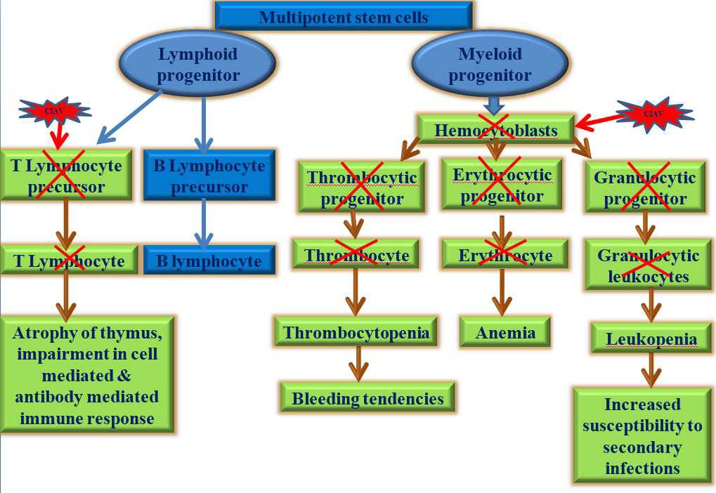

Slide 7
Clinical fndings
Incubation period 12-14 days
All ages of chickens are infected, the most clinical signs are seen in chickens younger than 2 weeks of age
Anorexia
Depression
Pale skin & its appendices and mucous membrane
Muscle hemorrhage and skin hemorrhage (blue wing disease): thrombocytopenia that is complicated by possible anoxic vascular changes
Blood may be watery and clot slowly
PCV is low (in chicks, anemia is defined as a PCV <27)
B/S reveal anemia, leukopenia, or pancytopenia
Mortality 10% -60%
Concurrent infection with IBDV, MDV, reticuloendotheliosis virus (REV), secondary bacterial infection enhances morbidity and mortality

Slide 8
Lesions
Yellow fatty bone marrow, atrophy of bone marrow
Thymic atrophy
Atrophy of Bursa
Discoloration and swelling of the liver and kidneys
Ecchymotic and petechial hemorrhages on the outer surface of the heart
S/C and muscular hemorrhages
Hemorrhages in the proventricular mucosa
Gangrenous dermatitis of the extremities

Slide 9
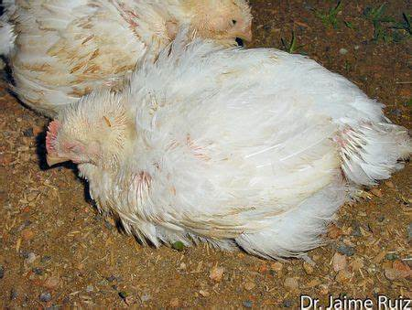
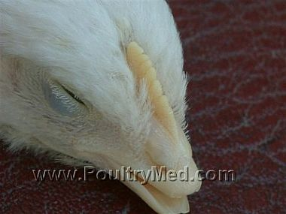
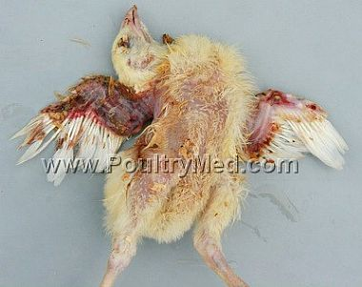
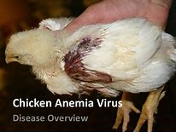
Depression
Pale skin
Muscle hemorrhage and skin hemorrhage

Slide 10
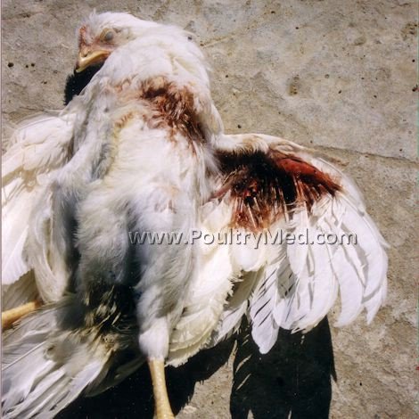
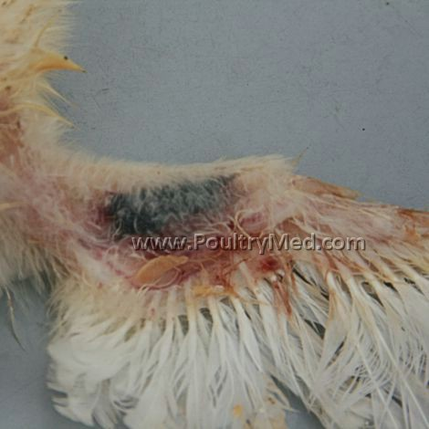
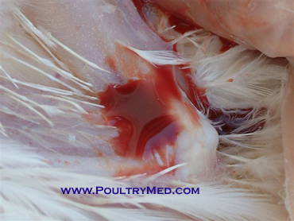
Blue wing disease
Blood :watery and clot slowly

Slide 11
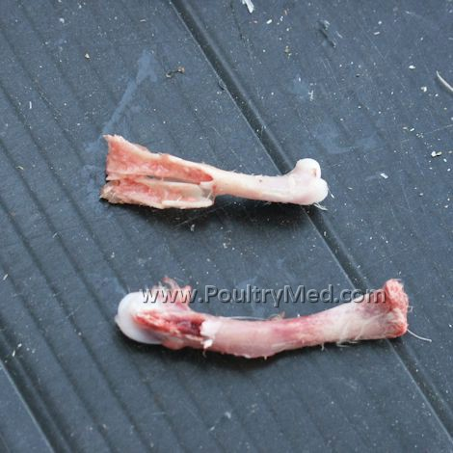
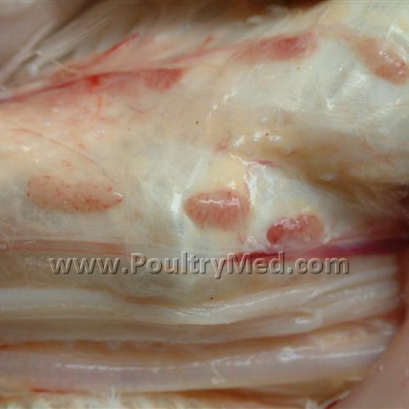
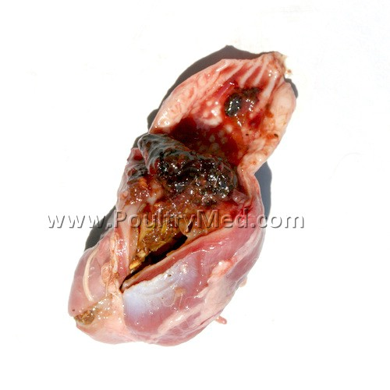
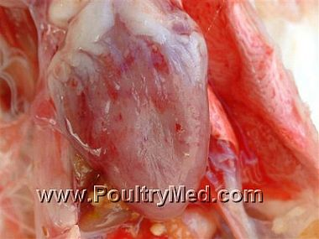
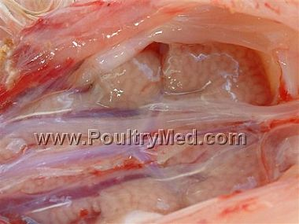
Proventricular
hemorrhage
Bone marrow: pale, atrophied
Thymic atrophy
Heart: Hemorrhages on the outer surface
Kidneys discoloration and swelling

Slide 12
Diagnosis
History, signs, and gross and histopathologic lesions
Detection of virus or viral DNA in the thymus or bone marrow: PCR, quantitative PCR
Viral isolation (slow and expensive)
Chloroform treated extracts of tissues are inoculated in MDCC-MSBl or MDCC-147 cultures (both are lymphoblastoid cell lines derived from Marek's disease tumors)
Into susceptible, inununocompromisecl and maternal antibody-negative day-old chicks
ELISA

Slide 13
Treatment and Prevention
No specific treatment
Virtually eradication of CIA is not possible
Improve hygiene and poultry health
Strict biosecurity measures
Standard management practices as well as regular maternal vaccination before to start laying
Proper immunization and genetic selection should be practiced to increase the resistance so that challenges of immunosuppressive agents can be bear up by the flock
Secondaiy bacterial infections may be treated with antibiotics
Live attenuated virus vaccine
recommended to vaccinate the breeder flock between 9 and 15 weeks before the start of egg production
Administration by injection or by addition to the drinking water

Slide 14
Thank You

