Slide 1
Diagnosis, Differential Diagnosis, Prognosis and Treatment
Department of Veterinary Medicine
Bihar Veterinary College, BASU, Patna
Dr Mritunjay Kumar
Associate Professor
VMD, BVC, BASU, Patna

Slide 2
Diagnosis of Animal Diseases
Term diagnosis from Greek word “diagignoskein” (Dia- through/across/ between and gignoskein – to know)
Diagnosis: Art of recognising a disease and of distinguishing it from other disease with the help of externally visible or otherwise appreciable changes in the condition of an animal or its organs
In other words diagnosis is the determination of the nature of a disease
A special effort should be made to establish at least the aetiological diagnosis, without this knowledge treatment cannot be other than empirical
A complete diagnosis include three parts
The specific cause
Abnormality of function or structure produced by causative agent
Clinical manifestation of that abnormality produced by causative agent

Slide 3
Purpose of Diagnosis
To recommend specific treatment
To provide an accurate prognosis
Recommendation for cost-effective control and prevention of new cases
Diagnostic methods
The syndrome or pattern recognizable method
In the first few movements of viewing the patient the diagnosis is made instantaneously and reflexly eg papillomatosis in cow
Identification of disease may be based on previous history and comparison of subject case and previous case
2. Hypothetico-deductive reasoning method
In this method multiple possible hypothesis are generated from the initial clue, and clinician test the hypothesis based on question asked by clinician and clinical examination
This hypothesis and deduction process is carried on until one diagnosis is preferred to the others

Slide 4
3. The arboristaion or algorithm method
This is extension of hypothetico-deductive reasoning method
This method similarly approaches a list of series of diagnosis and examines each one in turn with supporting or disproving questions; if they pass the proving test they stay in , but if they fail, they are removed eg red colour urine in cow (Q/? access to plant or not-no- haemoglobinuria or haemoturia- haemoglobinuria- PPH or any other )
4. The key abnormality method: More time consuming as compared to previous one and requires that the clinician rely on their knowledge of normal structure and function to select the key abnormality or clinical clue
This method consists of five steps
Determination of the abnormality present eg. Paralysis, hypoxia etc
Determination of the system or body as a whole or organ affected eg recumbency may be due to involvement of nervous system or musculoskeletal system or generalized weakness
Determination of location of the lesion within the system or organ affected. Eg Radiography for location of lesions in body

Slide 5
4. Determination of type of lesions eg lesions can be classified into anatomical or physical (degenerative or space occupying) lesions and functional disturbances eg Abscess in spinal cord or lungs
5. Determination of the specific cause of the lesion: Nature of abnormality and the type of lesions in the system can be determined satisfactorily
The specific causative agent must then be determined eg calf paralysis caused by a degenerative lesion of the musculature
5. The database method/Weed or problem oriented method
Conduct a thorough clinical and clinic-pathological examination of the patient in order to compile a comprehensive patient data
The problems (key signs ) in this database are then matched with the diagnostic database, in which collection of signs or syndromes are labeled with diagnosis to select the best fit with the patients data

Slide 6
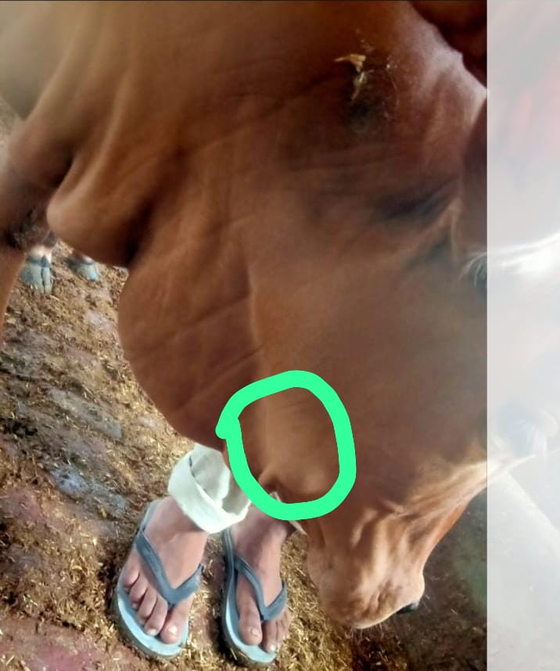
Classification of diagnosis
Depending on the method used to arrive at the diagnosis, it can be classified as
Tentative diagnosis: This is a process of determination of nature of disease on the basis of subjective changes evident through clinical examination and usually it is presumptive type of diagnosis, it should be confirmed by suitable laboratory investigation
Direct or definite diagnosis: Disease is clearly recognised by observing structural lesions or pathognomonic lesions directly, e.g. Hard swelling over mandible-Actinomycosis.
Confirmatory diagnosis: It denotes the actual disease condition of an animal through clinical, clinic-pathological and immunological investigations, e.g. bottle jaw in hypoproteinemia- lab investigation to check internal parasitism.

Slide 7
Snap shot diagnosis: It is a diagnosis declared at a very approach of a patient at a glance, e.g.
Snoring disease – Nasal schistosomiasis/nasal granuloma, here respiration is so loud that can be heard from 10-15 feet distance
Dragging of leg in patellar fixation.
This type of diagnosis may be biased and erroneous, e.g.
snoring is also seen in ethymoid carcinoma or nasal polyp.
Symptomatic diagnosis: If a particular prominent clinical sign is present, but the site and cause of primary abnormality are unknown, the diagnosis is said to be symptomatic, e. g. jaundice
Test therapy diagnosis: When the diagnosis of a disease depends on the response of the animal to a particular drug or medicine, e.g.
Polioencephalomalacia In calves or sheep cab be diagnosed by the favourable response to iv administration of thiamine hydrochloride within a few hour
Exclusion diagnosis: It is determining of a disease by excluding all other diseases

Slide 8
Laboratory diagnosis: It denotes the diagnosis of diseases through clinical pathology on the basis of examination of stool, urine, blood, milk etc.
Herd diagnosis: The herd diagnosis should be based on complete clinical examination of majority of clinically affected animals, meticulous examination of animal environment including feed, etc provided, post-mortem examination of dead animals and clinical pathological examination of suitable samples.
Open diagnosis: Diagnosis in which clinical abnormalities are detected but their cause can not be detected eg sudden onset of convulsion and a high case fatality rate in mature lactating cows on pasture
Undetermined Diagnosis: If diagnosis can not be made even with extensive epidemiological, clinical and laboratory investigations
Differential Diagnosis: It is an art of differentiation of a disease by comparison and contrast with similar diseases
e.g. Post parturient haemoglobinuria needs to be differentiated from babesiosis, leptospirosis, bacillary haemoglobinuria.

Slide 9
Problems of diagnosis
The patient is unable to express about its illness.
Animal owner/attendant/client may not reveal the correct picture of the illness of animal, history of disease.
Non-cooperation from the patient, e.g ruminal motility has to be checked but if animal is not cooperating then it is very difficult to diagnose.
Various species of animal has to be interacted by the veterinary doctor with varied physiological parameters.
In the diagnosis of animals diseases, factors such as susceptibility, anatomy, physiology, regional diseases and the purpose for which patient is used must be consider.

Slide 10
Prognosis of animal diseases
Prognosis (Pro- before + gnosis- inquiry/investigation/knowing) : The term prognosis (Greek word fore knowledge) refers to the opinion of a veterinarian regarding the probable duration and out come of the disease.
It is the forecast/prediction of the probable course and termination of a disease process.
The prognosis of animal diseases may be graded as favourable, doubtful, poor an grave depending n the nature of the disease.
A prognosis is made based on
Nature and course of disease
Expected morbidity and case fatality of disease
The stage of disease
Success or failure of previous treatment
Whether or not a specific treatment or surgical operation is available

Slide 11
Involvement of vital organ
Appetite
Complication arises from primary condition
Individual physical or psychological condition
Prognosis may be graded as
Favourable: Good chance of treatment success eg Simple indigestion, rhinitis
Doubtful: Doubt in treatment success eg TRP with adhesion of diaphragm with abdominal wall
Poor: Poor chance of treatment success eg TRP complicated with abscess in liver
Grave: Very less or no chance of treatment success eg bone marrow cancer, Stage IV renal failure, TP
A disease may end/terminate into cure, complication, sequele, relapse or death
Cure: By lysis or crisis.
Cure by lysis means gradual decrease of fever and slow return to health as in case of distemper.

Slide 12
Cure by crisis means there is rapid loss of fever and quick return to health as in case of pneumonia. In majority of cases cure by lysis is preferred to cure by crisis.
Convalescence is the period through which a patient passes, after an attack of some acute disease, till complete health and strength are regained.
Complication: It is defined as condition of different nature developed concurrently with the primary disease, e.g. laminitis in carbohydrate engorgement in cattle.
Sequelae: It is the affection occurring after recovery from the primary disease, e.g. chorea after distemper.
Relapse: It is the return of disease after a period of convalescence. Majority of relapses occur due to exposure, exertion, stress etc.
Death: Death may occur by two way- death by syncope (heart failure) and death by asphyxia (respiratory failure).
Death is usually of two types
Somatic Death refers to the cessation of vital functions like breathing and heartbeat while molecular death or cellular death, is the subsequent breakdown and death of individual cells.

Slide 13
Treatment of animal diseases
Veterinary therapeutics, the branch of medicine which is concerned with the treatment of animal diseases.
It covers medicinal agents, vaccines and sera, but also hygiene, dietetics and the care and management and nursing of sick animals.
When definite diagnosis is not possible leading clinical signs must received consideration
Economic considerations of the treatment
Rational therapeutics: It is a scientific method of administration of drug based on pathophysiology of the disease process and pharmacotherapeutics of drugs, e.g. sodium bicarbonate administration in acute carbohydrate engorgement, atropine sulphate administration in spasmodic colic in horse.

Slide 14
Empirical therapeutics: It is the art of treating a patient by experience gained through trial and error methods, e.g. inflation of udder with air to treat parturient paresis in cattle.
Specific therapy: It is the administration of specific curative medicines against certain diseases, e.g. calcium borogluconate therapy in parturient paresis.
Symptomatic treatment: Refers to the treatment of symptoms of a disease without reference to their source or causation, eg. Astringent preparation in enteritis, expectorant in bronchitis
Palliative treatment: When incurable diseases are treated to prolong the life of span of patient, e.g. insulin therapy in diabetes mellitus.
Helio Treatment: Patients are exposed to sunlight for curing certain diseases, e. g. rickets and hypopigmentation.

Slide 15
Multiple choice questions
Q.1. Determination of nature of a disease is
Diagnosis b) Prognosis c) Differential Diagnosis d) All of these
Q. 2. Diagnosis based on clinical sign and symptoms
Tentative diagnosis b) Lab diagnosis c) Confirmative diagnosis d) All of these
Q.3. Diagnosis declared at a very approach of a patient at a glance
Tentative diagnosis b) Snap shot diagnosis c) Confirmative diagnosis d) All of these
Q.4. Scientific method of administration of drug based on pathophysiology of the disease process and pharmacotherapeutics
a)Rational therapy b) Specific therapy c)Empirical therapy d) All of these
Q.4. Incurable diseases are treated to prolong the life of span of patient
a)Rational therapy b) Specific therapy c)Empirical therapy d) Palliative therapy

Slide 16
Thanks

