Slide 1
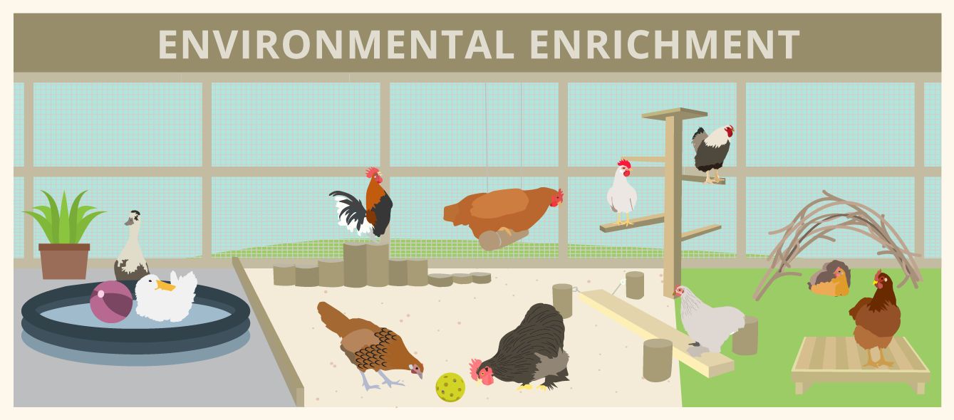
ENVIRONMENTAL ENRICHMENT
Dr. Ravi Shankar Kr Mandal
Assistant Professor
Veterinary Medicine
BVC, Patna

Slide 2
ENVIRONMENTAL ENRICHMENT
Process of improving an animal's environment to enhance its physical and psychological well-being by encouraging natural behaviors and reducing stress
One of the most powerful tools an animal caretaker has to improve welfare for an individual
Generally relate to adding sensory stimuli or providing choices in the environment
The provision of stimuli which promote the expression of species-appropriate behavioral and mental activities in an under stimulating environment
GOALS FOR ENRICHMENT
Increase behavioral diversity
Reduce the frequencies of abnormal behavior
Increase the range of normal (i.e., wild) behavior patterns
Increase positive utilization of the environment
Increase the ability to cope with challenges in a more normal way

Slide 3
GOALS FOR ENRICHMENT
Encourage natural behaviors
Reduce the frequencies of abnormal behavior
Increase the range of normal (i.e., wild) behavior patterns
Increase positive utilization of the environment
Increase the ability to cope with challenges in a more normal way
Prevent boredom and destructive behavior.
Promote physical health and mental stimulation.

Slide 4
Importance in Veterinary Practice
Welfare Improvement: Promotes better mental and physical health in animals
Behavioral Support: Reduces abnormal or stereotypic behaviors (e.g., pacing, feather plucking).
Rehabilitation: Assists in recovery and healing during treatment.
Ethical Responsibility: Part of providing high standards of care in clinical and non-clinical settings.

Slide 5
Types of Enrichment
Feeding
Tactile
Structural
Auditory
Olfactory
Visual
Social
Cognitive
Occupational
Human-animal

Slide 6
Feeding Enrichment
Manipulation of the food itself or the means through which it is delivered
Rather than providing all of an animal’s daily rations in an easily accessible, single delivery, zoos have shifted towards practices such as scatter feeding (spreading food around to require travel between locations to obtain all items)

Slide 7
TACTILE ENRICHMENT
Provisioning of objects such as bags or balls that are physically stimulating to an animal
Installing floor panels that provide extra heat or cooling when reclining
Bears and some great cats need water features so they can swim
A comfortable environment for many animals requires a full immersion pool, mud, and plenty of available dust

Slide 8
STRUCTURAL ENRICHMENT
longer-term or semi-permanent changes to an animal’s environment such as the introduction of a new platform for sitting or ropes for swinging.
Artificial tree was built in the orangutan exhibit. The tree contained several enrichment devices such as a computer for cognitive testing with a pellet-delivery system, water sprayers, and a heated platform
Artificial climbing structures

Slide 9
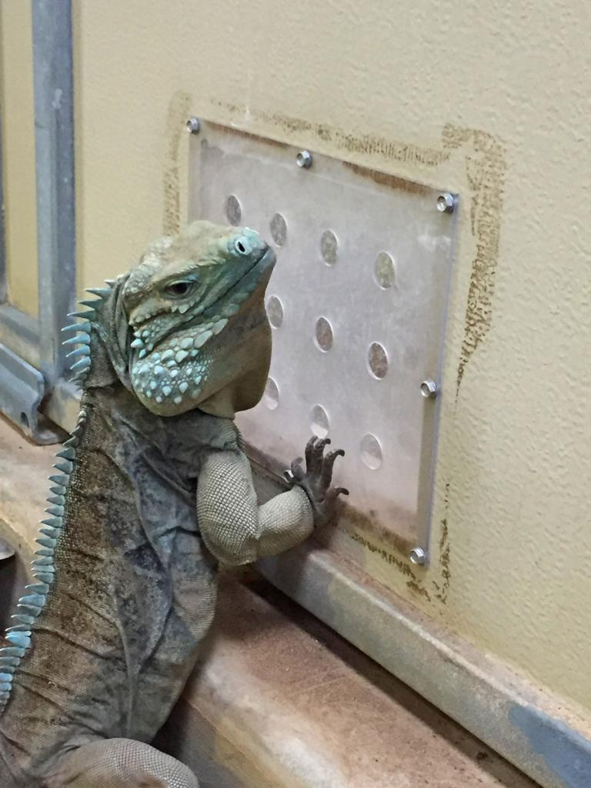
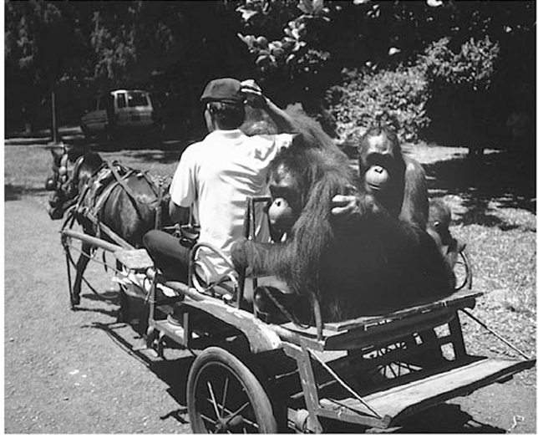
AUDITORY, OLFACTORY, VISUAL ENRICHMENT
Providing species-appropriate sounds may have the effect of enriching an animal’s environment.
Curatorial knowledge about which sounds are appropriate for a given specie
Playing lion roars
Authentic forest sounds of birds and insects:- decrease stress related behavior and marginally affect abnormal behavior
Odors from other individuals, even other species, can be spread in an animal’s enclosure through urine, feces, or materials that promote interaction with the substance
Visual forms of enrichment are commonly used with great apes in the form of television shows or movies
Howdy door

Slide 10
SOCIAL ENRICHMENT
Interaction with conspecifics (animals of the same species) or other species, including humans.
Example: Group housing for social animals like parrots, primates, or dogs.
HUMAN–ANIMAL INTERACTION
Most commonly reported as interactions between care staff and animals
Keepers and veterinary staff also play a role with training for basic behaviors and medical procedures.
OCCUPATIONAL ENRICHMENT
Offering activities that align with the animal’s natural instincts or jobs.
Example: Herding tasks for dogs or nest-building materials for birds.

Slide 11
COGNITIVE ENRICHMENT
Cognitive enrichment refers to the process of challenging and stimulating an organism’s memory, decision making, judgment, perception, attention, problem solving, executive functioning, learning and species-specific abilities.
The types of cognitive enrichment range from simple manipulations to more complex, computerized test systems and can be implemented with almost any species.
Problem-solving task such as a foraging opportunity that promoted species-typical behaviors (e.G., Extraction, manipulation, hunting)
Training sessions, interactive toys, or tasks that reward animals with food or play
Computerized or manual tasks can be introduced to explore issues such as self control, decision-making, social learning, memory, and perception.

Slide 12
Dogs
Physical: Regular exercise, interactive toys (e.g., tug ropes, frisbees).
Cognitive: Puzzle feeders, obedience training, scent work.
Social: Playdates with other dogs, interaction with humans.
Cats
Physical: Scratching posts, climbing trees, laser pointers.
Cognitive: Food-dispensing toys, interactive games.
Sensory: Catnip toys, perches for watching outside activity.
Rabbits
Physical: Tunnels, ramps, chewable toys (e.g., untreated wood).
Social: Bonded pairs or groups, human interaction.
Dietary: Hiding vegetables or hay for foraging.
Birds
Physical: Perches of varying sizes, swings, ladders.
Cognitive: Puzzle feeders, mirrors, training for tricks.
Sensory: Music, natural sounds, bird-safe plants.
Livestock
Physical: Pasture grazing, obstacle courses, scratching posts.
Social: Herd living or interaction with conspecifics.
Nutritional: Scatter feeding or hay nets for foraging

Slide 13
Primates
Swinging ropes, fruit hidden in puzzle feeders, mirrors for grooming.
Big Cats
Scented enrichment (spices, perfumes), cardboard boxes, climbing platforms.
Elephants
Large sandpits, tree logs for pushing or tearing, swimming pools.
Aquatic Mammals
Floating toys, interactive training, varying water depths.
Reptiles
Logs for basking, hiding spots, thermal gradients.

Slide 14
Challenges in Implementing Enrichment
Species-Specific Needs
Enrichment must be tailored to each species’ biology and behavior.
Logistical Constraints
Space, budget, and staff availability can limit enrichment options.
Safety
Enrichment items must be safe and non-toxic.
Evaluation and Adjustment
Regular monitoring is required to ensure the enrichment remains effective and engaging.

Slide 15
Thank You

