Slide 1
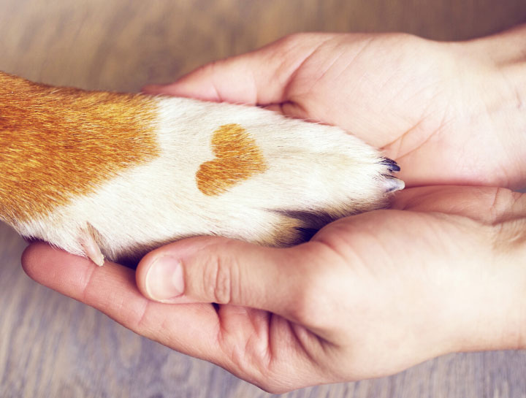
EUTHANASIA
Dr. Ravi Shankar Kr Mandal
Assistant Professor
Veterinary Medicine
BVC, Patna

Slide 2
EUTHANASIA
Greek: εὐθανασία (εὖ, eu, 'well, good‘+ θάνατος, thanatos, 'death)
Production of quiet, painless death in an animal for humane reasons.
Performed for the hopeless cases when treatment would be ineffective and the animal is suffering severe pain
Owners request to euthanise animal if the animals have behaviour problems or if the owners no longer wish to own the said animal.
The veterinarians should not advocate or recommend euthansia in any specific case.
Obtain a consent of the rightful owner or authorised agent in writing on a consent form
Failure to obtain owner and/or insurer permission invites a lawsuit.
The owner retains all property rights to the animal's body and may either remove it or ask the veterinarian to dispose it off.
Before euthanasia is performed, it has to be ascertained that animal involved is indeed the one to be euthanised.

Slide 3
The selection of the method of euthanasia is dependent upon the species of the animal, available means of control of the animal, numbers of animals, economic considerations and the wishes of the owner.
Points for consideration during euthanasia
The method should produce death without pain.
The time to produce unconsciousness and death should be short.
The method should be reliable.
The method should minimise undesirable psychological stress.
The method should be compatible with its purposes.
It should minimise the emotional effect upon observers and operators.
It should be economically feasible.
It should have a restricted environmental impact.
It should be safe for the personnel involved.

Slide 4
Methods of euthanasia
Pharmacological methods
Inhalant
Non-inhalant
Physical methods
Electrocution
Shooting

Slide 5
INHALANT ANAESTHETICS
Primarily chloroform, ether, halothane and methoxyflurane, have been used for the euthanasia of pups and kittens.
The animals are confined in a small, closed chamber into which cotton or gauze saturated with anaesthetics liquid is placed.
The vapours are inhaled by the animal until death ensues.
Advantages
valuable in the euthanasia of young animals when venipuncture is difficult.
Disadvantages
The struggling and excitement caused by irritant vapours and the stimulation of central nervous system during the induction stage of anaesthesia are undesirable.
Ether is flammable hence cannot be used near an open flame.
Chronic exposure to chloroform or halothane or methoxyflurane is injurious to personnel.
Both halothane and methoxyflurane are expensive.

Slide 6
CARBON MONOXIDE
Inhalation of pure carbon monoxide (CO) causes rapid and painless death.
It converts the haemoglobin to carboxyhaemoglobin and causes anoxia.
Effectively used for the euthanasia of small animals including dogs and cats provided that proper equipment is available and adequate safety precautions are observed.
The animals are placed in a closed chamber. Six per cent carbon monoxide concentration gives the fastest results.
Chemical interaction of crystals of sodium formate and sulphuric acid.
Exhaust fumes from engines combusting petroleum.
Use of cylinder gas.

Slide 7
CARBON DIOXIDE
Carbon dioxide has been effectively used to euthanise small laboratory animals such as mice, rats, guinea pigs and rabbits.
The combination of 40 per carbon dioxide and 3 per cent carbon monoxide is relatively cheap, non-inflammable, non-explosive, odourless and presents no hazard to the operator

Slide 8
HYDROGEN CYANIDE GAS
Causes lethal histotoxic anoxia.
Effect - rapid, reliable and irreversible.
Causes violent convulsive seizures and irritates the respiratory mucosa.
Endangers the operator- should not be used for euthanasia.
Produced by placing pellets of sodium cyanide in sulphuric acid

Slide 9
NON-INHALANT AGENTS
BARBITURATES
Used in excessive dosage to produce euthanasia of individual dogs, cats and other small animals
Depress the respiratory centre
Pentobarbital sodium is often used for euthanasia in small animals
Dose : 27 mg/lb (59mg/kg) for intravenous injection and 40 mg/lb (88 mg/kg) for intrapleural or intraperitoneal injection
Can be given orally in bait to vicious animals.
It produces death quietly and animal appears to go to sleep naturally.

Slide 10
CHLORAL HYDRATE
Used for euthanasia in large animals.
It fatally depresses the respiratory centres.
It is not recommended for use in small animals because of its slow action and death is preceded by unpleasant manifestations such as crying, muscular spasms and gasping.
The fatal dose is 0.2 mg per pounds (0.44mg/kg) in horses and is given intravenously relatively Inexpensive
STRYCHNINE
Strychnine in any form should not be used for euthanasia for any animal.
It increases the excitability produces violent muscular contractions.
The convulsion produces excruciating pain.

Slide 11
MAGNESIUM SULPHATE
Used to produce euthanasia in both small and large animals.
The magnesium lon depresses all parts of the central nervous system and unconsciousness occurs prior to fatal respiratory paralysis.
Saturated solution (1:1) of magnesium sulphate should be injected intravenously or intracardially in very small animals.
The temperature of the solution should be around 40 to 50°c at the time of injection.
The magnesium sulphate solution should be injected rapidly to produce a lethal concentration of magnesium ion in blood.
Small dogs | 10 ml
Large dogs | 30 ml
Large animals | 0.5 g per pound body weight

Slide 12
CURARIFORM DRUGS
Block neuromuscular transmission and cause paralysis of skeletal muscle
These drugs produce death by immobilising the respiratory muscles.
There is no depressant action on brain.
The use of these drugs to produce euthanasia is not recommended.

Slide 13
PHYSICAL METHODS
ELECTROCUTION
Usual procedure for electrical destruction of cats to pass on alternating current from the fore feet to hind feet for about one minute, with an open-circuit voltage of 500 to 1000 volts
In this methods, the current passes through the thorax but not through the head and brain.
Small currents cause death by asphyxiation, while larger ones produce ventricular fibrillation

Slide 14
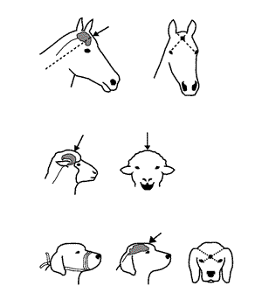
SHOOTING
Accurate and careful shooting is the most humane and the most rapid method of euthanasia.
The gunman should stand at a distance of five to eight feet.
Instantaneous unconsciousness is produced if the projecile is accurately placed to enter the brain.
For dogs and cats the captive-bolt pistol is employed with the barrel held against the target spot.
Shooting causes excessive haemorrhage and may be objectionable to the owner of the animal.
Adequate precautions must be taken to assure the safety of operating personnel

Slide 15
CONFIRMATION OF DEATH AFTER EUTHANASIA OF ANIMALS
Lack of pulse, breathing, corneal reflexes, and response to painful stimulation
Lack of audible heartbeat heard by use of a stethoscope
Graying of mucous membranes
Rigor mortis

Slide 16
DISPOSAL OF ANIMAL REMAINS AFTER EUTHANASIA
Animal remains must be disposed of in a legal manner that prevents contamination of food sources or the environment.
Any animal intended for food should not be euthanized with a barbiturate.
Owners may be informed about disposition options, such as burial, cremation, alkaline hydrolysis, rendering, and other authorized local disposal methods.

Slide 17
Thank You

