Slide 1
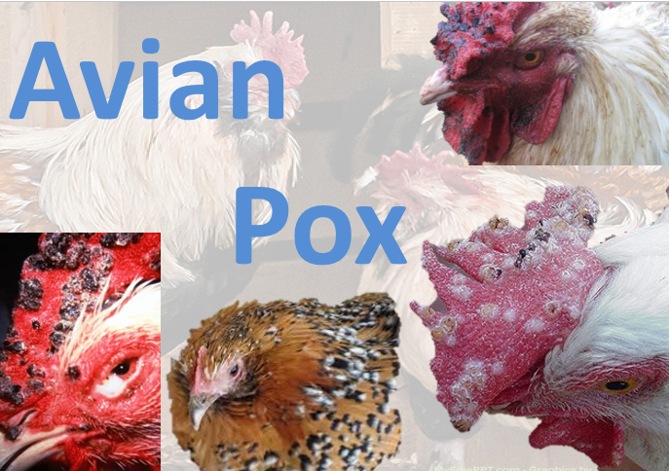
FOWLPOX
Dr. Ravi Shankar Kumar Mandal
Assistant Professor
Veterinary Medicine
BVC, Patna

Slide 2
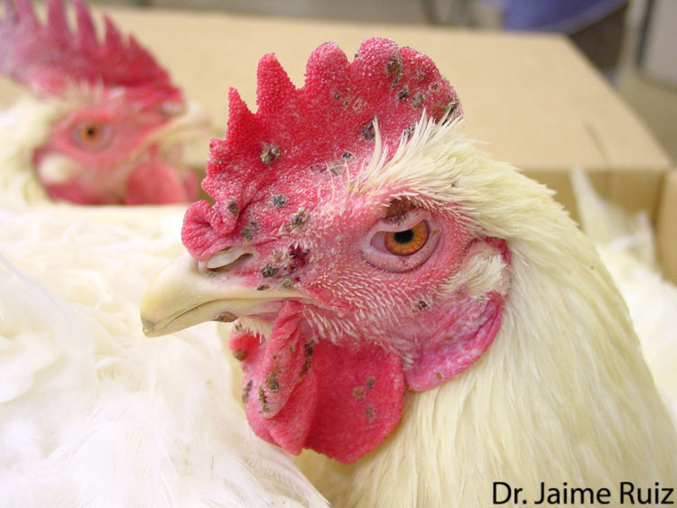
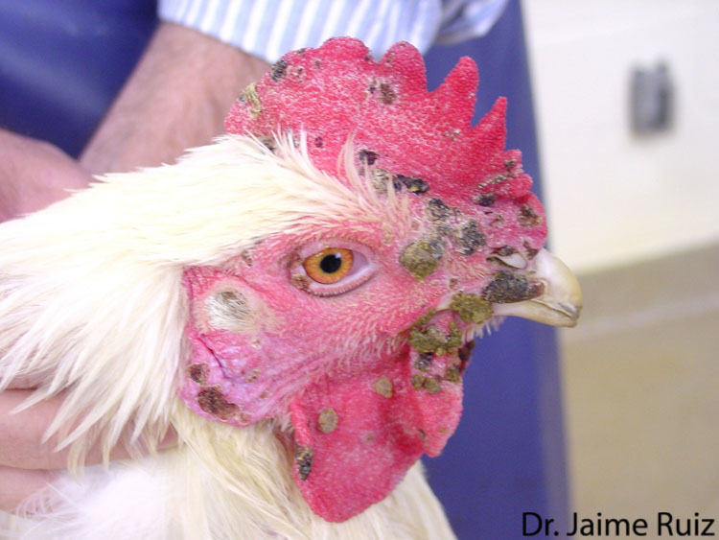
FOWLPOX
Highly contagious, slow-spreading viral disease of chickens and turkeys caused by fowlpox virus (FWPV) which induces proliferative nodular lesions of the skin that progress to thick scabs (cutaneous form) and/or diphtheritic lesions on the mucous membrane of the digestive and respiratory passages
Infected birds display various clinical signs depending on the route of transmission, lesion distribution, viral virulence and host susceptibility to the infecting strain
The disease has worldwide distribution but is endemic in tropical and subtropical countries with associated severe economic losses mainly through a transient drop in egg production, reduced growth rate in young birds, and significant mortality

Slide 3
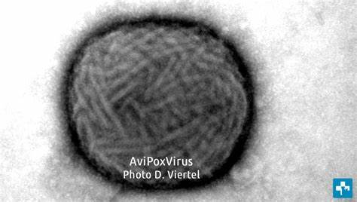
ETIOLOGY
FWPV is a large, enveloped dsDNA virus belonging to the genus Avipoxvirus (APVs) in the Chordopoxvirinae subfamily of the family Poxviridae
The mature virus is brick shaped and measures about 330 × 280 × 200 nm
Photolyase and A -type inclusion body protein genes in the genome of fowlpox virus protect the virus from environmental insults : resistant and may survive in the environment for extended periods in dried scabs
Fowlpox virus is used extensively as a viral vaccine vector against different infectious diseases largely due to its ability to accommodate multiple gene inserts
Highly infectious for chickens and turkeys

Slide 4
TRANSMSSION
Disease is more common in summer or spring season.
The virus is present in large numbers in the lesions and is usually transmitted by contact through abrasions of the skin
Feathers and dried scabs contaminate the environment and may cause skin and respiratory tract infection
Blood sucking insects like mosquitoes, flies, ticks and lice may serve as mechanical vectors

Slide 5
CLINICAL FINDINGS
Cutaneous or comb form:
Wart like nodules on combs, wattles, and skin of face, eyelids
The nodules initially yellowish, later becomes brownish and ultimately becomes blackish.
Lastly the growth drop-off as scabs in about 2 wks
Diphtheritic form :
Yellowish cheese like materials deposited on mucosa of tongue, palate, or laryngeal orifice, upper trachea which after removal leaves an ulcerated areas.
Oculonasal form :
There will be conjunctivitis and cheesy exudates accumulates under the eyelids which stick together and causes blindness.
Some times infection spread into the nasal cavity or infraorbital sinus, causing its swelling

Slide 6
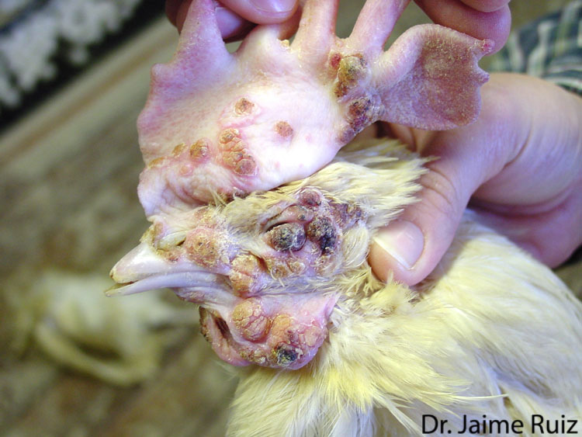
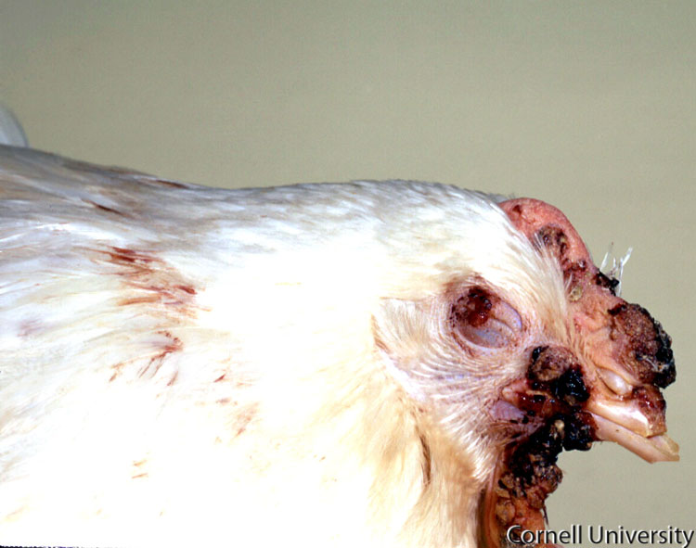
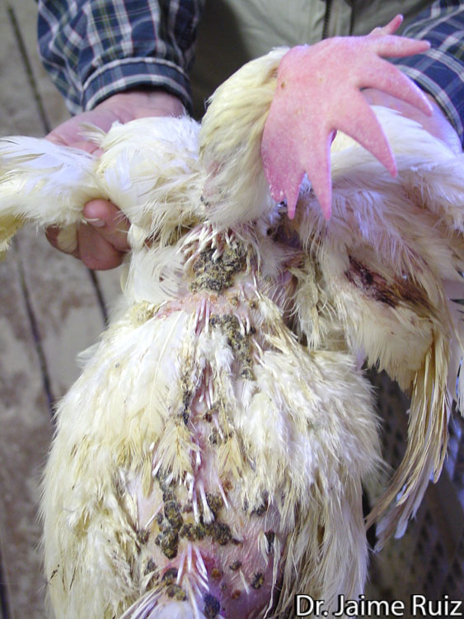
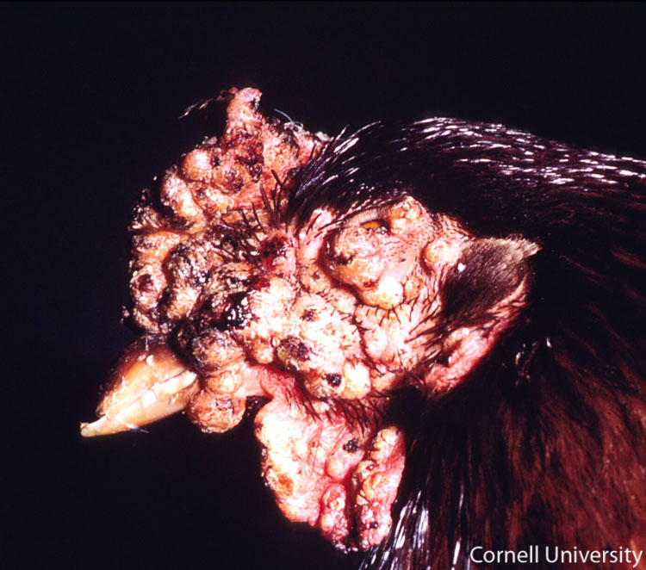
proliferative lesions and scab formation on the comb, wattles, and eyelid. In some cases, the eyelids can become so severely affected that vision is obstructed
Multiple, well-demarcated, raised, nodular masses

Slide 7
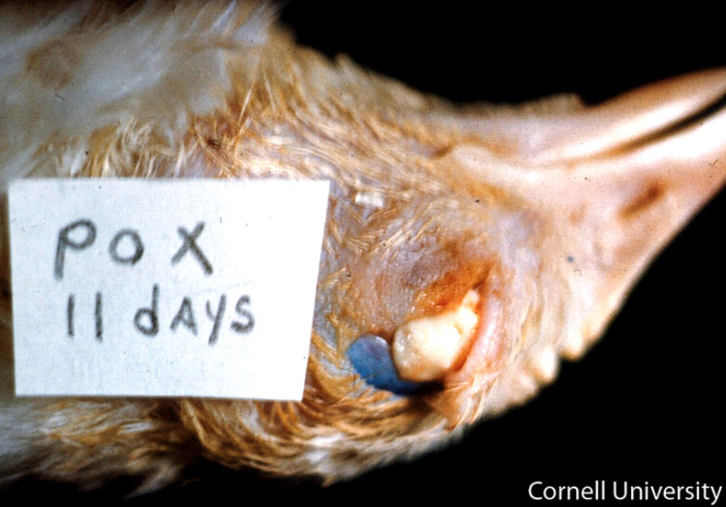
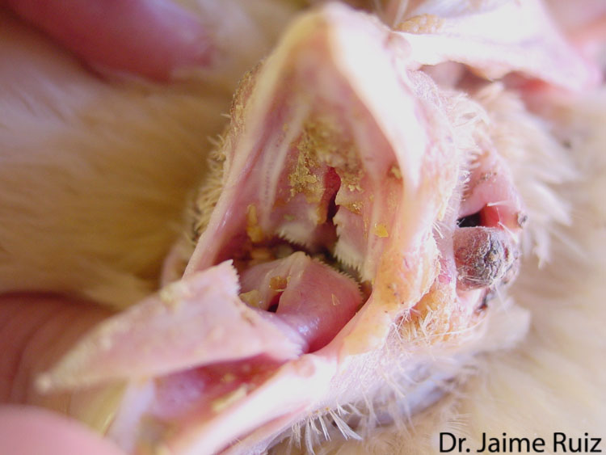
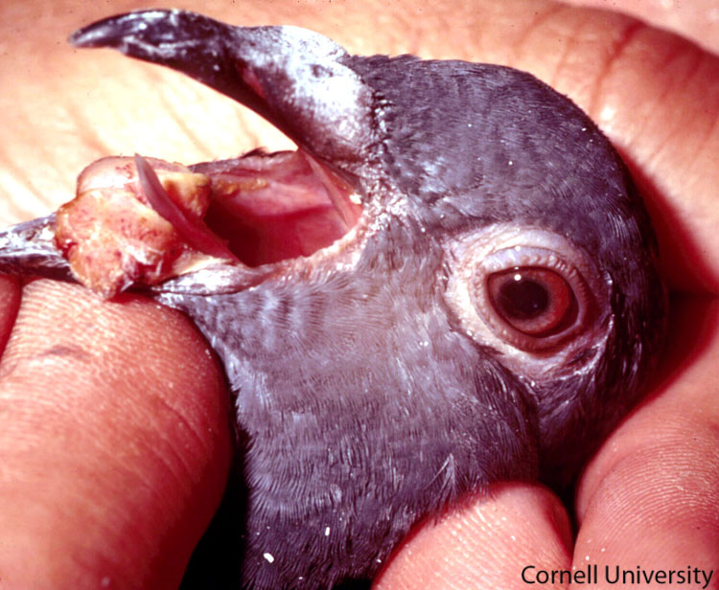
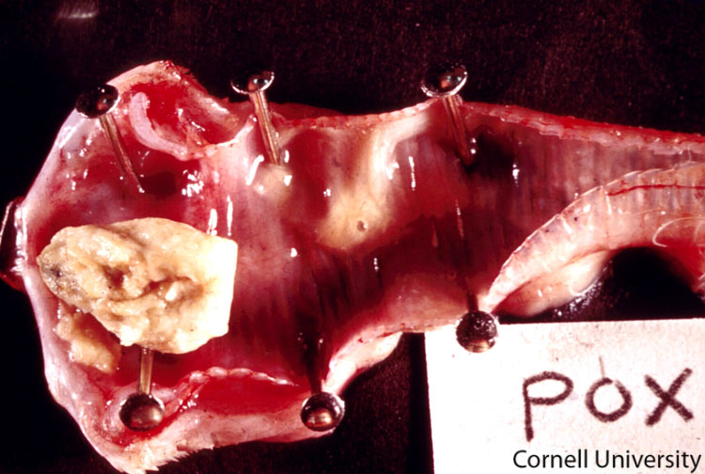
Fibrino-necrotic proliferative lesions on
the conjunctiva
Granular yellow plaques
Large diptheritic nodules
Trachea: Diphtheritic (wet) form of avian pox

Slide 8
DIAGNOSIS
Gross lesions
Microscopic lesions
stained with H&E reveals eosinophilic intracytoplasmic inclusion bodies (Bollinger bodies)
Elementary bodies (Borrel granules) in the inclusion bodies can be detected in smears from lesions stained by the Gimenez method
Negative-staining electron microscopy demonstrate viral particles with typical poxvirus morphology
Virus isolation
inoculating CAM of developing chicken embryos (9-12 d old)
PCR
Serological tests : ELISA, Passive HA test, FAT, VN
Field isolates and vaccine strains of fowlpox virus can be compared by restriction fragment length polymorphism

Slide 9
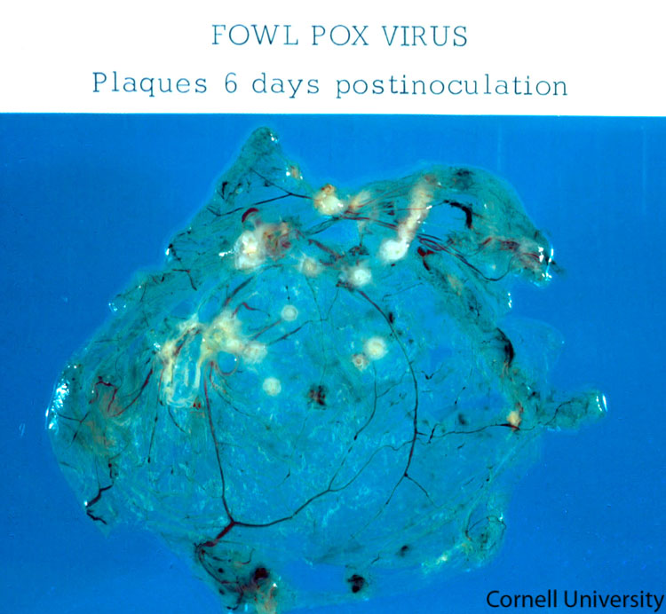
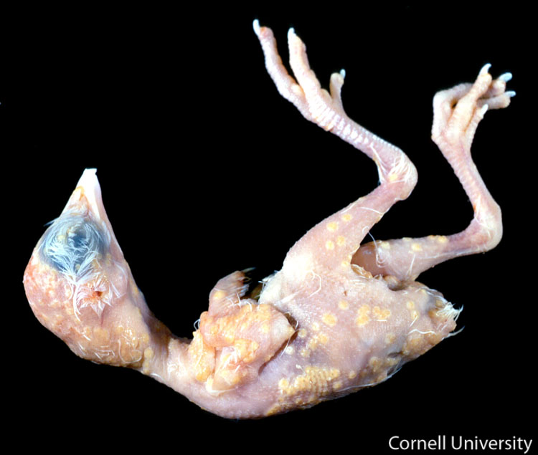
6 day post inoculation: transparent tissues of the chorioallantoic membrane are disrupted by multiple, well-demarcated, raised, pale yellow plaques
The skin of the embryo is covered by numerous, variably sized, sometimes coalescing pale yellow, raised plaques

Slide 10
PREVENTION AND CONTROL :
In face of outbreak, the affected birds must be immediately segregated and remaining birds must be vaccinated as soon as possible.
The sick birds may be treated with broad spectrum antibiotics to prevent death due to complications.
The infected equipments or fittings may be disinfected by 1:500 solution of sodium hydroxide, 1:400 cresol, or 3 percent phenol, 10% bleach solution
The dead birds and infective materials may be buried or burnt.
A mosquito-control programme.
Live attenuated vaccines given through the wing web and thigh can prevent the fowl pox.
Breeders and layers should be vaccinated 3 to 5 wks before laying.
Because of the virulence of the vaccine virus, birds must be 5 wks of age or older.
Being a live virus ,it is capable of spreading the disease, hence use carefully.

Slide 11
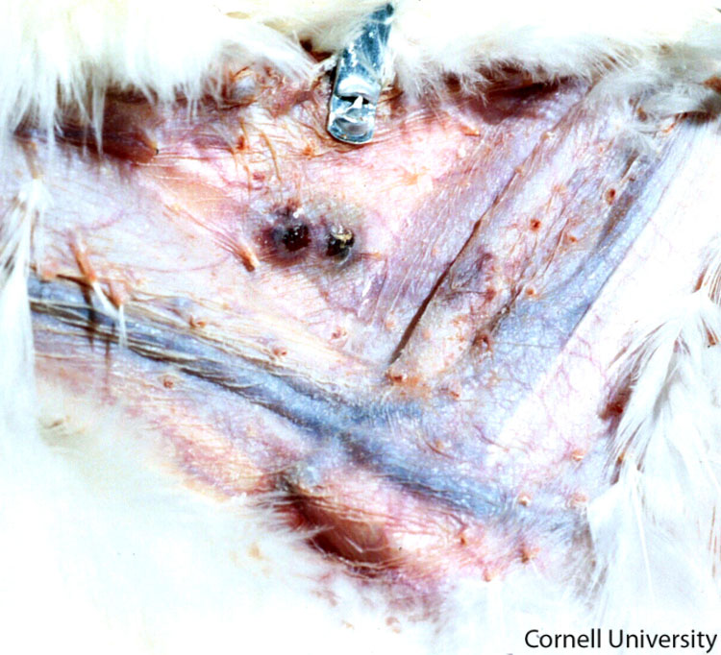
VACCINE “TAKE”
A “take” is a swelling of the skin or scab in the site where the vaccine was applied and is evidence of a successful vaccination.
When administering the avian pox vaccine in the wing web, special care should be taken to avoid injection in the adjacent veins as this will cause a severe inflammatory response and hemorrhage.
If the vaccine is properly administered the majority of the vaccinated birds should develop “takes” 7-10 days post-vaccination.
Vaccine “take” on the chicken’s wing web.

Slide 12
Zoonotic Risk:
There is no zoonotic risk associated with fowlpox virus.
Avian poxviruses cause a productive infection in avian species but a nonproductive infection in mammalian hosts.
Consequently, avianpox viruses have been used as vectors for expression of genes from mammalian pathogens in the development of safe recombinant vaccines.

Slide 13
Thank You

