Slide 1
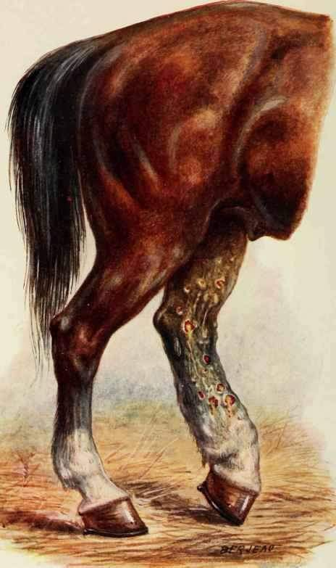
THE GLANDERS AND FARCY ACT, 1899
ACT NO. 13 OF 1899
Dr. Ravi Shankar Kr Mandal
Assistant Professor
Veterinary Medicine
BVC, Patna

Slide 2
GLANDERS (FARCY)
One of the most ancient of all diseases recognized
Scourge of solipeds
Fatal, highly contaigious and zoonotic
Characterized by nodular lesion in lung, and nodular and ulcerative lesions in respiratory tract, mocusa and skin
Acute to chronic form
Acute form –Ass
Subacute form – Mule
Chronic (latent) from – Horses
Occupatonal disease: Veterinarins, Farriers and animal workers

Slide 3
CLINICAL FINDINGS
Lameness, lymphadenopathy and fever are the cardinal clinical signs and they are accompanied by malaise and inappetance
Characteristic shifting polyarthritis
Acute disease
- High fever, Cough, Nasal discharge
- Rapidly spreading ulcers on the nasal mucosa
- Nodules on skin of the lower limbs, abdomen
- Ulcers formed due to the infection is little resistant to healing
- Death: septicemia (few days)

Slide 4
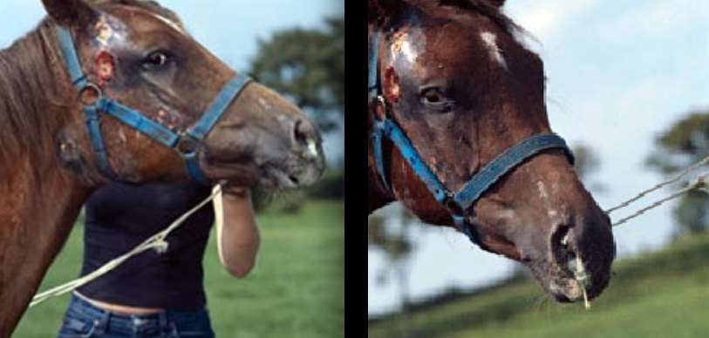
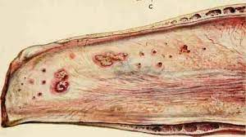
Chronic disease
Pulmonary form: chronic pneumonia, cough, frequent epistaxis, labored respiration
Nasal form : serous nasal discharge turns purulent and blood mixed
Nodule (1cm dia) Punched out ulcer Stellate scar (star shaped scars)

Slide 5
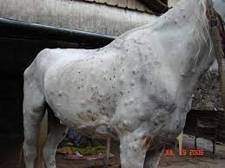
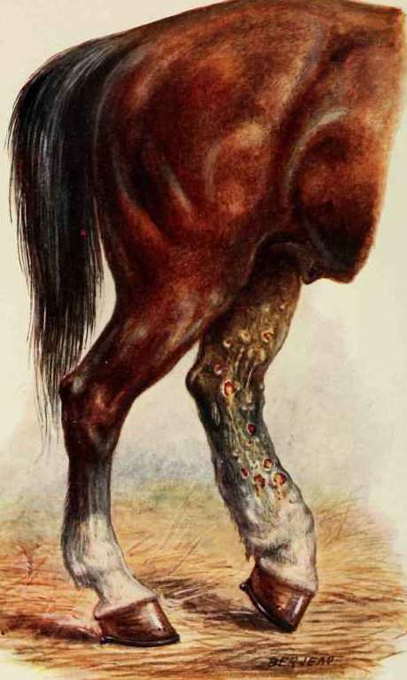
Skin form: FARCY
- Subcutaneous nodules (1-2 cm in dia) ulcerate and discharge honey like pus
- Skin of the lower limbs and abdomen are mostly affected
- Deep nodules discharge through fistulous tract
- Radiant and connected thickened fibrous lymph vessels
Farcy cord
Farcy bud

Slide 6
DIAGNOSIS
Based on clinical signs and necropsy findings
Principal tests
Mallein test
Serological tests
Demonstration of the organism
Haematological finding
Low Hb level, decreased erythrocyte count and PCV
Moderate leukocytosis and neutrophilia

Slide 7
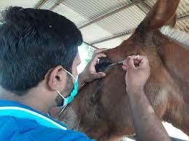
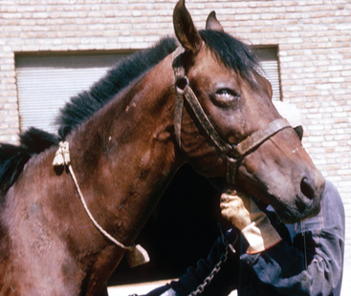
MALLEIN TEST
Allergic hypersensitivity test
Intradermopalpebral test
Mallein is PPD of B. mallei
Mallein (0. 1 mL) injected intradermally into
the lower eyelid with a tuberculin syringe
Reading at 48 hrs
Positive case | Marked edema of the lid with blepharospasm and a severe purulent conjunctivitis

Slide 8
SEROLOGICAL TESTS
CFT is the most accurate and usual official test
Some strains of B. mallei give cross-reactions with B. pseudomallei
CFT may be unsuitable in mules and asses because of anticomplement activity
Indirect hemagglutination test using mallein as the antigen
Dot ELISA
Fluorescent Antibody Technique
All serological tests may be inaccurate for periods up to 6 weeks following the mallein test

Slide 9
DEMONSTRATION OF ORGANISM
Sample : Pus material, lymphnode discharge and swabs
Culture of organism
Identification of organism: Gram negative, rod shaped organism can be seen in Gram staining of pus smears
Strauss reaction
Pus injected intraperitoneally into
male guinea pigs :
Severe orchitis
Inflammation of the scrotal sac

Slide 10
NECROPSY FINDINGS
Acute form
Multiple petechial hemorrhages throughout the body
severe catarrhal bronchopneumonia with enlargement of the bronchial lymph nodes
Chronic form
Lungs : miliary nodules
Nodular and ulcerative lesions in respiratory tract, mocusa and skin

Slide 11
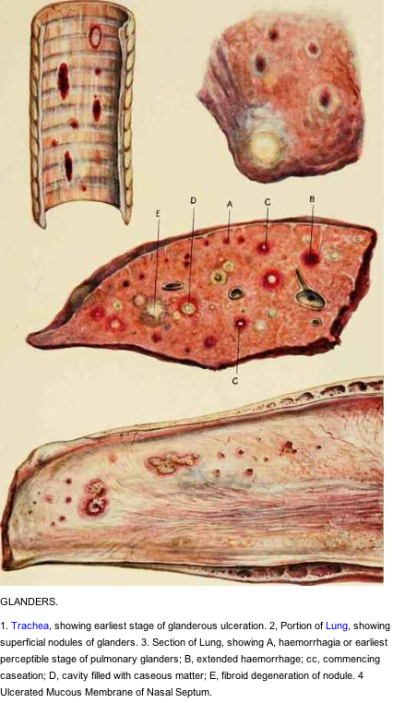
1. Trachea – showing ulceration
1
2
2. Portion of lung : superficial nodules
3. Section of lung :
A. Haemorrhage
Extended haemorrhage
Commencing caseation
Cavity filled wth caseous material
Fibroid degeneration of nodule
3
4
4. Nasal septum:
Ulcerated mucous membrane

Slide 12
THE GLANDERS AND FARCY ACT, 1899
ACT NO. 13 OF 1899
Passed by the Governor-General of India in council, 20th March, 1899
An Act to consolidate and amend the law relating to Glanders and Farcy, highly contagious disease primarily of equids
The provisions of this Act relating to horses shall apply also to Assess and Mules.
Under the Act, the local government has the power to appoint inspectors who shall be responsible for searching and seizing horses that are believed to be diseased and taking them to veterinary practitioners.
A horse if found to be diseased by the veterinary practitioner, they are required to immediately destroy the horse.
If the owners of the horse fail to comply with the provisions of this Act, they may be imprisoned, fined or both.

Slide 13
3. Application of Act to local areas by State Government
By notification in the local official Gazetee, apply this Act or any provision of this Act, to any local area, to be specified in such notification, within the province.
4. State Government to appoint Inspectors
By notification in the Official Gazette, appoint such persons as it thinks fit to be Inspectors under this Act and to exercise and perform, within the whole of the local area or such portions thereof as it may prescribe
5. Power of entry and search
Enter and search any field, building or other place for the purpose of ascertaining whether there is therein any horse which is diseased
6. Power of seizure
Seize any horse which believed to be diseased

Slide 14
7. Horse to be examined by Veterinary Practitioner
Seized horse has to be examined as soon as possible by Veterinary Practitioner as the State Government may appoint in this behalf
When the Inspector is also a Veterinary Practitioner so appointed, he may make the examination himself.
Veterinary Practitioner may submit the horse to any test or tests which the State Government may prescribe
8. Horse to be destroyed if found diseased: otherwise restored
If the Veterinary Practitioner
Certifies in writing that the horse is diseased, the Inspector shall cause the same to be immediately destroyed
Does not certify that the horse is diseased, the inspector shall at once deliver the same to the person entitled to the possession thereof.

Slide 15
9. When horse diseased, place where it has been to be disinfected, etc
Inspector may issue a notice to the owner of the building, shed, place or lines, or to the person in charge thereof, directing him to have the same disinfected and the internal fittings thereof,, destroyed
On the failure or neglect of such owner
Inspector shall cause the building, shed, place or lines to be disinfected and the fittings or other things to be destroyed, and the expense (if any) thereby incurred may be recovered from the owner or other person as if it were a fine.
10. Owner or person in charge of diseased horse to give notice.
11. Prohibition against removal, without license, of horse which has been with diseased horse.
12. Vexatious entries, searches and seizures
shall be punishable with imprisonment for a term which may extend to six months, or with fine which may extend to five hundred rupees, or with both

Slide 16
13. Penalty for refusing to comply with notice under section 9, or for removing horse contrary to section 11
shall be punishable with imprisonment for a term which may extend to one month, or with fine which may extend to fifty rupees, or with both
14. Power to make rules.
The State Government may make rules to carry out the purposes and objects of this Act
15. Appointment of same person to be both Inspector and Veterinary Practitioner
Veterinary Practitioner may be appointed by the State Government to be both Inspector and Veterinary Practitioner for all or any of the purposes of this Act or of any rule thereunder.
16. Protection to persons acting under Act.
No suit, prosecution or other legal proceeding shall lie against any person for anything which is, in good faith, done or intended to be done under this Act

Slide 17
Thank You

