Slide 1
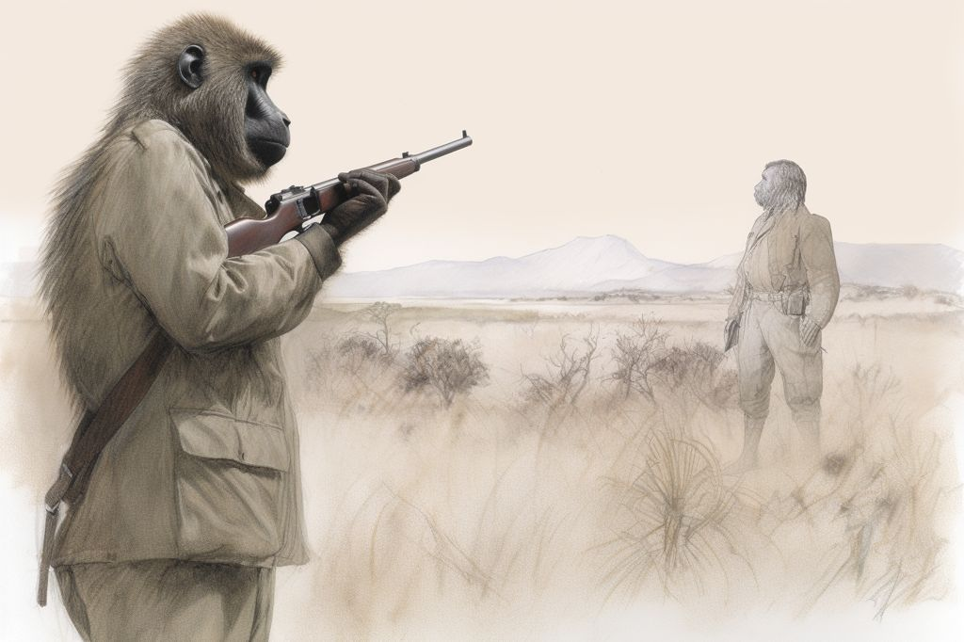
Human-Animal Conflict
(Human-Wildlife Conflict)
Dr. Ravi Shankar Kr Mandal
Assistant Professor
Veterinary Medicine
BVC, Patna

Slide 2
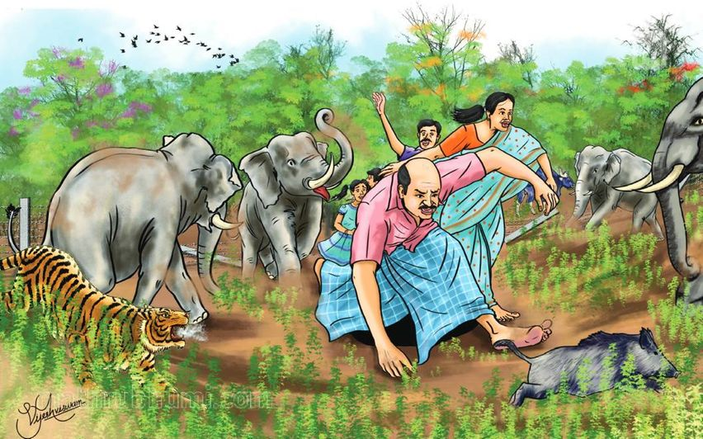
Human-Wildlife Conflict (HWC)
Fast becoming a critical threat to the survival of many globally endangered species, in particular to large and rare mammals
Takes many forms, and varies greatly in intensity – is one of the most serious threats to India’s wildlife.
Occurs when wildlife requirements overlap with those of human populations, creating costs to residents and wild animals (IUCN, World Park Congress, 2003)
Direct contact with wildlife occurs in both urban and rural areas, but it is generally more common inside and around protected areas, where wildlife population density is higher and animals often stray into adjacent cultivated fields or grazing areas.
Species most exposed to conflict are also shown to be more prone to extinction

Slide 3
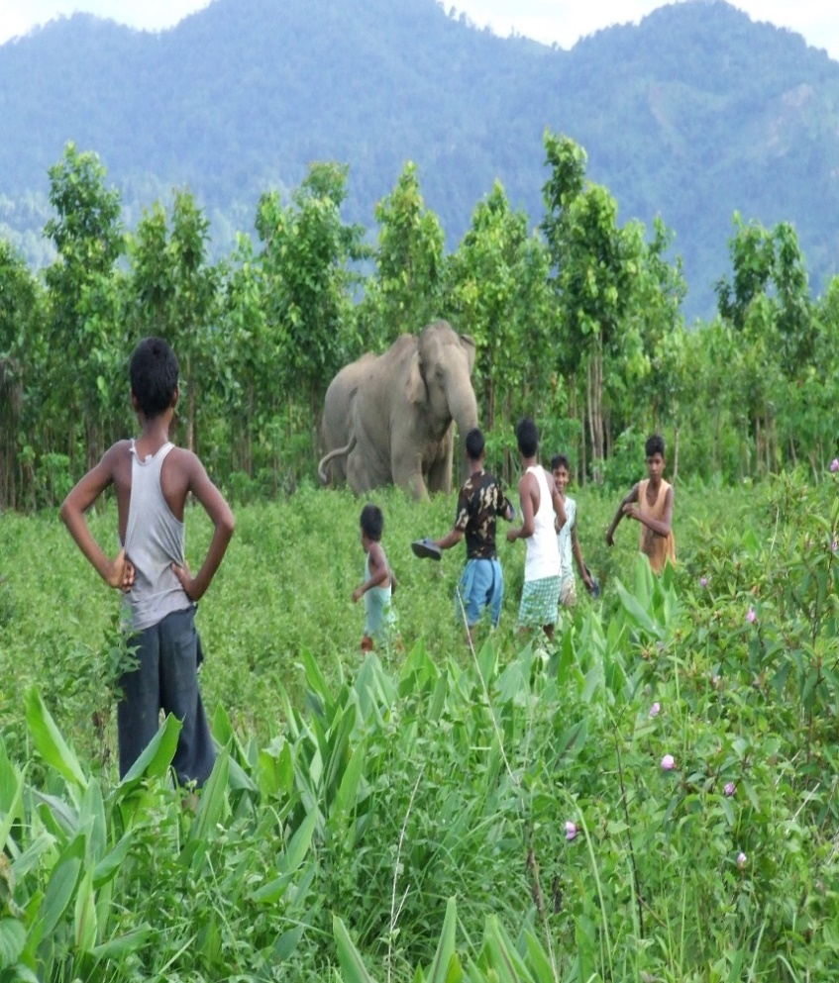
Far reaching environmental impacts
Undermine human welfare, health and safety, and have economic and social costs.
Nuisance encounters with small animals
Exposure to zoonotic diseases
Physical injury or even death caused by large predators’ attacks
Have high financial costs for individuals and society in the form of medical treatments to cure and prevent infections transmitted from animals through human contact
Destruction and damage to property and infrastructure
Livestock depredation
Negative social impacts include missed school and work, additional labour costs, loss of sleep, fear, restriction of travel or loss of pets

Slide 4
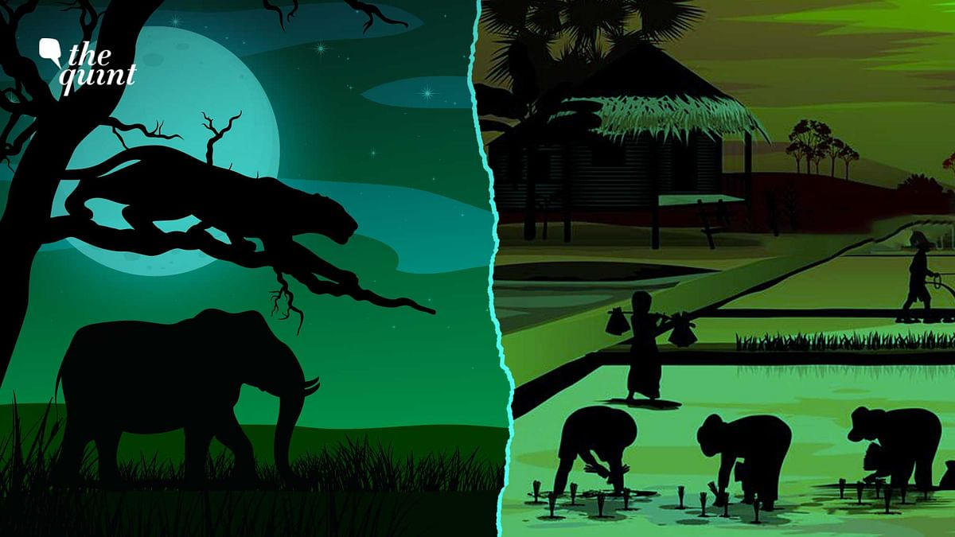
Driving forces
Human population growth
As human populations and demand for space continue to grow, people and wildlife are increasingly interacting and competing for resources, which can lead to increased human-wildlife conflict.
Demographic and social changes place more people in direct contact with wildlife
As human populations grow, settlements expand into and around protected areas, encroachment into wildlife habitats, constriction of species into marginal habitat patches and direct competition with local communities
Human population growth is correlated proportionally with the number of encounters and serious incidents with wildlife

Slide 5
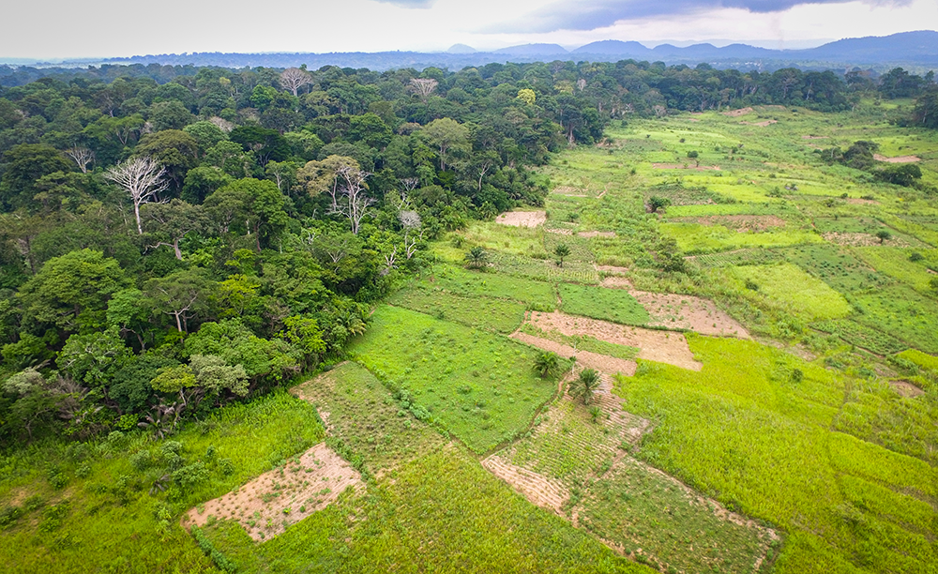
Driving forces
Land use transformation: Species habitat loss, degradation and fragmentation
Transformation of forests, savannah and other ecosystems into agrarian areas or urban agglomerates is a consequence of the increasing demand for land, food production, energy and raw materials
In Gujrat, on the periphery of Gir National Park and Sanctuary, intense and escalating conflicts with Asian lions (Panthera leo persica) and leopards (Panthera pardus) are due to the rapid and extensive change in land use associated with the conversion of groundnut and great millet fields into sugarcane and mango cultivation

Slide 6
Growing interest in ecotourism and increasing access to nature reserves
Expanding infrastructure for ecotourism (roads, lodges, and trails) can encroach on wildlife habitats, forcing animals into closer proximity with humans
Frequent human activity in nature reserves can disrupt wildlife behaviors such as feeding, breeding, and migration. Animals may become habituated to human presence or exhibit stress-related behaviors.
Wildlife and local communities often share resources like water, land, and food. Ecotourism can exacerbate competition if tourism activities strain these resources further
Overgrazing by livestock or depletion of water bodies due to increased tourism-related use can force wildlife into human settlements in search of sustenance.
When tourists feed animals or leave food waste, wildlife may become accustomed to human settlements as food sources. This habituation increases the likelihood of animals venturing into areas populated by humans, leading to conflict.

Slide 7
Increasing livestock populations and competitive exclusion of wild herbivores
Growing densities in livestock populations can create an overlap of diets and forage competition with wild herbivores, resulting in overgrazing and decline or local extinction in wild herbivore populations
In India, domestic animals often outnumber wild ungulates within protected areas, reaching densities of upto 1500/km² and it has been ascertained that livestock graze in 73% of wildlife sanctuaries and 39%

Slide 8
Abundance and distribution of wild prey
When wild prey populations decline due to habitat loss, overhunting, or competition with livestock, predators are forced to seek alternative food sources. This often brings them into closer proximity to human settlements, leading to livestock predation or crop raiding.
When native prey is abundant, wild predators consume it in preference to livestock and that impoverishment of prey populations is one of the major causes of carnivores shifting their diets to livestock
ease of capture and limited escape abilities of livestock
Fragmented Habitats: Uneven prey distribution caused by habitat fragmentation forces predators to expand their range, increasing encounters with humans and domestic animals.
Edge Effects: Wildlife near habitat edges often encounters agricultural or urban areas where livestock or crops serve as alternative prey, leading to conflicts.
Seasonal Variation: Migration patterns or seasonal fluctuations in prey availability can cause predators to temporarily shift their activity to human-populated areas.

Slide 9
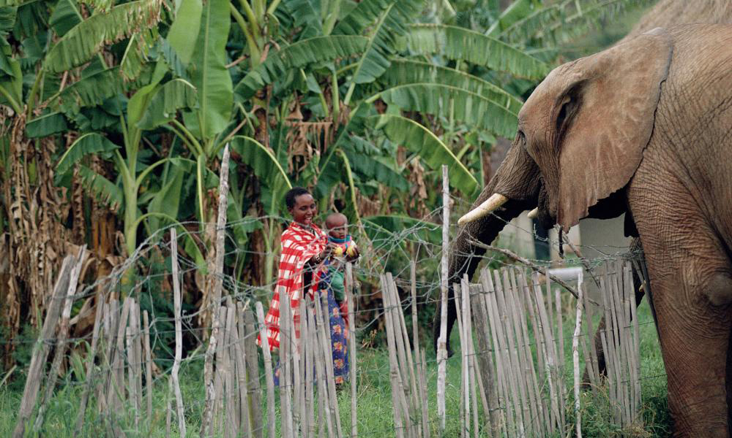
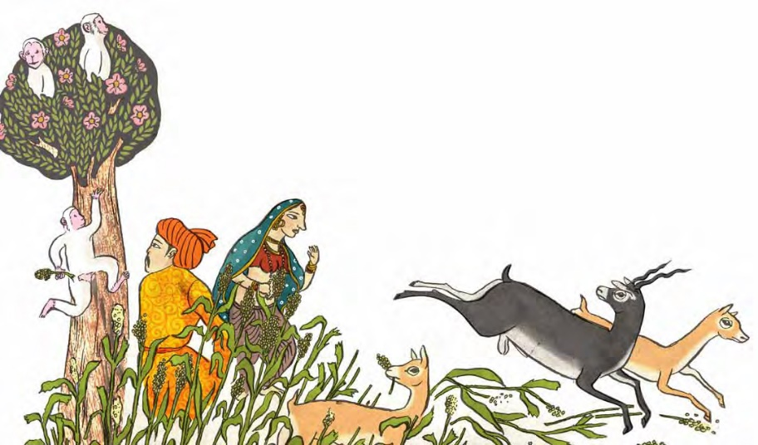
Increasing wildlife population as a result of conservation programme
When wildlife populations recover, they often exceed the carrying capacity of their habitats. This forces animals to venture into human-dominated landscapes in search of food, water, or space, increasing the likelihood of conflict
Conservation efforts for apex predators (e.g., lions, tigers, wolves) often result in increased predation on livestock, causing economic losses for local communities.
Growth in populations of large herbivores like elephants or deer can lead to significant crop damage and competition with livestock for grazing land.
High wildlife densities can cause competition for resources, prompting some species to adopt riskier behaviors, such as raiding crops or livestock

Slide 10
Climatic factors
Increasing temperatures and irregular rainfall exacerbate drought conditions, reducing water bodies and forcing more wildlife into human areas.
Habitat Loss: Conversion of wetlands for agriculture or urbanization leaves crocodiles with fewer natural habitats, increasing their reliance on shared water resources.
Reduced Prey Availability: Climate impacts on prey populations can drive predators to target livestock or enter human settlements for food.
Example: Polar bears in the Arctic increasingly scavenge in towns as sea ice loss limits their access to seals.
Unusual Predator Activity: Altered breeding cycles or increased competition among predators can lead to greater livestock predation or even attacks on humans

Slide 11
Climate-Induced Habitat Loss
Deforestation and Degradation: Climate change exacerbates habitat degradation through desertification, rising sea levels, and vegetation changes, reducing the availability of resources for wildlife.
Urban Encroachment: As climate change impacts agriculture, humans expand into wildlife habitats, increasing direct interactions and conflicts.

Slide 12
Droughts and Water Scarcity
Impact on Wildlife: Droughts reduce the availability of natural water sources and vegetation, forcing animals to move into agricultural or urban areas in search of water and food.
Elephants or big cats straying into villages to access water sources or livestock during dry seasons.
Crocodile attacks near shrinking water bodies as both humans and animals converge for water.

Slide 13
Poverty and other constraints that force disadvantaged humans to enter protected areas and to exploit natural resources (through hunting, grazing, collection of wood, leaves, fruits, etc.), bringing them into conflict with wild species, both directly and indirectly.

Slide 14
SUMMARY OF HUMAN-WILDLIFE CONFLICT ACROSS INDIA
Species | Types of Conflict | Areas of Major Conflict
Tiger (Panthera tigris) | Cattle lifting B. Injuries or death to humans/ man-eating | All India Sunderbans
Leopard (Panthera pardus) | A. Livestock depredation B. Injuries or death to humans/ man eating | All India Garhwal, Kumaon, Himachal Pradesh
Snow Leopard (Uncia uncia) | Livestock depredation | Ladakh, Himachal Pradesh, northern Uttaranchal, parts of North-East India
Lion (Panthera leo) | Habitual livestock depredation B. Injuries or death to humans | Gir Forest, Gujarat
Elephant (Elephas maximus) | Crop raiding Injuries or death to humans | A. All wild elephant bearing areas B. Injuries or death caused by domestic elephants
Wolf (Canis lupus) | Livestock depredation Child-lifting | A. Pockets of Northern, Central, Western India B. Uttar Pradesh

Slide 15
Bears Asiatic Black Bear (Ursus thibetanus) Sloth Bear (Melurus ursinus) Himalayan Brown Bear (Ursus arctos) | A. Livestock depredation (Brown Bears) B. Injuries or death to humans (Sloth Bears) | Ladakh All India, particularly Central India
Deer, Antelopes, Wild Cattle, Wild Boars | Crop raiding | All India
Reptiles | Injuries or death to humans Man eating (Salt water or Estuarine Crocodiles) | All India Sunderbans
Birds / Bats | Crop raiding Bird hits to aircraft | All India

Slide 16
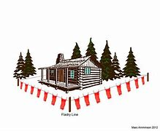
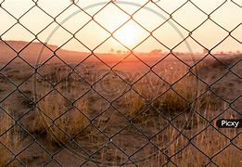
MANAGEMENT OF CONFLICT SITUATIONS
Artificial and natural barriers (physical and biological)
prevent spatial overlapping among wild animals and local communities; they are usually man-made, but natural barriers such as rivers, coasts or mountain ranges may occur along a nature reserve boundary
Building electric or physical fences to keep wildlife away from agricultural areas and settlements
Buffer Zones
Act as barriers that discourage wildlife from encroaching into human-occupied areas, such as farms, villages, or roads
Create a "no-conflict" space that reduces the chances of encounters that could lead to property damage or attacks
Kaziranga National Park (India): Buffer zones with unpalatable crops and trenches help protect communities from rhinos, elephants, and tigers

Slide 17
Waste Management
Good standards of waste management are important to avoid attracting wild animals to human settlements and to prevent wild populations being augmented and artificially sustained by human induced food availability.
Each stage of waste handling should be addressed, from collection to transportation to disposal.
Relocation: voluntary human population resettlement
Where alternative land and incentives are available, relocation of local communities to areas offering better access to natural resources and socio-economic opportunities can be an adequate solution
Resettlement schemes aiming to prevent the overlap between wildlife and people, can be successful in the long run

Slide 18
Lighting and Noise
Using lights or alarms to deter wildlife at night
Community Engagement
Education and Awareness: Educating communities about wildlife behavior and non-lethal deterrent methods.
Involving Locals: Engaging local communities in conservation projects and decision-making processes to promote coexistence.
Compensation Schemes: Offering compensation for losses due to wildlife to reduce retaliatory killings.

Slide 19
Thank You

