Slide 1
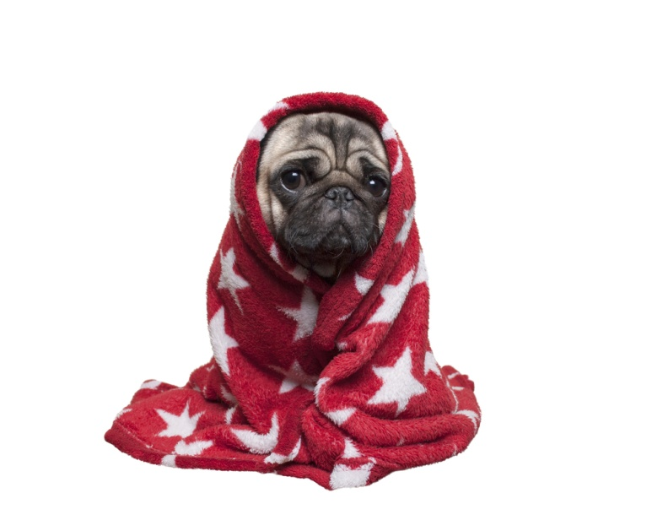
Hypothermia/Sub-normal body temperature
Department of Veterinary Medicine
Bihar Veterinary College, BASU, Patna
Dr Mritunjay Kumar
Associate Professor
Department of Veterinary Medicine
VMD, BVC, BASU, Patna

Slide 2
Hypothermia (subnormal body temperature) is sudden drop in normal body temperature below the normal range which occur when excess heat is lost or insufficient heat is produced
In most of the animals a body temperature of less than 35⁰C is termed hypothermia
It is most likely to occur in young, small animals or those with malnutrition
Within the first few days of life, neonatal hypothermia is a major cause of morbidity and mortality in new born farm animals
Classification as per etiology
Accidental (cold exposure)
Spontaneous (after trauma) and
Iatrogenic hypothermia or therapeutic hypothermia (cold intravenous fluid administration or prolonged anesthesia)
Pets that are very young, small, elderly, skinny, or poorly are at high risk of hypothermia

Slide 3
Etiology
Exposure to cold for long time
Wet fur and skin
Anesthesia for prolonged period
Malnutrition
Hypocalcaemia
Hypothyroidism
Haemorrhages
Anaemia
Shock

Slide 4
Exposure to cold ambient temperature
Pathogenesis
Heat loss
Hypothermia
Non-shivering thermogenesis
Shivering
BMR
Heart rate
Pulse rate
RR
Muscular weakness
Mental depression
Respiratory failure
Recumbency, COMA AND Death
Depletion of brown adipose tissue depletion

Slide 5
Neonates suddenly exposed to cold ambient temperature causes falls in rectal temperature below 37⁰C and may even drop to 30⁰C
Non-shivering induced thermogenesis may resulting in the loss of brown adipose tissue deposits
Piglets- Nervous signs with an insufficient intake of milk and exposure to cold environmental temperature – severe hypoglycaemia
Clinical signs/Classification
Mild hypothermia (35-37ºC)
Shivering
Feeling cold to touch
Weakness
Lack of alertness

Slide 6
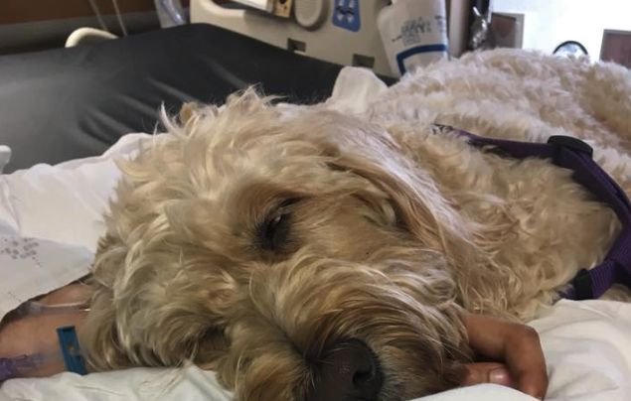
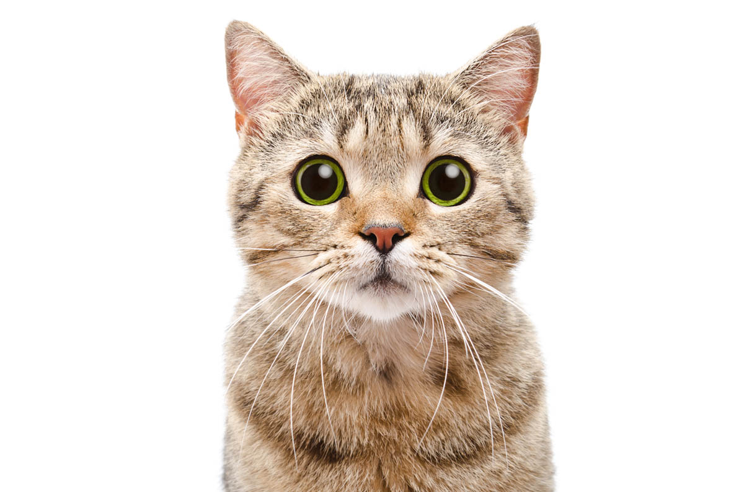
Moderate hypothermia (32 -35⁰C)
Bradycardia
Vasoconstriction
Low BP
Shallow breathing
Stupor like state
Severe hypothermia (<32 ⁰C)
Difficult breathing
Dilated pupil
Muscle stiffness
Pale or blue gums
Dry mouth
Reduced core temperature
Coma and Death

Slide 7
Clinical Pathology
Apparently of limited value
Decreased serum concentration of glucose, non-esterified fatty acid and immunoglobulins
Necropsy findings
Absence of milk in abomasum
Sub-cutaneous oedema and haemorrhages of body extremities
Noticeable reductions in the quality of perirenal adipose tissue

Slide 8
Treatment
First Aid
Move the animal to warm dry location
Cover the patient with blanket
Insulate the patient body from the cold ground
Monitor breathing- Provide cardiopulmonary resuscitation (CPR) immediately in case of stopped breathing or appears dangerously low
Provide warm water- if animal is alert and able to shallow
Use warm, dry compresses- Use a first aid warm compresses (use warm liquid to apply heat to an area) e.g. towel soaked in warm water or a dry warm compress (Uses a dry surface to transfer heat) e.g. warm water in a plastic bottle or a dryer-warmed towel or heating pad

Slide 9
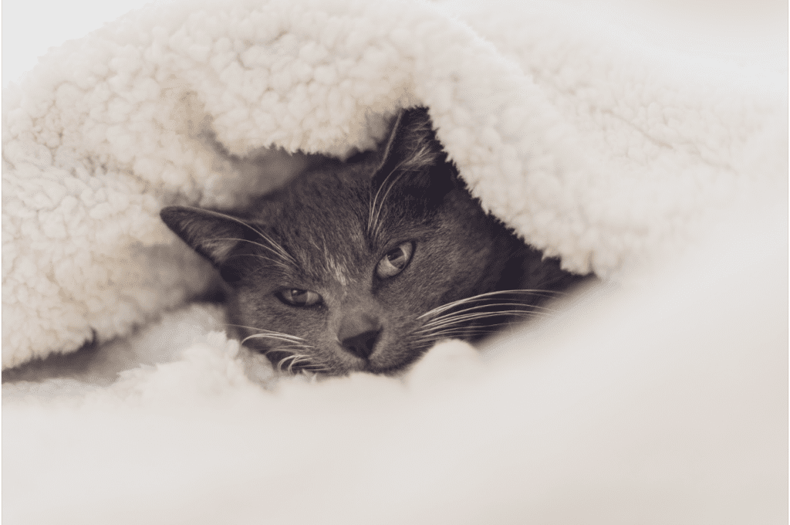
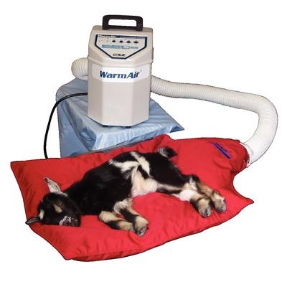
Medicinal treatment
Rewarming approaches are categorized as “passive external” “active external” or “active internal”
Passive external rewarming (inventions to promote heat retention)- Animal with mild hypothermia, it is enough to cover them with heated blankets and offer warm fluid to drink or increase room temperature
Active external rewarming involves the application of external heat to skin and peripheral tissues eg. Air blower, heat lamp, warm water bottles wrapped in cloths
The immersion of hypothermic animals in water at 38⁰C can result in the recovery to a euthermic state in an about half an hour

Slide 10
Active internal rewarming
Warm intra-venous fluids- Intravenous 50% dextrose at the dose rate of 1ml/kg body weight (as having moderate to severe hypoglycaemia)
Intra-peritoneal administration of warm glucose solutions to correct hypothermia
Repeated administration of warm (40⁰C) 0.9% NaCl enemas via a flexible soft tube through the anus
Active Internal lavage eg bladder lavage, gastric lavage etc
Airways rewarming- Humified oxygen administered with a mask or nasal tube can warm the airways and help raise the temperature of body
Extracorporeal (medical procedure performed outside the body- Dialysis to warm the blood

Slide 11
Multiple choice
1. What is the most common cause of hypothermia in animals?
A. Excessive food intake B. Prolonged exposure to cold environments C. Heat stroke D. High metabolic rate
2. Which organ is primarily responsible for thermoregulation in animals?
A. Liver B. Heart C. Hypothalamus D. Kidneys
3. Which of the following is NOT a compensatory mechanism against hypothermia?
A. Shivering B. Vasodilation C. Vasoconstriction D. Non-shivering thermogenesis
4. What is a common sign of moderate to severe hypothermia in animals?
A. Hyperactivity B. Increased appetite C. Muscle stiffness and bradycardia D. Bright red mucous membranes

Slide 12
5. Which animals are most at risk for developing hypothermia?
A. Healthy adult animals in warm climates B. Neonates and small animals C. Large adult ruminants D. Animals with thick fur
6. What temperature range typically indicates mild hypothermia in most mammals?
A. 37.5°C to 39°C B. 35°C to 37°C C. 33°C to 35°C D. Below 30°C
7. Which of the following is a potential complication of severe hypothermia in animals?
A. Increased fertility B. Cardiac arrest C. Increased metabolism D. Hypertension
8. What is the safest approach to rewarming a hypothermic animal?
A. Immersing in hot water B. Applying ice packs to the core C. Gradual rewarming using blankets and warm IV fluids D. Leaving the animal in the sun

