Slide 1
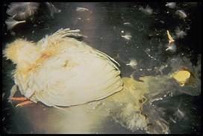
Infectious Bursitis
Department of Veterinary Medicine
Bihar Veterinary College, BASU, Patna
Dr Mritunjay Kumar
Associate Professor
VMD, BVC, BASU, Patna

Slide 2
Infectious Bursitis/Infectious bursal disease/Gumboro disease
It is a highly contagious disease commonly occurring in young chickens upto 6 weeks of age, caused by a IBD virus and is characterised by sudden, short course and immunosuppressant due to extensive destruction of lymphocytes in the bursa of Fabricius

Slide 3
Etiology
Double stranded RNA virus having bisegmented genome, 55-65 nm, non enveloped and having a cubical symmetry
Belonged to genus Avibirnavirus and family Birnaviridae
It is highly resistant to chemical agents and physical conditions
The name gumboro has been given to this disease because it was recognised in the Gumboro district of Delaware in USA
Morbidity rate can vary and even it can be 100% and mortality rate also varies and may reach 40-50%
Two serotypes occurs wherein serotype I is pathogenic

Slide 4
Epidemiology
Incidence: It occurs throughout the world and very important disease of chicken causing severe economic loss
All breeds are susceptible and white leg horns is appears to be very susceptible
Transmission: Usually through contact
Experimentally it can be transmitted through various routes
It also appears that meal worms (bettle larvae) and litter mites (Oribatid mite) also can transmit the disease
Chronic carrier status of the infected bird may not occur

Slide 5
Pathogenesis
The virus enters the circulation and commonly localizes in the bursa of fabricius causing bursitis
Initially there will be accumulation of fluid and heterophils occurs resulting in increase in size of the bursa which may be 4-5 times its normal size
Some haemorrhages on serosa can be seen
Later on there will be destruction of leukocytes and degenerative and necrotic changes in the follicles
These changes results in the atrophy of the bursa and hence the bursa is decreased in size

Slide 6
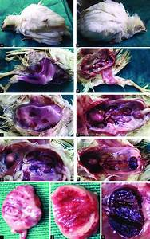
Clinical findings
The IP is short and is about 2-3 days
Acute form: Birds upto 5 weeks of age affected severely and the disease may be seen in the birds upto 15 weeks of age
The signs notices are whitish watery diarrhoea, soiled vent feathers, depression, anorexia, prostration
Vent pecking, trembling, ruffling of feathers and fever for few days followed by subnormal temperature
The course of disease is about 7 to 8 days

Slide 7
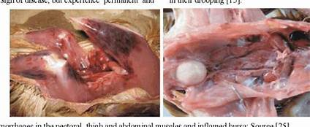
Sub-clinical form of the disease is noticed in chicks of 1-3 weeks of age and immuno-suppresion is most important outcome, and acute form of disease in chicks of 3-6 weeks of age
Necropsy findings
Enlarged bursa, atrophy of bursa, haemorrhages in thigh and brisket muscles
Atrophied thymus

Slide 8
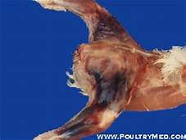
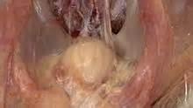
Diagnosis
By signs and lesions
Culturing and identification: Faecal swabs or Bursa of fabricious should be submitted
The suspected materials injected into the CAM. The virus will be found in embryo and in CAM is good amount
Serological test like VNT, AGPT & ELISA are useful in diagnosis

Slide 9
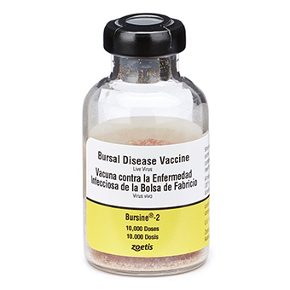
Treatment:
No treatment, only symptomatic
Control
Good hygiene measures, disinfecting the area with formaline, idophores and virex is effective
Biosecurity with adequate restriction to farm visitation and distancing from other flock
Vaccination: Three types of live vaccines and inactivated vaccine have been used. Here the main aim is to vaccinate the breeding stock, so that the maternal immunity is passed to the eggs, which will last for 3-4 weeks.
Gumboro disease vaccine (live) (Ventri): It is a live mild vaccine strain. This is administered to layers and broilers chicks between 18-21 days of age in drinking water. If necessary repeat in 7th weeks in drinking water.
Gumboro vaccine Nobilis strain 228E (Intercare) – Live freeze dried broilers 7-14 days layers, 14-28 days in drinking water

Slide 10
Choose most appropriate answer
1.What is the causative agent of Gumboro disease?
A) Avian influenza virus
B) Infectious bursal disease virus
C) Newcastle disease virus
D) Fowl pox virus
2.Which age group of poultry is most susceptible to Gumboro disease?
A) Chicks under 2 weeks
B) Chicks 3 to 6 weeks old
C) Adult birds
D) Birds older than 6 months
3.What is a primary symptom of Gumboro disease?
A) Swelling of the comb
B) Severe diarrhea
C) Feather loss
D) Respiratory distress
4.How is Gumboro disease primarily transmitted among poultry?
A) Airborne transmission
B) Direct contact with infected birds
C) Contaminated water and feed
D) All of the above
5.What type of immunity does the Gumboro vaccine primarily provide?
A) Passive immunity
B) Active immunity
C) Maternal immunity
D) Natural immunity

Slide 11
6. What is a common method for diagnosing Gumboro disease in affected birds?
A) Blood tests for antibodies
B) Necropsy and bursal examination
C) Fecal analysis
D) PCR testing of feathers
7.Which of the following is NOT a complication associated with Gumboro disease?
A) Secondary bacterial infections
B) Immunosuppression
C) Respiratory infections
D) Egg production increase
8.What is the recommended age for vaccination against Gumboro disease?
A) At hatch
B) 1 week old
C) 2-3 weeks old
D) 4-5 weeks old
9.What is the primary goal of controlling Gumboro disease in poultry flocks?
A) Increasing feed efficiency
B) Enhancing feather quality
C) Reducing mortality and improving immunity
D) Minimizing antibiotic use
10.Which of the following best describes the Gumboro disease virus?
A) It is a DNA virus.
B) It is a single-stranded bisegmented RNA virus
C) It is a double-stranded bisegmented DNA virus.
D) It is a segmented RNA virus.

Slide 12
Thanks

