Slide 1
INCLUSION BODY HEPATITIS/
HYDROPERICARDIUM SYNDROME
(HEPATITIS HYDROPERICARDIUM)
Dr. Ravi Shankar Kr Mandal
Assistant Professor
Veterinary Medicine
BVC, Patna

Slide 2
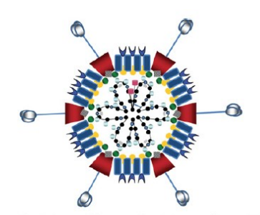
ETIOLOGY
Fowl adenovirus (FAdV) of the genus Aviadenovirus, family Adenoviridae
non-enveloped ds DNA viruses of icosahedral symmetry varying between 70 and 90 nm in diameter
FAdVs are highly diverse and are categorized into five species (A to E) and 12 serotypes (1 to 7, 8a, 8b and 9 to 11)
Association with immunosuppressive viruses such as IBDV, chicken anemia virus (CAV), MDV minmal pathogenic strain causes severe disease
Generally tolerant to heat and pH changes, as well as to the majority of commercial disinfectants

Slide 3
INCLUSION BODY HEPATITIS
An acute viral disease of young chickens associated with anemia, hemorrhagic disorders, and hydropericardium.
Characteristic basophilic intranuclear inclusion bodies in the affected hepatocytes
Disease has worldwide distribution
Broilers of 3–5 weeks of age are more susceptible to the disease, whereas layer and breeder flocks of varying ages can also be affected
Sporadic reports in other domestic birds, including pigeons, quails, ducks, and ostriches
Isolation of FAdVs from wild birds, indicates a possible carryover of the disease into and from wild birds
Inclusion body hepatitis (IBH) of chickens was first recognized in 1963

Slide 4
Hydro-pericardium Syndrome
First reported in broiler birds of 3 to 5 weeks of age from Angara Goth, near Karachi, Pakistan, in 1987 : ‘Angara Disease’ in Pakistan
In India, HPS was first noticed in the poultry belt of Jammuand Kashmir, Punjab and Delhi during April-July 1994
In India, the disease is commonly known as ‘‘leechi disease’’ due to the characteristic hydropericardium, giving the heart the appearance of the peeled Indian leechi fruit
Other names:
Inclusion-body hepatitis-hydropericardium syndrome,
Hydropericardium hepatopathy syndrome
Hydropericardium hepatitis syndrome
Etiology :- FAdV-4
Mortality:- 20-80%
Recovered birds are immune to subsequent attacks of hydropericardium syndrome

Slide 5
TRANSMISSION- Vertical and Horizontal
Infected birds develop a viremia and increase shedding of the virus after 2–3 days in high loads with feces, usually spreads laterally through contaminated food, water and litter within sheds
Contaminated vehicles, personnel, equipment, and biosecurity gaps could induce and spread the infection to the farm
PATHOGENESIS
Ingestion of virus - infecting the intestinal epithelium and replication in enterocytes - Extensive damage to the intestinal epithelium with hemorrhage - reached the blood stream via draining lymphatics and the thoracic duct(s) - cell free viremia - replication in kupffer cell and hepatocytes - hemorrhage, necrosis and liver damage - second and higher peak virema - dissemination into many different organs including spleen, pancreas, thymus, bone marrow, kidney

Slide 6
CLINICAL FINDINGS
Sudden mortality usually is seen in chickens <6 wk old and as young as 4 days of age
Mortality normally ranges from 20%--40%, may reach upto 80%
Lethargy, huddling with ruffled feathers, and yellow, mucoid droppings
duration of the infection usually ranges from 9-14 days

Slide 7
Disease | Adenovius | Host | Findings
Hemorrhagic enteritis | Turkey Adenovirus-3 of the species Turkey Adenovirus-A | 2 to 8 week old turkeys | Necrohemorrhagic enteritis and necrotic splenitis accompanied with high mortality (1-60%)
 |  | Pheasants Chickens | Marble spleen disease in pheasants Splenomegaly in chickens
Egg drop syndrome | Duck Adenovirus-1 of the species Duck Adenovirus-A | laying hens and quails | Distorted shape and size of eggs, Eggshells: lose color, soft or even fail to form due to destruction of the shell glands by virus replication. Virus is excreted in the eggs and in the reproductive tract secretions.

Slide 8
Disease | Adeno-virus | Host | Findings
Quail bronchitis | FAdV-1 | quails | Respiratory signs, swollen sinuses, expectoration of mucus, asphyxiation and high mortality (up to 50%)
Gizzard erosions and ulcerations | FAdV-1 of species A (Abe et al., 2001) | Laying chickens | Tanimura et al. (1993) first reported involvement of FAdV virus is epitheliotropic and multiplies in the epithelium of the proventriculus, gizzard and small intestines condemnation of giblets (gizzards) is of considerable economic importance

Slide 9
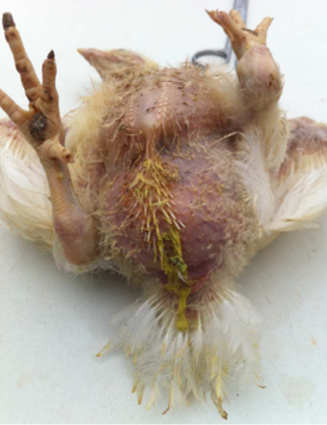
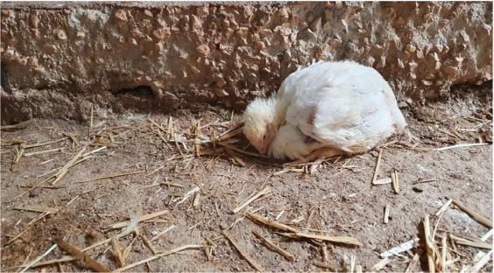
bird revealed non-specific clinical signs including depression, lethargy, ruffling feathers, and inappetence
yellowish mucoid diarrhea, soiling the feather around cloaca

Slide 10
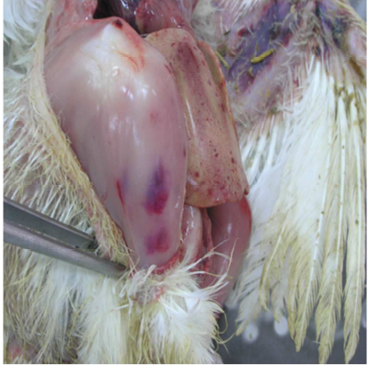
hemorrhages on the skeletal muscles of the bird is visible, whereas, the liver dominates in the visceral capacity with the lobes of the organ appearing swollen with a marble-like pattern ranging from pale and yellowish to red-dark

Slide 11
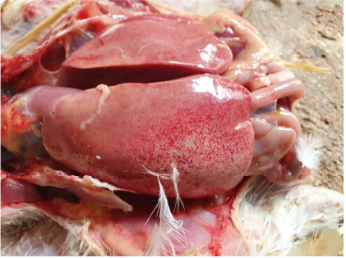
The liver dominates in the visceral capacity with the lobes of the organ appearing swollen with a marble-like pattern ranging from pale and yellowish to red-dark

Slide 12
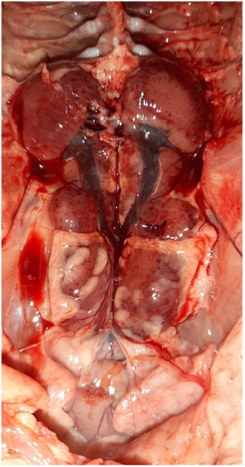
The kidneys of an affected bird are pictured oedematous and mottled, enlarged with accumulation of urates

Slide 13
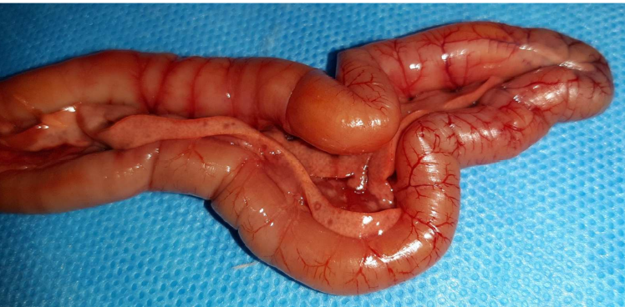
Pancreas showing necrotic spots and hemorrhage or/and congestion on
the surface of the organ

Slide 14
LESIONS
Gross lesions
Accumulation of 3 to 20 ml clear or amber-coloured, watery or jelly-like fluid in the pericardial sac
flabby appearance to the heart which is found floating in the pericardial sac
Generalized congestion,enlarged, pale, friable liver with focal hepatic necrosis
Petechial and ecchymotic haemorrhages in the heart musculature and other organs
Congestion and oedema in the lungs, and pale kidneys with the deposition of urates in the kidney
Histopathologic lesions
Myocardial edema in the heart with degeneration, necrosis, and mild mononuclear cell infiltration
Basophilic intranuclear inclusion bodies in liver, pancreas, gizzard, proventriculus, duodenum, cecum and kidney

Slide 15
DIAGNOSIS
based on clinical signs, gross and histopathological lesions, particularly the detection of basophilic INIBs in hepatocytes
Isolation of adenovirnses from the liver
demonstration of virus particles in the infected tissues by transmission electron microscopy
Serology test : Agar gel immunodiffusion (AGID), counter immunoelectrophoresis (CIE), fluorescent antibody techniques(FAT), immunoperoxidase assays, ELISA
Molecular techniques:- restriction endonuclease assay (REA), in situ hybridization using DNA probes, and polymerase chain reaction (PCR)

Slide 16
PREVENTION AND CONTROL
No specific treatment
Strict biosecurity and farm hygiene are of prime importance
Proper control of infectious immunosuppressive agents such as IBD and CAV as well as noninfectious factors such as stress and aflatoxins
Antibiotics to control 2° bacterial infection
(Sulfonamides are contraindicated in case of immunosppression and hematologic disease)
Liver protestants (eg., silymarin), amino acids, multivitamins in drinking water

Slide 17
Minimum “chicken-free” downtime of 3 weeks recommended to ensure the reduction of the viral load in the farm
Vaccination
Both live and attenuated vaccines are used
Live vaccine given via drinking water for breeders between 10-14 wk of age to ensure the transfer of maternal immunity from breeding flocks to their progeny.
Broilers are vaccinated at <10 days of age

Slide 18
Thank You

