Slide 1
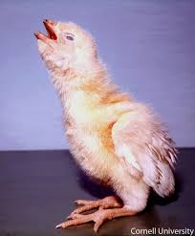
INFECTIOUS BRONCHITIS
GASPING
Dr. Ravi Shankar Kumar Mandal
Assistant Professor
Veterinary Medicine
BVC, Patna

Slide 2
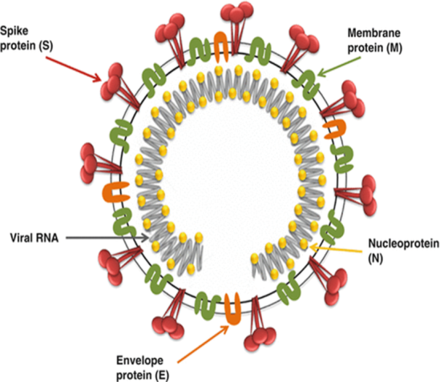
INFECTIOUS BRONCHITIS
Acute, highly contagious disease of major economic importance in commercial chicken flocks throughout the world.
Characterized by respiratory signs and decreased egg production and poor egg quality
Nephropathogenic strains of IBV causes interstitial nephritis
Associations with myopathy and proventriculitis have also been reported.
ETIOLOGY
Infectious Bronchitis Virus (IBV), is a coronavirus: enveloped and positive-sense single-stranded RNA virus.

Slide 3
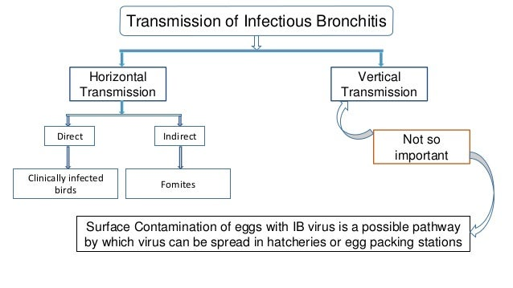
TRANSMISSION
IBV is shed by infected chickens in respiratory discharges and feces
Spread by aerosol, ingestion of contaminated feed and water, and contact with contaminated equipment and clothing
Naturally infected chickens and those vaccinated with live IBV may shed virus intermittently for up to 20 wk after infection
Coinfection with Mycoplasma gallisepticum, Mycoplasma synoviae, Escherichia coli, and/or Avibacterium paragallinarium can exacerbate disease.

Slide 4
PATHOGENESIS
Infectious bronchitis virus initially infects and replicates in the upper respiratory tract causing the loss of protective cells lining the sinuses and trachea.
After a brief viraemia, the virus can be detected in the kidneys, reproductive tract, and caecal tonsils
Nephropathogenic strains are known to cause lesions in the kidney.

Slide 5
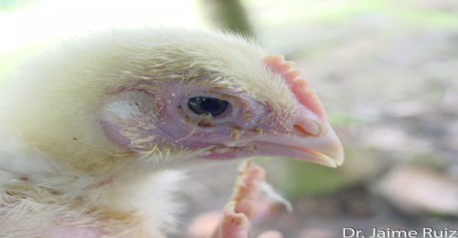
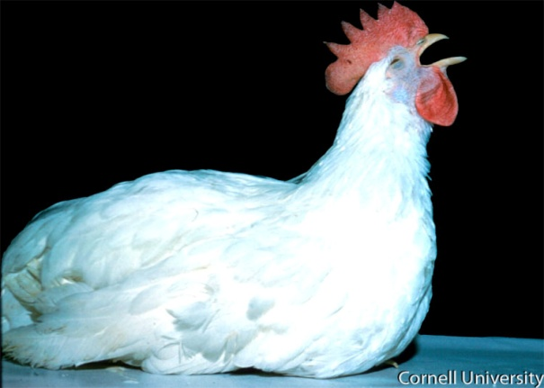
CLINICAL FINDINGS
The incubation time for the IBV varies from 18-36 hours.
Morbidity ≈ l00%
Chicks may appear depressed and huddle under heat lamps
Dyspnea, cough, sneezing, tracheal rales, conjunctivitis, facial swelling
Feed consumption and weight gain are reduced
Infection with nephropathogenic strains can cause initial respiratory signs, then later depression, ruffled feathers, wet droppings, greater water intake, and death.

Slide 6
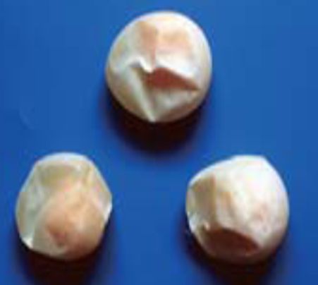
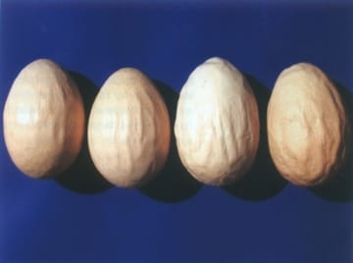
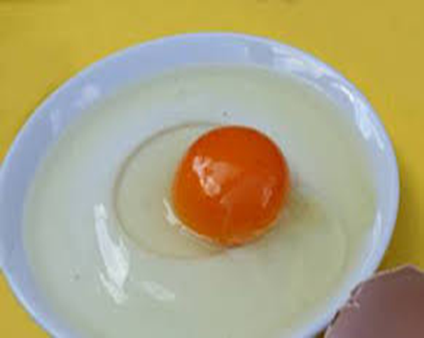
In layers, egg production may drop by as much as 100%, and eggs are often misshapen, with thin, soft, rough, and/or pale shells, and can be smaller and have watery albumen.
In most outbreaks mortality is 5%, although mortality rates are higher when disease is complicated by concurrent bacterial infection.
Nephropathogenic strains can induce interstitial nephritis with high mortality ( up to 60%,) in young chicks
Infection of young chicks may cause permanent damage to the oviduct, resulting in layers or breeders that never reach normal levels of production : False Layers

Slide 7
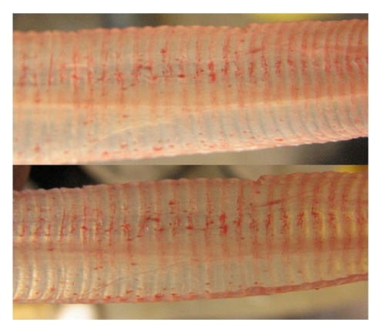
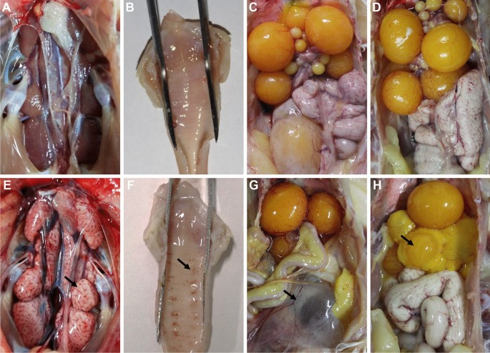
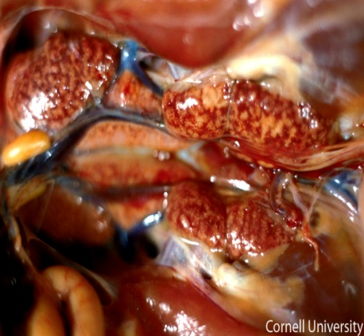
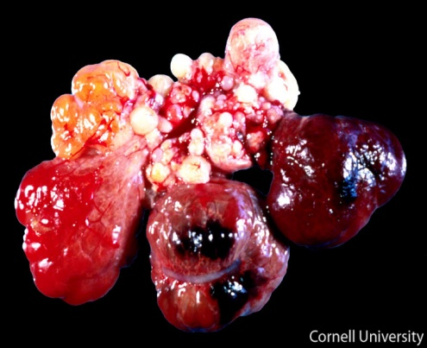
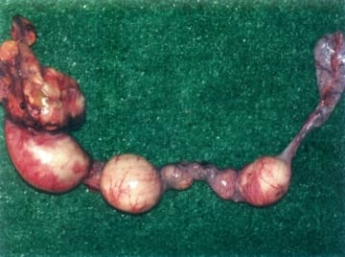
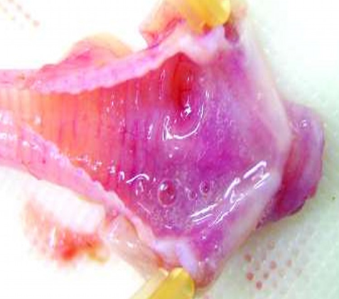
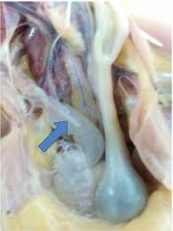
LESIONS
Trachea, sinuses, and nasal passages may contain serous, catarrhal, or caseous exudates
Air sacs filled with foamy exudate initially, progressing to cloudy thickening
Cystic oviducts, regression of the ovaries
Swollen, pale kidneys, with the tubules and ureters distended with urates
A,B,C Normal

Slide 8
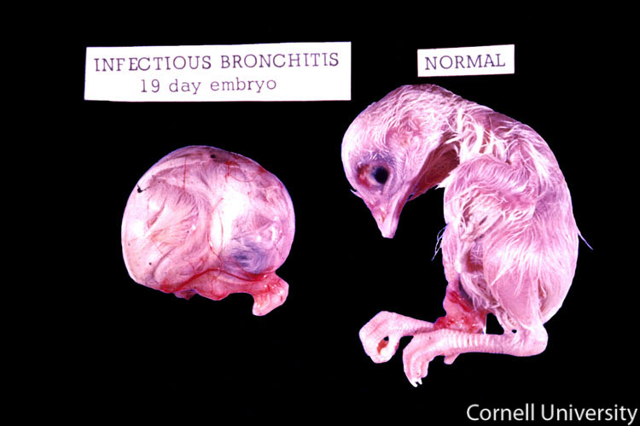
DIAGNOSIS
Clinical signs
PM findngs
Virus detection and identification
Serological tests:
Virus neutralisaton (VN)
Immunodiffusion (ID)
Haemagglutination inhibition (HI)
Immunofluorescence (IF)
ELISA

Slide 9
CONTROL
Vaccination, effective management system and biosecurity measures are of primary importance to control infectious diseases
Antimicrobial therapy to prevent complicating bacterial infections
In cold weather, increase the ambient temperature
Protein concentrations in feed and electrolytes in drinking water may assist in outbreaks caused by nephropathogenic strains
Vaccination
Initially given to 1- 14-day-old chicks by spray, drinking water, or eye drop, and birds are commonly revaccinated

Slide 10
Thank You

