Slide 1
INFECTIOUS
LARYNGOTRAEITIS
Dr. Ravi Shankar Kumar Mandal
Assistant Professor
Veterinary Medicine
BVC, Patna

Slide 2
INFECTIOUS LARYNGOTRACHEITIS
Infectious laryngotracheitis (ILT) is an acute or subacute , highly contagious, herpesvirus infection of chickens and pheasants characterized by severe respiratory distress dyspnea, coughing, and rales, gurgling and rattling sound, breathing with open beak
ILT was first described in 1925 as tracheolaryngitis, and shortly thereafter its viral etiology was demonstrated. The term infectious laryngotracheitis was adopted in 1931 by the Special Committee on Poultry Diseases of the American Veterinary Medical Association.
ILT was the first major viral avian disease against which an effective vaccine was developed based on the cloacal administration in 1930 by Hudson and Beaudette, at Cornell University.

Slide 3
ETIOLOGY
Caused by the infectious laryngotracheitis virus [Gallid herpesvirus 1 (GaHV-1)], ds DNA enveloped virus of genus Iltovirus, subfamily Alphaherpesvirinae family Herpesviridae
Infected birds shed the virus in their respiratory secretions
Source of infection
Carrier birds that have survived from previous outbreaks
Darkling beetles and mealworms
Dogs and cats
ILTV enters into the host through the respiratory tract, ocular and to a lesser extent through oral routes
Neither vertical transmission nor transmission of virus through the egg shell has been demonstrated

Slide 4
PATHOGENESIS
The natural portal of entry of ILTV is respiratory and ocular routes
The initial replication takes place in the epithelium of the conjunctiva, respiratory sinuses, larynx and upper respiratory tract to a greater extent
The active cytolytic infection of ILTV results in severe damage to tracheal and conjunctival epithelial lining leading to haemorrhages and other clinicopathological manifestations in birds
Subsequently, the ILTV disseminates to the underlying lamina propria of the tracheal epithelium after invading through the basement membrane with the help of up-regulated cellular proteases and reaches to the liver, caecal tonsils and cloaca
ILTV can establish latency in the trigeminal ganglion of the central nervous system after 7 days of acute infection
The virus gets reactivated under the stress conditions during shifting, onset of laying and mixing of flocks

Slide 5
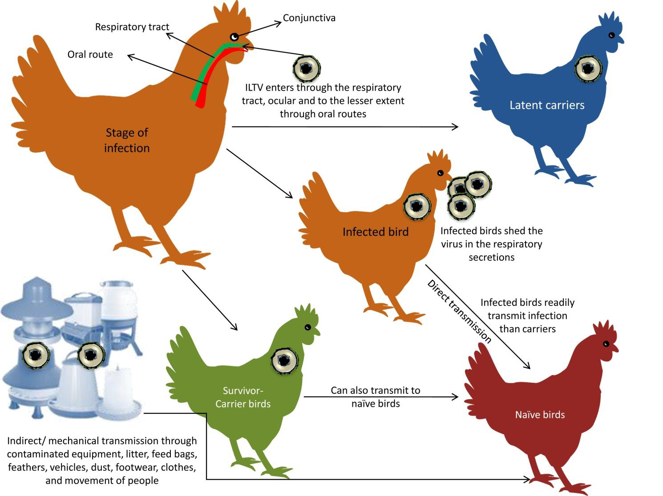
The disease is severe in adult birds but mild in chicks below 3 wks of age.
The disease becomes severe when others disease producing agents such as RD, IB and Fowl pox and also Haemophilus paragallinarum and Mycoplasma gallisepticum occurs at the same time
Deficiency of vit. A and excess ammonia predispose to severe disease

Slide 6
CLINICAL SIGN
Peracute form
Sudden onset of rapid spread and high mortality which may exceed 50%
Affected birds become lethargic, often exhibit moderate-to-severe conjunctivitis with swollen eyelids and increased lacrimation
Dyspnea and gasping with an extension of the head and neck. Coughing, rattling, and gurgling also noticed when the birds try to expel the clotted blood and debris from the obstructed trachea
The clotted blood is also found in cages, feed turfs, walls and floor of the poultry houses. The affected birds usually die within 3 days

Slide 7
Acute form
Severe respiratory distress- sneezing, coughing, rattling sound
Tracheal obstruction with clotted blood and exudates results in a long drawn out gasps with open-mouthed breathing, high-pitched squawk and moist rales
Cough may result in expulsion of bloody mucous from trachea
Head and neck remain extended and beak opened during each inspiration
Cyanosis of comb and wattles
Purulent conjunctivitis with frothy exudates in the inner canthus of the eye, sinusitis and nasal discharge
Drop in egg production
Morbidity may reach 100% and the mortality varies from 10 to 30%

Slide 8
In sub acute form :
The adult birds shows dullness, wet eyes, conjunctivitis, swelling of infraorbital sinus and nasal discharge.
Effects on eyelids cause blindness, starvation and death.
Less pathogenic strains, cause failure to gain weight gain.

Slide 9
Different clinico-pathological manifestations of ILTV infection:
a. Acutely infected bird shows severe gasping.
b. Oculo-nasal discharges in early stages of infection.
c. Facial swelling and persistent oophoria in sub-acute to chronic stage of ILTV infection.
d. Dried bloody exudates on the commissure of the mouth.

Slide 10
LESIONS
Mucoid rhinitis and haemorrhagic tracheitis with blood clots
Yellow caseous diphtheritic membranes adherent to the larynx and mucosa of the upper trachea
Pseudomembrane formation with fibrino-necrotic exudates adhering to the upper respiratory tract
Fibrino-haemorrhagic exudates in the lumen of the trachea.
Bloodclots in the lumen of the trachea in acute form of ILT.

Slide 11
DIAGNOSIS:
Symptoms.
Lesions of trachea and larynx.
Virus isolation
Serological tests: AGPT, FAT, DIFA.
TREATMENT :
To check complications broad spectrum antibiotics.
PREVENTION and CONTROL :
In outbreak, slaughter and proper disposal of birds.
Disinfection of infected premises with gaps of 2 months.
Vaccination :
Orally, cloaca, eyes, or by rubbing into feather follicles.
In areas, where the disease is prevalent a live vaccine is used.
Given at 6 to 8 weeks of age, followed by the booster at 12 to 15 weeks for layers and breeders

Slide 12
Thank You

