Slide 1
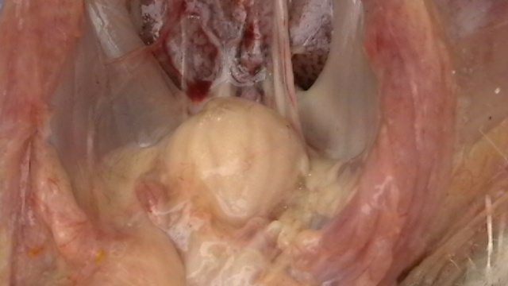
INFECTOUS BURSAL DISEASE
(GUMBORO DISEASE, INFECTIOUS BURSITIS, AVIAN NEPHROSIS)
Dr. Ravi Shankar Kumar Mandal
Assistant Professor
Veterinary Medicine
BVC, Patna

Slide 2
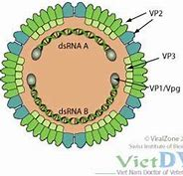
INFECTIOUS BURSAL DISEASE (IBD)
Infectious bursal disease (IBD) is highly contagious disease, seen in domestic chickens worldwide
It can present as a clinical or subclinical disease, but irnmuno-suppression and related secondary infections are typically seen
Severity of immunosuppression depends on the virulence of the infecting virus and age of the host
First time recorded in Gumboro area of U. S. A by Cosgrove
ETIOLOGY : Birna virus, dsRNA Virus
2 main serotypes i.e. serotype 1 and 2
serotype 1 produces disease in chicken
Antigenic drift is largely responsible for antigenic variation
Serotype 2 strains of the virus infect chickens and turkeys but have not caused clinical disease

Slide 3
TRANSMISSION
Mainly oro fecal route but may be by conjuctiva or respiratory route
Affected birds excrete the virus in feces for 10-14 days
Virus is very stable
• Remains highly infectious for many months (up to 122 days) in the poultry house environment
Mealworms and Aedes vexan (Mosquito), personnel handling birds, equipment, vehicles act as carriers of infection
No vertical transmission
Incubation period is very short
Clinical signs within 2-3 days post infection

Slide 4
CLINICAL FINDINGS
Infections before 3 wk of age are usually subclinical
Early subclinical infections destruction of immature lymphocytes in the bursa of Fabricius, thymus, and spleen long-lasting immuno-suppression do not respond well to vaccination and are predisposed to infections with normally nonpathogenic viruses and bacteria
Chickens are most susceptible to clinical disease at 3-6 wk of age when immature B cells populate the bursa and maternal immunity has waned
Humoral (B cell) immune response is most severely affected
Cell-mediated (T cell) immnune response is affected to a lesser extent

Slide 5
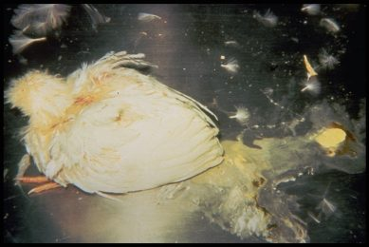
CLINICAL FINDINGS
Severe prostration, incoordination, watery diarrhea, soiled vent feathers, vent pecking, and inflammation of the cloaca
Flock morbidity is typically 100 %, and mortality can range from 5%-20 %

Slide 6
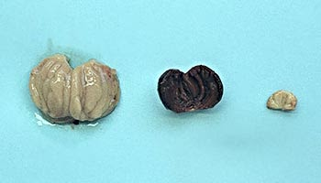
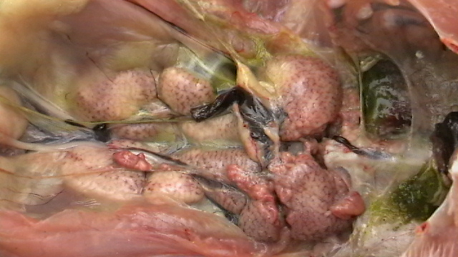
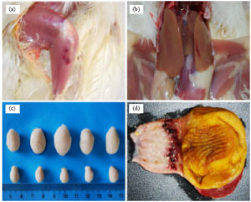
LESIONS
Initially swollen bursa followed by atrophied bursa with hemorrhage in its inner surface
Swollen kidney and pale due to urates
Hemorrhages in thigh and breast muscles and also under the skin, at the junction of proventriculus and gizzard

Slide 7
DIAGNOSIS
Isolation of virus
Infective materials inoculated in CAM in 9-11 day old chick embryo leading to death in 3-5 days with mottled liver and kidney and congested lungs
Molecular diagnostic assays: Reverse Transcriptase-PCR
Serological test
IF, AGPT, VN , ELISA
VN test is a choice method of measuring IBDV antibodies
P M findings

Slide 8
TREATMENT : No treatment.
PREVENTION and CONTROL :
Rigorous disinfection of contaminated farms after depopulation has achieved limited success
Disposal of litter, dead birds, used gunny bags, curtains, and other disposables by incineration or deep burial with slaked lime
Restricting vehicular moments with crates, egg trays, and culled birds
Treating feeders, and waterers with 5% formalin.
Fumigating new poultry sheds with Formalin fumes
Restricting personell to their sheds for work
Vaccination
Primary vaccination with mild or intermediate strain after 2 weeks
Booster vaccination with intermediate strain (live) after 5 weeks
Vaccination of breeder stock and seromonitoring by hatcheries to ensure adequate levels of maternal antibodies in the chicks.

Slide 9
Thank You

