Slide 1
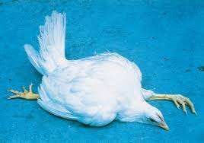
MAREK'S DISEASE
RANGE PARALYSIS, SKIN LEUKOSIS, NEURAL LEUKOSIS, NEURAL LYMPHOMATOSIS GALLINARUM, PEARL EYE
Dr. Ravi Shankar Kr Mandal
Assistant Professor
Veterinary Medicine
BVC, Patna

Slide 2
MAREK’S DISEASE
Marek’s disease (MD) is a lymphoproliferative, highly contagious disease of poultry and caused by a highly cell associated Gallid herpes virus, a DNA virus belonging to Herpesviridae family
Causes one of the most prevalent cancers in the animal kingdom
First described by Hungarian Veterinarian (Pathologist) Jozsef Marek in 1907 as fowl paralysis, a generalized polyneuritis in chickens.
Disease exists in poultry-producing countries throughout the world
Domestic chicken most commonly affaected>Quail, Turkey

Slide 3
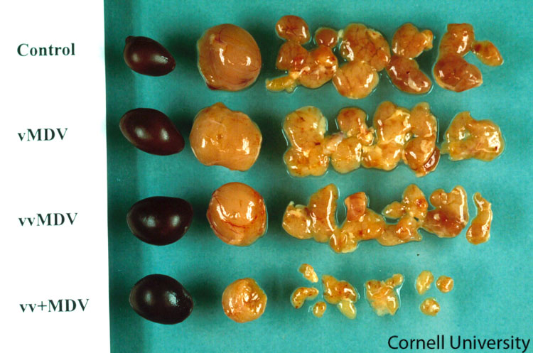
ETIOLOGY
Marek's disease virus (MDV)- Gallid herpesvirus 2 (Serotype 1); dsDNA virus
• Pathotypes
Mild (m) MDV,
Virulent (v) MDV
Very virulent (vv) MDV,
Very virulent plus (vv+) MDV strains
• Genus: Mardivirus
• Subfamily: Alphaherpesvirinae
Family: Herpesviridae
Serotype 2: (Gallid herpesvirus 3) Nonpathogenic (avirulent) nononcogenic
Serotype 3: Herpesvirus Turkey (HVT) Nonpathogenic (avirulent), nononcogenic
Serotypes 2 and 3 and attenuated serotype-1 virus are used for vaccine production

Slide 4
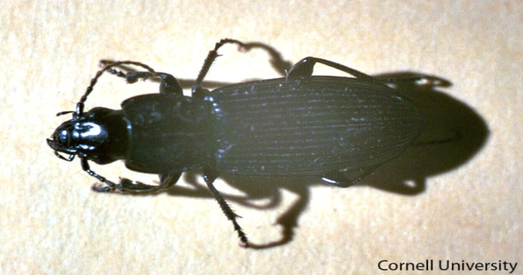
The feather follicle epithelium (FFE) produces fully infectious virus
Virus particles can persist for a considerable period of time in the dandruff of feather follicles, which are released in environment
The infective materials are oral, nasal and tracheal secretions and litter materials.
The darkling beetle (Alphitrbius diaperinus) is acting as mechanical transmitter of the disease
Only Horizontal transmission
The infection is transmitted through inhalation of infected material from the environment

Slide 5
PATHOGENESIS
Four phases of infection in vivo
Early cytolytic infection (Early productive-restrictive phase)
Latent infection
Second phase of cytolytic infection ( productive-restrictive infection coincident with permanent immunosuppression )
Proliferative phase / Development of lymphoma

Slide 6
1. EARLY PRODUCTIVE-RESTRICTIVE PHASE
Poultry house dust contained the virus → virus enters the host via the respiratory tract phagocytosis by macrophages → spread to lymphoid organs (spleen, cloacal bursa, and thymus) → infect B lymphocytes and some activated T lymphocytes (mostly CD4+); resting T lymphocytes are resistant → apoptosis of many infected B & T lymphocytes → temporary atrophy of the lymphoid organs, especially the thymus and the bursa → temporary immunosuppression

Slide 7
2. LATENT INFECTION
The infection in the T lymphocytes becomes latent at 6-7 days post-infection and the virus is spread throughout the body by the infected lymphocytes, which persist as a cell associated viremia

Slide 8
3. SECOND PRODUCTIVE RESTRICTIVE PHASE
Again spread of virus to lymphoid organs (spleen, cloacal bursa, and thymus) apoptosis of lymphocytes → permanent immunosuppression
• Infected lymphocytes reaches to the skin infect feather follicle epithelium (FFE) → FFE is only known site of complete virus replication → virus replication in FFE→ infectious-cell-free virus is produced and shed into the environment in feather debris and dander

Slide 9
4. The proliferative phase/ Development of lymphomas
The latently infected T lymphocytes are subsequently transformed to neoplastic cells → Marked infiltration of neoplastic cells in different organs → leading to the development of lymphomatous lesions in the visceral organs.
Though transformed T cell contain viral genome, the synthesis of viral antigen and particles is restricted.
A new antigen, MATSA (Marek’s disease associated tumor specific antigen) appears in the transformed T cell.
Latent infection of activated T cells is responsible for the long term carrier state

Slide 10
CLINICAL FINDINGS
Classical form or Neural Form
Birds of 16-20 weeks age usually suffer
Signs are mostly concerned with the affection of nerves
Paralysis of legs, drooping wings.
Nerves like sciatic nerve, brachial nerve, celiac and vagus nerve running through neck, thoracic and abdominal viscera are affected.
Birds unable to stand remain in recumbent position, legs and wings may stretched in either direction. The “split leg” stance is the usual feature.
Vents remain soiled with green diarrhoea.
Mortality rate is comparatively low and mostly noted at the onset of maturity

Slide 11
CLINICAL FINDINGS
Acute or Visceral Form
Generally birds at the age of 3-4 weeks are affected.
Depression, droopiness, unthirfitness, dehydration, emaciation and anaemia.
Internal organs of the birds affected.
Mortality rate may go as high as 60%.
Chicks may die suddenly without showing any clinical manifestation.
Ovaries of the affected layers and pullets – looks like a cauliflower and mulberry respectively

Slide 12
CLINICAL FINDINGS
Transitional Paralytic Form
Occurs in chickens at the age of 5-18 weeks of age.
Sudden development of paresis or paralysis of the legs, wings and neck
Signs usually disappear within 24-48 hours
Ocular Form
Blindness in birds due to mononuclear cell infiltration in the iris causing “grey eye” or “pearl eye”
Skin or cutaneous form
Distinct white nodules on the skin and in extreme cases looks like brownish nodules
Muscular form
Superficial and deep muscles like pectoral muscles affected.
Muscles look lusterless, whitish grey and there are tiny white streaks to nodular tumours in the muscles

Slide 13
LESIONS
Striation and glistening appearance of nerve is lost and looks oedematous
Celiac, cranial, mesenteric, brachial and sciatic plexes and greater splanchnic nerves are mostly affected
Tiny whitish streaks to nodular tumours in muscles
Atrophy of bursa
Ovary- cauliflower like appearance
Pale, single or multiple nodular tumours in myocardium
Skin- whitish nodule, scab with brownish colour.

Slide 14
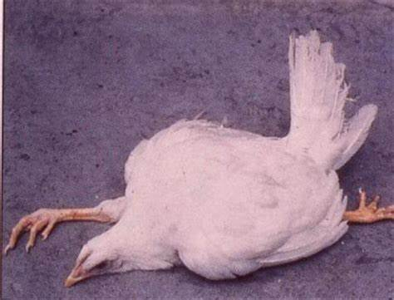
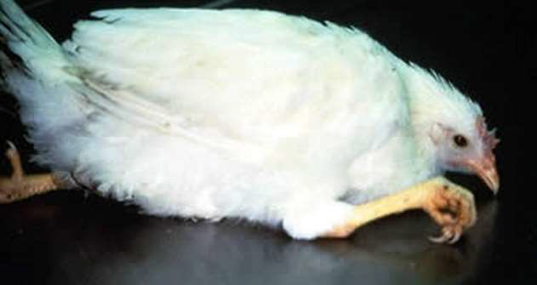
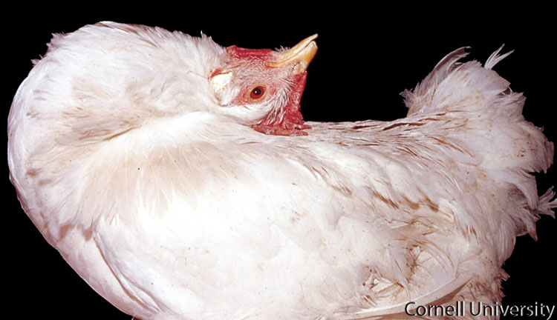
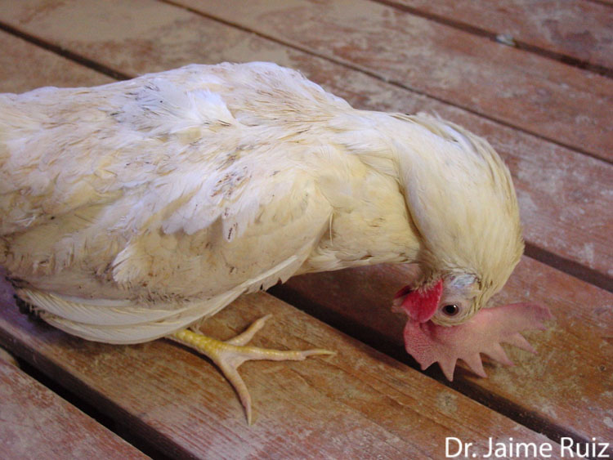
Paralysis of wings and legs
Ophisthotonous
Torticollis

Slide 15
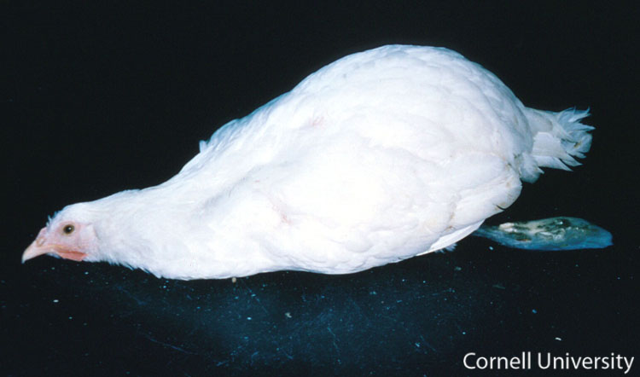
Depression, anorexia, weight loss, and diarrhea. These signs are often related to visceral infiltrations of neoplastic cells.

Slide 16
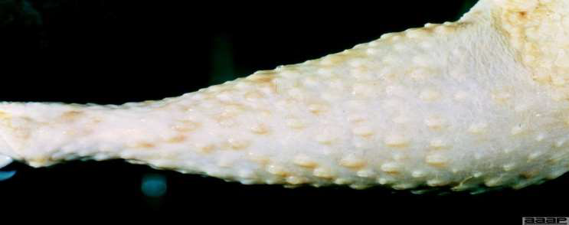
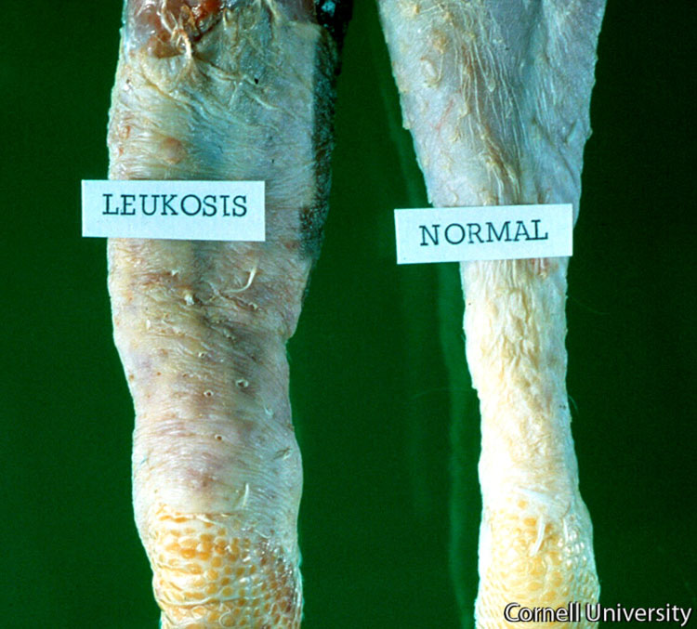
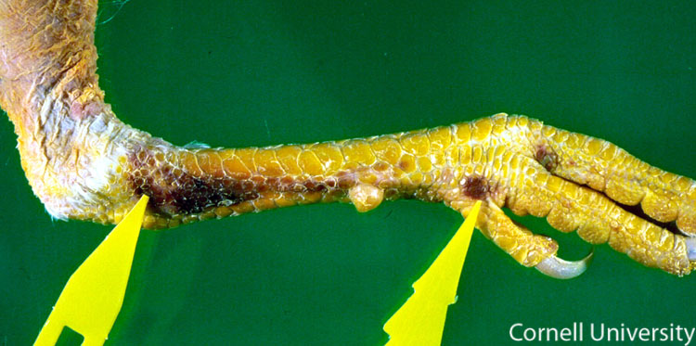
Infiltration of feather follicles, s/c tissue
“Alabama red leg” is a Marek's disease syndrome associated with tumors in broiler breeders and roosters. Lesions consist of severe hyperemia of the skin of the shanks that can eventually become ulcerated and have brown crusts.

Slide 17
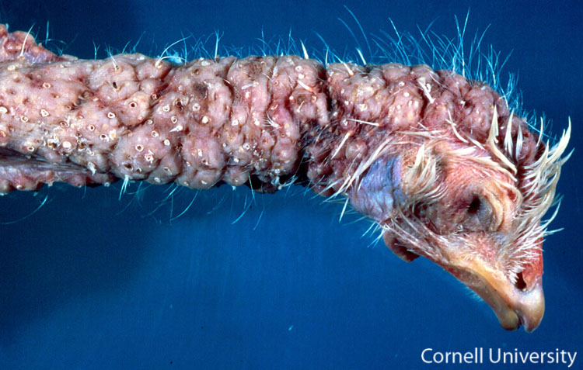
Skin lesions; large patches of tumors

Slide 18
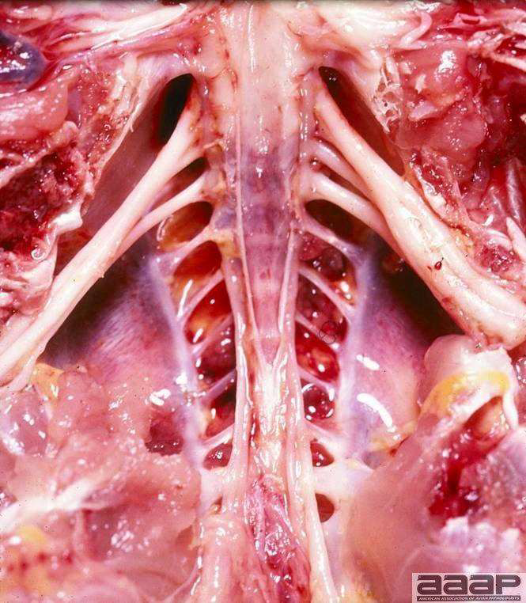
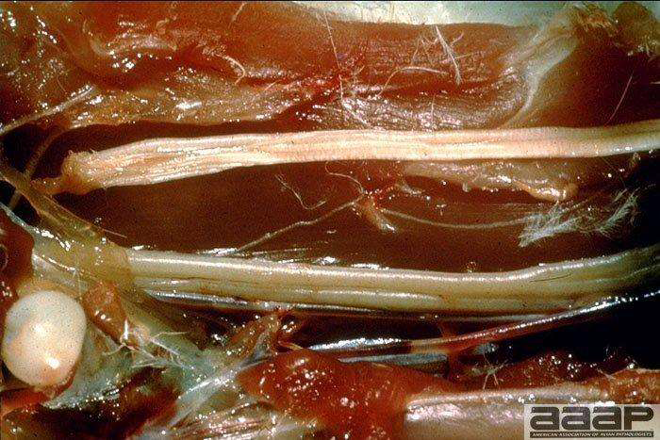
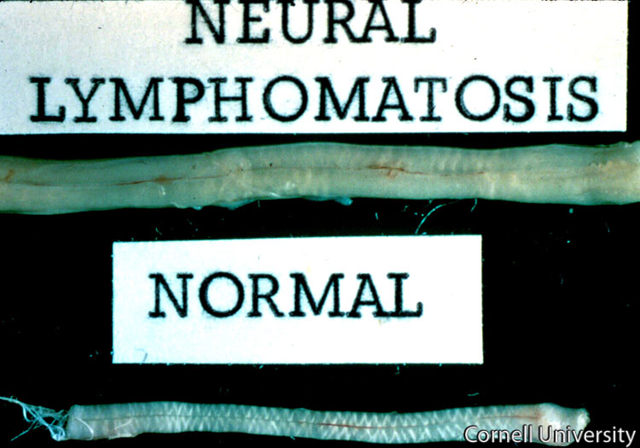
Sciatic plexus enlargement
Nerve enlargement & loss of striations

Slide 19
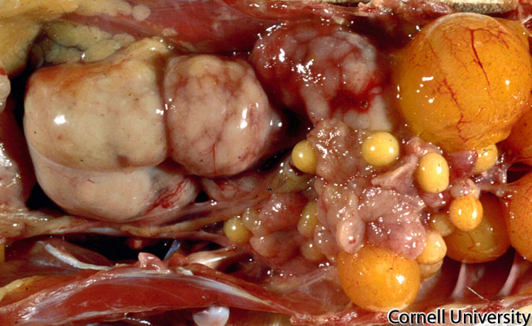
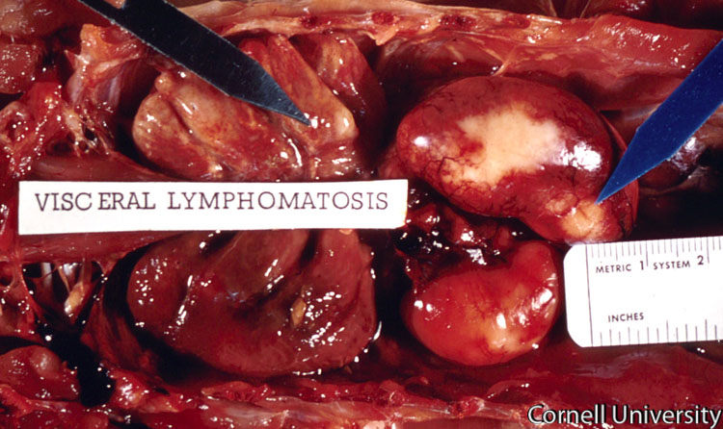
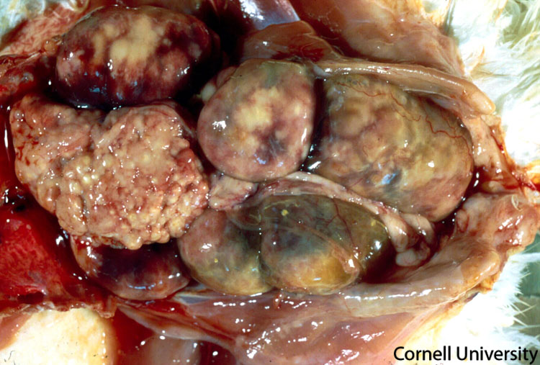
Marek's disease tumors in the ovary
Marek's disease tumors kidney
Marek's disease tumors in the ovary, kidney

Slide 20
Marek's disease tumors in the kidneys

Slide 21
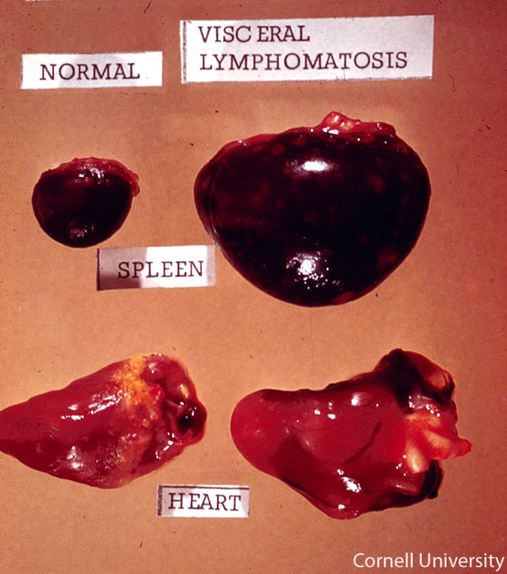
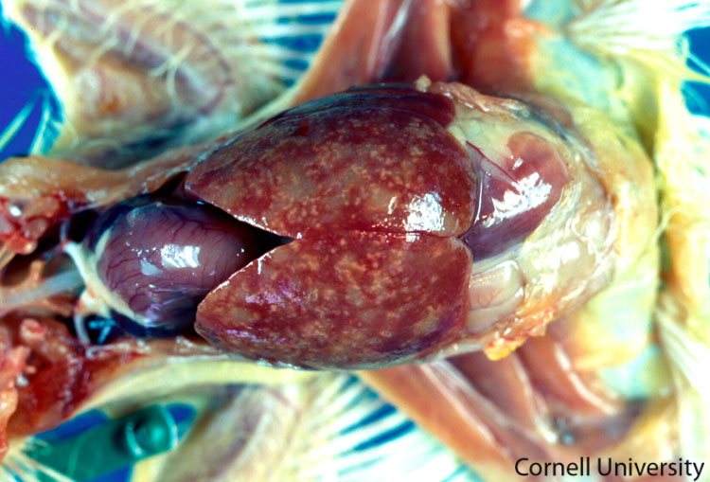
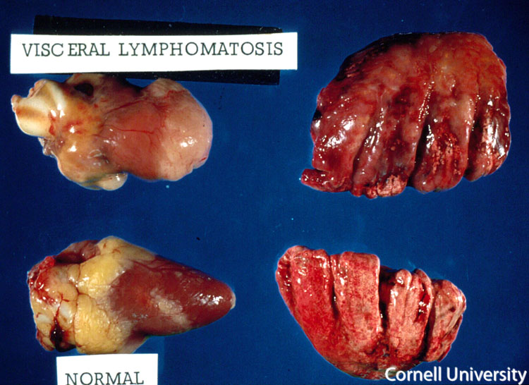
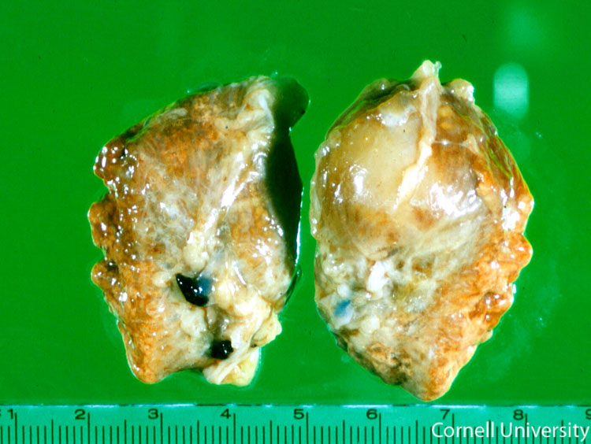
Lymphomas on virtually any visceral organ: Spleen, heart, liver, lung

Slide 22
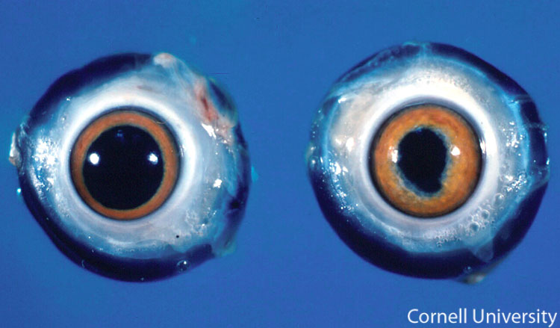
Ocular lesions, sometimes associated with Marek's disease, is usually due to lymphoid infiltration of iris that causes white discoloration. The pupil is often irregular (as shown here) and does not respond to changes of light. A normal eye is on the left.

Slide 23
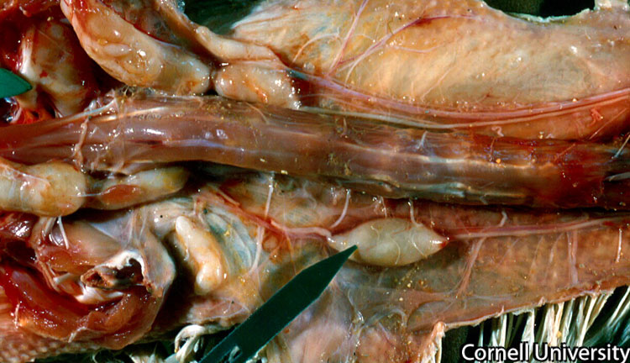
Vagus nerve on the bottom (black arrow) has a grossly evident focal enlargement

Slide 24
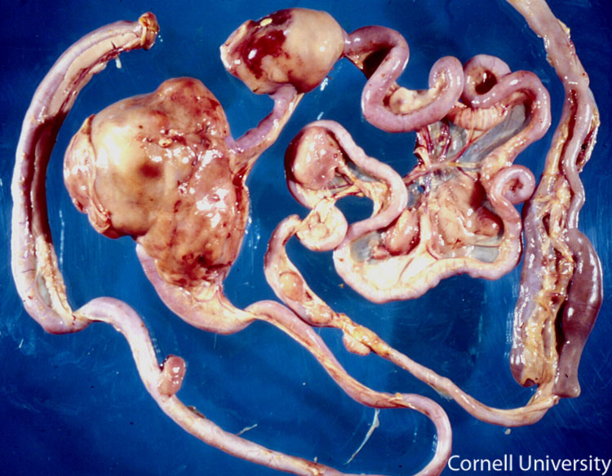
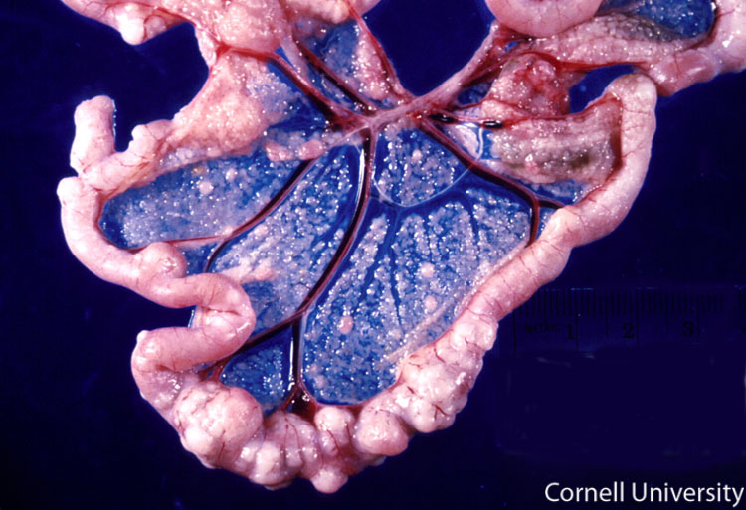
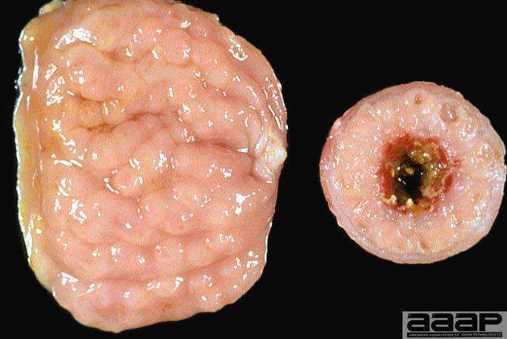
Marek's disease tumors distributed throughout the entire gastrointestinal tract
Proventricular tumor
Tumors in the pancreas

Slide 25
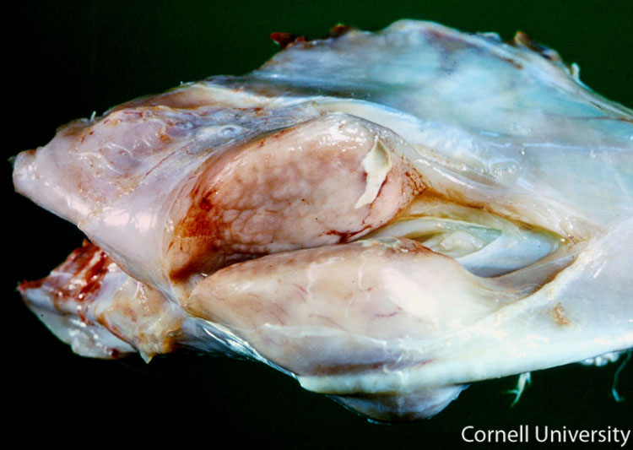
Tumors found in the pectoral muscles

Slide 26
DIAGNOSIS
Based on the clinical signs and post-mortem lesions
Identification of the agent
Specimens to be collected: Skin, dander, feather tips of infected chickens, blood
infection is usually detected by inoculating live buffy coat cells on to monolayer cultures of chicken kidney cells or duck embryo fibroblasts, in which characteristic viral plaques develop within a few days.
PCR
Serological tests
Antibodies to MDV develop within 1–2 weeks of infection
Agar gel immunodiffusion (AGID) test
Indirect fluorescent antibody test
Enzyme-linked immunosorbent assay
Virus neutralization tests

Slide 27
PREVENTION AND CONTROL
There is no effective treatment for Marek's disease
Prevention methods include vaccination, biosecurity, and genetic resistance
Three classes of vaccines
1. Turkey herpes virus (HVT, naturally avirulent Meleagrid alphaherpesvirus 1)
2. SB-1 or 301B/1 (naturally avirulent Gallid alphaherpesvirus 3)
3. CVI988/Rispens (attenuated Gallid alphaherpesvirus 2)
Herpes virus turkey (HVT) – most extensively used because it is economical to produce and cell free virus extracted from infected cells
HVT vaccine has seen rapidly increased use as a backbone in recombinant vaccines: offer protection against both Marek's disease virus and the inserted virus
Bivalent vaccines consisting of HVT and either the SB-1 or 301B/1 strains of Gallid alphaherpesvirus 3 have been used to provide additional protection against challenge with virulent Marek's disease virus isolates

Slide 28
The most protective commercial vaccine: CVI988/Rispens, an attenuated Marek's disease virus strain that is also commonly mixed with HVT at vaccination
Vaccines administered at hatch (0 day age by intra nasal or intra ocular route) or in ovo to embryos at the 18th day of incubation. In ovo vaccinations now performed by automated technology
Management and hygienic measures are adopted to control of the disease
Attempt should be made to rear the chicks in strictly isolated manner
Sophisticated method of rearing by using Filtered air positive pressure(FAPP)
Disinfection of farm and house should be kept vacant for about a month following outbreak
All in and all out method of rearing
Use of insecticide to prevent insect load in farm
Attempt should be made to evolve a MD resistant stock by careful breeding and repeated testing: B²¹ Blood group allele- marker for genetic resistance

Slide 29
Thank You

