Slide 1
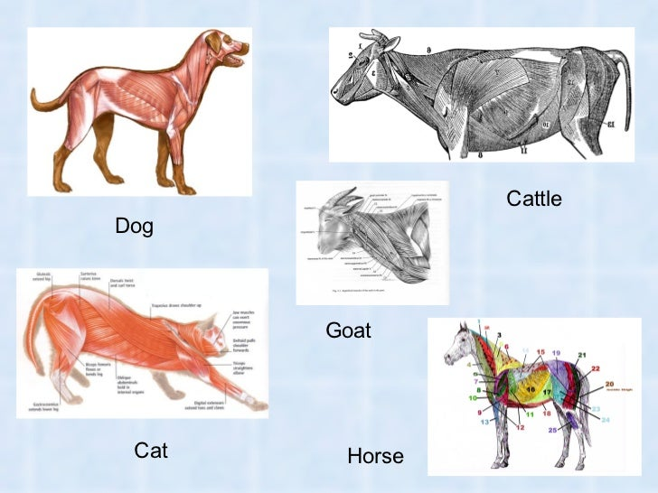
MUSCULOSKELETAL SYSTEM
Dr. Ravi Shankar Kr Mandal
Assistant Professor
Veterinary Medicine
BVC, Patna

Slide 2
INTRODUCTION
Bones, cartilage, muscles, ligaments, tendons and other connective tissue that supports and binds tissues and organs together comprise the musculoskeletal system
Primary functions of the musculoskeletal system
Provides support to the body and gives ability to move
Skeletal system protect the body’s internal organs
Support the weight of the body and serves as the main storage depot for calcium and phosphorus
Muscular system keep bones in place; they assist with movement by contracting and pulling on the bones
To allow motion, different bones are connected by joints which are connected to other bones and muscle fibers via connective tissues such as tendons and ligaments.
Allowing for movements as diverse as standing, walking, running, and grasping items
Cartilage prevents the bone ends from rubbing directly on each other.
Contains critical components of the hematopoietic system (blood cell production)

Slide 3
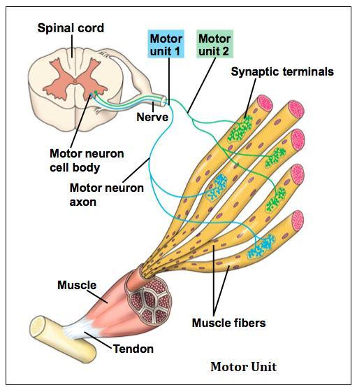
Diseases of the musculoskeletal system most often involve motion deficits, functional disorders, and lameness.
The degree of impairment depends on the specific problem and its severity.
Skeletal and articular disorders are by far the most common and have the greatest economic impact
Skeletal muscle contraction
The structural and functional unit of skeletal muscle is the motor unit
Ventral motor neuron with its cell body
in the central horn of the spinal cord
Peripheral axon
Neuromuscularjunction
Muscle fibers innervated by the neuron

Slide 4
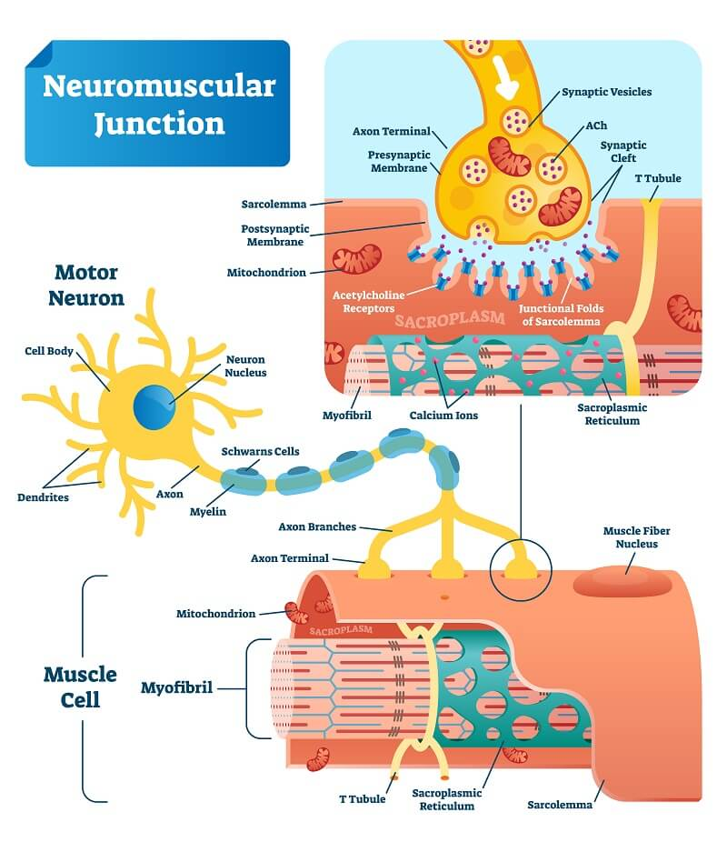

Slide 5
Each of these components must be functionally intact for the muscle to contract properly.
The ventral motor neuron is the final common pathway conducting neural impulses from the CNS to the muscle.
The transmission of a nerve impulse at the neuromuscular junction involves massive release of acetylcholine (Ach) from small synaptic vessels
The acetylcholine fills the synaptic cleft between the nerve terminal and the muscle fiber membrane
Ach destroyed by cholinesterase within a fraction of a second
This short period of activity is sufficient to excite the muscle fiber membrane, results in a significant increase in membrane permeability to sodium ions and allows rapid influx of sodium into the muscle fiber

Slide 6
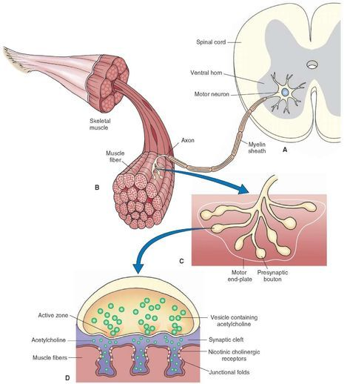
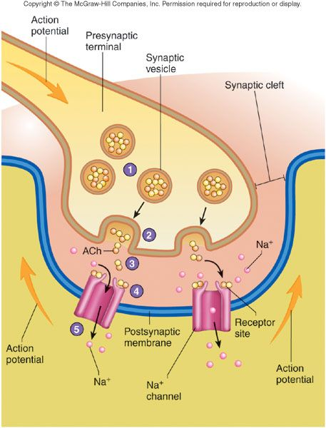
The sodium ion increases the end plate potential, which elicits electrical currents that spread to the interior of the fibers, where they cause a release of calcium ions from the sarcoplasmic reticulum
The calcium ions initiate the chemical events of the contractile process
When this occurs in all the muscle fibers innervated by each motor neuron (possibly thousands), muscle contraction results.

Slide 7
Primary disorder can be attributed to the nervous system with the muscular system merely representing the effector organ.
e.g. tetanus, rhinopneumonitis, cailine distemper, protozoa] myelitis
Disorders that affect the neuromuscular junction can result in muscle fatigue, weakness, and paralysis
eg, myasthenia gravis, hypocalcemia, hypennagnesemia
Myopathies:- disorders primarily of the muscle membrane and muscle fibers
Muscle membrane disorders
hereditary eg, myotonia congenita in goats
acquired eg, vitamin E and selenium deficiencies, hypothyroidism, and hypokalemia
Muscle fiber disorder
muscular dystrophy, polymyositis, eosinophilic myositis, white muscle disease, and exertional rhabdomyolysis
Disorder of Muscles

Slide 8
DISORDERS OF TENDONS
Tendons act as bridging and attachment structures for the muscles and target bone
Prone to injury
Often loaded to the extreme
Minimally capable of elastic elongation
Poor blood supply of both tendons and ligaments
Healing is always prolonged with inelastic scar tissue, and the injured tendon never returns to its original strength
Management of tendon and ligament injuries requires patience with conservative long-term rehabilitation
Re-injury is common

Slide 9
DISORDERS OF BONE
Congenital, hereditary, nutritional, or traumatic
Congenital disorders
In utero malformations and atavisms :- polydactyly or persistent ulnae or fibulae in foals
Genetic defects:- atlanto-occipital malformations in Arabian horses, canine hip dysplasia, abnormal bone formation such as that caused by parathyroid hypoplasia
Nutritional disorders
Imbalances or deficiencies in minerals (Ca, P, Cu, Zn, Mg)- Rickets and osteomalacia
Either deficiency or excess intake of certain vitamins (vitamins A and D) may influence growth and development of bone
Excessive protein intake of growing animals

Slide 10
Traumatic causes
Characterized by lack of weight bearing, lameness, reduced motion, instability, pain, heat, or swelling
DISORDERS OF JOINTS
Caused by trauma, chronic inflammation, developmental factors, or infections.
Severe trauma frequently results in luxation, subluxation, fracture, or instability of a joint
Direct penetration of the joint capsule may lead to septic arthritis, which is characterized by an increase in synovial WBCs resulting in an increased concentration of proteolytic enzymes within the synovial fluid

Slide 11
Involvement of synovial structures are typically recognized based on their extreme heat, swelling, pain localized to the joint, and lameness
Osteoarthritis
Degenerative, progressive disease of diarthrodial joints
Multi-factorial etiology:- aging, trauma mechanical forces, hormonal, and genetic factors
Major cause of musculoskeletal pain and decreased performance in all species
Cartilage damage is recognized clinically when sufficient joint damage occurs to cause synovitis or lameness.
As damage accumulates, cartilage fibrillation or complete eburnation can occur at areas of high stress

Slide 12
DIAGNOSIS
Determine the nature, extent, and exact location of the injury
Thorough history, inspection, and physical examination to look for sources of heat, swelling, and pain on manual palpation
Radiography, ultrasonography, MRI, CT, nuclear imaging and thermography

Slide 13
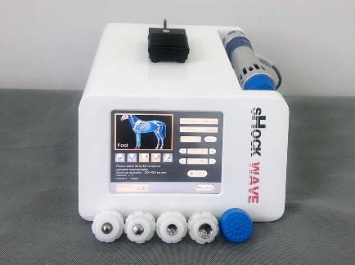
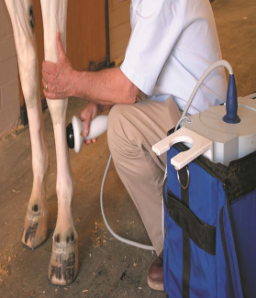
Therapeutic options
Restricted or modified activity
Immobilization of diseased or injured structures in splints and casts
NSAIDs, corticosteroid
Physical therapy:- acupuncture, extracorporeal shock wave therapy
Surgical repair
Regenerative medicine:- growth factors and mesenchymal cell therapy have been used to augment healing
A return to a useful life for many animals is possible when diagnosis and subsequent treatment is done early in the disease process

Slide 14
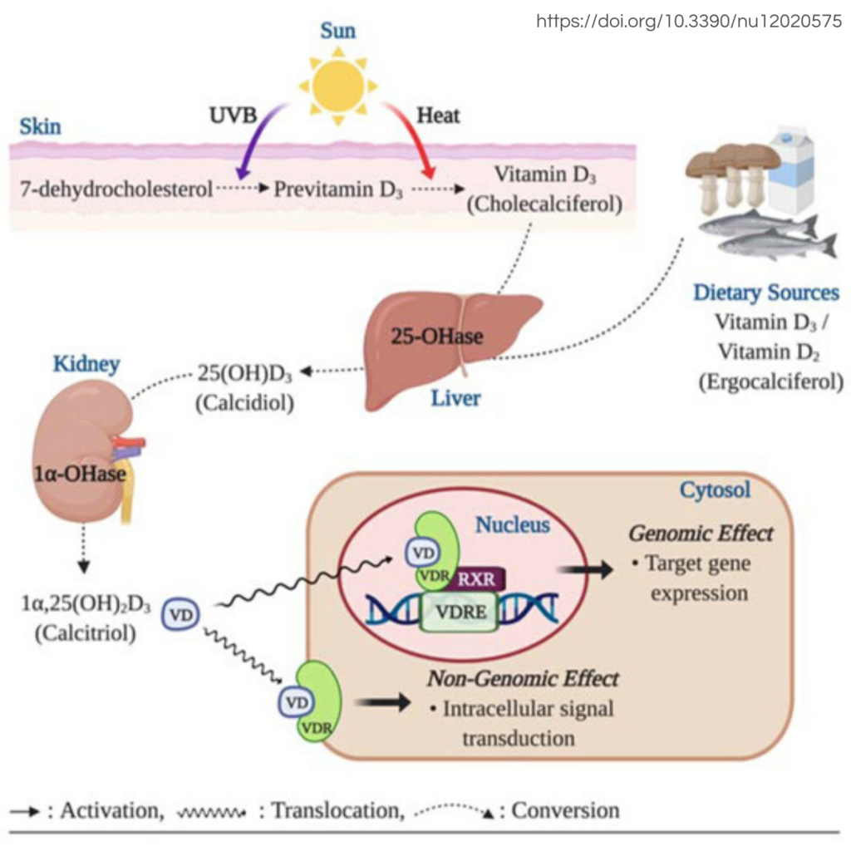
OSTEODYSTROPHIES ASSOCIATED WITH CALCIUM, PHOSPHORUS, AND VITAMIN D
Deficiencies or imbalances of dietary Ca, P, and vit D, as well as dysregulation of parathyroid hormone (PTH) activity
Primary source of Ca and P is the diet
Absorption depends on the source of the minerals, intestinal pH, dietary levels of vit D, Ca, P, Fe and fat
Vitamin D3 acts primarily on the GI tract to increase absorption thereby increasing availability of elemental Ca.
PTH secretion occurs in response to a low circulating calcium ion concentration and availability of magnesium

Slide 15
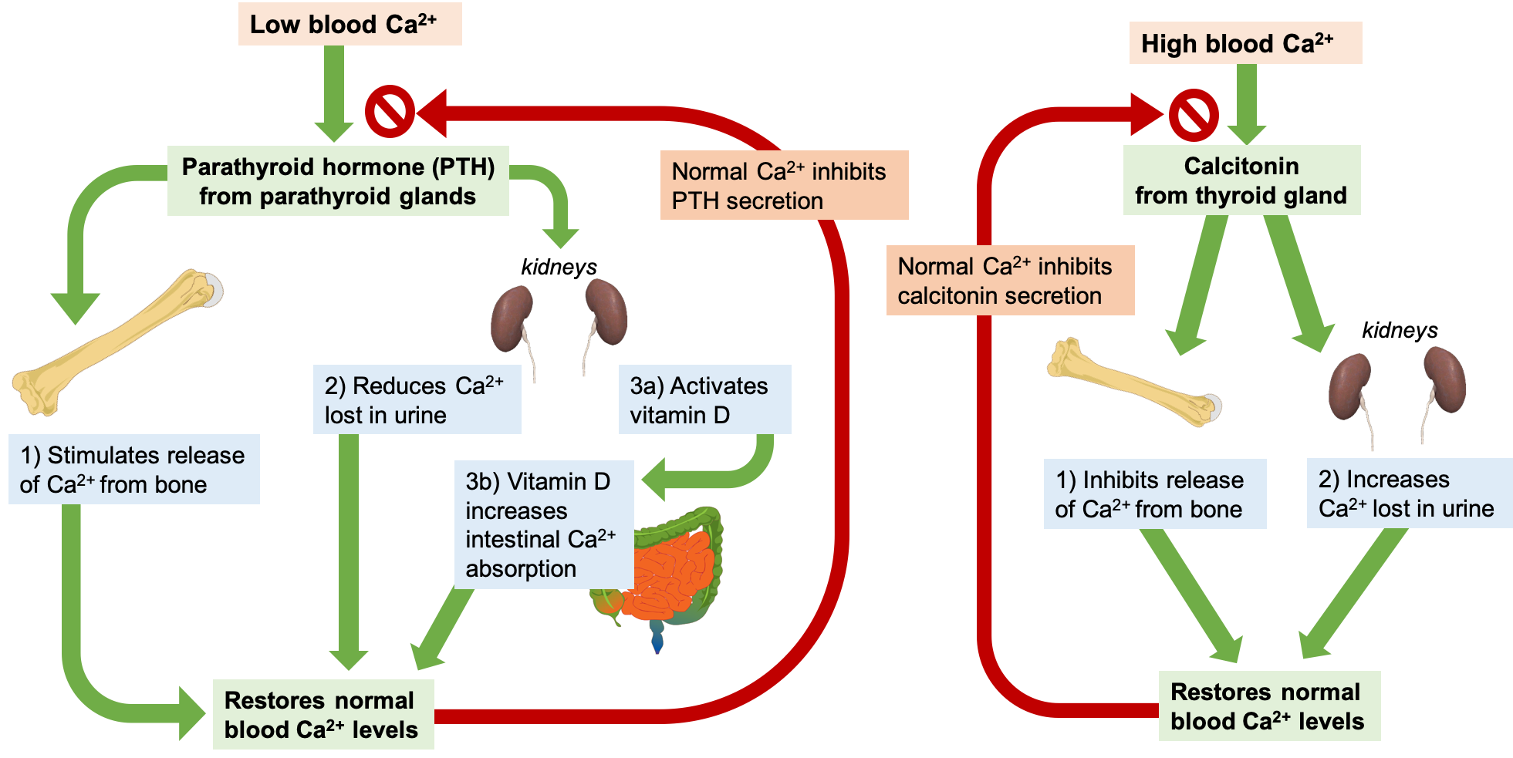
Target organs of PTH are the kidneys, bones, and intestines. In the kidneys,
PTH promotes renal tubular absorption of calcium while enhancing the renal excretion of phosphorus, as well as the activity of 1^{α}-hydroxylase
In the intestine, PTH promotes absorption of calcium.
PTH also facilitates mobilization of Ca and P from bone by allowing utilization of c f rom the osteoid matrix

Slide 16
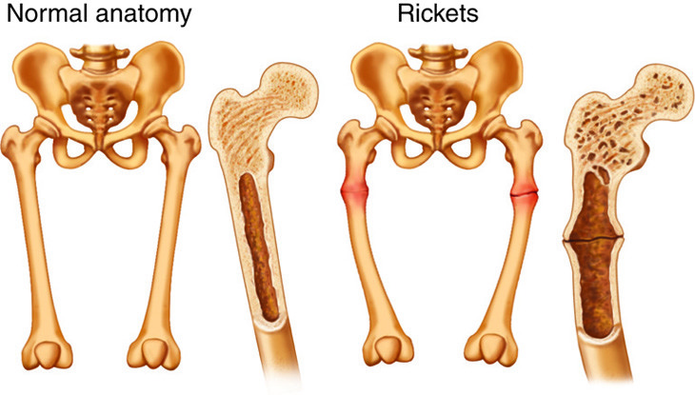
NUTRITIONAL OSTEODYSTROPHIES
RICKET
disease of the bony growth plate and thus only affects young, growing animals
abnormal calcium:phosphorus ratio and dietary insufficiencies of vitamin D most common cause
Deficiecy of Ca
Deficiecy of Ca in diet
Improper balance of Ca:P
Recommended range b/w 1:1 and 2:1
Failure of absorption of Ca

Slide 17
Formation of insoluble complex:-
oxalates and phytates
Oxalic, lactic, tartaric and malic acids
Acid breakdown products of protein
Sulphur
Steatorrhoea
Renal disease
Increased requirements in growing animals
Deficiecy of P
Inadequate amount in diet
Formation of insoluble complex:- Ca,Fe, Al
Steatorrhoea

Slide 18
Deficiecy of Vit D
Steatorrhoea
Diseases of liver
Diseases of kidney
Deficiency of sunlight
The essential defects in rickets are
Cartilage cells are not calcified
Cartilage cells are resistant to degeneration
Failure of blood vessels to invade and corrode the cartilage
Overgrowth of the osteoid on the persistent and growing cartilage
Increased growth of fibrous tissue in the osteochondral zone
Absence of calcification of osteoid

Slide 19
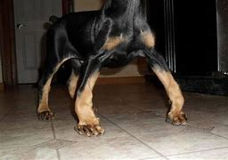
Clinical Findings
Bowing of limbs (“Bow Leg”)
Pot- bellied appearance of the abdomen
Kyphosis and scoliosis
Enlargement of end of bones and joints
Bending of knees and fetlocks
Overextension of pasterns with overgrowth of hooves
Deformity of pelvic bones (maternal dystocia)
Cranium is more dome shaped and frontals are wide
Rickety-rosary (enlarged chondrocostal joints appearing as a string of beads)
Crooked sternum in birds
Poorly formed and irregular jaws- cannot be closed
Rachitic dwarfism- shortening of bones
Flat toe appearance
Bone pain, stiff gait, lameness and pathologic fractures
Eruption of teeth is delayed and irregular
Unthriftiness, pica and occasional diarrhoea

Slide 20
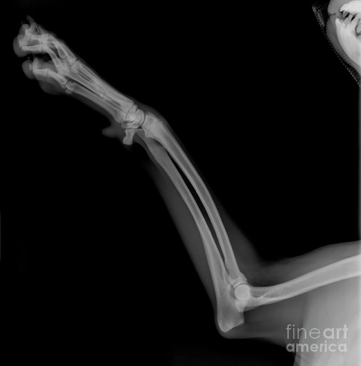
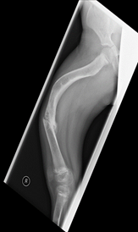
Diagnosis
Radiographic examination of large bones and joints is the most reliable in vivo diagnostic tool
Radiopacity of rachitic bones is characteristically less than that of normal bone
Widening of epiphyseal plate and epiphyseal line
Long bones have wooly, moth eaten appearance and have concave or flat appearance instead of normal convex contour
Growth plates appear widened and irregular
Bending of bones
Decrease in serum Ca and P and increase in alkaline phosphatase
Macroscopically epiphyseal cartilages are abnormal, wider, soft and easily be cut
Microscopic lesions:- impaired endochondral ossification, which are most prominent in fast-growing bones

Slide 21
Treatment
Correction of the diet is the primary treatment for rickets.
The prognosis is good in the absence of pathologic fractures or irreversible damage to the physes.
lf the animals are housed, exposure to sunlight ( ultraviolet radiation) will also increase production of vitamin D3 precursors
Many homemade diets for dogs are deficient in minerals and have altered Ca:P ratios
Therefore, a high-quality commercial food, or one designed by a credentialed veterinary nutritionist, is recommended
Vit D-therapy at a level of 10-20 times the daily requirement
Daily requirement
Dog – 700 I.U.
Sheep, cattle, pig, horse – 1500 I.U.

Slide 22
OSTEOMALACIA (ADULT RICKET)
Seen in mature bones and associated with disruption of normal bone remodeling
Characterized by an accumulation of excessive un-mineralized osteoid on trabecular surfaces.
Because bones mature at different rates, both rickets and osteomalacia can be seen in the same animal
Etiopathogenesis
Inadequate blood level of vitamin D3, P or both
Chronic nephritis
Extensive resorption of minerals and failure of mineralization of newly formed matrix
Softening and spongy bones
There is no enlargement of the ends of the long bones
Clinical findings
Unthrifty and have a rough hair coat
Weight loss, shifting limb lameness, limb defomities, and spontaneous fractures
Pica may predispose affected animals to esophageal obstruction, reticuloperitonitis, botulism, or other intoxications

Slide 23
Diagnosis
Evaluation of diet for calcium, phosphorus, and vitanlin D content
radiographic evidence of generalized skeletal demineralization, loss of lamina dura dentes, subperiosteal cortical bone resorption, bowing deformi ties, and multiple folding fractures of long bones due to intense localized osteoclast proliferation
Blood levels of hydroxyproline to assess the extent of ongoing bone mobilization
Treatment
Attempt should be made to correct the specific causes
Confined for several weeks after initiation of the supplemental diet

Slide 24
FIBROUS OSTEODYSTROPHY
(Renal Ricket, Rubber jaw syndrome)
Defective calcification of bones of jaws and head
Etiology
Primary hyperparathyroidism
Disease of older age group animals
Renal damage cause retention of phosphorus
Retention causes increase in level of blood P over Ca
Relative hypocalcemia induce hyper function of PTH gland resulting increase level of PTH hormone mobilizes Ca from bones
Secondary hyperparathyroidism
Due to feeding of diets containing high P and low Ca- cereals, bran, hays
In horses k/a Bran disease, Big head or Millers disease

Slide 25
Pathogenesis
Imbalance of Ca:P due to excess intake of P
Improper mineralisation causes rarefaction of bones
Resulting in development of fibrous dysplasia – soft cellular fibrous tissue are laid down on the bones
Demineralisation of bones due to which long bones become weak and porous and prone to fracture
There may be detachment of muscles & tendon form bones, and erosion of articular surface of cartilages
Blood forming bone marrow is replaced by fibrous tissue- Anaemia

Slide 26
Clinical Findings
Shifting lameness due to development of painful deformity in legs
Arching of back
Affected animal dislike movement
Cracking of joints is common on walking
In severe cases, there is swelling of alveolar aspect of the mandible
Facial bone are soft & swollen on both sides & may create respiratory problems
Swollen joints, deformed limb bones, ribs are flattened, ligaments may be detached

Slide 27
Diagnosis
Examination of deformed composition of the ration
Clinical findings
Biochemistry: Low calcium & high phosphorus level
Alkaline phosphatase activity in blood is always higher

Slide 28
Treatment
Balanced ration with calcium & phosphorus is to be provided
Replacement of cereal fodder with leguminous fodder
Renal failure will require additional management for renal failure syndrome
Limestone 10-30 g may be fed to cattle

Slide 29
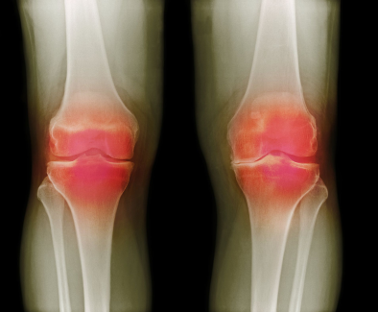
ARTHRITIS
Inflammation of joints
Accompanies inflammation of the synovial membrane
Osteoarthritis- inflammatory as well as degenerative changes
Etiopathogenesis
Trauma or infection
Infection is mostly haematogenous
Localisation of infection in joints take place following bacteraemia
Inflammatory changes in synovial membrane characterized by oedema and fibrin deposition
Swollen and painful joint
In chronic cases extensive proliferation of osseous tissues around the joint leading to ankyloses of the joint

Slide 30
Types
Acute serous arthritis
Acute serofibrinous arthritis
Purulent arthritis
Chronic osteoarthritis
Chronic exudative arthritis
Chronic deforming arthritis
Rheumatoid arthritis

Slide 31
Clinical Findings
Pain sensation of the affected joint
Deformities of the joint
Joints are thickened, swollen and hot
Crepitation sound on movement of joint
Difficulty in movements due to pain
Animal may not put the limb on the floor
May remain in recumbent condition
Defect in locomotion
Working capacity is permanently lost in ankylosis

Slide 32
Diagnosis
Clinico pathological examination
Radiography
Treatment
There may not be permanent cure
Absolute rest
Physical therapy
NSAIDs
Intra-articular corticosteroids- will prevent further accumulation of fluid
Intra-articular sodium hyaluronate, Polysulfated glycosaminoglycans (PSGAGs)
Broad spectrum antibiotics
Abst for specific antibiotic
Surgical intervention- arthroscopic surgery

Slide 33
Thank You

