Slide 1
Gout in Zoo and Wild Animals
Department of Veterinary Medicine
Bihar Veterinary College, BASU, Patna
Dr Mritunjay Kumar
Associate Professor
VMD, BVC, BASU, Patna

Slide 2
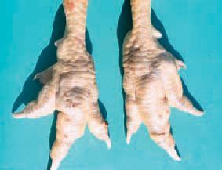
GOUT
Gout is more common in captive birds and reptiles
Among the aviary species, especially raptors like hawks, eagles, kites, vultures, falcons are highly susceptible in addition to ostrich, cassowary, peafowls, budgerigars, love birds, parakeets, cormorant, goose, duck etc
Broader classification and the specific classification of gout should be known for a good understanding about this disorder
Classifications
Broader classification
True gout: Deposition of monosodium urate crystals
Pseudo gout: This is formed by deposition of any crystal other than sodium urate

Slide 3
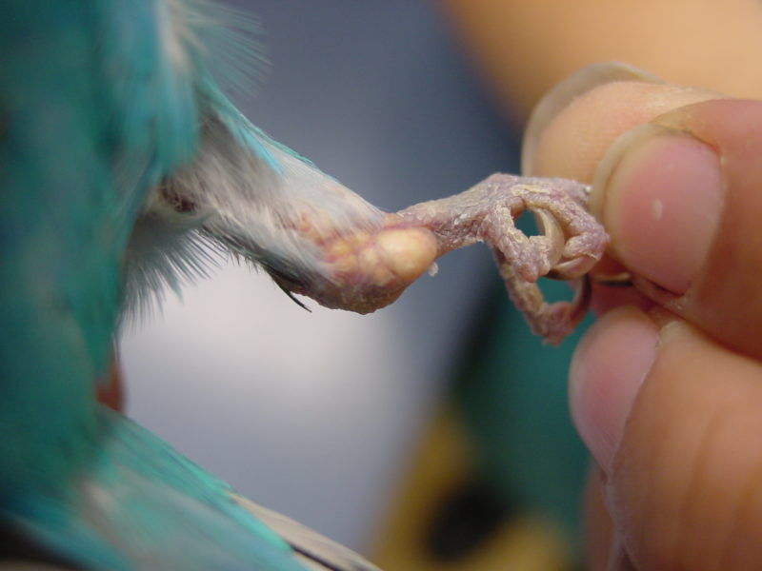
Specific Classification
Visceral Gout (Usually occurs in acute form) | Deposition of whitish urate or uric acid crystals in case of reptile and birds (urate crystals are deposited as white coloured powder or foci often on pericardium and liver mainly and also on kidney
Articular Gout or Synovial Gout (Usually occurs as Chronic form) | Urate deposition in and around the joints Deposition of urate crystals form in joints, form small nodules called as tophi or tophus due to tissue reaction leading to swelling
Etiology
Renal problems (infection/inflammation/renal lesions due to nephrotoxic substances like gentamicin and anti-inflammatory drugs like salicylates, probenecids, phenylbutazone etc.) are the basic cause because liver and esp. the renal tissues are involved in production of urate crystals
Nutrition (increased protein intake with or without provision of water and incorrect balance of amino-acids in the feed
Stress leading to dehydration or dehydration due to diseases all lead ultimately reduced renal blood flow and thereby renal efficiency is lots and ultimately gout occurs
Congenital - Nile crocodile hatchlings

Slide 4
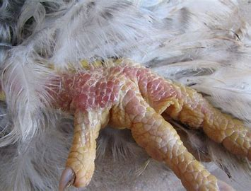
Clinical signs
In crocodiles or lizards or chelonians affected by gout, general depression is there but antemortem-diagnosis is difficult in visceral gout
In articular gout, the affected leg joints become painful and the animal is reluctant to move
In advanced arthritic gout, the swollen joints can be easily seen or palpated
In captive aviary species, affected by visceral gout, antemortem- diagnosis is difficult as in case of many species
In articular gout, urate tophi may be seen esp. in advanced cases (seen as whitish areas at joints)

Slide 5
Diagnosis
Elevated serum uric acid helps the diagnosis in general, in addition to the specific examination for urate crystals in joints
The signs of articular gout often are confused with bumble foot
Muroxide test helps to confirm uric acid crystals and in this test, take one drop of nitric acid on a clean slide and mix it with the crystals aspirated from a urate typhus and slowly flame it till this becomes dry and cool
Add one drop of ammonia and presence of a reddish-purple color will indicate the presence of uric acid
Treatment
Dietary management or modification is the primary focus of treatment
Correcting environmental deficiencies
The animal may be hospitalized for proper hydration (fluid therapy) and supportive care
Surgery is occasionally used to "clean out" the joints; in severe cases, the damage to the joints is enormous and irreversible
Allopurinol 20mg/kg b wt PO SID lower serum uric acid and promote urate excretion from body

Slide 6
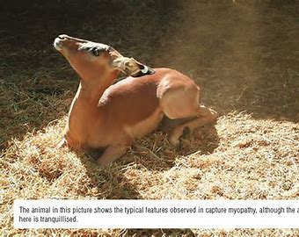
Capture Myopathy (CM)
Capture myopathy (CM) is a noninfectious, metabolic disease of wild and domestic animals commonly associated with pursuit, capture, restraint, transport, secondary to other diseases and natural hazards encountered in the environment and characterized by metabolic acidosis, muscle necrosis and myoglobinuria
It may lead to significant morbidity and mortality
CM has been termed muscular dystrophy, white muscle disease, overstraining disease, capture disease, cramp, leg paralysis, spastic paresis, stress myopathy, transport myopathy, incipient myopathy, degenerative polymyopathy, muscle necrosis, and idiopathic muscle necrosis
Now most commonly referred to as CM, exertional myopathy, or exertional rhabdomyolysis

Slide 7
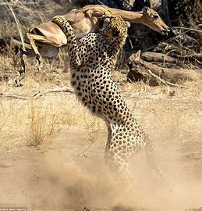
Etiology
Predisposing factors
Species
Prey species are considered the most susceptible to CM in the
mammalian taxa, particularly ungulates
Highly susceptible species include zebra, deer, giraffe, nyala, roan antelope, red hartebeest, eland, springbok, kudu, giraffe, white-tailed deer, pronghorn, fallow, and hog deer
The long-legged wading birds are particularly predisposed to CM within the avian taxa
Carnivores –Rarely reported
Environmental factors: Extremes in ambient temperature, rain, and high humidity
Capture-related factors: : Techniques that involve high chase speeds, prolonged exertion without rest, excessive handling, prolonged restraint, the restraint that promotes struggling from unnatural positioning, crating, transport, subjection to fear stimuli over periods, and renewed stresses, such as repeated moving and transport
Nutrition: Animals with a pre-existing vitamin E or selenium deficiency

Slide 8
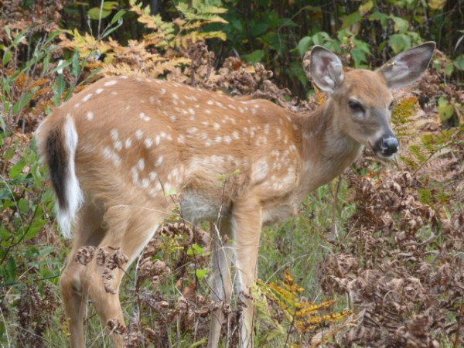
Other diseases: Severe worm and tick infections cause anemia and weaken the animal
Drugs: Potent opioids, such as fentanyl, etorphine, carfentanil, and thiafentanil, are often used in combination with alpha-2 agonists, butyrophenones, benzodiazepines, and cyclohexamines for wildlife capture
Signalment: Extremely old and extremely young animals, males and pregnant animals may be the most susceptible

Slide 9
Clinical signs
Hyperacute or capture shock syndrome: It occur during immobilization or within a short time after capture. Death usually occurs within 1–6 hours post capture. Clinical signs include depression, hyperpnea/ tachypnea, tachycardia, elevated body temperature, weak thready pulses, and death.
Acute or ataxic myoglobinuric syndrome: Most common syndrome and may become evident several hours to several days post capture
Clinical signs may include mild to severe ataxia, torticollis, and myoglobinuria
c) Subacute or ruptured muscle syndrome: Clinical signs exhibits 24–48 hours post-capture, marked drop in the hindquarters and hyperflexion of the hock due to unilateral or bilateral rupture of the gastrocnemius muscle
d) Chronic debility or delayed per-acute syndrome: It occurs in animals captured at least once in the past and when exposed to a second, death occurs within few minutes

Slide 10
Post Mortem findings
Gross examination reveals massive subcutaneous hemorrhage of the rear limbs, and multifocal small to large, pale, soft lesions in the forelimb,
Multiple, small to large ruptures may be found in necrotic muscle bodies
The gastrocnemius, subscapularis, middle and deep gluteal, semitendinosus, and semimembranosus muscles are often ruptured
Histologic lesions are primarily located within the skeletal muscles and they are characterized by severe, diffuse necrosis
Differential diagnosis
White-muscle disease, plant toxicities such as Cassia occidentalis, Cassia obtusifolia, and malignant hyperthermia, early tetanus, hypocalcemia, and myositis
Diagnosis
Based on history, clinical signs of myoglobinuria and elevation of biomarker enzymes like Creatinine kinase (CK), LDH, AST
CK elevation more than 10 times the upper reference limit
Hyperkalaemia and elevated BUN

Slide 11
Treatment
Low success rate eventhough animals rehabilitated with intensive efforts
Costs and logistics associated with treating wild animals, particularly in field situations, pose significant challenges
Analgesia
Opioid administration with or without a sedative should also be considered
Corticosteroids
Dantrolene: Used to prevent malignant hyperthermia in humans and exertional rhabdomyolysis in horses
Muscle relaxants: Benzodiazepines, including diazepam, midazolam, and zolazepam, are centrally acting muscle relaxants that reduce muscle spasms and spasticity
Dietary supplements Vitamin E and selenium are biological antioxidants, balanced formulation of B vitamins with vitamin C in parenteral form, Coenzyme Q10, and L-carnitine
Hyperbaric oxygen : Used as adjunct therapy, induces high oxygen partial pressure in all tissues, inhibits toxin formation, and promotes wound healing
Sodium bicarbonate: It manage acidemia and alkalinize the urine
Approximately 4 mEq/kg of sodium bicarbonate administered intravenously is successful in resolving metabolic acidosis and reducing mortality in large animals

