Slide 1
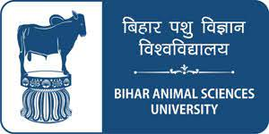
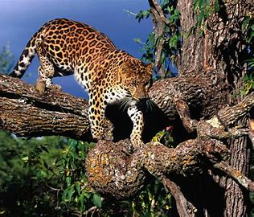
Department of Veterinary Medicine
Bihar Veterinary College, BASU, Patna
NATIONAL AND INTERNATIONAL ORGANIZATIONS AND INSTITUTIONS LINKED TO WILD AND ZOO ANIMALS – ROLE AND FUNCTIONS
Dr Mritunjay Kumar Associate Professor, VMD BVC,BASU, Patna

Slide 2
International organisations linked to Wild and Zoo animals
1. International Union for Conservation of Nature and Natural Resources (ICUN)
2. Convention on International Trade in Endangered Species (CITES)
3. United Nations Development Programme (UNDP)
4. Food and Agriculture Organization (FAO)
5. Trade Records Analysis of Flora and Fauna in Commerce (TRAFFIC)
6. United Nations Educational, Scientific and Cultural Organizations (UNESCO)
7. World Wide Fund for Nature (WWF)
8. Zoological Society of London (ZSL)
9. Royal School of Veterinary Studies

Slide 3
National organisations linked to Wild and ZOO animals
1. Bombay Natural History Society (BNHS)
2. Wildlife Institute of India (WII)
3. Indian Board For Wildlife (IBWL)
or National Board for Wildlife (NBWL)
Botanical Survey of India (BSI)
Zoological Survey of India (ZSI)
Wildlife Protection Society of India (WPSI)
Central Zoo Authority (CZA)
Wildlife Trust of India (WTI)

Slide 4
Others
International Commission on Zoological Nomenclature (ICZN)
International Commission on Botanical Nomenclature (ICBN)
Global Tiger Forum (GTF)
It is an International platform to discuss features pertaining to the protection of tiger population in the world
Role and Functions
• Establishment of wildlife sanctuaries and national parks
• Establishment of special squad to discover poaching etc.
• Focuses on welfare of tiger-populations

Slide 5
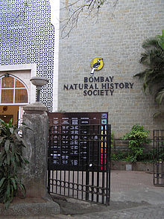
1. Bombay Natural History Society (BNHS)
National
Founded on 15 September 1883
Non-governmental organization in India engaged in conservation and biodiversity research
Grants for research and publishes the Journal of the Bombay Natural History Society
Many prominent naturalists, including the ornithologists Sálim Ali and S. Dillon Ripley, have been associated with BNHS
Headquarter
Hornbill House, Mumbai

Slide 6
2. Wildlife Institute of India (WII)
Established in 1982 in Dehradun (Uttarakhand) under Ministry of Environment Forest and Climate, Change, Government of India
It offers training program (Indian Forest Service Officers), academic courses and advisory in wildlife research and management
The Institute is actively engaged in research across the breadth of the country on biodiversity related issues

Slide 7
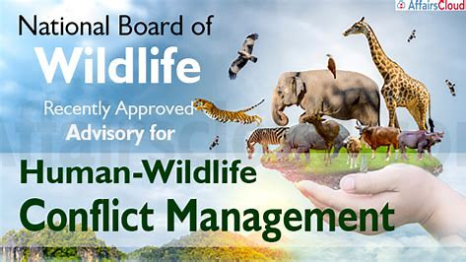
3. Indian Board For Wildlife (IBWL)
To conserve the wildlife the GOI had constituted an advisory body designated as the Indian Board for Wildlife (IBWL) in 1952 chaired by the Prime Minister
The Wildlife (Protection) Act, 1972 was enacted for providing special legal protection to wildlife
As per the Wildlife (Protection) Amendment Act, 2002, National Board for Wildlife was constituted by replacing the Indian Board for Wildlife
Function
The board advises the GOI in conservation and development of wildlife and forests
It review all wildlife-related matters and approve projects in and around national parks and sanctuaries
National Board for Wildlife approval is needed for any alternation of boundaries in national parks and wildlife sanctuaries

Slide 8
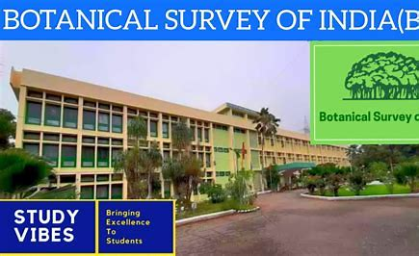
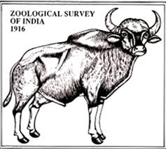
4. Botanical Survey of India (BSI)
The Botanical Survey of India (BSI) established in 1890, is the apex research organization under the Ministry of Environment, Forests and Climate Change, Govt. of India for carrying out taxonomic and floristic studies (type, no., and distribution of plant species in a particular area) on wild plant resources of the country
5. Zoological Survey of India (ZSI)
Exploration, Survey, Inventorying and Monitoring of faunal dive States,systems and Protected areas of India. • Established in 1916 by the Ministry of Environment, Forest and Climate Change of the Government of India as a premier Indian organisation in zoological research and studies to promote the survey, exploration and research of the fauna in the country
ZSI has published the Red Data Book on Indian animals
6. Indian Institute of Sciences (IIS)
This is located at Bangalore and is involved in studies on ecology and wildlife of Western Ghats species. • Preparation of Red Data Book, Fauna of India and Fauna of States. • Bioecological studies on selected important communities/species. • Preparation of databases for the recorded species of the country. • Maintenance & Development of National Zoological Collections. • Training, Capacity Building and Human Resource Development. • Faunal Identification, Advisory services and Library Services. • Publication of results including Fauna of India and Fauna of States.
Headquarter- Kolkota
Headquarter- Kolkota

Slide 9
6. Wildlife Protection Society of India (WPSI)
Founded in 1994 by Belinda Wright, its Executive Director, who was an award-winning wildlife photographer and filmmaker till she took up the cause of conservation
WPSI's main aim has been to bring a new focus to the daunting task of tackling India's growing wildlife crisis
Providing support and information to government authorities to combat poaching and the escalating illegal wildlife trade - particularly in wild tigers
Supports in enforcement of wildlife protection act
Promotes wildlife tourism
Headquarter- New Delhi

Slide 10
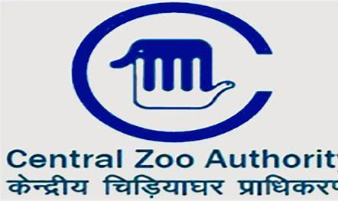
7. Central Zoo Authority (CZA)
The Central Zoo Authority (CZA) is the body of the Government of India responsible for over sight of zoo established in 1992 under the section 38A of Wild Life (Protection) Act, 1972
It is an affiliate member of the World Association of Zoos and Aquariums (WAZA)
The Authority consists of a Chairman, ten members and a Member Secretary
The main objective of the authority is to complement the national effort in conservation of wild life
Standards and norms for housing, upkeep, health care and overall management of animals in zoos has been laid down under the Recognition of Zoo Rules, 1992
Headquarter- Kolkota,WB

Slide 11
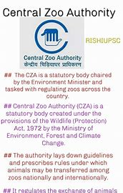
• To specify the minimum standards for housing and veterinary care of the zoo animals
• To provide technical and other assistance to zoos for their proper management
• To identify endangered species of wild animals for the purpose of captive breeding
• To recognize or derecognize zoos
• To evaluate the functioning of a zoo
• To co-ordinate research in captive breeding and educational programmes
• To ensure maintenance of stud book (OFFICIAL RECORD OF PEDIGREE OF PURE BREED ANIMAL) of endangered species of wild animals bred in captivity
• To restrict the power of a zoo regarding acquisition or transfer of any wild animal specified in schedule I and II

Slide 12
8. Wildlife Trust of India (WTI)
The Wildlife Trust of India (WTI) is a registered charity for wildlife conservation
Founded in 1998 in New Delhi, India, as a response to the rapidly deteriorating condition of wildlife in India
It works on conservation related programmes in India through a team of professionals comprising of biologists, veterinarians, communication specialists , lawyers , etc.
This organization has special programmes pertaining to sloth bear, elephant, tiger, rhinoceros , etc.
Headquarter- Noida, U.P.
Department of Wildlife Science, Tamil Nādu Animal and Veterinary Sciences University, Chennai and Centre for Wildlife Forensic and Health, M.P. Veterinary University, Jabalpur and Indian Veterinary Research Institute, Bareilly, UP state and Karnataka Veterinary, Animal and Fisheries Sciences University, Karnataka state are currently involving in teaching, research and extension activities pertaining to wildlife science.

Slide 13
International organisations linked to Wild and Zoo animals
1. International Union for Conservation of Nature and Natural Resources (ICUN)
2. Convention on International Trade in Endangered Species (CITES)
3. United Nations Development Programme (UNDP)
4. Food and Agriculture Organization (FAO)
5. Trade Records Analysis of Flora and Fauna in Commerce (TRAFFIC)
6. United Nations Educational, Scientific and Cultural Organizations (UNESCO)
7. World Wide Fund for Nature (WWF)
8. Zoological Society of London (ZSL)
9. Royal School of Veterinary Studies

Slide 14
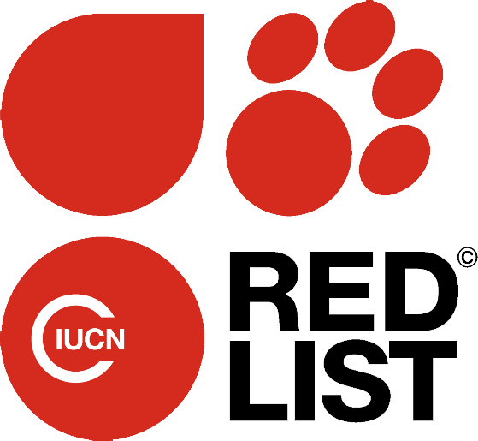
1. International Union for Conservation of Nature and Natural Resources (ICUN)
IUCN is an international organization set up in 1948 to protect plants, animals and habitats
It was first called the "World Conservation Union
Head quarter in Gland, Switzerland
Role and Functions
It links both research and results to local, national, regional and global policy by convening dialogues between Governments, civil society and private sector
It supports and develops cutting-edge conservation science and implements this research in field projects around the world
It facilitates paths for peace between countries in areas of conflict and works with the corporate sector on energy and bio-diversity
Species Survival Commission (SSC) is one of the Commissions of IUCN which has aim of conservation of bio-diversity

Slide 15
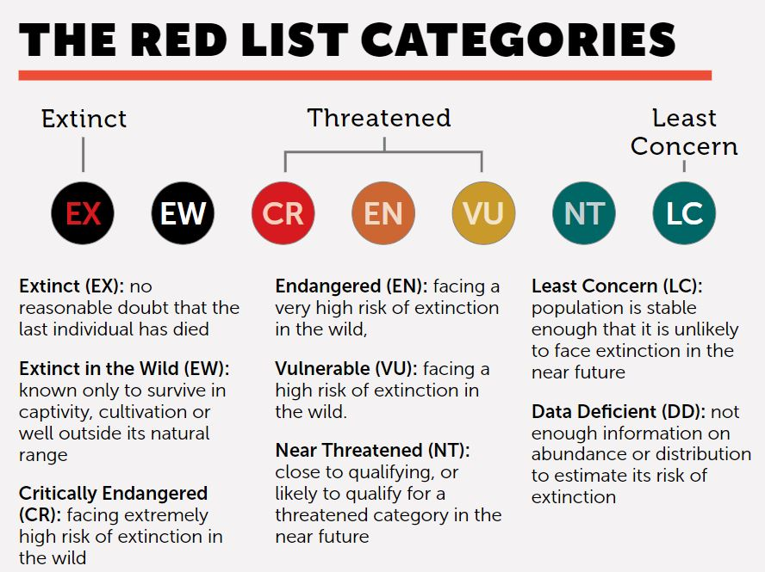
IUCN Red list of animals EX- Tasmanian Tiger, Quagga, Golden toad EN- African elephant, Panda, Golden lion

Slide 16
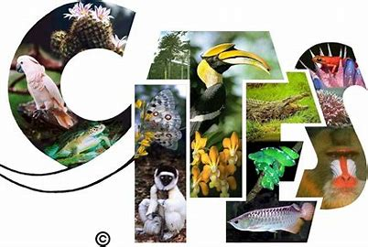
2. Convention on International Trade in Endangered Species (CITES) of Wild Flora and Fauna
The CITES (SIGH-teez), is an agreement between governments that regulates the international trade of wildlife and wildlife products—everything from live animals and plants to food, leather goods, and trinkets
It came into force in 1975 with the goal of ensuring that international trade does not threaten the survival of wild plants and animals
Roughly 5,600 species of animals and 30,000 species of plants are protected by CITES against over-exploitation through international trade
Role and Functions
People and states are linked for best protection of their own wild fauna and flora
Stresses on need of International collaboration
Stresses on need of undergoing the ever-growing value of wild fauna and flora from aesthetic, scientific, cultural and economic point of view
Emphasizes that the wild fauna and flora in their many beautiful varied forms are on irreplaceable part of the natural systems of the earth
Headquarter- Geneva, Switzerland

Slide 17
3. United Nations Development Programme (UNDP)
It is a United Nations agency tasked with helping countries eliminate poverty and achieve sustainable economic growth and human development
Associated with all features of conservation
4. Food and Agricuture Organisation (FAO)
Established in 1945
It was founded with a goal to provide food security for everyone and assure that people will have access to high-quality food in sufficient quantities to achieve a healthy lifestyle
Associated with all features of conservation
Headquarter- New york
Headquarters - Rome, Italy

Slide 18
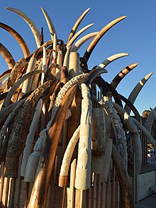
5. Trade Records Analysis of Flora and Fauna in Commerce (TRAFFIC)
The TRAFFIC is a global non-governmental organisation monitoring the trade in wild animals and plants that focuses on biodiversity and sustainable development
It is a wildlife trade watch group of IUCN and WWF for nature
Started in 1975 with the aim of monitoring wildlife trade worldwide in Cambridge, U.K.
It collects and analyses the data on wildlife trade
TRAFFIC – India was established on 1/01/1992 as a division of WWF – India and a part of global TRAFFIC network
Headquarters - Cambridge, U.K.

Slide 19
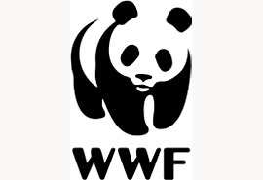
6. United Nations Educational, Scientific and Cultural Organization (UNESCO)
The United Nations Educational, Scientific and Cultural Organization is a specialized agency of the United Nations (UN) aimed at promoting world peace and security through international cooperation in education, arts, sciences and culture
It has 193 member states and 12 associate members
It launched man and bio-diversity programme
7. World Wide Fund for Nature (WWF)
It was set up in 1961 and giant panda is the official symbol of WWF
It was earlier called as world wildlife fund but in 1990 it was renamed as world wide fund for nature
Role and Functions
It helps to raise funds for urgent conservation requirements and promoting conservation through the world wide education campaign and public consciousness
Grants are raised by donations from public, heritable foundations, regular members, etc.

Slide 20
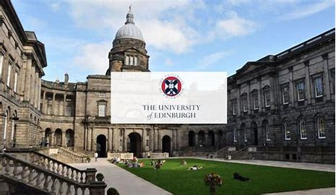
8. Zoological Society of London (ZSL)
The Institute of Zoology under ZSL focuses its research on five areas: evolutionary biology, genetics, ecology, reproductive biology and wildlife epidemiology
ZSL runs ZSL London Zoo, ZSL Whipsnade Zoo
9. Royal School of Veterinary Studies
The Royal (Dick) School of Veterinary Studies, commonly referred to as the Dick Vet, is the veterinary school of the University of Edinburgh in Scotland and part of the College of Medicine and Veterinary Medicine

