Slide 1
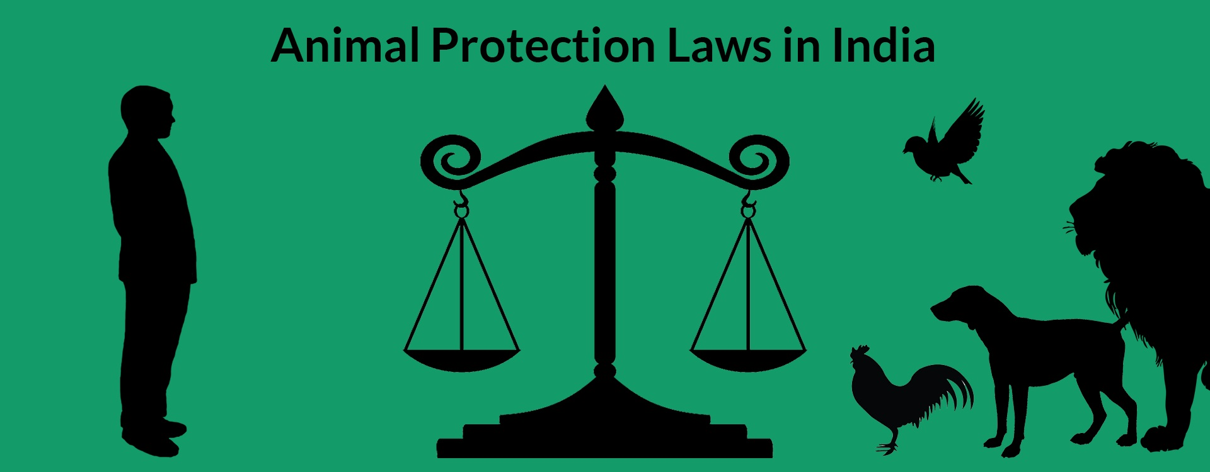
PROVINCIAL AND CENTRAL ACT
RELATING TO ANIMALS
Dr. Ravi Shankar Kr Mandal
Assistant Professor
Veterinary Medicine
BVC, Patna

Slide 2
Provincial Act
Act made by the Governor in Council, Lieutenant Governor in Council or Chief Commissioner in Council of a Province under any of the Indian Councils Acts or the Government of India Act, 1915, or an Act made by the Local Legislature or the Governor of a Province under the Government of India Act, or an Act made by the Provincial Legislature or Governor of a Province or the Coorg Legislative Council under the Government of India Act, 1935.
Central Act
Piece of legislation passed by Parliament that includes: A statute of the Dominion Legislature or the Indian Legislature enacted before the Constitution’s inception, and An Act passed by the Governor-General in Parliament or his or her legislative capacity before the act’s commencement

Slide 3
LAW
ACT
A law is defined as an assemblage of rules and regulations that are indispensable and must be followed.
Law holds its single purview over the larger picture.
Law ensures that the people will strictly follow the defined rules and regulations.
Law is more generic in its nature of operations and is not that complicated to comprehend.
Law can be enforced as it has been established by the regulatory procedures.
A law is defined to stop malpractices, maintain public order, and, most importantly to protect Fundamental Rights.
An Act is a decree that is approved by the respective legislature, i.e. in India’s case, the State Legislative Assembly or Parliament of India.
An Act is a sub-set of Law.
An Act is employed in specific situations meaning establishing regulations and rules in specified domains.
Acts are conditional and specific depending on the domains they have been applied for
An Act is represented by the bill it is passed for and will not be enforced until it becomes law.
Acts are made to make people aware of certain rules and regulations that are in place.

Slide 4
New criminal laws will replace IPC, CrPC, Indian Evidence Act effective from July, 1st 2024
Before December 25, 2023 | After December 25, 2023
Indian Penal Code (IPC), 1860 511 sections | Bharatiya Nyaya Sanhita (BNS), 2023 358 sections
Criminal Procedure Code (CrPC), 1973 484 sections | Bharatiya Nagrik Suraksha Sanhita (BNSS), 2023 531 section
Indian Evidence Act, 1872 167 sections | Bharatiya Sakshya Adhiniyam (BSA), 2023 170 sections

Slide 5
INTRODUCTION
India is one of the most bio-diverse countries in the world and consists of 2.4 % of the world’s land area that accounts for 7-8% of all recorded species including 45,000 species of plants and 91,000 species of animals.
Animals are also essential for maintaining the ecological balance on the earth
The Constitution of India
Supreme law of India which lays down the fundamental political code, rights and duties of citizens, directive principles of state policy, procedures, structures and powers of governmental institutions.
Widely regarded to be a “living document”- dynamic and constantly evolving with changing times.
Longest written constitution in any country on earth and is divided into 395 articles (demarcated into 22 parts) and 12 schedules
Recognized the sanctity of animal life and laid down protection and treatment of animals with dignity as a fundamental duty of the citizens of India.

Slide 6
According to Article 51(g) of the Indian Constitution
Indian citizens shall be obliged to preserve and improve the environment, including forests, lakes, rivers, and wildlife, and to have compassion for living creatures
World Animal Protection
Animal Protection Index (API)
Ranks 50 countries around the world according to their animal welfare policy and legislation
Support efforts to promote stronger laws for better protection animals
Highest score (A) and lowest score (G)
India was rated ‘C’ on the API released in 2020

Slide 7
Why animal rights
The concept of animal rights advocates for the ethical and moral consideration of animals, emphasizing that they have inherent rights and should be treated with respect and compassion.
Inherent Value and Sentience
Animals, like humans, are sentient beings capable of experiencing pain, pleasure, fear, and other emotions.
They have inherent value and a right to live their lives free from unnecessary suffering.
Ethical Consideration
Treating animals with respect and compassion aligns with ethical principles that extend beyond human interests. It acknowledges that all sentient beings deserve moral consideration and should not be exploited or harmed unnecessarily.

Slide 8
Environmental Impact:
Many species play crucial roles in ecosystems, and their well-being is essential for maintaining biodiversity and ecological balance
Health and Welfare:
Ensuring animal rights can contribute to better public health outcomes
Scientific and Technological Advancement
Respecting animal rights includes using humane methods in research and seeking alternatives whenever possible to minimize animal suffering
Legal Protection and Advocacy
Advocating for animal rights involves promoting and enforcing laws and policies that protect animals from cruelty, abuse, and exploitation.
Legal frameworks provide a basis for holding individuals and industries accountable for their treatment of animals.

Slide 9
Compassion and Empathy:
Recognizing and respecting animal rights fosters empathy and compassion towards all living beings.
It encourages a more compassionate society that values kindness and considers the well-being of animals in everyday choices and actions.
Global Responsibility
Animal rights are increasingly recognized as a global issue that requires collective responsibility and international cooperation.
Future Generations:
Upholding animal rights contributes to creating a sustainable and ethical future for generations to come.
It involves educating and inspiring individuals to make choices that respect the rights and welfare of animals, thereby shaping a more compassionate world.

Slide 10
The "Five Freedoms”
Originally developed by the Farm Animal Welfare Council (FAWC) in the UK in 1965
Basic principles for the welfare of animals under human care, focusing on their physical and mental well-being
Widely adopted internationally and serve as a guideline for assessing and improving animal welfare standards
1. Freedom from Hunger and Thirst:
Animals should have access to fresh water and a diet that maintains health and vigor. They should be provided with access to food at appropriate intervals to meet their nutritional needs
2. Freedom from Discomfort
Animals should be provided with an appropriate environment, including shelter and a comfortable resting area.
This includes protection from extremes of temperature, adverse weather conditions, and physical discomfort.

Slide 11
3. Freedom from Pain, Injury, or Disease:
Animals should be protected from physical pain, injury, and disease. This involves prevention or rapid diagnosis and treatment of illnesses and injuries by trained professionals.
4. Freedom to Express Normal Behavior:
Animals should have sufficient space, proper facilities, and the company of their own kind to allow them to express natural behaviors. This includes opportunities for exercise, play, and social interaction according to their species-specific needs.
5. Freedom from Fear and Distress:
Animals should not be subjected to mental suffering. This includes ensuring conditions and treatment that avoid mental distress such as fear, anxiety, and stress. Handling, transportation, and housing should be done in a manner that minimizes fear and discomfort.

Slide 12
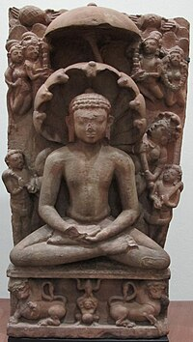
HISTORICAL BACKGROUND OF ANIMAL LAWS IN INDIA
Animals act as a “messenger of God”
Animals are considered as the creation of “The Almighty” and also a deep sense of respect, love to the almighty with his extended creations on earth like trees, forests, rivers, mountains, etc.
There exists a universal concept of harmony between humans, animals, and the environment that become a part of the spiritual life of its people.
Vedas (the first scriptures of Hinduism) teaches ahimsa and non-violence towards all living organisms
Jainism and Buddhism, the practice of vegetarianism and avoiding killing animals have followed to a great extent

Slide 13
The first Indian society was founded by Briton Colesworthy for the prevention of cruelty to animals in 1861 in Calcutta.
After this many movements arose in the late 1800s in northern parts of India against the slaughter of cattle.
After independence, the first animal welfare law, the Prevention of Cruelty to Animals Act, 1960, criminalizes cruelty against animals.

Slide 14
The Constitution of India, 1960
42nd amendment in 1976
Under Article 21 of the Constitution, the expression ‘life’ has been expanded to include all forms of life including animal life which is essential for human life. Moreover, the Right to Dignity and fair treatment is also significant to animal rights.
Article 48 A states that the state shall endeavor to protect and improve the environment and safeguard the country’s forests and wildlife.
Article 51 A (g) states that every citizen has a fundamental duty to safeguard and improve the natural environment including forests, lakes, rivers, and animals as well as to have compassion for living creatures.
Seventh Schedule of the Indian Constitution gives power to central and state to make laws on:
Prevention of cruelty to animals
Protection of wild animals and birds

Slide 15
THE PREVENTION OF CRUELTY TO ANIMALS ACT, 1960
Enacted by Parliament in the year of 26th December, 1960
To prevent the infliction of unnecessary pain or suffering on animals and for that purpose to amend the laws related to the prevention of cruelty to animals.
6 chapters
CHAPTER I: PRELIMINARY
1. Short title, extent and commencement
It extends to the whole of India except the State of Jammu and Kashmir
2. Definitions.
“animal” means any living creature other than a human being
“Board” means the Board established under section 4, and as reconstituted from time to time under section 5A

Slide 16
“captive animal” means any animal (not being a domestic animal) which is in captivity or confinement, whether permanent or temporary, or which is subjected to any appliance or contrivance for the purpose of hindering or preventing its escape from captivity or confinement or which is pinioned or which is or appears to be maimed;
“domestic animal” means any animal which is tamed or which has been or is being sufficiently tamed to serve some purpose for the use of man or which, although it neither has been nor is being nor is intended to be so tamed, is or has become in fact wholly or partly tamed;
“local authority” means a municipal committee, district board or other authority for the time being invested by law with the control and administration of any matters within a specified local area;

Slide 17
“owner”, used with reference to an animal, includes not only the owner but also any other person for the time being in possession or custody of the animal, whether with or without the consent of the owner;
“phooka” or “doom dev” includes any process of introducing air or any substance into the female organ of a milch animal with the object of drawing off from the animal any secretion of milk;
3. Duties of persons having charge of animals
It shall be the duty of every person having the care or charge of any animal to take all reasonable measures to ensure the well-being of such animal and to prevent the infliction upon such animal of unnecessary pain or suffering.

Slide 18
CHAPTER II : ANIMAL WELFARE BOARD OF INDIA
4. Establishment of Animal Welfare Board of India
In 1962 under section 4 of PCA, 1960
5. Constitution of the Board.
Different members
5A. Reconstitution of the Board
Every third year
6. Term of office and conditions of service of members of the Board.
7. Secretary and other employees of the Board
Appointed by Central Govt
8. Funds of the Board
Grant by Govt/Gifts by local authority or by any other person

Slide 19
9. Functions of the Board
To keep law in force
To advise Central Govt on making rules
To advise Govt or local authority
to give financial and other assistance to animal welfare organisations
10. Power of Board to make regulations
The Board may, subject to the previous approval of the Central Government, make such regulations as it may think fit for the administration of its affairs and for carrying out its functions.

Slide 20
CHAPTER III :CRUELTY TO ANIMALS GENERALLY
11. Treating animals cruelly: If any person―
beats, kicks, over-rides, over-drives, over-loads, tortures or otherwise treats any animal so as to subject it to unnecessary pain or suffering or causes or, being the owner permits, any animal to be so treated;
wilfully and unreasonably administers any injurious drug or injurious substance to [any animal] or wilfully and unreasonably causes or attempts to cause any such drug or substance to be taken by [any animal]
conveys or carries, whether in or upon any vehicle or not, any animal in such a manner or position as to subject it to unnecessary pain or suffering
keeps or confines any animal in any cage or other receptacle which does not measure sufficiently in height, length and breadth to permit the animal a reasonable opportunity for movement;

Slide 21
being the owner, neglects to exercise or cause to be exercised reasonably any dog habitually chained up or kept in close confinement
being the owner of 3[any animal] fails to provide such animal with sufficient food, drink or shelter
without reasonable cause, abandons any animal in circumstances which render it likely that it will suffer pain by reason of starvation or thirst;
offers for sale or, without reasonable cause, has in his possession any animal which is suffering pain by reason of mutilation, starvation, thirst, overcrowding or other ill-treatment

Slide 22
12. Penalty for practising phooka or doom dev
punishable with fine which may extend to one thousand rupees, or with imprisonment for a term which may extend to two years, or with both, and the animal on which the operation was performed shall be forfeited to the Government.
13. Destruction of suffering animals
any magistrate, commissioner of police or district superintendent of police
Any police officer above the rank of a constable or any person authorised by the State Governmen
No appeal shall lie from any order of a magistrate for the destruction of an animal

Slide 23
CHAPTER IV : EXPERIMENTATION ON ANIMALS
14. Experiments on animals
Nothing contained in this Act shall render unlawful the performance of experiments (including experiments involving operations) on animals for the purpose of advancement by new discovery of physiological knowledge or of knowledge which will be useful for saving or for prolonging life or alleviating suffering or for combating any disease, whether of human beings, animals or plants.
15. Committee for control and supervision of experiments on animals (CCSEA)
Committee for the Purpose of Control and Supervision of Experiments on Animals (CPCSEA)
Formed in 1964, it was revived in 1998, under the committed chairpersonship of Maneka Gandhi.
665 laboratories are registered with the CPCSEA

Slide 24
Institutional Animal Ethics Committees (IAECs)
Constituted in every laboratory
Approve research project proposals that use rats, mice, guinea-pigs or rabbits;
Project that uses canines, ovines, bovines or non-human primates can only be conducted if approved by the panel of scientific experts constituted for this purpose
Formulation and enforcement of guidelines on laboratory animal care and practice
Protocol for the production of immunobiologicals from equines (has been formulated and ratified by the Supreme Court of India)

Slide 25
16. Staff of the Committee
17. Duties of the Committee and power of the Committee to make rules relating to experiments on animals
18. Power of entry and inspection
19. Power to prohibit experiments on animals
20. Penalties
punishable with fine which may extend to two hundred rupees, and, when the contravention or breach of condition has taken place in any institution, the person in charge of the institution shall be deemed to be guilty of the offence and shall be punishable accordingly.

Slide 26
CHAPTER V : PERFORMING ANIMALS
Performing animal for the purpose of entertainment to which the public are admitted through sale of tickets
21. “Exhibit” and “train” defined
“exhibit” means exhibit at any entertainment to which the public are admitted through sale of tickets and
“train” means train for the purpose of any such exhibition
22. Restriction on exhibition and training of performing animals
23. Procedure for registration
24. Power of court to prohibit or restrict exhibition and training of performing animals
25. Power to enter premises
26. Offences
Punishable on conviction with fine which may extend to five hundred rupees, or with imprisonment which may extend to three months, or with both
27. Exemptions
bona fide military or police purposes
zoological garden or by any society or association which has for its principal object the exhibition of animals for educational or scientific purposes

Slide 27
CHAPTER VI : MISCELLANEOUS
28. Saving as respects manner of killing prescribed by religion.―Nothing contained in this Act shall render it an offence to kill any animal in a manner required by the religion of any community.

Slide 28
THE PREVENTION OF CRUELTY TO DRAUGHT AND PACK ANIMALS RULES, 1965
(as amended upto 9th December, 1968)
Conferred by sub-section (2) of section 38'of the PCA, 1960
Definitions
“large bullock”or "large buffalo" B. wt. >350 Kgs
“medium bullock” or "medium buffalo" B. wt. 250-350 Kgs
“small buffalo” B. wt. ⋡250 kilograms

Slide 29
Maximum loads for draught animals: Two-wheeled vehicle
Small” bullock or buffalo | if fitted with ball bearing | 1000 Kg
 | if fitted with pneumatic tyres | 750 Kg
 | if not fitted with pneumatic tyres | 500 Kg
Medium” bullock or buffalo | if fitted with ball bearing | 1400 Kg
 | if fitted with pneumatic tyres | 1050 Kg
 | if not fitted with pneumatic tyres | 700 Kg
Large” bullock or buffalo | if fitted with ball bearing | 1800 Kg
 | if fitted with pneumatic tyres | 1350 Kg
 | if not fitted with pneumatic tyres | 900 Kg
Horse or mule | if fitted with pneumatic tyres | 750 Kg
 | if not fitted with pneumatic tyres | 500 Kg
Pony | if fitted with pneumatic tyres | 600 Kg
 | if not fitted with pneumatic tyres | 400 Kg
Camel | Two-wheeled vehicle | 1000 Kg

Slide 30
Maximum number of passengers for animal drawn vehicles
No more than four persons, excluding the driver and children below 6 years of age, to ride on the vehicle
General Conditions for use of draught and pack animals
No person shall use or cause to be used any animal for drawing any vehicle or carrying any load for more than nine hours in a day in the aggregate.
For more than five hours continuously without a break for rest for the animal
In any area where the temperature exceeds 37'C (99'F) during the period between12.00 noon and 3.00 p.m.
Animals to be disengaged after work
Use of Spiked bits prohibited
Saddling of horses

Slide 31
The Prevention Of Cruelty To Animals
(Licensing of Farriers) Rules, 1965
Published vide Government of India, Ministry of Food and Agriculture, Notification No. 9-18/62-LD, dated 23.3.1965
Cattle” means buffaloes, bullocks, horses, mules or donkeys and includes other animals used for draught, pack or carriage purpose, which require shoeing
Farrier” means a person who carries on the business of shoeing cattle
Persons entitled to apply for license .—Every person who–
(i) has completed the age of eighteen years, and
(ii) has undergone any such training in the business of showing cattle as may be approved by the licensing authority, or
(iii) has been carrying on the business of a farrier for not less than two years before the commencement of these rules, shall be entitled to a license

Slide 32
The Performing Animals Rules, 1973
The Prevention of Cruelty to Animals (Application of Fines) Rule, 1978
The Prevention of Cruelty to Animals (Registration of Cattle Premises) Rule, 1978
Every person owning or in charge of premises in which not less than five heads of cattle are kept for the purpose of profit, shall, in any case, where the premises are already in existence, within three months from the commencement of these rules and, in any case where, after the commencement of these rules any such premises, apply to the registering authority for the registration of such premises
Performing Animals (Registration) Rules, 2001
Performing Animals (Registration) Amendment Rules, 2001

Slide 33
Prevention of Cruelty to Animals (Transportation of Animals on Foot) Rules, 2001
Prevention of Cruelty to Animals (Slaughter House) Rules, 2001
Prevention of Cruelty to Animals (Establishment and Regulation of Societies for Prevention of Cruelty to animals) Rules, 2001
Animal Birth Control (Dogs) Rules, 2001
The Experiments on Animals (Control and Supervision) Rules, 1968
The Breeding and Experiments on Animals (Control and Supervision) Rules, 1998

Slide 34
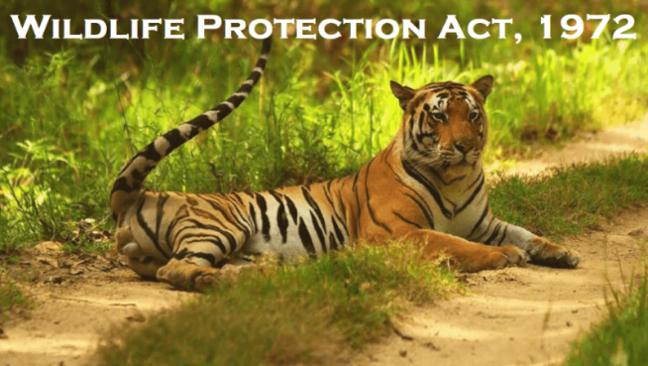
THE WILDLIFE (PROTECTION) ACT, 1972
An Act to provide for the protection of wild animals, birds and plants and for matters connected therewith or ancillary or incidental thereto with a view to ensuring the ecological and environmental security of the country
An Act of Parliament of India enacted on 09th Sept, 1972
It extends to the whole of India, except the State of Jammu and Kashmir
It has six schedules which give varying degree of protection

Slide 35
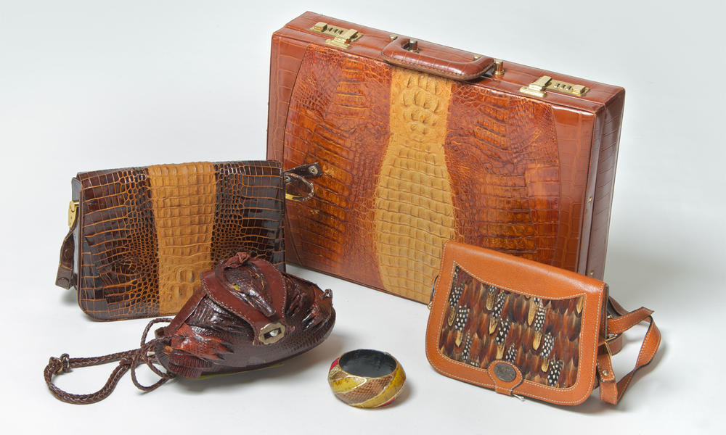
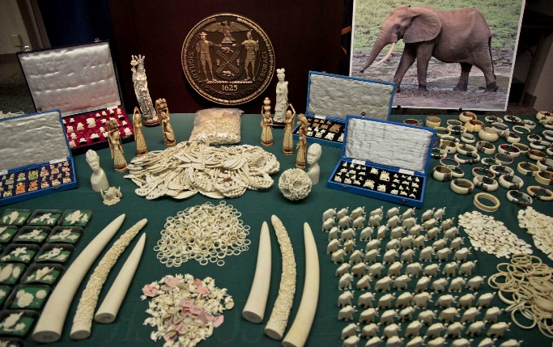
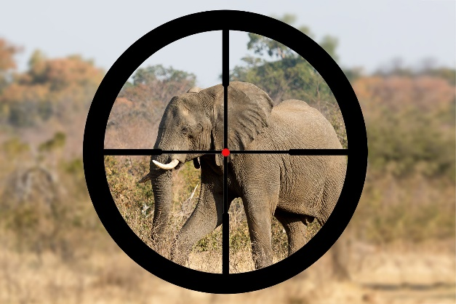
DEFINITIONS
“Animal” includes amphibians, birds, mammals and reptiles and their young, and also includes, in the cases of birds and reptiles, their eggs
“Animal article” means an article made from any captive animal or wild animal, other than vermin, and includes an article or object in which the whole or any part of such animal has been used, and ivory imported into India and an article made therefrom
“Hunting” includes killing, capturing, poisoning, trapping, injuring animal, birds or reptiles

Slide 36
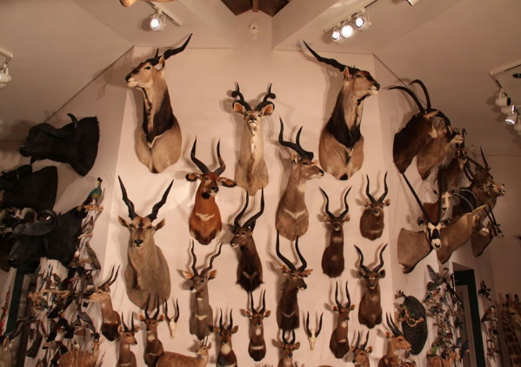
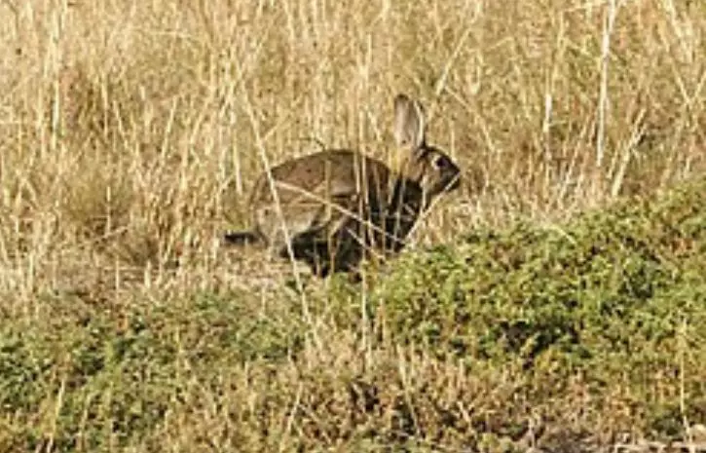
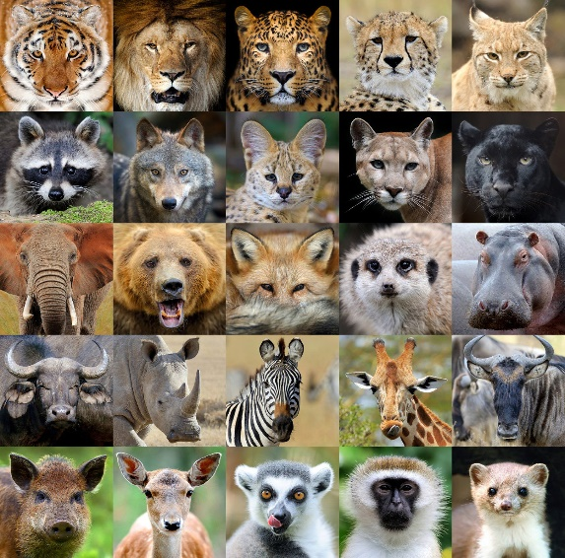
“Trophy” means the whole or any part of any captive animal or wild animal, other than vermin, which has been kept or preserved by any means, whether artificial or natural
“Taxidermy”, means the curing, preparation or preservation or mounting of trophies
“Vermin” means any wild animal specified in Schedule V
“Wild animal” means any animal specified in Schedules I to IV and found wild in nature
“Wild life” includes any animal, aquatic or land vegetation which forms part of any habitat;

Slide 37
AUTHORITIES TO BE APPOINTED OR CONSTITUTED UNDER THE ACT
The Central Govt may appoint
Director of Wildlife preservation
Assistant Directors of Wildlife Preservation
Such other officers and employees as may be necessary
The State Govt may appoint
Chief Wild Life Warden
Wild Life Wardens
One Honorary Wild Life Wardens
In each district
Such other officers and employees as may be necessary

Slide 38
WILDLIFE ADVISORY BOARD
National Board for Wild Life
The Prime Minister as Chairperson
The Minister in-charge of Forests and Wild Life as Vice-Chairperson
State Board for Wild Life
The Chief Minister of the State and in case of the UT, either Chief Minister or Administrator- Chairperson
The Minister in-charge of Forests and Wild Life - Vice-Chairperson

Slide 39
Duties of State Board for Wild Life
In the selection and management of areas to be declared as protected areas
In formulation of the policy for protection and conservation of the wild life and specified plants
In any matter relating to the amendment of any Schedule
In relation to the measures to be taken for harmonising the needs of the tribals and other dwellers of the forest with the protection and conservation of wild life
In any other matter connected with the protection of wild life, which may be referred to it by the State Government

Slide 40
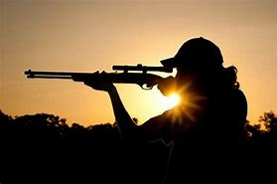
HUNTING OF WILD ANIMALS
Prohibition of hunting.—No person shall hunt any wild animal specified in Schedules I, II, III and IV except as provided under section 11 and section 12
Section 11. Hunting of wild animals to be permitted in certain cases
Any wild animal specified in Schedule I has become dangerous to human life or is so disabled or diseased as to be beyond recovery: Chief Wild Life Warden permit any person to hunt such animal or cause such animal to be hunted
The killing or wounding in good faith of any wild animal in defence of oneself or of any other person shall not be an offence
Any wild animal killed or wounded in defence of any person, shall be Government property

Slide 41
Section 12. Grant of permit for special purposes
Education
Scientific research, scientific management
Collection of specimens— for recognized zoos, museums and similar institutions
Derivation, collection or preparation of snake-venom for the manufacture of life-saving drugs

Slide 42
PROTECTION OF SPECIFIED PLANTS
Prohibition of picking, uprooting, etc. of specified plant
NO person shall
wilfully pick, uproot, damage, destroy, acquire or collect any specified plant from any forest land and any area specified, by notification, by the Central Government
posses, sell, offer for sale, or transfer by way of gift or otherwise, or transport any specified plant, whether alive or dead, or part or derivative
Grants of permit for special purposes
Education
Scientific research
Collection, preservation and display in a herbarium of any scientific institution
Propagation by a person or an institution approved by the Central Government in this regard.

Slide 43
SANCTUARIES, NATIONAL PARK, CLOSED AREAS
Declaration of area as sanctuary
any area comprised within any reserve forest or any part of the territorial waters, which is considered by the State Government to be of adequate ecological faunal floral geomorphological, natural or zoological significance for the purpose of protecting, propagating or developing wild life or its environment, is to be included in a sanctuary
No person shall destroy, exploit or remove any wild life including forest produce from a sanctuary or destroy or damage or divert the habitat of any wild animal by any act whatsoever or divert, stop or enhance the flow of water into or outside the sanctuary
The Chief Wild Life Warden shall be the authority who shall control, manage and maintain all sanctuaries

Slide 44
Declaration of National Parks
An area, whether within a sanctuary or not, is, by reason of its ecological, faunal, floral, geomorphological or zoological association or importance, needed to be constituted as a National Park for the purpose of protecting, propagating or developing wild life therein or its environment
Declaration of Closed areas
The State Government may, by notification, declare any area closed to hunting for such period as may be specified in the notification.
No hunting of any wild animal shall be permitted in a closed area during the period specified in the notification.

Slide 45
TRADE OR COMMERCE IN WILD ANIMALS, ANIMAL ARTICLE AND TROPHIES
No person shall:
a) Commence or carry on the business as:
Manufacturer, dealer, taxidermist of scheduled animal or animal articles or trophies or captive animals.
b) Dealer in meat derived from any schedule animal in eating- house

Slide 46
PENALTIES
Imprisonments varying from six months upto seven years and/or fine ranging from ₹ 500 upto not less than ₹ 10,000 depending on the nature or seriousness of the offence committed regarding the specified wildlife.
Forfeiture of Property Derived from Illegal Hunting and Trade or a fine equal to the market value of such property in lieu or forfeiture.

Slide 47
THE WILDLIFE TRANSACTION AND TAXIDERMY RULES 1973
come into force on the 9th April 1973
extend to the whole of the State of Bihar, Gujarat, Haryana, Himachal Pradesh, Madhya Pradesh and Uttar Pradesh
3. Acquiring, receiving, or keeping specified animal, etc. in control, custody, or possession or put under process of taxidermy or make articles, etc.,
No person shall
(i) acquire, receive, keep in his control, custody or possession , any specified animal or any animal articles, trophy, uncured trophy, or meat derived therefrom, or
(ii) put under a process of taxidermy or make animal articles containing part of whole of such animal, except with the previous permission of the officer.

Slide 48
4. Submission of report of stocks
Every licensee shall submit, report regarding the stocks of specified animal or animal article, trophy, uncured trophy, or meat, within a period of [thirty days] of the acquisition, receipt or keeping of the same in his control, custody or possession.
5. Sale of specified animal. etc.
No licensed dealer shall sell or offer for sale any specified animal or any animal article,
6. Taxidermy or making animal article
Every licensed taxidermist or licensed manufacturer shall, at the time of returning the trophy or animal article, issue a voucher to the owner of the said trophy or animal article.

Slide 49
Thank You

