Slide 1
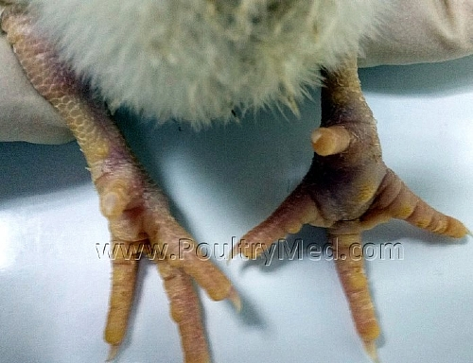
VIRAL ARTHRITIS IN POULTRY
TENOSYNOVITIS,
REOVIRAL ARTHRITIS
Dr. Ravi Shankar Kr Mandal
Assistant Professor
Veterinary Medicine
BVC, Patna

Slide 2
REOVIRAL ARTHRITIS
Inflammation affecting leg joints and/or tendons in poultry species that is attributable to reovirus infection
Acronym for “respiratory, enteric orphan,” since they were first isolated from these sites in humans with no apparent association with disease
First isolated in 1954 from the chicken respiratory tract and later in 1957 from a case of synovitis in chickens

Slide 3
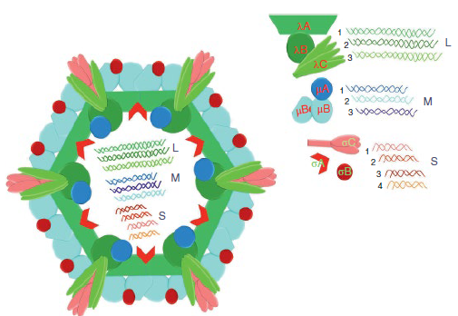
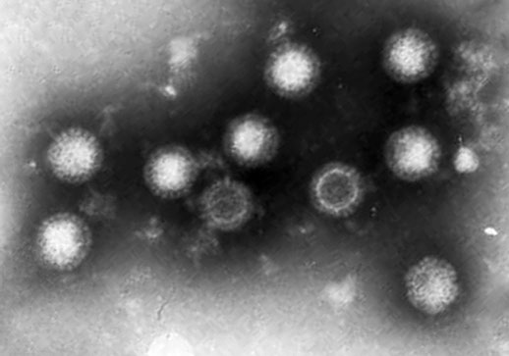
ETIOLOGY
Reoviruses belong to the family Reoviridae in the genus Orthoreovirus : nonenveloped, with a 10-segmented, ds RNA genome
Sigma C protein, encoded on the S1 gene, is located on the outer capsid of the virus and is responsible for cell attachment and induction of virus-neutralizing antibodies
target for diagnostic genotyping
Reoviruses are ubiquitous in commercial poultry worldwide
Frequently isolated from both healthy and diseased chickens

Slide 4
TRANSMISSION
Vertically and Horizontally
Birds <2 weeks of age are immune incompetent, and, unchecked viremia occurs in the absence of virus-specific maternal antibodies,
Transient viremia in older or mature birds
A transient viremia in a flock in egg production can result in vertical transmission of the virus, which can then spread horizontally among naïve, maternal antibody-negative offspring

Slide 5
PATHOENESIS
Ingestion
Intestinal epithelium
Viremia
Spread to multiple locations
Cellular infiltration and edema
Associated with a number of diseases in chickens including arthritis/tenosynovitis, runting‐stunting syndrome (RSS), hepatitis,pericarditis, myocarditis, hydropericardium, osteoporosis, malabsorption syndrome (MAS), immunosuppression, respiratory and enteric diseases as well as central nervous system disease

Slide 6
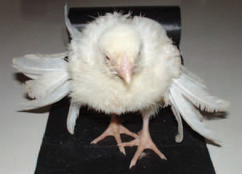
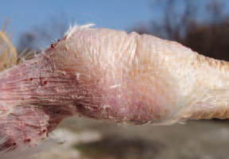
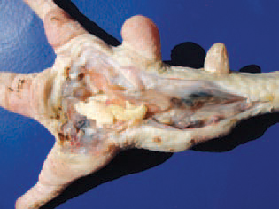
CLINICAL FINDINGS
The growing primary wing feathers are abnormally big for chickens with retarded growth, they protrude at various angles, so the disease is termed helicopter disease (malabsorption syndrome)
Swollen hock joints and enlargement in the area of the gastrocnemius or digital flexor tendons
Poor mobility, lameness, and retarded growth rates and may be recumbent close to drinkers
Tendon damage and subsequent fibrosis
Jumping motion can result in rupture of fibrotic tendons
Lameness usually appears at 4–5weeks of age

Slide 7
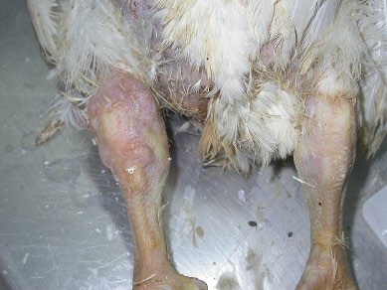
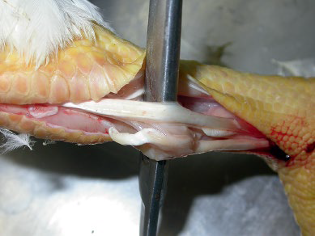
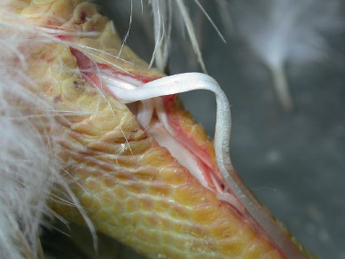
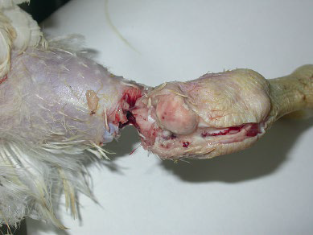
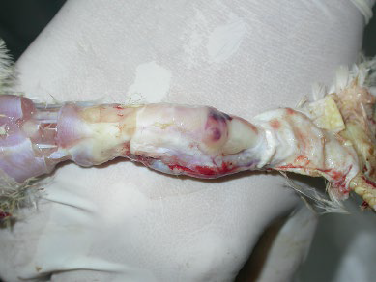
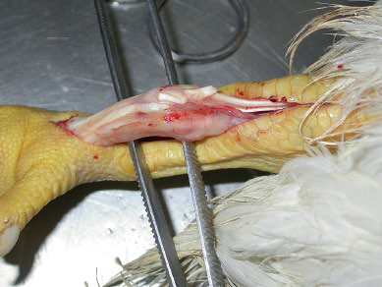
A
B
C
Swelling of the right hock joint
(B and C) fibrinotic exudation, adhesions, and hemorrhages hock joint
(A)tears, (B) looseness, and (C) separation of the Gastrocnemius tendons

Slide 8
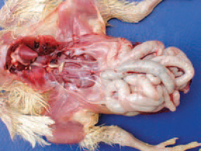
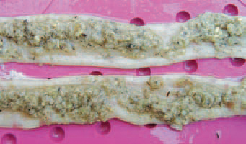
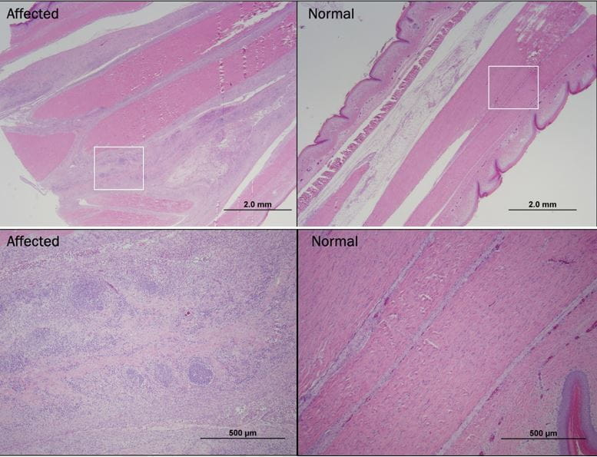
The small intestine is pale, dilated and contain indigested forage
Histologic lesion
Synovial cells are hypertrophied, hyperplastic, and infiltrated by lymphocytes and macrophages
The synovia and tendon sheaths contain lymphoid aggregates with heterophils and macrophages
Normal and affected tendons

Slide 9
DIAGNOSIS
On the basis of clinical signs and gross and histologic lesions
Virus Isolation
Isolation from hock joint tissues can be taken as an evidence of a causal relationship
Tissues of choice: hypotarsal sesamoid bone with the tendons that pass through it, synovial membrane, and articular cartilage.
Molecular Methods: RT‐PCR
Serology : ELISA

Slide 10
PREVENTION, TEATMENT and CONTROL
No treatment for infected birds once clinical signs of viral arthritis are apparent, other than general supportive care
Birds that are lame and unable to reach feed and/or water should be euthanized
Commercially available poultry vaccine strains for reovirus include S1133, 1733, 2408, and 2177
Vaccination prevents vertical transmission of virus and provided progeny with maternal antibody to prevent clinical disease

Slide 11
Thank You

