Slide 1
VETERINARY DISASTER MANAGEMENT
Dr. Ravi Shankar Kr Mandal
Assistant Professor
Veterinary Medicine
BVC, Patna

Slide 2
DISASTER
Impact of a natural or man-made event that negatively affects life, property, livelihood or industry often resulting in permanent changes to human societies, ecosystem and environment
A serious disruption of the functioning of a community or a society at any scale due to hazardous events interacting with conditions of exposure, vulnerability and capacity, leading to one or more of the following: human, material, economic and environmental losses and impacts
Natural disasters: avalanches, floods, earthquakes, and wildfires
Human-made disasters: oil spills, terrorist attacks, war, bomb blasts, chemical leaks and power outage

Slide 3
Their possibility of occurrence, time, place and severity of the strike can be reasonably and in some cases accurately predicted by technological and scientific methods.
Animals are silent victims of disaster
DISASTER MANAGEMENT
continuous and integrated multi-sectoral, multi-disciplinary process of planning and implementation of measures aimed at prevention and mitigation, preparedness, response and recovery in relation to natural and man-made disaster
India is one of the world's most disaster-prone countries due to climatic conditions as well as socio-economic susceptibility.
Disaster Management Act 2005: National Disaster Management Authority to implement a holistic and integrated approach to disaster management

Slide 4
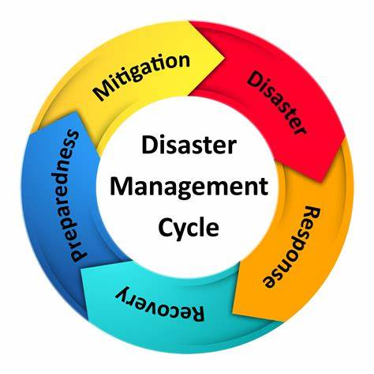
AIM
To reduce, or avoid, the potential losses from hazards, assure prompt and appropriate assistance to victims of disaster, and achieve rapid and effective recovery.
DISASTER MANAGEMENT CYCLE
(i) Disaster phase
(ii) Respose phase
(iii) Recovery/Rehabilitation phase
(iv) Risk reduction/Mitigation phase
(v) Preparedness phase

Slide 5
Response
Goal: Provide immediate assistance to save lives, protect property, and reduce health impacts.
Activities: These take place immediately before, during, or after a disaster to address urgent needs, such as:
Conducting search and rescue operations.
Providing emergency medical care.
Establishing shelters and food distribution points.
Restoring critical infrastructure like power and water supplies.
Examples: Rescuing people trapped in buildings after an earthquake, delivering food to affected areas, setting up temporary housing.

Slide 6
Recovery
Goal: Restore the community to normal or improved conditions.
Activities: Long-term efforts to restore and improve upon the pre-disaster condition, often leading to a return to stability and resilience:
Rebuilding infrastructure, homes, and businesses.
Offering financial and psychological support to affected populations.
Implementing measures to reduce vulnerability to future disasters.
Supporting economic recovery through grants and loans.
Examples: Reconstructing homes destroyed by a earthquake, providing financial aid to affected families, conducting community rehabilitation programs.

Slide 7
Mitigation
Goal: Reduce the risk and impact of potential disasters.
Activities: Implementing measures to prevent or lessen the impact of disasters before they happen. This may include:
Enforcing building codes and land-use planning.
Developing flood defenses or constructing dams.
Promoting public education on safety practices.
Implementing environmental policies to protect ecosystems that reduce disaster risks.
Examples: Building earthquake-resistant infrastructure, establishing buffer zones in flood-prone areas, conducting hazard assessments.

Slide 8
Preparedness
Goal: Prepare communities, resources, and personnel for disaster response.
Activities: Developing plans and systems to respond to disaster scenarios effectively. This can include:
Emergency response planning and simulation exercises.
Stockpiling essential resources like food, water, and medical supplies.
Establishing communication and evacuation plans.
Training personnel in emergency response skills.
Examples: Conducting fire drills, creating emergency kits, and organizing community awareness programs.

Slide 9
DISASTER MANAGEMENT PLAN FOR ANIMALS
Planning (short term and long terms) may have to be followed up by monitoring, impact assessment and evaluation.
Control rooms, temporary Veterinary hospitals, equipments and other infrastructure are important along with stockpile of equipments and drugs.
DISASTER PREPAREDNESS
Disaster preparedness as ideal facilities may not always be available as expected.
On the basis of the disaster experience one has to improve or modify the preparedness or establish one where it was not existent.
The objectives should be to
1. Minimize suffering, losses and damages,
2. Prevent any communicable disease
3. Reduce losses due to delay with prompt communication, improving and optimizing existing facilities, equipping support system
4. Assisting rehabilitation.

