Slide 1
Viral Diseases of Zoo and Wild animals
Department of Veterinary Medicine
Bihar Veterinary College, BASU, Patna
Dr Mritunjay Kumar
Associate Professor
VMD, BVC, BASU, Patna

Slide 2
Common Viral Diseases of Zoo and Wild animals
FMD
Rabies
Canine Distemper
Avian influenza
Measles (Rubela)
Infectious Canine hepatitis
Kyasanur forest disease (KFD)
Herpesvirus virus infection
Feline Pan leukopenia
Parvo virus infections
Feline Infectious Peritonitis
Pox virus

Slide 3
Foot and Mouth Disease (FMD)
Etiology
Aphtha virus belonging to family Picornaviridae
Positive sense single stranded RNA virus and is the smallest known virus of animal origin
Seven major serotypes viz O, A, C, Asia 1 and SAT 1, SAT 2 and SAT 3
Epidemiology
Affects all cloven footed artiodactyla
Pigs including wild boars are main source of infection
Unprocessed contaminated meat and meat products and contaminated feed, utensils may spread the virus
Morbidity rate is very high and many animals affected same time
Virus may survive for 1 year in infected premises

Slide 4
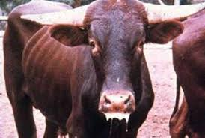
Clinical signs
Fever, profuse salivation, vesicular lesions in udder, vesicles in mouth and feet, sudden death in young animals
PM findings
Vesicular erosion/ ulcerative stomatitis, oesophagitis
Vesicle and erosion on feet and udder
Tiger heart appearance in young animals
Diagnosis
Clinical signs and symptoms
Virus isolation and typing and positive virus neutralization, ELISA, CFT, RT-PCR
Specimen Collection
Epithelial suspension, serum, fresh vesicular fluid/tissue in glycerine saline, formalin fixed specimen of oral mucosa

Slide 5
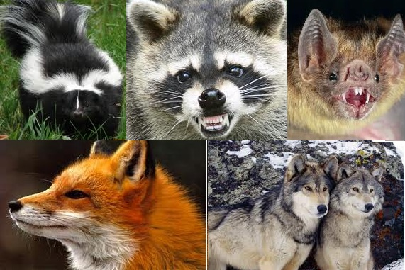
Rabies
Etiology
It is caused by lyssa virus a RNA of family Rhabdoviridae, enveloped virus with helical symmetry
It is one of the large viruses and it is relatively fragile as destroyed within few hours when exposed to sunlight
It is susceptible to most of the disinfectants like 70% alcohol, carbolic acid and iodine
Epidemiology
Affect all warm blooded animals all over the world except in Australia and New Zealand
Highly fatal and caused death to several free ranging and captive wild animals including large felids, bears, dears, rhinoceros, wild ass
Many wild animals act as vector of disease like vampire birds, foxes, skunks, mongoose, jackals
Transmission mainly occur by bite or licking of exposed area by infected animals

Slide 6
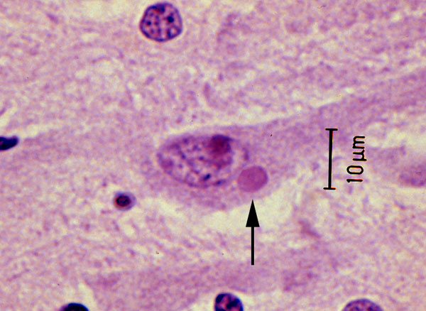
Clinical signs
a) Furious form- Anorexia, hiding to isolated dark corner, disobedience to command, involuntary defaecation/urination, sexual excitement, abnormal behaviour like jumping, roaring, bellowing, chewing, biting and dashing at the object, drooling of saliva, paralysis, death
b) Dumb form- Yawning, bellowing, roaring, barking, no excitement, inco-ordination, unable to chew or swallow, paralysis, coma ,death
PM examination: No gross lesions, non suppurative lesions may be seen
Specimen Collection:
One half of mid sagittally sectioned brain, cervical spinal cord and parotid salivary gland in 10% formal saline for histopathology
Other half of brain in 50% buffered glycerin saline for mice inoculation test, corneal smear and saliva for detection of viral antigen
Diagnosis
Positive fluorescence antibody test (FAT) –GST and Negri bodies in impression smear from brain (Pyramidal or purkinje cells)
Mice inoculation test
Dot ELISA and Immunohistochemical test
Fig.: Negri bodies (Roud/oval, .25 to 27 µm

Slide 7
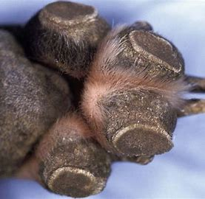
Canine Distemper
Etiology
It is caused by canine distemper virus (CDV) of genus morbillivirus, family Paramixoviridae
Epidemiology
Occurs mostly in unvaccinated young carnivores (fox, jackal, wolf, wild dog, hyena, mink, ferret) and also in tigers, snow leopard, jaguars, lions etc
Clinical signs
Biphasic fever, conjunctivitis, keratitis, photophobia, blindness, hyperkeratosis of foot pads, some times pustules on abdomen
Twitching of facial and limb muscles in CNS form
Fig. Hard Pad disease

Slide 8
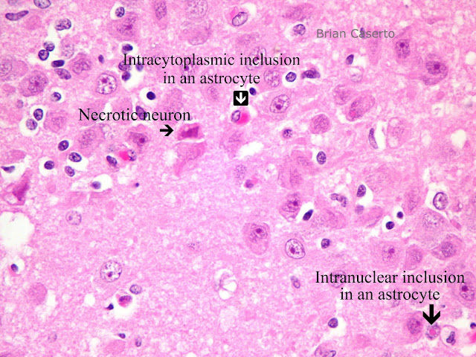
PM findings
Thymic atrophy (young pups), necrosis of lymphatic tissues, Bronchopneumonia, enteritis
Specimens collections
Impression smear from conjunctiva, buffy coat from peripheral blood and formalin fixed specimen of brain, spinal cord, lungs, stomach, intestine, urinary bladder tissues
Diagnosis
Isolation and identification of virus
Demonstration of intranuclear eosinophilic inclusions in respiratory, GI and urinary epithelium
Fig. Intranuclear inclusion in Racoon brain

Slide 9
Avian Influenza
Etiology
Avian influenza or Bird flue is a disease caused by infection with avian influenza type A virus of Orthomyxoviridae
Highly pathogenic avian influenza (HPAI) H5N1 in birds
N5H8 is highly fatal to wild birds and poultry
Epidemiology
Duck, geese, pheasants, partridge, psittacine, gulls, shorebirds, emu, eagles and many other species like felids including tiger
Pigs play vital role in the interspecies transmission and migratory wild birds specially water fowls are natural host and reservoir
Clinical signs
Mild and severe respiratory distress, ruffled feathers, depression, decreased feed and water intake in low pathogenic avian influenza (LPAI)
HPAI is characterized by respiratory signs, depression, sinusitis, watery diarrhoea, oedema of comb and wattle with cyanosis and haemorrhages, neurological signs and heavy mortality
Wild felids show sneezing, nasal discharge, malaise and pyrexia

Slide 10
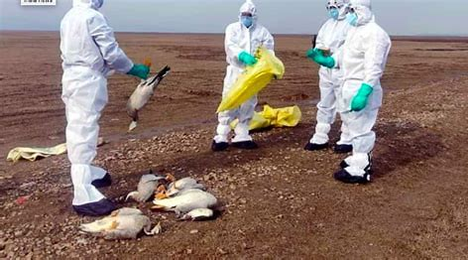
Differential Diagnosis
Botulism, Ranikhet, Pasteurellosis
Post Mortem findings
Haemorrhages in epicardium, pectoral muscle and proventriculus in poultry
Necrotic foci in pancreas, spleen and heart
Severe lung congestion with haemorrhages, pleural effusion and serosanguinous exudates in trachea and bronchiolar lumen are found in infected tiger
Sample collection
Cloacal and oropharyngeal swabs or fresh faeces in virus transport medium
Visceral organ stored at -80⁰C or fixed in 10% formalin
Diagnosis
Detection of virus by egg inoculation, virus isolation method and by RT-PCR
BSL- 3 Lab facilities is needed for diagnosis of virus

Slide 11
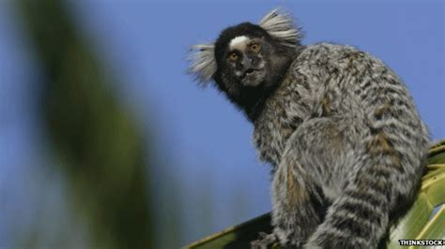
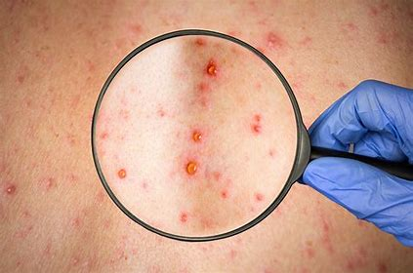
Miseales
Etiology
It is caused by measle virus of family paramixoviridae in human and non human primate.
Epidemiology
Measles is a highly contagious viral disease in nonhuman primates in which infections range from asymptomatic to rapidly fatal, resulting in significant morbidity and mortality in captive populations
This has been documented in marmosets, tamarins, owl monkeys etc. and is fatal to them
Clinical signs
Common marmosets with measles infection become clinically apparent with lethargy, facial edema, and nasal discharge and occasionally develop an exanthema
Death occurs 8–18 h after the onset of the first clinical signs.
PM findings
Necrotizing enterocolitis with hemorrhagic diarrhea
Control
Vaccination of infant rhesus monkeys and other macaques with human measles vaccine is recommended.

Slide 12
Infectious Canine hepatitis
Etiology
It is a viral disease caused by canine adenovirus (CAV-1) of adenoviridae family
CAV-1 is a relatively tough virus that is able to survive most disinfectants
Epidemiology
Dog, foxes, wolves and bears are commonly affected
Solitary cases of inclusion body hepatitis reported in panther
Clinical signs
Saddle back fever with leukopenia
Blue eye condition (Corneal opacity)
Increase blood clotting time and bleeding around deciduous teeth

Slide 13
Diagnosis
Signs of abrupt onset and prolonged bleeding
Gall bladder with thickened and oedematous wall and necrosis in liver
Paint brush haemorrhage in gastric mucosa, lymph nodes, pancreas and sub cutaneous tissues
Specimen for lab
Formalin fixed liver, kidney, lymph nodes and gastic mucosa
Live animals- Whole blood and serum
Virus isolation, immuno-flurescence test and presence of characteristics intra-nuclear inclusion in hepatocytes

Slide 14
Kyasanur forest disease (KFD) Kyasanur forest disease (KFD) is a tick-borne viral haemorrhagic fever endemic to South-western part of India
Etiology
KFD is Caused by Kyasanur Forest disease virus (KFDV), a member of the virus family Flaviviridae
Epidemiology
Hard ticks (Hemaphysalis spinigera) are the reservoir of KFD virus and once infected, remain so for life
Rodents, shrews, and monkeys are common hosts for KFDV after being bitten by an infected tick
Monkeys, predominantly, the black-faced langur (Presbytis entellus) and the red faced bonnet monkey (Macaca radiata) are susceptible to KFDV

Slide 15
Clinical signs
Incubation period of 3-8 days
The symptoms of KFD begin suddenly with chills, fever, and headache
Severe muscle pain with vomiting, gastrointestinal symptoms and bleeding problems may occur 3-4 days after initial symptom onset
Zoonotic importance
Gastrointestinal bleeding complication
Diagnosis
Molecular detection by PCR or virus isolation from blood
Serologic testing using enzyme-linked immunosorbent serologic assay (ELISA) in later stage

Slide 16
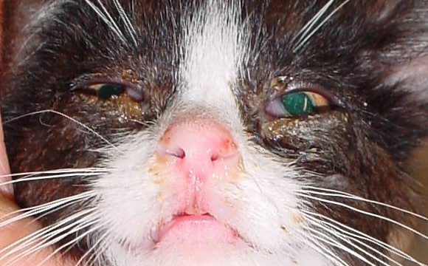
Herpes virus infections
Etiology
Herpes simplex virus type 1 (HSV-1) - oral herpes (affects the mouth and surrounding skin but can also affect the genital region)
Herpes simplex virus type 2 ( HSV-2)- typically causes genital herpes, usually sexually transmitted
Epidemiology
Herpes virus infections are documented in non-human primates, elephant calves etc
Rhesus macaques and cynomolgus (crab eating macaque) are considered as the primary natural hosts
Clinical signs
Lesions in non-human primates are mostly confined to the mucosa of buccal cavity
Ulcers or vesicles do occur around the lips and external nares and the most common site is the tongue
All macaques are considered to be potential shedders of Cercopithecine (Old world monkey family) herpesvirus type 1 (Herpesvirus simiae B virus)
The infection is generally subclinical or mild (conjunctivitis or oral vesicles) in Macaca spp but usually causes a fatal encephalitis and encephalomyelitis in people

Slide 17
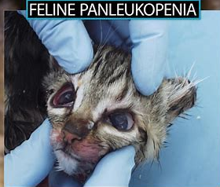
Feline Panleukopenia/Feline Distemper
It is a highly contagious and life-threatening viral disease in the cat population and characterized by severe dehydration, vomiting, diarrhoea, fever and leukopenia.
Etiology
Feline parvovirus (FPVis closely related to mink enteritis virus and the type 2 canine parvoviruses (CPV) that cause canine parvoviral enteritis
All are now designated as members of the species Carnivore proto-parvovirus 1
Epidemiology
FPV can cause disease in all felids and in some members of related families (eg, raccoon, mink), but it does not harm canids
Clinical signs
Per-acute: Sudden death
Acute: Biphasic fever, leukopenia, vomiting, diarrhoea and terminally hyperthermia and death

Slide 18
PM findings
No specific lesions, dehydration, dark tarry coloured blood
Hyperaemic gastric and intestinal mucosa
Necrotic ulcer in ileum and colon
Specimen for lab
Heparnised whole blood, pieces of intestine, bone marrow and lymph nodes in 10% formalin saline or 50% glycerine saline and on dry ice separately
Faecal or rectal swab for virus isolation
Diagnosis
Isolation of virus and demonstration of characteristic inclusion body in intestinal epithelial cell and histiocytes
Kits for Feline panleukopenia antibody detection are available

Slide 19
Parvo virus infection
Etiology
Several antigenically and genetically very closely related viruses causes
Feline pan-leukopenia virus (FPV)
Canine parvovirus(CPV-2) along with its antigenic types CPV-2a and CPV-2b
Mink enteritis virus(MEV)
Blue fox parvovirus (BFPV)
Rac-coon parvovirus (RPV) and
Raccoon dog parvovirus (RDPV), are grouped informally within the feline parvovirus subgroup

Slide 20
Epidemiology
Ingestion of the virus from the environment or by preying on an infected animal
Environmental contamination is usually due to viruses that have been shed 4-10 days after infection
Parvoviruses are very hardy and can survive for months in cool, moist conditions protected from sunlight and remain viable when frozen
Clinical signs
Lethargy, depression, and inappetence about four or five days after exposure followed by fever, vomiting, and diarrhea
Feces may range from soft to liquid consistency but are typically foul-smelling and may contain mucous or blood

Slide 21
Diagnosis
The virus can be detected in feces by ELISA tests or by virus isolation in tissue culture
Identification of lesions within the intestines, brain and spinal cord, or lymph tissue during necropsy
Canine Parovirus antigen rapid test kit

Slide 22
Feline infectious Peritonitis
Feline infectious peritonitis (FIP) is a viral-induced, immune-mediated disease with high fatality rates, affecting domesticated cats and some wild felids globally
Etiology
Feline infectious peritonitis (FIP) is an immune-mediated disease triggered by infection with a feline coronavirus (FCoV)
FCoV belongs to the family Coronaviridae, a group of enveloped, positive-stranded RNA viruses frequently found in cats
Epidemiology
FCoV infection and FIP occur worldwide with similar prevalence and are found in domestic and wild cats.

Slide 23
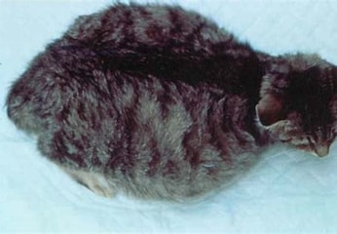
Clinical signs
Diarrhea and/or vomiting due to replication of FCoV in enterocytes
FIP were distinguished
1) An effusive, exudative, “wet form” : Fibrinous peritonitis, pleuritis, and/or pericarditis with effusion in the abdomen, thorax, and/or pericardium
2) A non-effusive, non-exudative, granulomatous, parenchymatous “dry form”; Granulomatous changes in different organs that may include the eyes and CNS
3) A mixed form
Diagnosis
Peritoneal fluid analysis: The protein content is very high (>3.5 g/dL), consistent with an exudate, whereas the cellular content is low (<5,000 nucleated cells/mL), resembling a modified transudate
Cerebrospinal Fluid: Increased protein (50–350 mg/dL with a normal value of <25 mg/dL) and pleocytosis (100–10,000 nucleated cells/mL)
PCR has been used to detect FCoV in fecal samples
Immunostaining of Feline Coronavirus Antigen

Slide 24
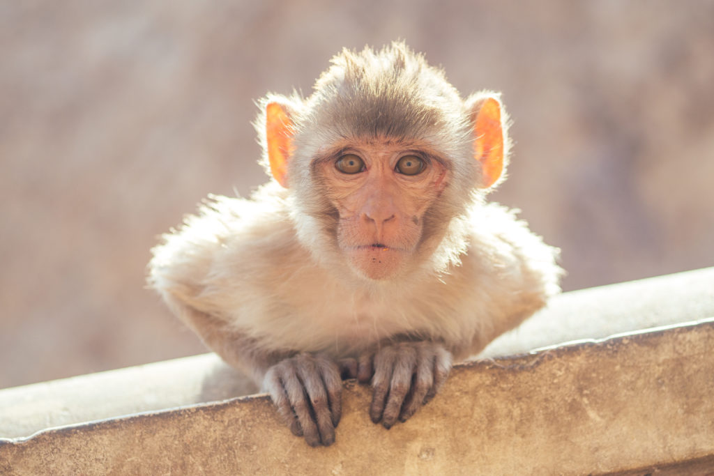
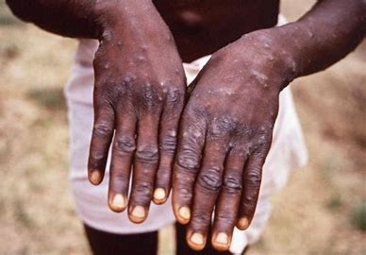
Monkey Pox (Mpox)
Mpox is a disease of zoonotic importance
Etiology
Mpox is caused by mpox virus which is a type of orthopoxvirus of poxviridae. This group of viruses also includes cowpox and smallpox.
Epidemiology
Evidence of monkeypox virus infection has been found in animals including squirrels, Gambian pouched rats, dormice, different species of monkeys, human and others
It can be transmitted through contact with bodily fluids, lesions on the skin or on internal mucosal surfaces
Clinical signs
Common symptoms of mpox in human are a skin rash or mucosal lesions which can last 2–4 weeks accompanied by fever, headache, muscle aches, back pain, low energy, and swollen lymph nodes
Signs and symptoms in animals are not clear and they may act as reservoir
Diagnosis
Detection of DNA by PCR

