Slide 1
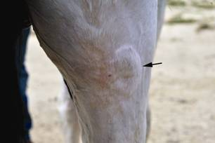
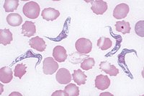
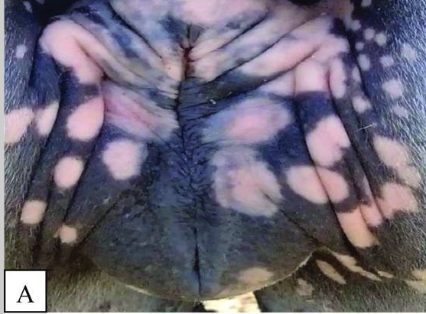
THE DOURINE ACT 1910
Dr. Ravi Shankar Kr Mandal
Assistant Professor
Veterinary Medicine
BVC, Patna

Slide 2
THE DOURINE ACT, 1910
An Act to provide for the prevention of the spread of Dourine.
Enacted 25th February, 1910
1. Short title and extent
extends to the whole of India except the territories which, immediately before the 1st November, 1956, were comprised in Part B States
3Registration of horses
Registration of entire horses maintained for breeding purposes
4. Appointment of inspectors and veterinary practitioners
5Powers of inspector
(a) enter and search any building, field or other place for the purpose of ascertaining whether there is therein any horse which is affected with dourine
(b) prohibit, by order in writing, from using such horse for breeding purposes,
(c) direct, by order in writing, the owner or keeper of any horse which, is affected with dourine to remove it
6Duties of inspector
An inspector issuing an order, shall forthwith forward a copy of such order to the veterinary practitioner

Slide 3
7Inspection of horses
A veterinary practitioner, as soon as possible after receipt of such copy, examine the horse mentioned therein, and may for such purpose enter any building, field or other place.
8Powers of veterinary practitioner
A veterinary practitioner may
(a) cancel any order issued under section 5
(b) if on microscopical examination (or by other scientific test) he finds that any horse is affected with dourine,
(i) in the case of an entire horse- it to be castrated
(ii) in the case of a mare- it to be destroyed

Slide 4
9Compensation for horse destroyed
the market-value of such horse immediately before it became affected with dourine shall be ascertained; and the State Government shall pay as compensation to the owner thereof
10Settlement of compensation
A veterinary practitioner may award, as compensation to be paid under section 9 in respect of each horse castrated or destroyed under section 8, a sum not exceeding two hundred and fifty rupees.
If, exceeds two hundred and fifty rupees, veterinary practitioner shall report accordingly to the Collector, who shall decide the amount to be so paid.
11Committees for hearing appeals.
12Appeals
Any owner may, within two months from the date of a decision under section 10, appeal against such decision to the committee
Decision of such committee shall be final.

Slide 5
13Vexatious entries and searches
Shall be punishable with imprisonment for a term which may extend to six months, or with fine which may extend to five hundred rupees, or with both.
15Penalties
In the case of a first conviction, to fifty rupees, or, in the case of a second or subsequent conviction, to one hundred rupees
16Protection to persons acting under Act
No suit, prosecution or other legal proceeding shall lie against any person for anything which is, in good faith, done or intended to be done under this Act.

Slide 6
Thank You

