Slide 1
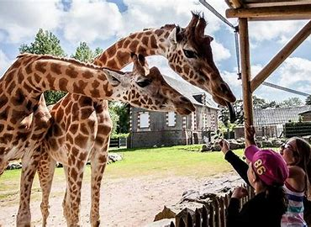
PUBLIC HEALTH PROBLEM ARISING FROM ZOO
Dr Mritunjay Kumar Associate Professor BVC,BASU, Patna

Slide 2
Public health problem arising from zoo are mostly zoonotic diseases
World Health Organization (WHO): Any disease or infection that is naturally transmissible from vertebrate animals to humans or from humans to animals is classified as a zoonosis
Among the human pathogens, about 61% are zoonotic in nature
60% of the emerging human infections are zoonotic in nature and among these pathogens more than 70% originated from wildlife species

Slide 3
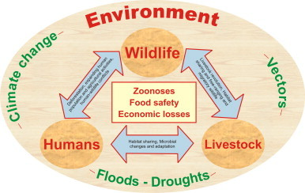
Factors influence the emergence or re-emergence of wildlife/Zoo related zoonoses
Expanding human population
Climate change
Movements of vectors and animal host species
Microbial changes and adaptation

Slide 4
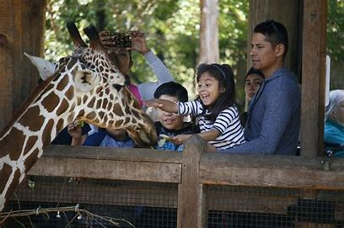
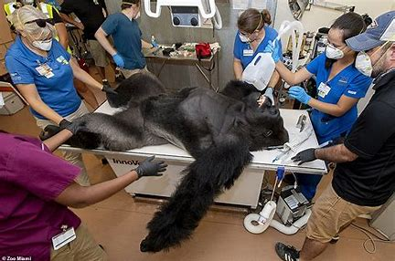
People at risk of health problem from Zoo
Visitors
Workers and employees
Veterinarians
People with weakened immune system
Older people
Children (Below 5 years)
Pregnant women

Slide 5
Based on etiology, zoonoses are classified as
1. Bacterial zoonoses (anthrax, salmonellosis, tuberculosis, Lyme disease, brucellosis, and plague)
2. Viral zoonoses (rabies, acquired immune deficiency syndrome- AIDS, Ebola, and avian influenza)
3. Parasitic zoonoses (trichinosis, toxoplasmosis, trematodosis, giardiasis, malaria, and echinococcosis)
4. Fungal zoonoses (ring worm)
5. Rickettsial zoonoses (Q-fever)
6. Chlamydial zoonoses (psittacosis)
7. Mycoplasma zoonoses (Mycoplasma pneumoniae infection)
8. Protozoal zoonoses (Toxoplasmosis) and
9. Diseases caused by acellular non-viral pathogenic agents (such as transmissible spongiform encephalopathies or mad cow disease)

Slide 6
Rabies
Etiology
Lyssa viruses of Rhabdovirus family
Mode of Transmission
Via introduction of virus laden saliva into tissues usually by the bite of rabid animals
Wild animals
Raccoons, bats, skunks and foxes, but any mammal can be infected with rabies
Clinical signs
a) Furious form: Attacking behaviour
b) Paralytic/Dumb form: Animal appear tame and no fear of human, excessive wobbly, circling, paralysis

Slide 7
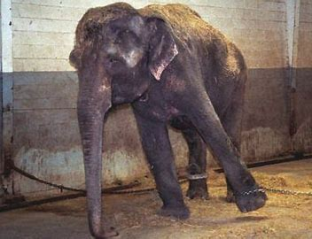
TUBERCULOSIS
Etiology
Mycobacterium tuberculosis
Clinical signs
Chronic cough, sputum production, appetite loss, weight loss, fever, night sweats and hemoptysis
Mode of Transmission
Aerosol
Wild Animals: Asian elephants, Psittacine birds, non- primate human (Bison, wild boar, African buffalo, European badgers, Rhinoceroses,Tapirs etc

Slide 8
Anthrax
Etiology
Bacillus anthracis
Clinical signs
Fever and neck swelling occur,
Sore throat, dysphagia, respiratory distress, and oral bleeding
Mode of Transmission
Wound inoculation, ingestion or inhalation of spores
.Wild Animals:
Rhinocerous, Zebra, Deer, Hippopotamuses,

Slide 9
LEPTOSPIROSIS
Etiology
Pathogenic serovars of Leptospira spp.
Clinical signs
First phase (with fever, chills, headache, muscle aches, vomiting, or diarrhea
Second phase kidney or liver failure or meningitis
Mode of Transmission
Direct contact
Wild animals: Rodents, White-tailed deer, Raccoons, foxes, Skunks, and California sea lions

Slide 10
Q-fever
Etiology
Coxiella burnetii
Clinical signs
Most cases are clinically
asymptomatic or mild
characterized by a nonproductive cough, fever, and minimal auscultatory abnormalities
Mode of Transmission
Ixodid ticks ( reservoir host )
Inhalation, Ingestion or direct contact with birth fluid or placenta
Wild animals: Canine, Feline, Ruminants, Rodents, Reptiles and Amphibians

Slide 11
Psittacosis
Etiology
Chlamydia psittaci
Clinical signs
Respiratory distress, varies from flu-like symptoms (Fever, chills, headache, malaises ) to systemic disease
Mode of Transmission
Aerosols
Wild animals
Parrot family birds

Slide 12
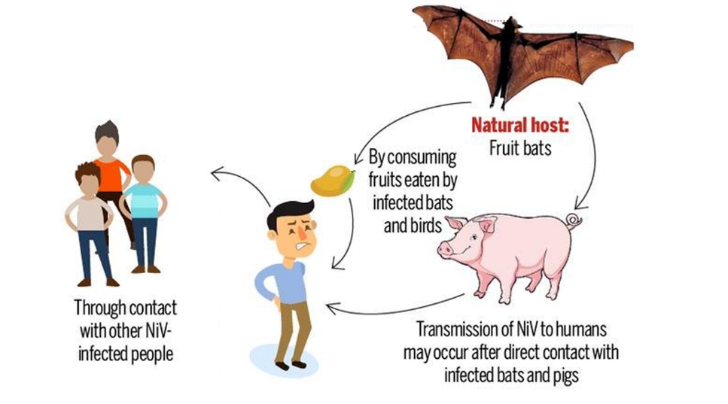
NIPAH VIRUS
Etiology
Nipah virus (Genus- Henipavirus, Family- Paramyxoviridae)
Clinical signs
Fever with encephalitis, death
Mode of Transmission
Direct contact
Wild animals
Fruit Bats act as reservoir host
Others - Pigs
Human

Slide 13
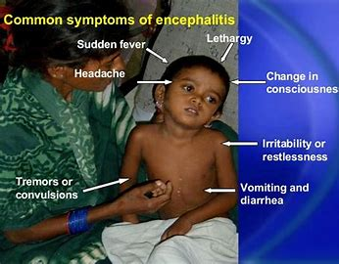
HERPES B ENCEPHALITIS
Etiology
Herpes B virus
Clinical signs
Seizures, hemiparesis or hemiplegia, progressive ascending paralysis
Mode of Transmission
monkey bites, monkey scratches, or cage scratches; direct contamination of a pre-existing wound
Wild animals
Owl monkeys, gibbons, capuchins, tree shrews

Slide 14
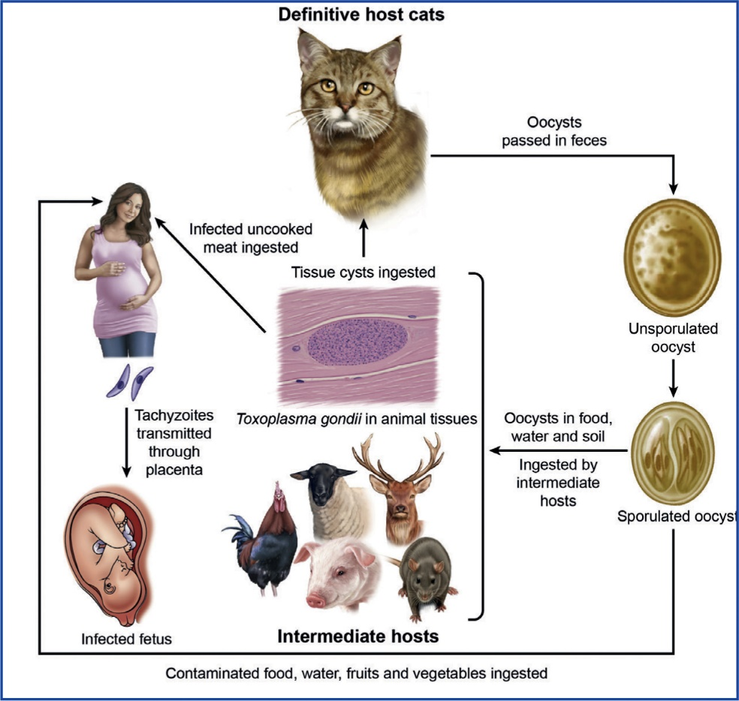
TOXOPLASMOSIS
Etiology
Toxoplasma gondii
Clinical signs
Cervical lymphadenopathy
Fever, night sweats
Mode of Transmission
Oral route
Wild animals
Feline, New world monkeys, meerkats, lemurs, and macropodids (Kangaroos)

Slide 15
Kyasanur Forest Disease (KFD)
Etiology
Flaviviridae family
Clinical signs
High fever with frontal headaches, chills, Severe muscle pain with vomiting, gastrointestinal symptoms and bleeding problems
Mode of Transmission
Bite of infected hard ticks
Wild animals
Monkey, porcupines, rats, squirrels, mice, and shrews

Slide 16
Guideline to be adopted to decrease health risk to human personnel’s in Zoo
New animals should be properly screened for disease, before they are added to the zoo
Proper restraint technique, either physical or chemical should be employed to prevent animal bites
Protective clothing that can be cleaned or disposed of after use
Personnel hygiene, including washing hands before eating, should be strictly enforced

Slide 17
Good sanitation and ventilation greatly decrease the rate of disease transmission
Vaccinations of zoo keepers for measles, polio, rabies, mumps, tetanus
Zoos should not receive or transport any animals that are in bad condition
Proper quarantine measures should be carried out
Proper report of zoonotic disease is essential

Slide 18
Multiple choice questions
Q.1. Percent of emerging zoonotic pathogens of human originating from wild animals
> 70% b) < 70% c) 50% d) 30%
Q.2. Factors influence the emergence or re-emergence of wildlife/Zoo related zoonoses
a) Expanding human population & climate change
b) Movements of vectors and animal host species
c) Microbial changes and adaptation
d) All of these
Q.3. People at risk of health problem from Zoo
Visitors b) Workers and employees c) Veterinarians
d) All of these

Slide 19
Q. 4. Which of the following is not a zoonotic disease
Rabies b) Q- fever c) Tuberculosis d) None of these
Q.5. KFD is transmitted by
a) Rat b) Tick c) Cattle d) None of these

Slide 20
Thanks

