Slide 1
Vitamins
Dr. Dharmendra Kumar
Associate Professor
Department of Animal Nutrition, Bihar Veterinary College,
Bihar Animal Sciences University, Patna, Bihar, India

Slide 2
Vitamins ----?
Organic compounds present in food, required in tiny amounts for essential metabolic reactions in a living organism.
Vitamines derived from ‘vital amines’ (contained amino nitrogen) was coined by Funk.(1912)
Each vitamin has its unique chemical properties on which biological activities depends.
Absence or deficiency of vitamins causes deficiency disorders.
Scurvy by lemon juice. Cod liver oil-rickets.
Brown rice grain not polished grain- beri beri
Not building blocks or energy yielding.
Mediators of biohemical pathways and failure of metabolic pathway.
In general vitamins cannot be synthesized by animals and hence must be taken from diet
except Vit D, Nicotinic acid (from tryptophan).
Derived from plants except Vit B12.
Vit B12 synthesized from certain microorganisms only (not any plant or animal cell)
Ruminal vitamin synthesis confirmed → A.I. Virtanen and R. R. Oltjen on purified diet method.

Slide 3
Metabolic essential and Dietary essential Vitamins
Some Vitamins are metabolic essential but not dietary essential due to synthesis in body.
Vit B12: not dietary essential in Ruminant if Co provided in diet
due to microbial synthesis in Rumen.
Vit C: Only dietary essential in Humans and guinea pig.
But metabolic needs are similar in most animals.

Slide 4
Classification
Fat-soluble vitamins include vitamin A, D, E and K.
Water-soluble vitamins include vitamin B complex group and vitamin C.
Vitamin | Synonym | Vitamin | Synonym
Vitamin A | Retinol, Retinal, Retinoic Acid | Vitamin B1 | Thiamin
Vitamin D2 | Ergocalciferol | Vitamin B2 | Riboflavin
Vitamin D3 | Cholecalciferol | Vitamin B3 | Niacin
Vitamin E | Tocopherol, tocotrienols | Vitamin B5 | Pantothenic acid
Vitamin K1 | Phylloquinone | Vitamin B6 | Pyridoxine, Pyridoxal, Pyridoxamine
Vitamin C | Ascorbic acid | Vitamin B8 | Biotin, Vitamin H
 |  | Vitamin B9 | Folic acid, Folate, Vitamin M,
 |  | Vitamin B12 | Cyancobalamine, APF
 |  | Choline

Slide 5
Difference between Fat Soluble and water soluble Vitamins
Si. No. | Fat Soluble | Water Soluble
1 | Extractable from foods with fat solvents | Extractable from foods with water
2 | Primarily excreted in feces via the bile | Excreted in urine
3 | Excess Vit A and D are toxic | Relatively non toxic except hyper-vitaminosis Niacin & B6.
4 | Consist only of C,H,O | Some vitamins also contain nitrogen , sulfur or cobalt S--Thiamin (vitamin B-1) and biotin (vitamin H) Co, P- Cyanocobalamin----- N- Vit B
5 | Absorbed by passive diffusion through the lipid phase of mucosal cell membrane | Some vitamin absorbed by active process when diet contains low levels of vitamin.
6 |  | Ring compounds except Pantothenic acid
7 | Pro-vitamin to vitamin | Vit B- function in the form of Coenzyme or prosthetic group of enzymes. Vit C- as reducing agent
8 | Synthesis: Vitamin K by symbiotic microorganisms Vitamin D in Skin | Niacin from Tryptophan except in cat Vit C: except human and guinea pigs Vit B12 in Rumen
9 | Stored in body in appreciable amount | Not stored, except Vit B12 stored in liver.

Slide 6
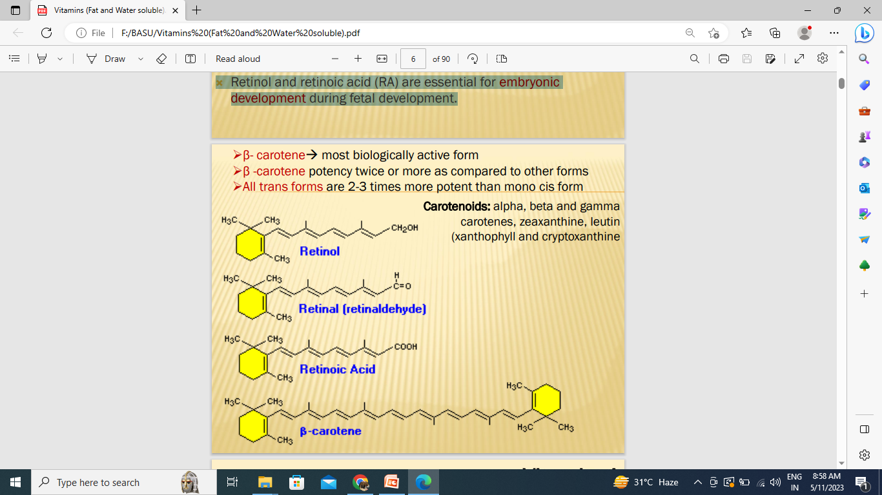
Vitamin A
Does not exist as such in plants, but exist as precursors/ provitamin (carotenoids)
Body transform it into active vitamin.
Discovered by McCollum and Davis in 1913.

Slide 7
Provitamins
Vit A does not exist as such in plants, but present as precursor or provitamins in the form of certain carotenoids.
β carotene is the main source of Vit A of farm animals.
Green plant tissues contain 90% β-carotene and 10% gama Carotene.
Conversion to Vit A ( Oxidative scission) in two stages
1) intestinal mucosa by dioxygenase (majority)
2) Liver by retinol reductase (NADPH or NADH as electron donor)

Slide 8
β-carotene:
One molecule of β-carotene can be converted into two molecules of retinol (theoretically).
But biologically gives rise to one molecule only.
Highest efficiency is seen in chicken and rat.
Factor affecting disturbing the GIT integrity also affect this conversion efficiency.
Buffalo good convertor, while cow is poor convertor (that’s why cow milk possess yellowish appearance).
Horse and cattle have considerable level of β-carotene in blood and rest is stored in liver and adipose tissue.
Absorption efficiency of β-carotene is 1/3 of intake, while vitamin A absorbed almost completely.
β-carotene found in cellular membrane function as an antioxidant.

Slide 9
One IU of Vitamin A = 0.3 µg retinol.
In general, 1 mg β carotene = 1667 IU of vitamin A.
One IU of Vitamin D = 0.025 µg cholecalciferol
In cat and mink carotene is not utilized.
Vit E and Synthetic antioxidants : enhancing bioavailability of Vit A
By Protecting the integrity of Vitamin A in the gut.

Slide 10
General Functions
1) Vision: Synthesis of the visual pigment Rhodopsin
2) Maintenance of mucus secreting cells of epithelia:
Synthesis of glycoprotein to maintain integrity of epithelial cells
3) Bone growth: In bone formation synthesis of mucopolysacharides .
Retinol and retinoic acid (RA) are essential for embryonic development.

Slide 11
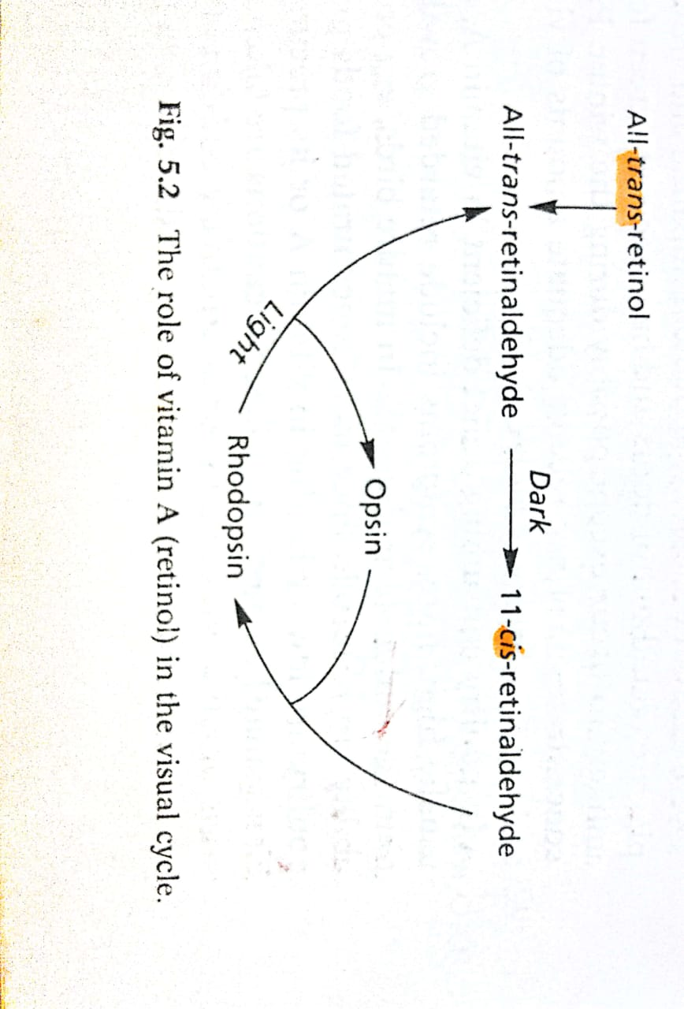
1. Vitamin A: role in vision
Oxidized
Excess retinol is esterified to form a retinyl ester, which can be stored.
When needed, retinyl esters are broken apart to form 11- cis retinol, which can be oxidized to form 11-cis retinal
Notes:
In retinal cells of eye vit A (retinol) oxidized to the aldehyde (all- trans- retinaldehyde) which is converted into the 11-cis isomer in the dark.
11- cis retinaldehyde combine with protein opsin to form rhodopsin (visual purple) which is photoreceptor ( present in rods) for vision in low light intensity.
When light falls on retina cis- retinaldehyde molecule back converted into all- trans forms and release opsin.
Retinol is transported to the retina via the circulation, where it moves into retinal pigment epithelial cells.
There, retinol is esterified to form a retinyl ester, which can be stored. When needed, retinyl esters are broken apart to form 11- cis retinol, which can be oxidized to form 11-cis retinal.
11-cis Retinal can be shuttled to the rod cell, where it binds to a protein called opsin to form the visual pigment, rhodopsin (visual purple)."

Slide 12
Rhodopsin synthesis – Visual cycle ………
Rod cells with rhodopsin can detect very small amounts of light,
making them important for night vision.
Once released all-trans retinal is converted to all-trans retinol, which can be transported to the
retinal epithelial cell to complete the visual cycle.
Inadequate retinol available to the retina results in impaired dark adaptation,
known as "night blindness."

Slide 13
2. Bone growth:
Control the activity of Osteoclast and osteoblasts of epithelial cartilage.
Blindness occurs due to narrowing of the bone canal through which optic nerve passes.
Changes in bone growth rise in cerebrospinal fluid pressure.
3. Maintenance of mucus secreting cells of epithelium:
Basal cells form columnar mucus secreting epithelium in presence of Vit A.
Anti-infective vitamin:
Maintenance of mucus secreting cells of the epithelia:
Basal cells Keratinized in the absence of Vit. A
Keratinization lower the resistance of epithelium
Reproduction: Regulate Ovarian steroid production.
influence the establishment and maintenance of pregnancy.
Through its antioxidant properties it may protect the ovarian cells from damage by free radicals.

Slide 14
Vitamin A: deficiency
Night blindness:
Xerophthalmia (dry eye): Severe or prolonged deficiency result in corneal opacity,
keratinization of the cornea, corneal ulcers, scarring, and blindness.
Some times vitamin A deficiency can lead to obstruction of lacrimal ducts due to degenerated epithelial cells leading to decreased out put of tears.
Bitot's spots: Mild deficiency may result in abnormal changes in the conjunctiva (corner of the eye)
Congenital Blindness : constriction of optic nerve.

Slide 15
Vitamin A: deficiency
Keratinization of epithelium: Infections. Diarrhoea, kidney and bladder stone.
Blood level uric acid increases from 5mg to as high as 40mg/100ml blood.
Nutritional roup in poultry:
Nasal and ocular discharge (mucopurulent rhinitis) causes Occlusion of respiratory tract
Early symptoms include retarded growth, weakness, ruffled plumage and a staggering gait.
Copious lacrimation in in cows and horses.
Reproductive performance:
Decrease no. and motility of spermatozoa
Disturbed estrus, abortion
Egg production and hatchability are reduced. high mortality rate.
Nervous lesions: Increased CSF pressure. Due to less skeletal but more nervous growth.

Slide 16
Supplementation
Animal source: Oils from livers of certain fish (Cod and Halibut), egg yolk, milk fat,butter.
Plant source: All green leaves are rich in provitamin A, β -carotene. Yellow maize. Carrots.
Colostrum :10-100 times more vitamin A, 3 times more vitamin D than normal milk
In addition Vit A some species require β carotene.
Ovaries of bovine species are contain high concentration of β carotene during luteal phase
Retinoic acid in poultry carries out all the functions of vitamin A
except vision and reproduction.
Chicks fed retinoic acid as vitamin A, became blind;
hatched eggs were also devoid of vit A having malformed embryos.
Mycotoxin infested feed reduce the absorption of carotenoids and increases their requirement.
Vitamin A: Supplementation

Slide 17
Vitamin A: Toxicity
Toxicity:
The condition caused by vitamin A toxicity is called hypervitaminosis A.
Symptoms include nausea, headache, fatigue, loss of appetite, dizziness, and dry skin.
Bone abnormalities, increased spinal fluid pressure.
Formation of new bone at the ventral aspect of the cervical vertebrae in a 3 year old cat (exostoses)
Requirement :
Growing Cattle :80 IU/ kg body weight
Adult dairy cow (Dry/ lactating) : 110 IU/ kg body weight
Poultry
Broiler : 20,000 IU / kg feed
Layer : 5,000 IU / kg feed
Piglet :500 – 1000 IU / kg feed
Pig : 2000 – 3000 IU / kg feed

Slide 18
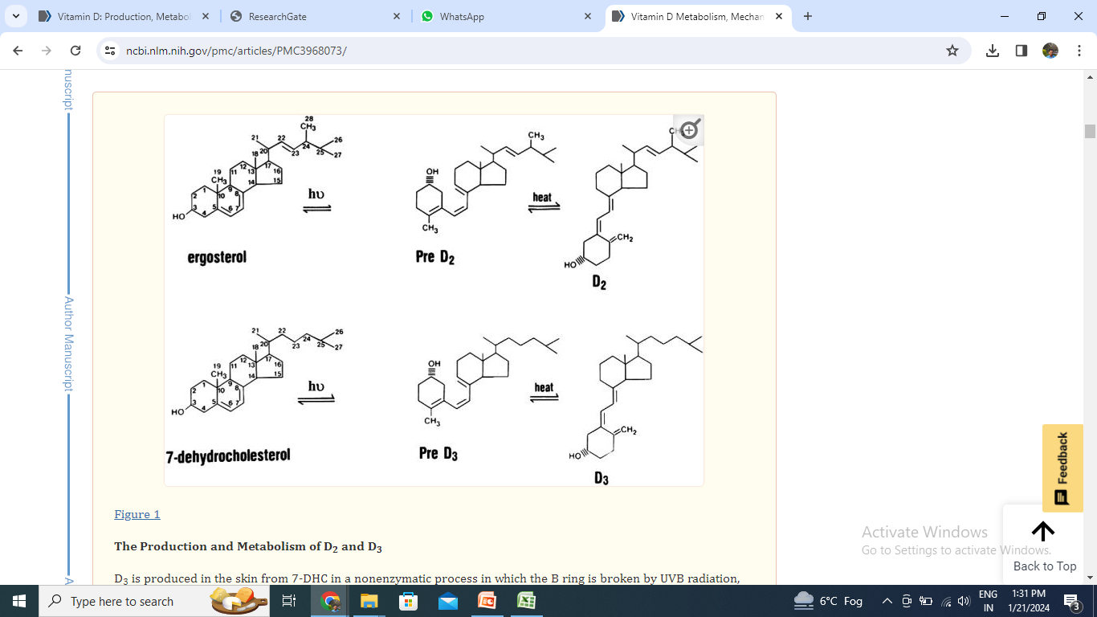
Vitamin D
1922- McCollum named the new substance as vitamin D
Provitamin Ergosterol of plant and 7-dehydrocholesterol
Two most important form of Vit D
i) Ergocalciferol (D2) and
ii) cholecalciferol (D3)
Sunshine Vitamin, antirachitic factor
1919-Sir Edward Mellanby was able to experimentally produce rickets in puppies by feeding synthetic diets
He further showed that rickets could be prevented by the addition of cod- liver oil or butterfat to the feed.

Slide 19
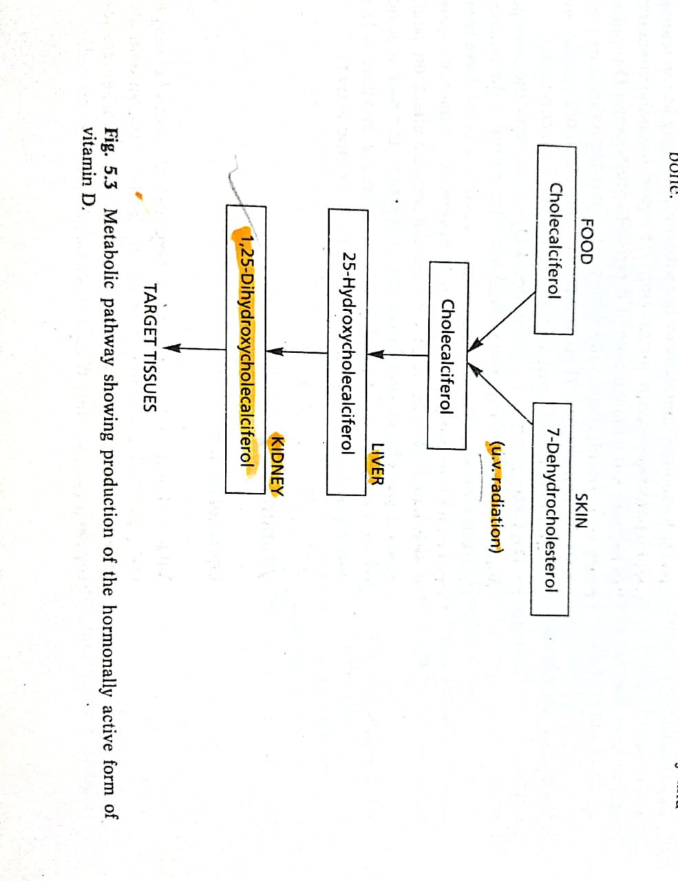
Precursors / Provitamin
Provitamin Ergosterol (plants) – Vit D2
Provitamin 7-dehydrocholesterol (skin)- Vit D3
If irradiation for prolonged period then vitamin altered to toxic compound.
Absorption of the vitamin can take place from the skin so deficiency treated by rubbing cod liver oil into the skin
IU Vit D= 0.025 µg
UV light causes scissoring of B ring of
7-dehydrocholesterol to from Vit D3
Vit D absorb in lower half of SI
PTH control the activity of Kidney

Slide 20
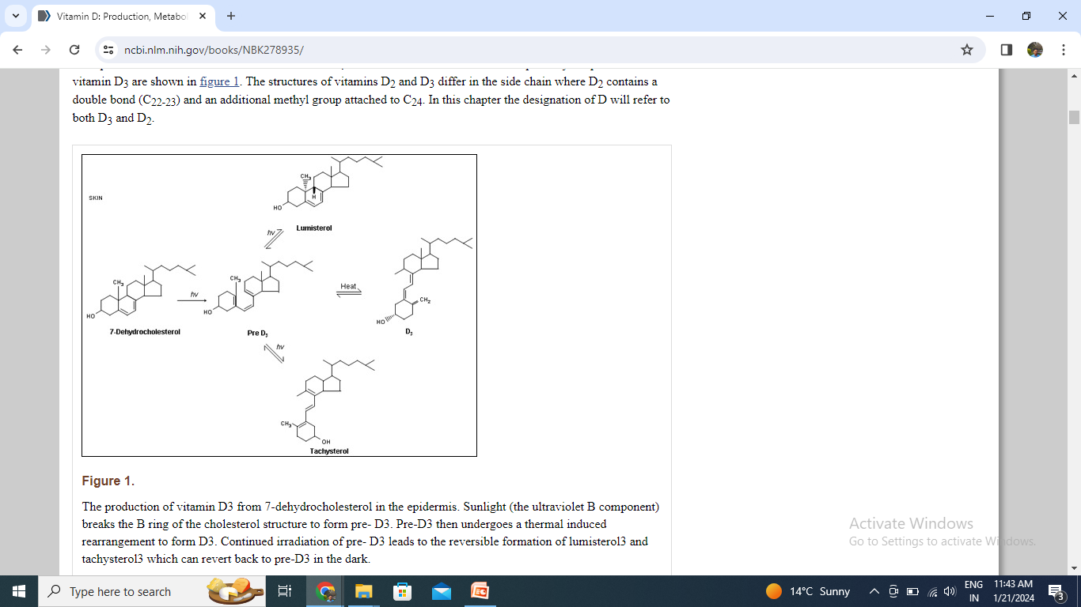
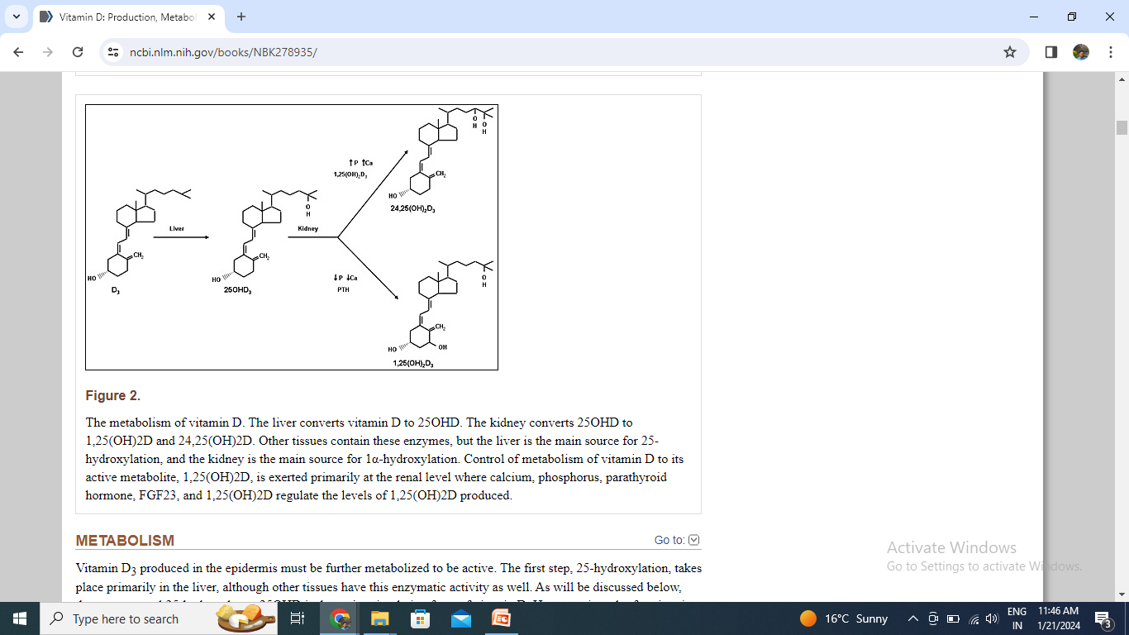

Slide 21
Role of Vitamin D
Active form of Vitamin D₃ (1-25, DHCC) --- synthesis of messenger RNA which -----
Stimulates the synthesis of calcium binding protein (CBP).
CBP involved in Absorption of calcium from intestine. Also P transport. Mobilisation of bone Ca & P induced by PTH dependent upon +nce of Vitamin D.
Homeostasis
↓ plasma Ca →↑ PTH →→ →1,25-(OH)2 D3 in kidney
1,25-(OH)2 D3 increases intestinal Ca & P absorption
Also Ca & P are mobilised from bone,
Reabsorption from kidney.
Overall picture, hypocalcaemic signal will increase plasma Ca, while P level will remain constant.
PTH causes P diuresis (↓ P reabsorption from kidney)
The potency of D₂ and D₃ are same for cattle, sheep and pig
In poultry, the potency of D₂ is 1/10th w.r.t. D₃, as catabolic breakdown of D₂ is much faster in chickens.

Slide 22
Vit D are water insoluble but
Vit D present in milk is water soluble due to sulphate derivative of Vit D.
D3 is more stable than D2
D2 and D3 are more resistant to oxidation than Vit. A
Dietary requirements of vitamin D are not essential for the animal, who get an exposure to Sun for a couple of hours.
Sources:
Sundried roughages
Dead leaves of growing plants
Halibut liver and cod liver oils are rich source of Vit D3
Egg yolk is good source but cow milk is normally a poor source.
Summer milk is richer than winter milk
Colostrum contain 3 time more than ordinary milk.
Vitamin D requirement for adult dairy cows: 30 IU / kg BW.
Vit. D req. in chicken are expressed as international chick units (ICU)
1 ICU = 0.025 μg of vitamin D₃.

Slide 23
Vitamin D: Toxicity
Vitamin D toxicity (hypervitaminosis D) induces abnormally high serum calcium levels (hypercalcemia), which could result in
bone loss,
kidney stones, and
calcification of organs like the heart and kidneys if untreated over a long period of time

Slide 24
Vitamin D: Deficiency
Rickets: young
Ca and P deposition in bones is affected
and the bones are weak, more prone to fractures and deformities.
Commonly seen are bowing of legs, swollen knees and hock and arching of back.
Occasionally there is paralysis.
Rickety Rosary – enlargement of Osteochondral junction in ribs are also noticed Osteomalacia : Adult
Resorption of calcium and phosphorus from the bone.
Bones become weak, more prone to fractures and deformities.
It can occur in pregnant and lactating animals, which require increased amount of calcium and phosphorus.
Rubbery legs in poultry
In poultry bones and beak become soft and rubbery; legs become weak.
Egg production is reduced and shoft shelled eggs.

Slide 25
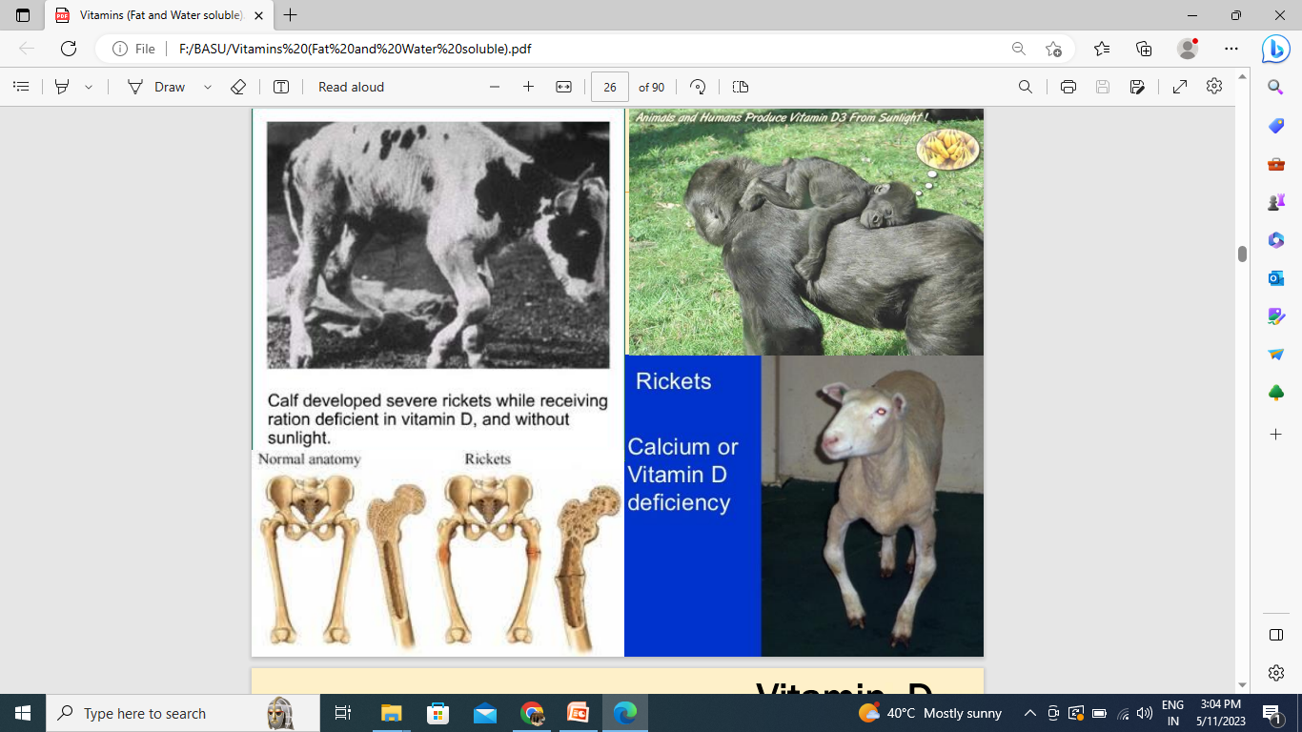

Slide 26
Vitamin D: Deficiency
Deficiency
Deficiency rare in animals and humans that spend considerable time in direct
sunlight.
Malabsorption of vitamin may occur due to a disease k/a steatorrhoea and conditions
with insufficient bile secretions
In severe hepatic and renal disorders body will not be able to convert vitamin D to
their biologically active form.
Vitamin D3 is more efficient (above 30 times) as compared to D2 for preventing
rickets in poultry.
Vit. D 3 resembles somewhat to that of hormones:
Chemical structure and mechanism of action resembles Steroid hormones.
Very small quantities (ng) sufficient for full biological activity.
Can be synthsized in one of the organ and transported via blood to target cells intestine and bones.
Toxic in in excessive amounts.

Slide 27
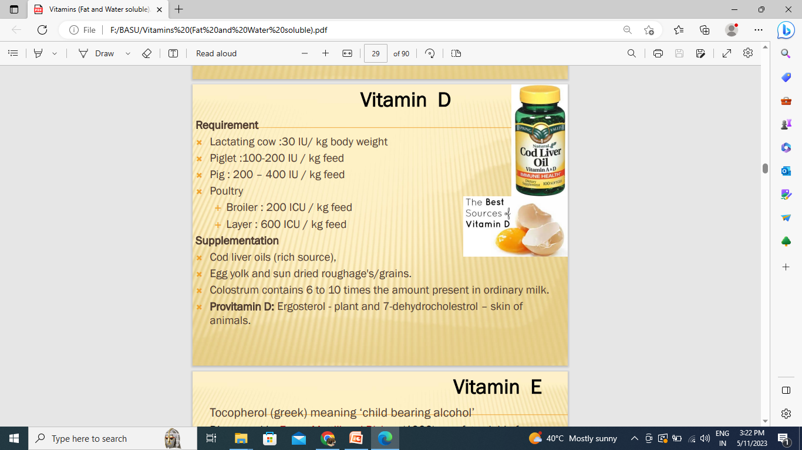
Vitamin D
Requirement
Lactating cow :30 IU/ kg body weight
Piglet :100-200 IU / kg feed
Pig : 200 – 400 IU / kg feed
Poultry
Broiler : 200 ICU / kg feed
Layer : 600 ICU / kg feed
Supplementation
Cod liver oils (rich source),
Egg yolk and sun dried roughage's/grains.
Colostrum contains 6 to 10 times the amount present in ordinary milk.
Provitamin D: Ergosterol - plant and 7-dehydrocholestrol – skin of animals.

Slide 28
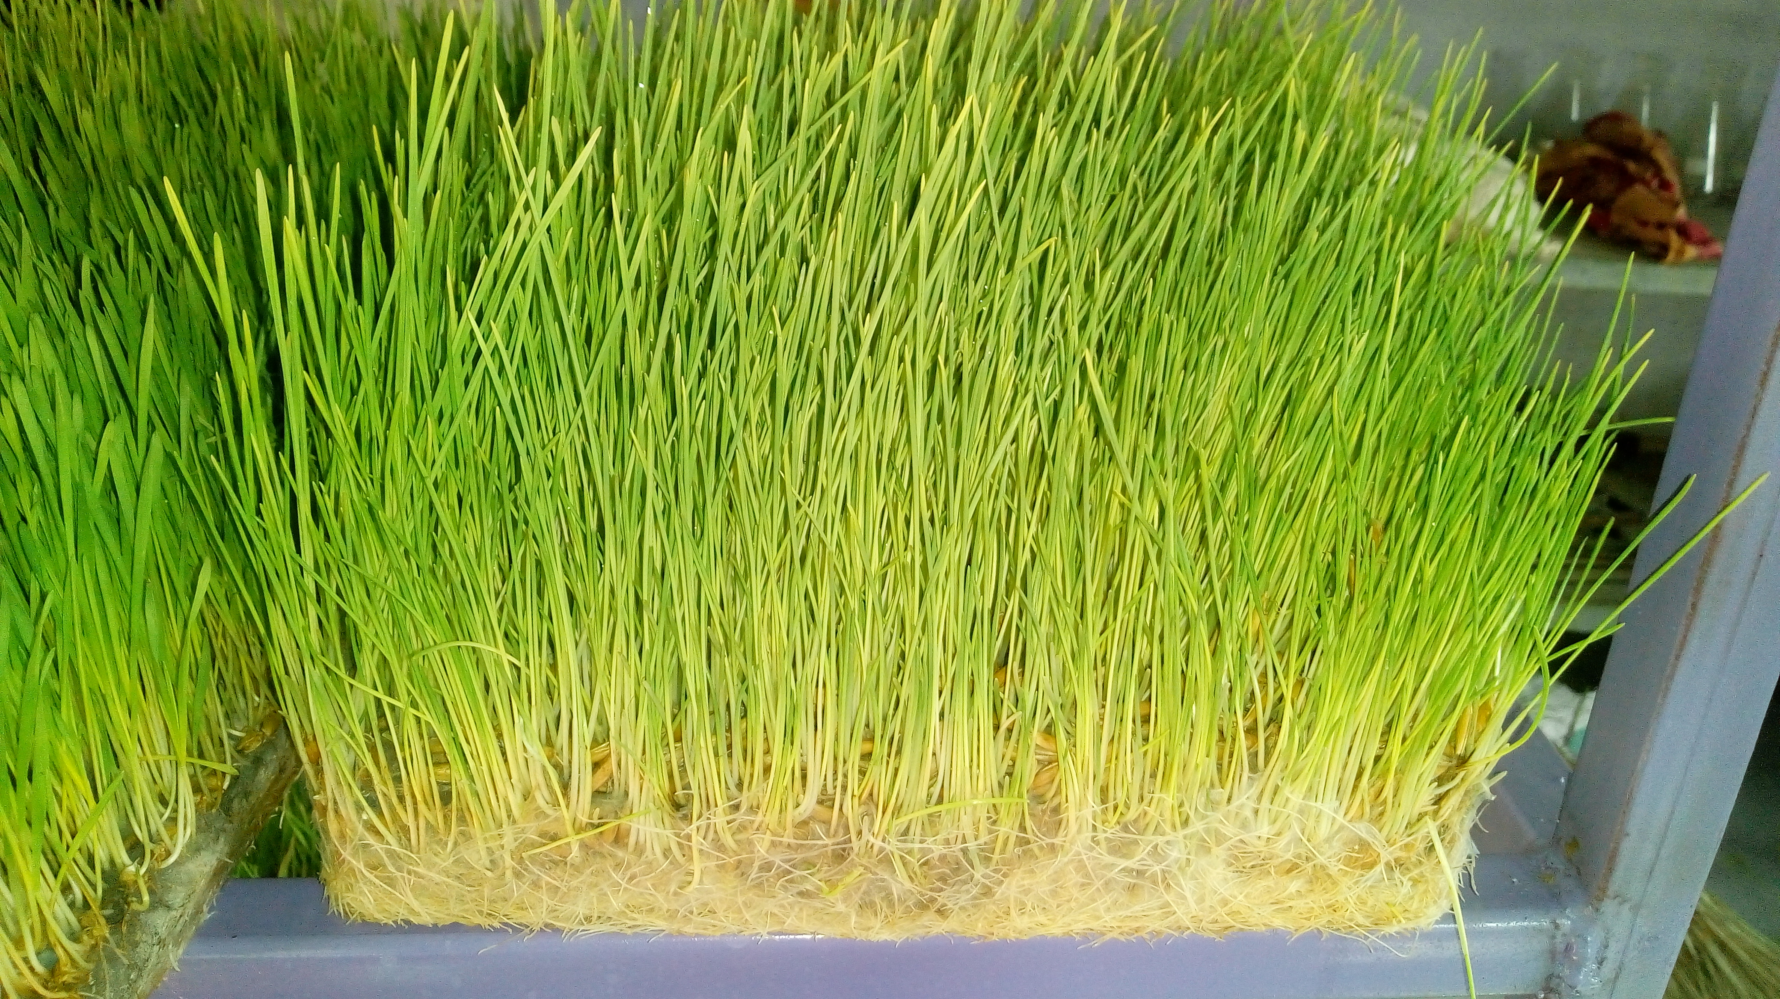
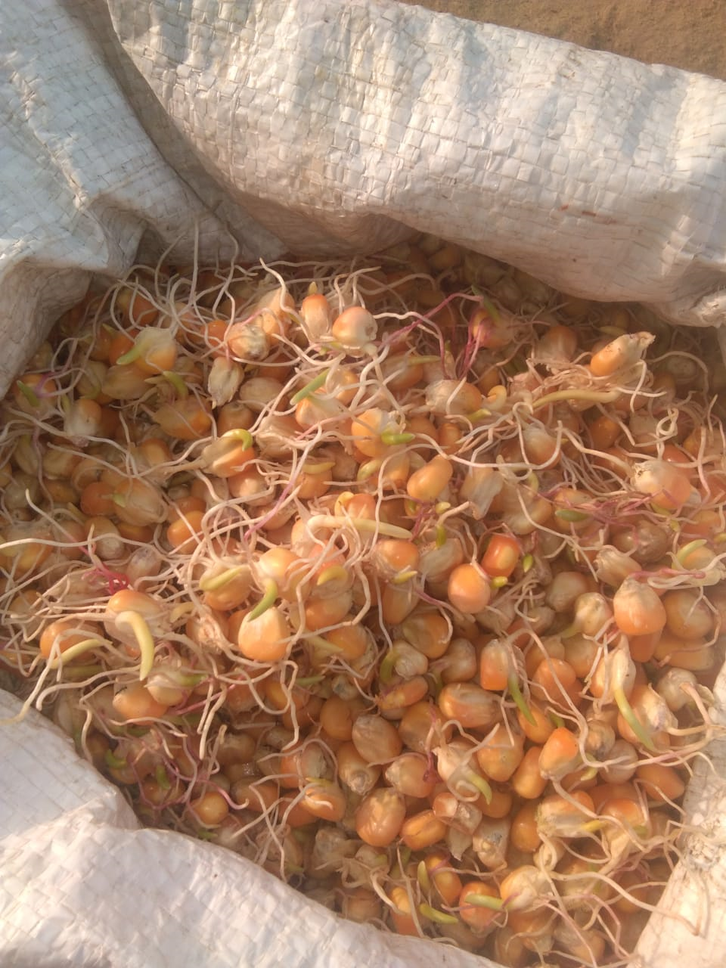
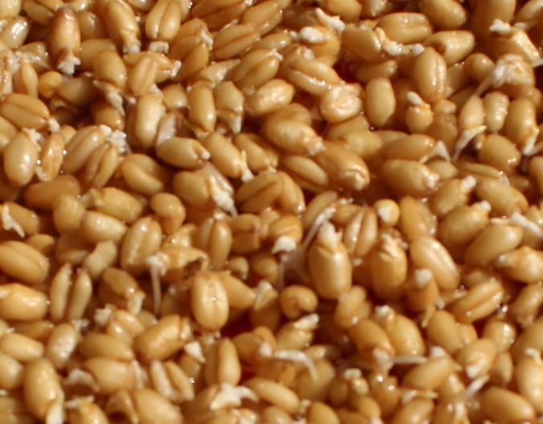
Vitamin E
Tocopherol (greek) meaning ‘child bearing alcohol’
Eight naturally form of vitamins E i.e tocopherols and tocotrienols (α, β, γ and δ)
α-tocopherol→ most potent among all
Unlike Vit A, not stored in animal body in large amount so regular dietary source is important.
Sources:
Green fodders, Young grasses being a better source than mature herbage.
Leaves contain 20-30 times as much vitamin E as the stem.
Artificial drying losses is low.
Germinated seeds
Cereal grains: Wheat and barley grain resemble grass in containig α –tocopherol.
Maize contains in addition to α –tocopherol, appreciable quantities of γ –tocopherol.
Animal products are relatively poor source.
Discovered by Evans Mattill and Bishop (1922) as a fat soluble factor
1936 isolated as α-tocopherol

Slide 29
Vitamin E
*Free radicals are Super oxide O2*^{- and} hydroxyl OH* formed during cellular metabolism and, as they are capable of damaging cell membranes, enzymes and cell nuclear material.
Role:
i) Biological antioxidant
In association with the selenium-containing enzyme glutathione peroxidase,
it protects cells against oxidative damage caused by free radicals*.
Vit E scavenging the free radicals and
Glutathione peroxidase causes destruction of peroxides.
Ii) It protects carotenoides and Vit A from oxidation.
iii) Preventing oxidation of polyunsaturated fatty acids
iv) Development and function of immune system.
v) Aid in absorption and utilization of vitamin A, carotene.
vi) Helps extend the storage of Vit A in the liver.
Metabolism of sulphur aminoacids., Vit A and Selenium.
Vit E donates hydrogen atom to the free radicals to form stable molecule.
Oxidation of unsaturated fatty acids produces hydroperoxides*
Notes:
The animal has two main methods of protecting itself against oxidative damage. Firstly, radicals are scavenged by vitamin E as a first line of defence and secondly, glutathione peroxidase destroys any peroxide formed before they can damage the cell.

Slide 30
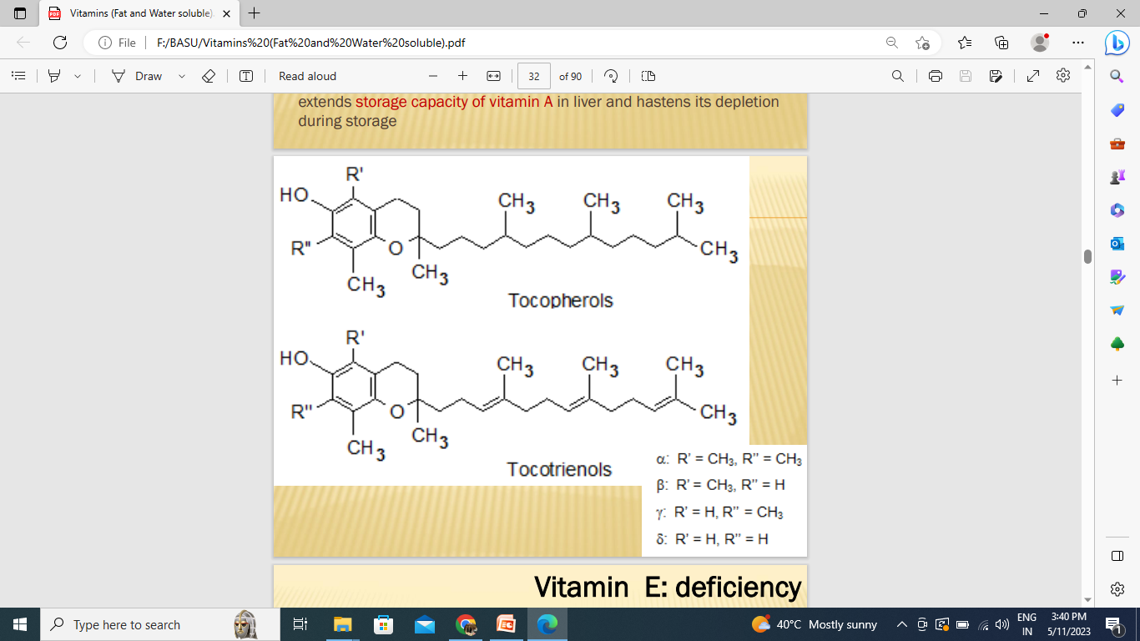

Slide 31
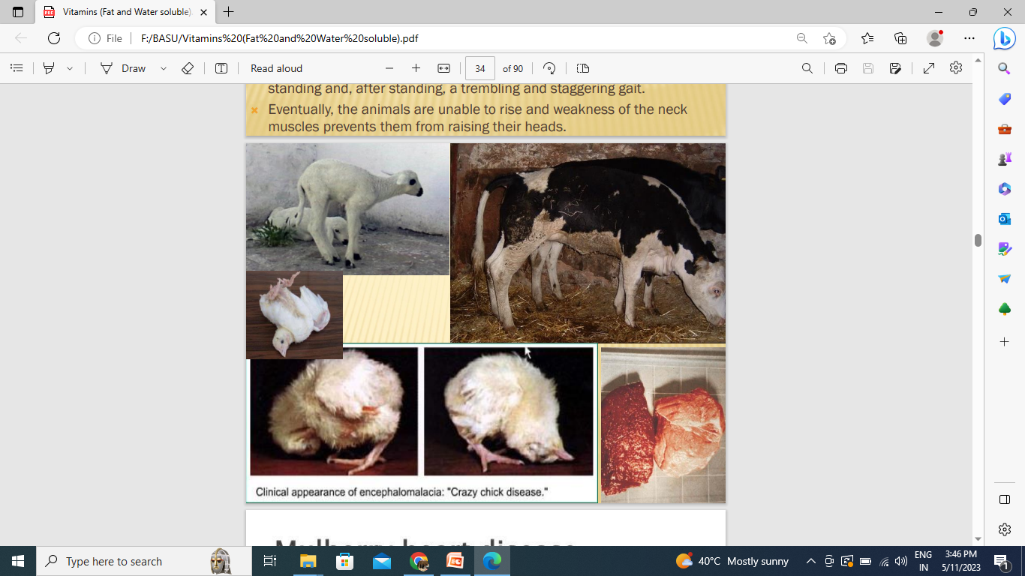
Vitamin E: Deficierncy
Nutritional myopathy / white muscle disease / stiff lamb disease /
Nutritional myopathy (nutritional muscular dystrophy), in young ones particularly calves
affecting skeletal muscles and occasionally heart muscle.
In spring pasture in young grass having high concentration of PUFAs and low intake of Vit E and
selenium.
Requirement of Vit E increases with increase of PUFA in diet.
In pig called mulberry heart disease.
Infertility is the classical manifestation in females (antisterility vitamin) Also causes immobility of
spermatozoa and degeneration of germinal epithelium.
Antioxidant properties protecting Arachidonic acid and
maintaining the functional integrity of the reproductive organs.

Slide 32
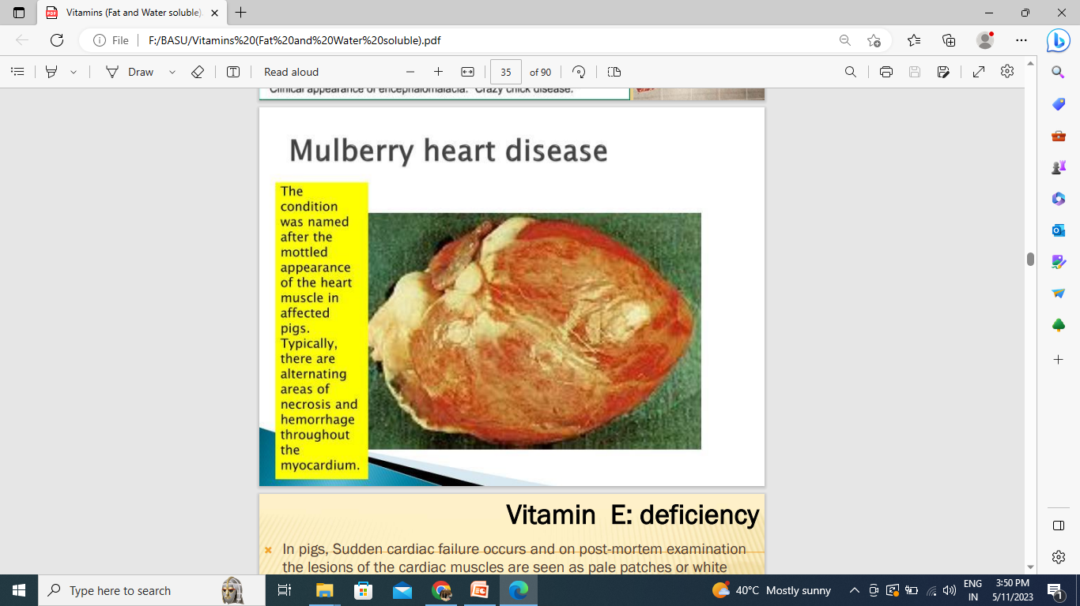

Slide 33
Vitamin E: Deficierncy
In pigs, mulberry heart disease: Sudden cardiac failure and on post-mortem examination the lesions of the cardiac muscles are seen as pale patches or white streaks.
In chicks may lead to : i) nutritional myopathy, ii) exudative diathesis and iii) encephalomalacia
i) Nutritional myopathy: the mainly pectorals muscles affected but the leg muscles may be involved.
Ii) Nutritional encephalomalacia or crazy chick disease:
chick is unable to walk or stand, and is accompanied by hemorrhages and necrosis of brain cells.
Only due to deficiency of vit E not Se
Exudative diathesis is a vascular haemorrhagic disease of chicks characterized by a generalized oedema of the subcutaneous fatty tissues, associated with an abnormal permeability of the capillary walls.
In Nutrition myopathy and in exudative diathesis: Both selenium and vitamin E involved
but nutritional encephalomalacia: selenium does not seem to be important
Horse: coffee coloured urine—haemolysis of RBC.

Slide 34
Vitamin E: Deficierncy
Def. also leads to ‘yellow fat disease’ or steatitis or pansteatitis in cats, crocodiles and herons.
When high level of PUFA are fed with low levels of vitamin E leading to deposition of ceroid pigment in adipose tissue with fat cell necrosis and susequent inflammation.
Requirement
Lactating cow : 0.8 IU/ kg body weight or 80IU/ kg DMI and 120IU/ kg DMI
Piglet : 5- 10 IU / kg feed
Pig : 20 - 30 IU / kg feed
Poultry
Broiler : 5 - 10 IU / kg feed
Layer : 5 IU / kg feed
Supplementation
Green fodders, cereal grains, vegetable oils, fats, and nuts, oil seeds and legumes.
One IU Vit E= 1mg synthetic α-tocopherol acetate

Slide 35
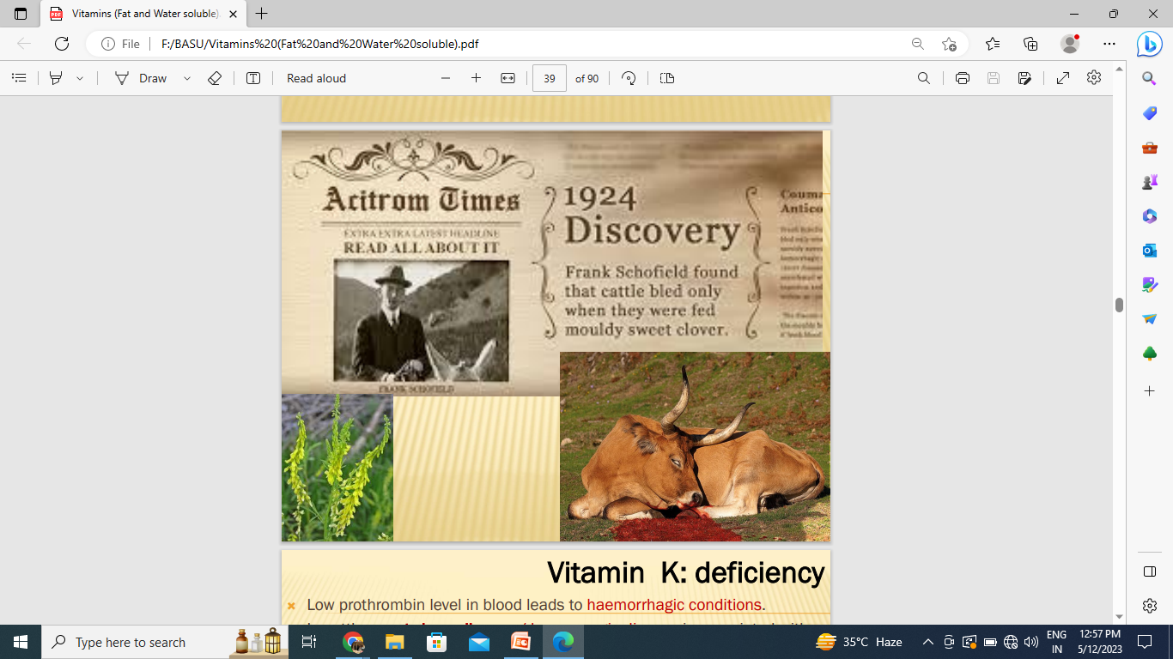
Vitamin K
Henrik Dam identified it and designated its name as vit K (Koagulation; danish word)
Discovered as essential factor in the prevention of haemorrhagic symptoms in chiks.
Phylloquinone—K1→ green plants and oils
Menaquinone– K2 → synthesized by intestinal bacteria
Menadione—K3 → synthetic form
K2 produced by human intestinal microflora is subsequently absorbed.
Source: Green leafy materials with lucern, cabbage and Kale being good sources.
Egg yolk, liver and fish meal

Slide 36
Vitamin K
Role:
Vitamin K is required for synthesis of prothrombin in the liver and other clotting factors (plasma thromboplastin and tissue thromboplastin)
and involved in the conversion of prothrombin to thrombin.
Also involved in electron transport and oxydative phosphorylations.

Slide 37
Vitamin K
Deficiency:
In vit K deficiency, prothrombin molecule remains deficient in γcarboxyglutamic acid, which is req for synthesis of calcium binding protein (Prothrombin must bind to calcium inos before it can be activated)
Sweet clover disease– Sweet clover (Melilotus albus) contains coumarins converted by fungi like Aspergillus to dicoumarol.----Vitamin K antagonist.
This lowers the prothrombin content of the blood.
Sulfaquinoxalene and warfarin also Vitamin K inhibitor.
Bacteria synthesize sufficient vitamin in digestive tract so symptoms not reported in ruminants.
In hindgut ferementors it may not be useful unless coprophagy.
Partially feremnted feed has large amounts of Vitamin K.
Poultry must require through diet.

Slide 38


