Slide 1
BIHAR ANIMAL SCIENCES UNIVERSITY
Bihar Veterinary College, Patna
Department of Animal Nutrition
Measures of Feed Energy
Dr. Pankaj Kumar Singh
University Professor & Head
Department of Animal Nutrition
Bihar Animal Sciences University, Patna, India
e-mail: vetpank@gmail.com ; 7909079625

Slide 2
Objectives of the Lecture
To impart knowledge on partitioning of feed energy for livestock.

Slide 3
Energy
Greek words “en ergon” which means “in work”
Carbohydrates, lipids, protein, and amino acids are the primary sources of dietary energy
Livestock require energy for maintenance, growth, production and reproduction.

Slide 4
Figure : Partitioning of Feed Energy
Digestible energy (DE)
Metabolisable energy (ME)
Net energy (NE)
Gross energy (GE) or Heat of combustion
Faecal energy
Urinary energy
Gaseous energy
Heat of Increment energy
Maintenance energy
Production energy

Slide 5
Partitioning of Feed Energy
Gross energy (GE) or Heat of combustion
Fecal Energy (FE)
a. Undigested feed residues and enzymes
b. Gastrointestinal microbes and their products
c. Cellular debris from the gastrointestinal tract
Digestible energy (DE)
Urinary energy (UE)
Gaseous energy (Products of fermentation viz. methane)
Metabolizable energy (ME)
Heat of increment energy (HI)
a. Heat of nutrient metabolism (HNM)
b. Heat of fermentation (HF)
Net energy (NE)
Maintenance energy (NEm)
a. Basal metabolism
b. Activity at maintenance
c. Sustaining body temperature
Production energy (NEp)
a. Growth
b. Work
c. Stored in products (milk, wool etc.)

Slide 6
Glossary of terms
Gross energy (GE): Gross energy is the amount of heat that is released from a given amount of food following complete combustion in a bomb calorimeter.
Digestible energy (DE): Digestible energy is the energy remaining after subtracting the gross energy of feces from the gross energy of food.
Metabolizable energy (ME): Metabolizable energy is the energy remaining after subtracting the gross energy of urine and the gross energy of gaseous products of fermentation from digestible energy.
Net energy (NE): Net energy is the energy remaining after subtracting heat increment (heat production associated with the consumption of food from metabolisable energy.
Heat increment (HI): Heat increment is the energy expenditure associated with ingestion, digestion, assimilation, and metabolism of food. Heat increment is also called thermic effect of feeding, diet-induced thermogenesis, or meal-induced thermogenesis.

Slide 7
GROSS ENERGY (GE)
Gross energy (GE): Gross energy is the amount of heat that is released from a given amount of food following complete combustion in a bomb calorimeter.
Energy is stored in the chemical components of feed as chemical energy.
Primary sources of dietary energy - Carbohydrates, lipids, protein, and amino acids.
When a substance is completely burned to its ultimate oxidation products, viz. carbon dioxide, water, and other gases, the heat given off is considered as its gross energy, or ‘heat of combustion’.

Slide 8
Difference in GE of nutrients
Different nutrients - difference in gross energy value.
The gross energy (GE) of
Carbohydrates: 4.3 Kcal/g,
Protein: 5.6 Kcal/g
Fat: 9.2 Kcal/g.
GE of the fats has approx. twice (2.25) the energy value of the carbohydrates.
Proteins occupy an intermediate position in energy value.
Why?

Slide 9
Benefits of Gross energy
GE is simple and is precisely defined attributes of a feed.
GE is the starting point for estimating various feed energy values.
Limitations of Gross energy
GE depends on nutrient composition but doesn’t tell anything about the contribution of the energy.
GE value varies little between feeds (e.g Lucerne hay and saw dust have GE value of 20 and 18 MJ/kg dry matters, respectively).
GE gives little information about the energy available to the animal since foods are not entirely digested and energy is lost in feces, urine, and as heat produced during metabolism of dietary nutrients.

Slide 10
Measurement of Gross Energy
Gross energy is measured in a bomb calorimeter.
Bomb calorimeter contains a strong metal chamber (bomb) resting in an insulated tank of water (a thermodynamically closed system).
The food sample is dried, weighed, pelleted and placed in the bomb, which is then completely burned by igniting electrically it in a high pressure (25-30 atmospheres of oxygen) with oxygen.
The initial temperature of the water in the bucket is recorded before the sample is electrically ignited. The heat produced during oxidation is dissipated through the wall of the bomb, causing the temperature of the water in the bucket to rise.

Slide 11
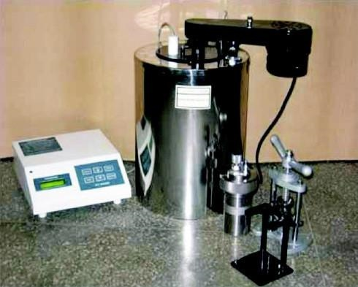
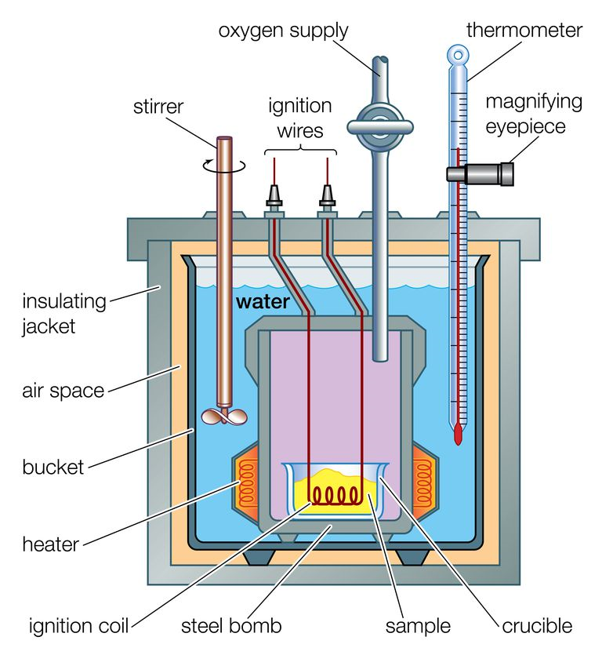
Bomb calorimeter …
When equilibrium is reached, the final temperature is recorded.
The quantity of heat produced (H) is then calculated from the rise in temperature (∆T) and the weights (M) and specific heats (S) of the water and the bomb (H= MS∆T) and compared with that produced by burning a substance of known energy content.
Bomb calorimeter is calibrated by benzoic acid.

Slide 12
Digestible Energy (DE)
Digestible energy is the energy remaining after subtracting the gross energy of feces from the gross energy of food.
Not all of the gross energy in foods is available for use by the animal. Some is lost from the animal in faeces, urine or gaseous excretory products, and some is lost as heat.
The first loss of the GE occurs in digestion through faeces.
Digestible energy = Gross energy -Fecal energy
This value is ‘apparent digestible energy’ because the fecal energy includes that of undigested feed as well as metabolic products of the body (digestive fluid and abraded intestinal mucosa).
Apparent digestible energy = Gross energy -Fecal energy
True digestible energy= Gross energy-Fecal energy (of feed origin only)

Slide 13
Faecal energy loss is variable loss of energy from animal foods.
Cattle and sheep- 40 to 50%, Horses- 35 to 40 %,
Pigs & Poultry- 20%.
Digestible energy represents energy absorbed by the animal.
DE is a far better measure of the energy available to support animal production than GE.
DE and TDN (total digestible nutrients) have similar variables which affect digestion and the same additional losses.
DE varies with gross energy and digestibility of feed.
DE (Kcal/g) = TDN x 4.41

Slide 14
Metabolizable Energy (ME)
Metabolizable energy is the energy remaining after subtracting the gross energy of urine and the gross energy of gaseous products of fermentation from digestible energy.
In addition to energy lost in faeces, energy is also lost as energy-containing compounds in urine, and as combustible gases such as methane produced as a consequence of microbial fermentation in either the rumen or hind gut.
Urinary energy (UE)
Urinary energy (UE) includes the energy content of the non-oxidised portion of the absorbed nitrogen products, primarily urea in mammals and uric acid in birds and the energy contained in the endogenous fraction of the urine.
Losses of energy in the urine are proportional to the protein content of the feed.
The urine contains energy of the order of 2 to 3 percent of the gross energy in the case of pigs and 4 to 5 percent in the case of cattle.

Slide 15
Metabolisable energy (ME) for Poultry
In poultry ME can be further categorized into apparent ME (AME), True ME (TME), nitrogen corrected AME (AME_{n}), and nitrogen corrected TME (TME_{n}).
Apparent Metabolisable Energy (AME or ME):
AME is measured as the difference between the energy of the feed and the energy of the faeces plus urine which, in poultry, are combined as single excreta.
True Metabolisable Energy (TME):
An estimation of ME in which correction is made for metabolic faecal and endogenous urinary energy losses (Endogenous Energy Loss, EEL). TME system argue that EEL represents a maintenance cost, which should not be charged against the feed.
Nitrogen corrected AME (AMEn):
A correction is made on AME for nitrogen retention by the chickens
Nitrogen, when catabolised, is excreted as energy containing products like uric acid.
To correct nitrogen retention, a factor of 34.36kJ/g, or 8.21kcal/g, of nitrogen retained is often used.
When the test diets are relatively balanced in protein and energy, nitrogen retention of bird could be assumed to be 20% of body weight gain divided by 6.25.

Slide 16
Gaseous Products of Digestion (GPD)
Gaseous Products of Digestion (GPD) includes the combustible gases produced in the digestive tract by the fermentation of the ration such as methane, hydrogen, carbon dioxide, hydrogen sulphide etc.
Energy losses are proportional to the apparent digestibility of the diet and the purpose for which the energy is used by animals.
Methane contains 13.34 kcal per gram energy.
In the non-ruminants GPD is negligible.
Metabolisable energy represents energy that is available for use by the animal.
ME= DE-FE-UE- GPD
On average, about 18 per cent of the apparently digestible energy is excreted in the urine and as methane.
ME=DE× 0.82
In poultry, metabolisable energy is measured more easily than digestible energy, because the faeces and urine are voided together.

Slide 17
Factors affecting ME value of feeds
Nature of feed: Structural carbohydrate like cellulose need more energy for their digestion and metabolism than any other nutrients. Proteins need less than cellulose, but still more than sugars and starch, while fats and oils generate the least heat increment.
This is the reason of recommendations of feeding diets high in fiber during winter and rich in fat during summer.
Digestibility: Digestibility is the main factor affecting the ME value of a feed. Losses of energy in methane and in urine are greater for ruminants than for non ruminants, and so foods such as concentrates will have a higher ME value for non-ruminants.
Feed processing: In ruminants, foods such as silages that have been fermented before consumption by the animal will incur smaller energy losses in digestion but will already have incurred losses in the silo. Thus, silages are said to contain less fermentable metabolisable energy (FME) than comparable foods such as hays.
Physiological stage of animals: Efficiency of utilization of ME is higher for maintenance (80%) as compared to milk production (72%) and growth (70%).

Slide 18
Heat Increment (HI) of Feeds:
Heat increment is the energy expenditure associated with ingestion, digestion, assimilation, and metabolism of food. Heat increment is also called ‘Thermic effect of feeding’ or diet-induced thermogenesis, or meal-induced thermogenesis.
If a fasting animal is given food, then within a few hours its heat production will increase above the level represented by basal metabolism. This increase is known as the heat increment of the feed.
Heat increment increases with the amount of feed consumed.
Heat increment= Heat of fermentation (HF) and heat of nutrient metabolism (HNM).
Heat of fermentation is the heat produced in the digestive tract as a result of microbial action, whereas, Heat of nutrient metabolism is the heat produced from the ingestion, digestion, absorption, and assimilation of food.
Heat of fermentation is much larger in ruminants than in other species due to microbial fermentation in the digestive tract in ruminants.

Slide 19
Heat Increment (HI) of Feeds Cont….
Max Rubner coined the term ‘specific dynamic action’ to denote the increase in metabolic rate following food intake and showed that protein resulted in larger increase in heat production than either carbohydrate or fat.
The largest specific dynamic action is exerted by protein followed by carbohydrate and fat.
High protein feeds were considered ‘hot’ because of larger amount of SDE.
Heat increment is subject to many variables. The heat increment varies depending on the nature of the food, the type of animal consuming it and the various processes for which nutrients are used (viz. maintenance, growth, lactation etc.).
HI is larger in roughages than for concentrates.
The heat lost by the animal can be regarded as a direct tax on the food energy.

Slide 20
Net energy (NE)
H B Armsby (1921) coined this term Net energy as the metabolisable energy (ME) minus heat increment (HI).
NE= ME-HI
NE content of a food is not a fixed value but varies depending on the species of animal, the productive process and the nature of energy supply.
The net energy system separates the energy requirements into their fractional components to such as net energy for maintenance (NE_{m}), net energy for gain (NE_{g}), and net energy for lactation (NE_{l}).

Slide 21
Vibrate good energy into others soul;
making them never forget the beauty of yours….
Enjoy the beauty of positive energy….

Slide 22
THANK YOU

