Slide 1
BIHAR ANIMAL SCIENCES UNIVERSITY
Bihar Veterinary College, Patna
Department of Animal Nutrition
Importance, of minerals in animal health and production
Dr. Pankaj Kumar Singh
Department of Animal Nutrition
Bihar Animal Sciences University, Patna, India
e-mail: vetpank@gmail.com ; 7909079625

Slide 2
Minerals
Inorganic component of diet~ Total ash
Represented by total ash~ Proximate Principle
Estimated with the help of Muffle Furnace
Perform essential functions & must be present in food
In animal tissues and feeds, minerals are present in varying amounts and concentrations.
Total body mineral → Ca (46%)
→P (29%)
→ Mg, Na, K, Cl, S (25%)
→ micro minerals (3%)
Sir Humphery Davy (1875) identified Potassium in residue of incinerated wood and gave name ‘Pot ash’

Slide 3
Essential Minerals
Essential Minerals: are those having a metabolic role in the body. Purified diet lacking the essential element cause deficiency symptoms in animals and those symptoms can be eradicated or prevented by adding the element to the experimental diet
Major/macro mineral are those minerals that are present in high concentration (>70 mg/kg live weight) are termed as major minerals. | Trace elements or Micro minerals are those minerals that are present in low concentration (<70 mg/kg live weight) physiologically equally important.
Calcium (Ca) | Iron (Fe)
Phosphorus (P) | Copper (Cu)
Magnesium (Mg) | Cobalt (Co)
Sodium (Na) | Manganese (Mg)
Potassium (K) | Zinc (Zn)
Chlorine (Cl) | Iodine (I)
Sulphur (S) | Selenium (Se)
 | Molybdenum (Mo)
 | Chromium (Cr)
 | Fluorine (F)

Slide 4
Minerals: General functions
Structural: form structural components of body organs and tissues,
eg. as calcium, phosphorus and magnesium in bones and teeth; and phosphorus and sulfur in muscle proteins.
Physiological: in body fluids and tissues as electrolytes concerned with the maintenance of osmotic pressure, acid–base balance, membrane permeability and transmission of nerve impulses.
eg. sodium, potassium, chlorine, calcium and magnesium in the blood, cerebrospinal fluid and gastric juice
Catalytic: act as catalysts in enzyme and endocrine systems, as integral and specific components of the structure of metallo enzymes and hormones or as activators (coenzymes) within those systems.

Slide 5
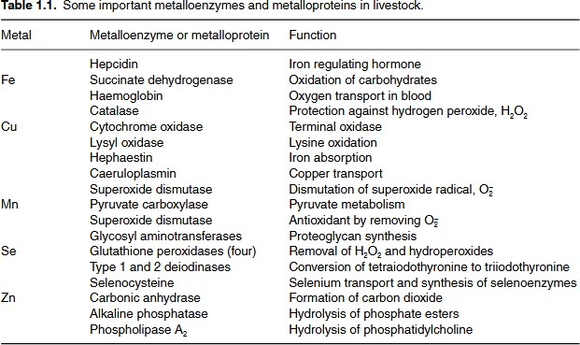
Minerals

Slide 6
Minerals: General functions
Regulatory: minerals regulate cell replication and differentiation;
eg. calcium ions influence signal transduction and selenocysteine influences gene transcription, The pivotal metabolic role of thyroxine has been attributed to the influence of triiodothyronine on gene transcription
Component of biomolecules: of biologically important compounds
Iron in haemoglobin
Cobalt in vitamin B₁₂
Iodine in the hormone thyroxine

Slide 7
Dietary sources of Mineral
Concentrate feed and forages
Mineral supplements such as bone meal, mineral mixture, common salt, calcite, shell grit etc.,
Drinking water – minor source
Soil contamination of herbage source for grazing animals.

Slide 8
Factors affecting mineral requirement and utilization
Mineral req. are more difficult to define (w.r.t. organic nutrients) due to
involvement of so many factors.
Strong interrelationship/ interaction among minerals causes increased or decreased utilization.
Presence of antimetal compounds in food
E.g. oxalates, phytates etc.
Actual amount of mineral in diet affect utilization. Higher concentration reduced absorption efficiency
Mineral status of animal.
Iron deficient animal will have better efficient absorption than that with higher iron reserve
Form of mineral: salt (generally sulphates are more available than oxides)
Animal factors: Age, sex, productivity level, genetic make up

Slide 9
Calcium & Phosphorus
Second most abundant nutrient element (after N) in body.
Functions of Ca
Structural component of body (Skeleton and teeth): 99% of the calcium in the body is present in the bones and teeth.
controls the excitability of nerves and muscles
required for normal clotting of blood
Functions of P
occurs in close association with calcium in bone.
vital role in energy metabolism (ATP)
key role in metabolic reaction of carbohydrate, protein and lipids (phosphorylated intermediate compounds).
component of phospholipids, which are important in lipid transport and metabolism as constituent of cell membranes.
constituent of RNA and DNA.
component of many enzyme systems.

Slide 10
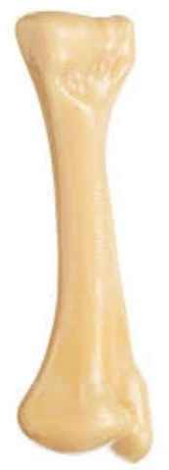
Calcium & Phosphorus
Ca & P in bones:
Total mineral in animal body→ 3%
Out of total mineral→ 70% Ca & P
Majority of Ca (99%) and P (80%) in bones (store of Ca & P) and teeth.
In bones exist in ratio of 2: 1
Moisture and fat free bone= 36% Ca and 17% P Adult bone
Water→ 45%
Ash (minerals)→ 25%
Protein→ 20%
Fat→ 10%

Slide 11
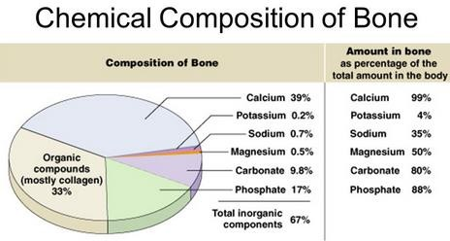

Slide 12
Calcium & Phosphorus
Blood cells are devoid of Ca
Plasma Ca in two forms: soluble ionised form (60% of total) and bound with proteins (albumin and plasma protein)
Blood Ca→9-11 mg/dl
Whole blood P→ 35-45 mg/dl (most of it present in cells
Plasma iP→ 4-9mg/dl
Blood concentration of P is more dependent on dietary manipulation as compared to that of Ca.?????

Slide 13
Calcium
Regulation of calcium metabolism
Whenever blood calcium level decreases below the normal, parathyroid gland is stimulated to secrete parathormone. This hormone mobilizes calcium from the bone and also facilitates reabsorption of calcium in the kidney.
It also increases calcium absorption in the small intestine by increasing the synthesis of 1,25 dihydroxy cholecalciferol (active form of vitamin D) from 25 hydroxy cholecalciferol in the kidneys, which in turn increases the synthesis of calcium binding protein resulting in increased calcium absorption.
High level of blood calcium stimulates the secretion of calcitonin,
which has antagonistic action to that of parathormone.

