Slide 1
BIHAR ANIMAL SCIENCES UNIVERSITY
Bihar Veterinary College, Patna
Department of Animal Nutrition
Major Minerals (Calcium and Phosphorus)
Dr. Pankaj Kumar Singh
Department of Animal Nutrition
Bihar Animal Sciences University, Patna, India
e-mail: vetpank@gmail.com ; 7909079625

Slide 2
Essential Minerals
Essential Minerals:
Major/Macro- 07
Minor/Micro-15
Major/macro:
The seven minerals that are present in high concentration (>70 mg/kg live weight) are termed as major minerals.
Calcium (Ca), Phosphorus (P), Magnesium (Mg),
Sodium (Na), Potassium (K),Chlorine (Cl) Sulphur (S)

Slide 3
Calcium
Second most abundant nutrient element (after N) in body.
Functions of Ca:
Skeletal Functions:
Structural component of body (Skeleton and teeth):
99% of the calcium in the body is present in the bones & teeth.
Non-Skeletal Functions:
Nerve conduction
1% of body calcium that lies outside the skeleton is found as the free ion, bound to serum proteins.
Ionized calcium is essential for nerve conduction, muscle contraction and cell signalling.
Blood clotting
Calcium is required for normal blood clotting.
Curdling of milk

Slide 4
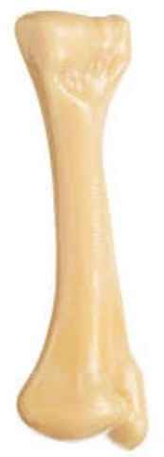
Calcium & Phosphorus
Ca & P in bones:
Total mineral in animal body→ 3%
Out of total mineral→ 70% Ca & P
Majority of Ca (99%) and P (80%) in bones (store of Ca & P)
and teeth.
In bones exist in ratio of 2: 1
Moisture and fat free bone= 36% Ca and 17% P
Ca & P level in blood:
Blood Ca: 9-12 mg/dl
– Laying hens: 30-40 mg/dl
Plasma P: 4-9mg/dl

Slide 5
Phosphorus
Functions of Phosphorus:
Occurs in close association with calcium in bone.
Energy metabolism (ATP)
Component of phospholipids- as constituent of cell membranes.
Constituent of RNA and DNA.
key role in metabolic reaction of carbohydrate, protein and lipids (phosphorylated intermediate compounds).
component of many enzyme systems.

Slide 6
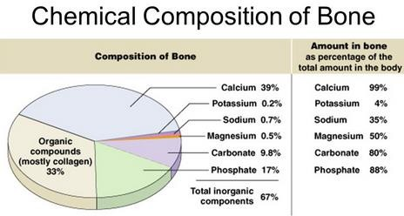

Slide 7
Calcium & Phosphorus
Blood cells are devoid of Ca
Blood Ca: 9-12 mg/dl
– Laying hens: 30-40 mg/dl
Plasma P: 4-9mg/dl

Slide 8
Metabolism of Calcium
Calcium is absorbed by an active process in the small intestine under the control of two hormones:
Parathyroid hormone (PTH)
1,25 dihydroxy cholecalciferol or calcitriol- the physiologically active form of vitamin D3,
•
Calcitonin
Calcitonin inhibits activity of osteoclasts, resulting in
decreased bone resorption (and decreased plasma Ca levels).

Slide 9
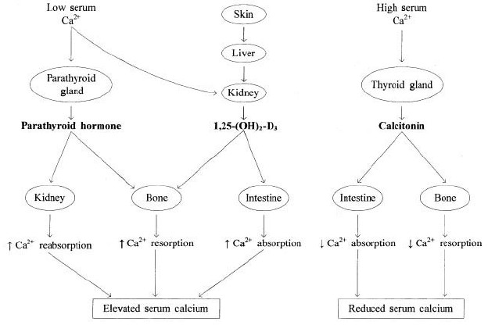
Hormonal regulation of calcium homeostasis

Slide 10
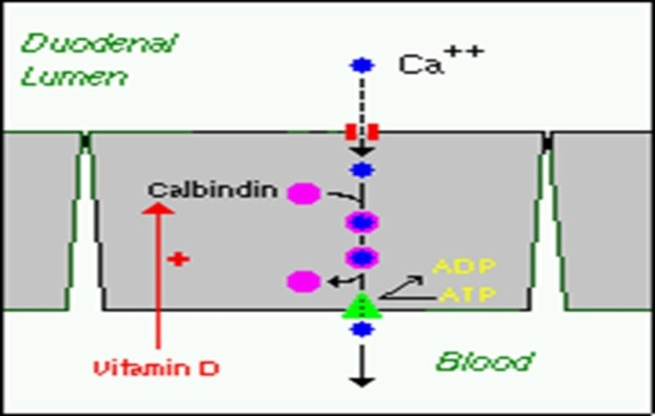
Regulation of calcium metabolism
The parathyroid gland responds to small reductions in ionic calcium in the extracellular fluid by secreting PTH .This stimulates the double
hydroxylation of vitamin D₃, first to 25-OHD₃ in the liver and then to 1,25-(OH)₂D₃ (1,25 dihydroxy cholecalciferol – Hormonal form of vitamin D) in the kidneys.
Activated 1,25-(OH)₂D₃ opens calcium channels in the intestinal mucosa to facilitate calcium uptake and transfer with the help of a calcium binding protein, calbindin.
- the synthesis of calbindin
is dependent on vitamin D.
Role of Calbindin in facilitating the absorption of calcium according to supply and demand.

Slide 11
Calcium Flow
Milk, fetus
Formation
Filtration
Bone
Calcium pool
Kidney
Resorption
reabsorption
Secretion Absorption
Intestine

Slide 12
Calcium and Phosphorus source
Milk is rich in calcium that is well absorbed by the young animals.
Forages : Forages are generally satisfactory sources of calcium for livestock
- Legumes contain more Ca as compared to non-Leguminous forage).
Concentrate:
Cereals are low in calcium
Vegetable protein sources usually contain no more than 2–4 g kg⁻¹ DM.
Fish meal and meat and bone meals are good sources of calcium (50-100 g kg⁻¹ DM)
Source | Ca % | P%
Animal bone (steamed dehydrated) | 29 | 14
Di-calcium phosphate | 26 | 21
De-fluorinated phosphate | 29-36 | 12-18
Limestone | 34 | -
Calcium phosphate | 17 | 21
Sodium phosphate | - | 22
Diammonium phosphate | - | 20
Oyster shell | 35 | -

Slide 13
Deficiency Diseases
Depression in performance of Livestock and poultry
Decreased Milk yield Depressed egg production Depressed hatchability.
13

Slide 14
Abnormalities of bones
•
The type of bone disorder that develops is partly dependent on the age at which calcium deprivation develops:
Rickets
A condition that results in weak or soft bones in young animals.
Symptoms include bowed legs, stunted growth, bone pain, large forehead.
14

Slide 15
Abnormalities of bones
Osteomalacia
It describes the excessive mobilization of minerals leaving a surfeit of matrix in bones in which the growth plate has ‘closed’ (i.e. the calcium-deprived adult).
incomplete mineralisation of osteoid, adults
Osteoporosis
indicates that bones contain less mineral than normal but proportionately less matrix, so that the degree of mineralization of matrix remains normal. Matrix osteoporosis is characteristic of protein deficiency rather than simple calcium or phosphorus deficiency and can occur in young as well as mature animals.

Slide 16
Deficiency Diseases
Milk fever
or
Parturient Paresis
Milk fever is principally seen in high-yielding
dairy
the
cows. It is associated with parturition and
initiation of lactation in older cows (5–10 yrs).
•
•
Within 48 h of calving, the cow becomes listless, shows muscular weakness, circulatory failure, muscular twitching, anorexia and rumen stasis (i.e. a parturient paresis).

Slide 17
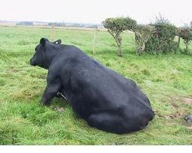
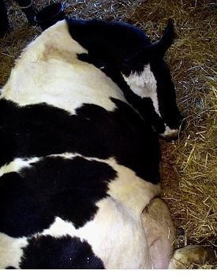
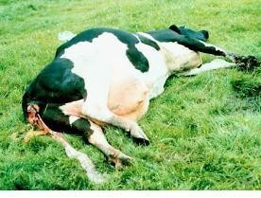
Milk fever
1
2
3
17

Slide 18
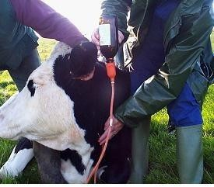
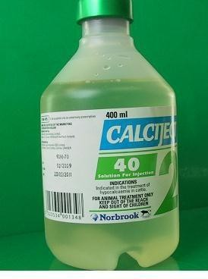
Treatment and Prevention of Acute Disorders
Administer 400 ml of 40%calcium borogluconate solution warmed to body temperature by slow intravenous injection (over5-10min) into the jugular vein.

Slide 19
Phosphorus
Pica or Depraved Appetite: Feeding of inanimate things, licking of soil or urine.
Nutritional secondary hyperparathyroidism or osteodystropha fibrosa orbig head disease:
Low or marginal Ca and high P diet
Hyperplasia of Parathyroid gland in horse fed bran and monkey)
Periodontal disease in dogs and human

