Slide 1


Conservation of green fodder (Silage)
Dr. Dharmendra Kumar
Associate Professor
Department of Animal Nutrition,
Bihar Veterinary College,
Bihar Animal Sciences University, Patna, Bihar, India
Email: drdharmendravet2310@gmail.com

Slide 2
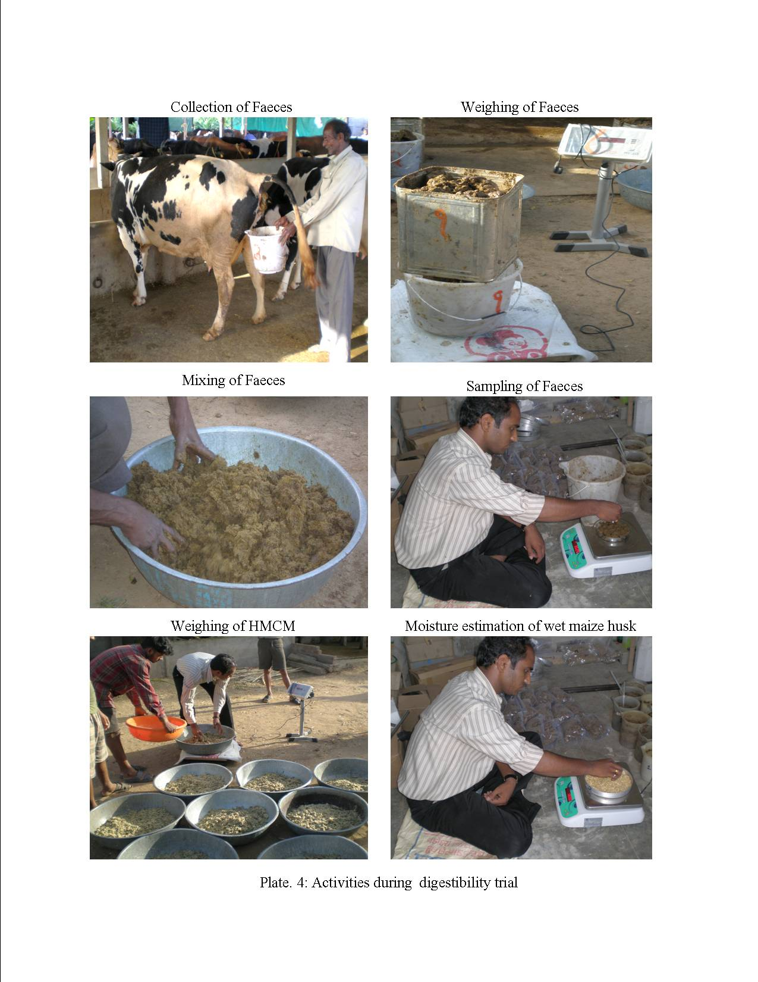
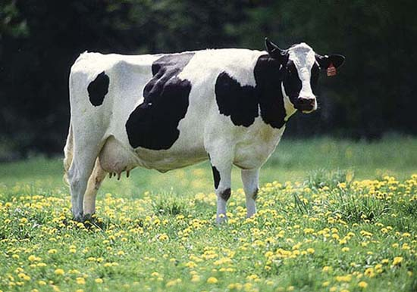

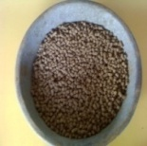
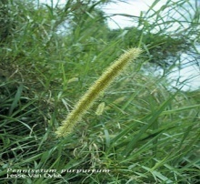
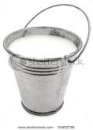
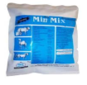
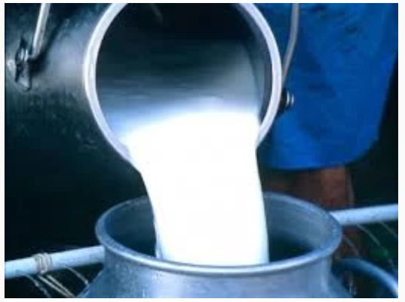
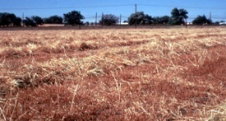
Feeding of Animal as per requirement
i) Water
ii) Energy
iii) Protein
iv) Mineral
v) Vitamin
Water, Energy, Protein, Mineral, Vitamin
i) Water
ii) Energy
iii) Protein
iv) Mineral
v) Vitamin

Slide 3
Round the year green fodder Production
Si.No. | Crop | Sowing time | Fodder availability
1. | i) Maize/ Sorghum + Cowpea/ Guar / Rice bean | Feb –March | April-July
 | ii) Sorghum/ Hybrid Nepiar/ Paragrass + Cowpea/ Guar/ Rice bean/ stylo/ Clitoria | June-July | August-November
 | iii)Barseem + Oat/ Maize | October-November | December-April
2 | Hybrid Napier +Cowpea/ Berseem | March- April | Round the year

Slide 4
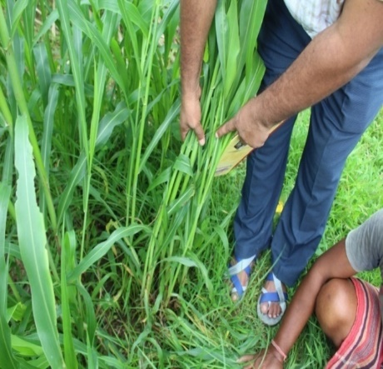
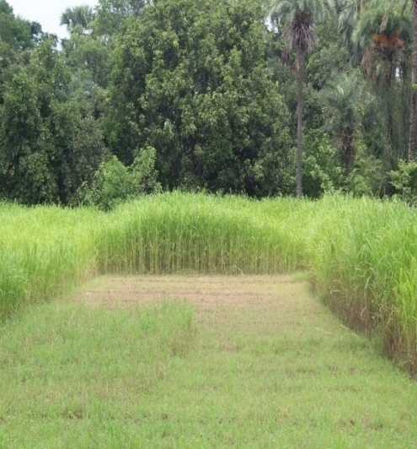
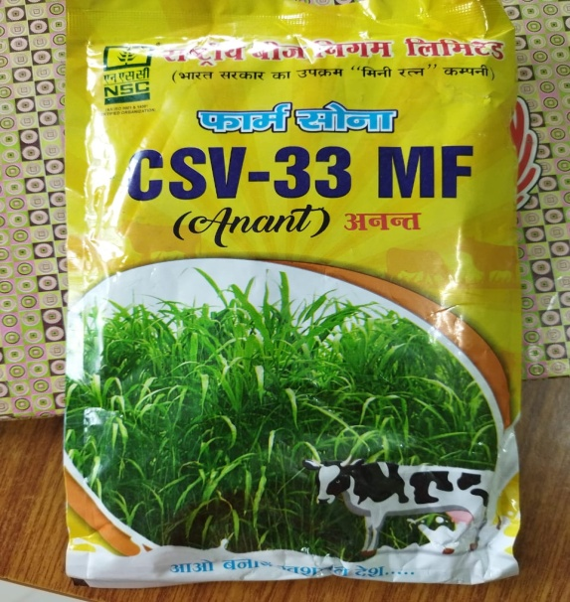
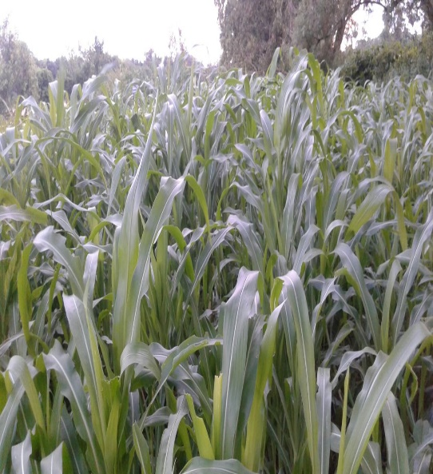
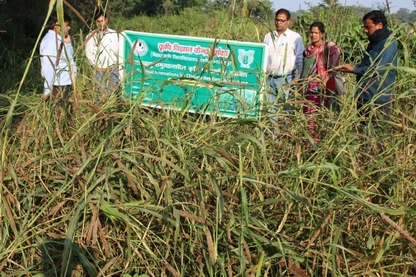
Cereals green fodder
Sorghum bicolor
Sudan
Maize (Zea maize)
Bajra (Pearl millet)-Cenchrus americanus)

Slide 5
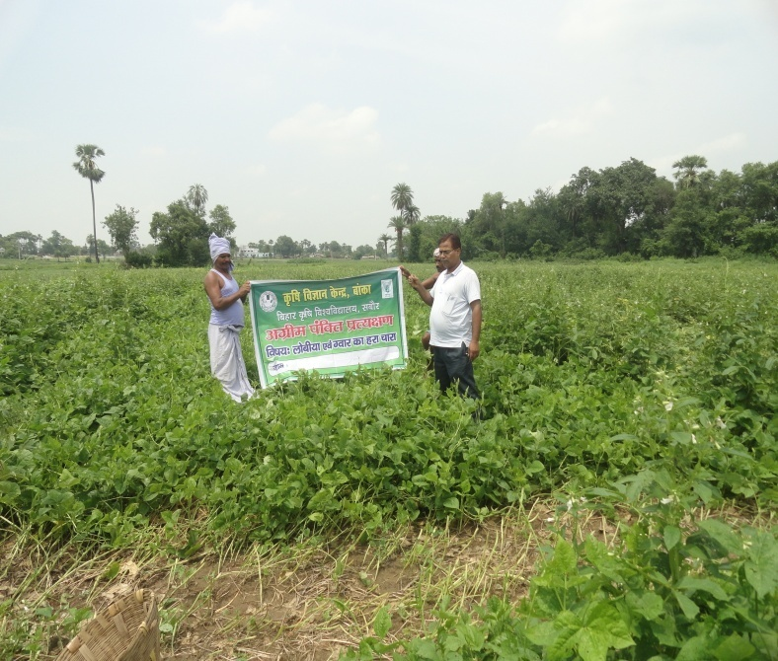
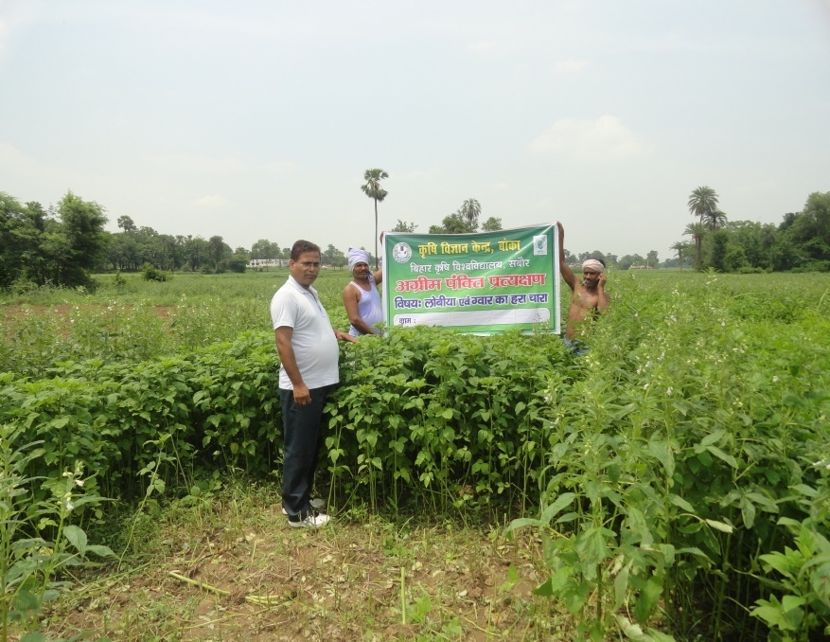
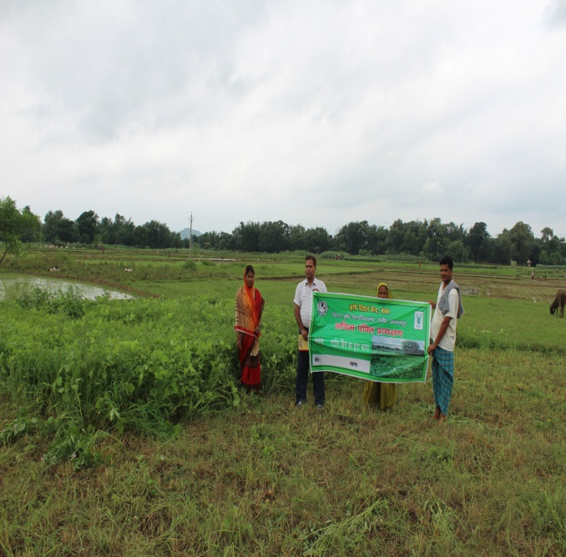
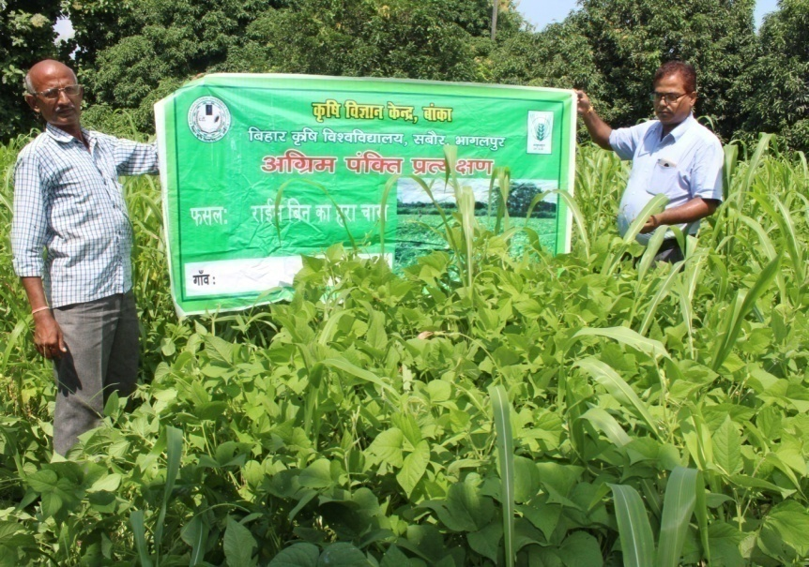
Leguminous green fodder (Kharif)
Cowpea (EC/4216)-Vigna unguiculata
Guar-Cluster bean (BG-1)
Cyamopsis tetragonoloba
Rice bean (Bidhan-2)- Vigna umbellata

Slide 6
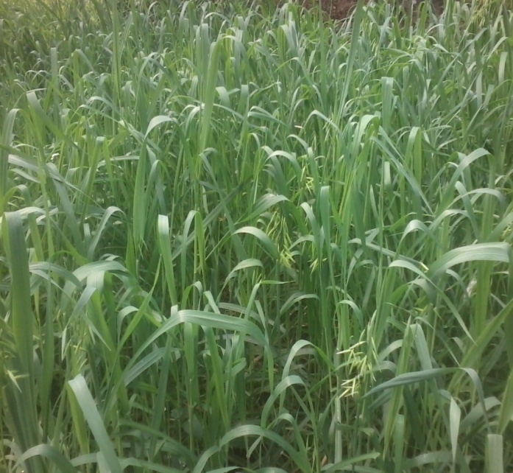

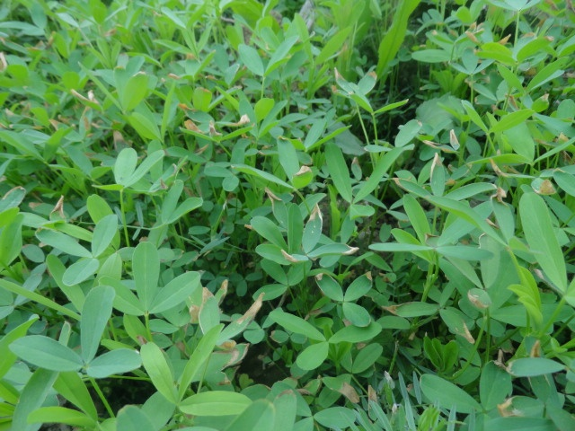
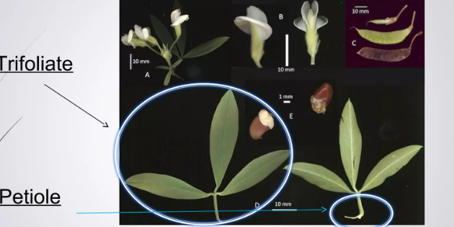
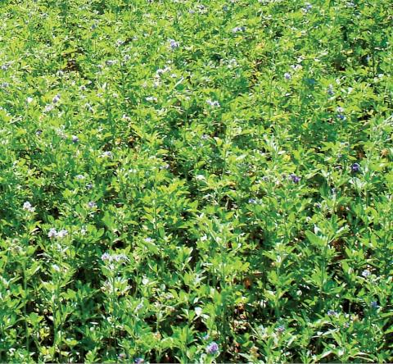
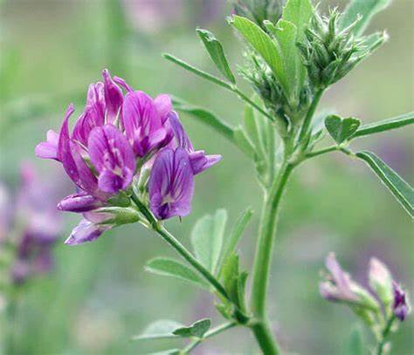
Cereal green fodder (Rabi)
Oat (Avena sativa)
Maize (Zea maize)
Berseem (Wardan)-
Trifolium alexandrinum
Lucern- Medicago Sativa
Leguminous Green fodder (Rabi)

Slide 7
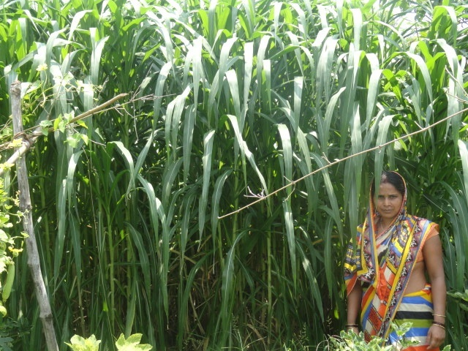
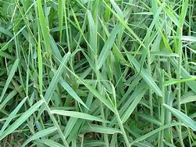
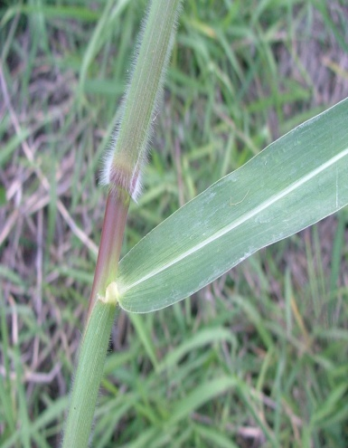
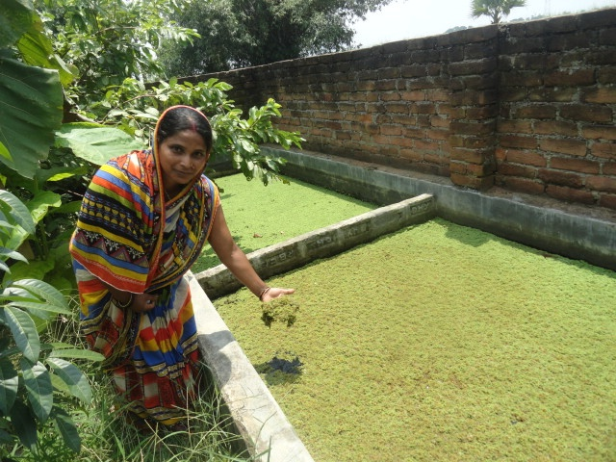
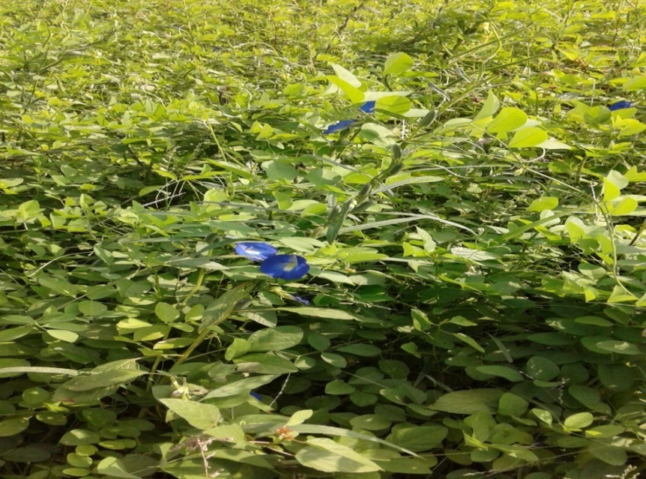
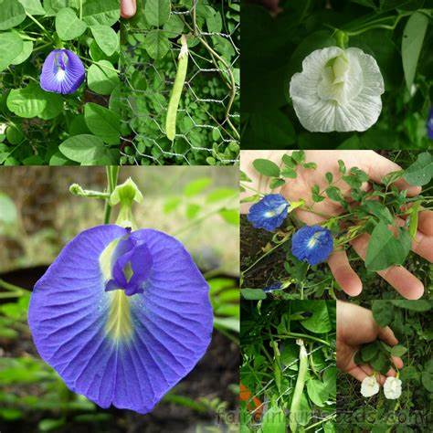
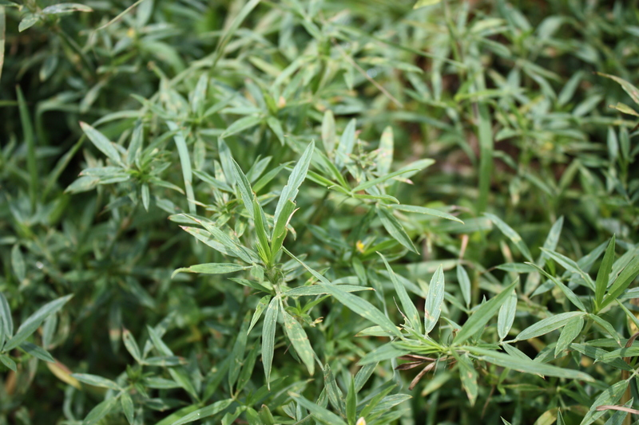
Perennial Green fodder
Napier-
Cenchrus purpureus
Paragrass-
Brachiaria mutica
Azola
Leguminous (Perennial)
Clitoria ternatea
Stylosanthes Guianensis

Slide 8
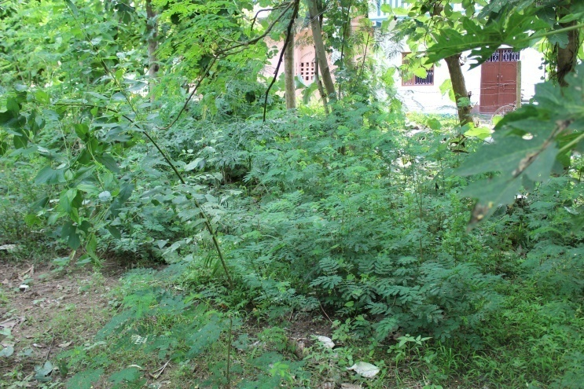

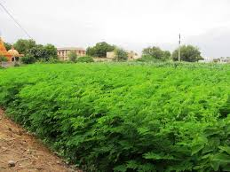
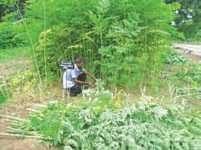
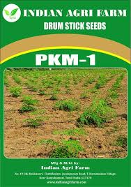
Subabul Vachellia nilotica
Moringa oleifera

Slide 9
Conservation of fodder ?
It means preservation & careful maintenance of fodder, unchanged during chemical reactions or physical transformations of fodder when it is excessively available for future needs.
Objective
To preserve feed when it is available in excess.
To maintain optimum nutritional value of fodder.
To shift available feed from the present to the future.
To move feed from one location to another location.
To assist pasture management and field.
Methods of Conservation
• Hay & silage are the main methods of conserving forage
• Hay is preserved by drying
• Silage involves natural fermentation, which produces lactic & other acids,
which ‘pickle’ or preserve the forage.

Slide 10
Silage: Green material produced by controlled anaerobic fermentation of green fodder crop retaining
its moisture content.
Hay: A method of conserving green crops by reducing the moisture content up to 15-20% to inhibit
the action of plant and microbial enzyme.
Haylage: Material wilted to 40-50% DM before ensiling is referred to haylage.
When grasses and legumes generally meant for hay are ensiled.
Wastelage: A silage containing animal organic waste (poultry drooping, poultry litter, bovine dung etc.)

Slide 11
What is silage?
• Silage is the green material produced by controlled fermentation of the green fodder crop retaining the high moisture content.
• Containing 25-35% DM
Ensilage: The process of conserving green fodder is called ensilage.
Advantages of silage making
• Preservation of green fodder.
• Prepared from plants having thick stems & are generally not very suitable for
Hay making like sorghum, maize etc.
• Weeds can also be utilized along with main fodder crops for silage making
• Silage making kills majority of weed seeds.
• Highly palatable.
• Organic acids produced in the silage are similar to those normally produced
in the GIT of ruminants so, used in the same manner.

Slide 12
What is the Principle of Silage making?
• Anaerobic condition is first & foremost requirement for silage making, as it
allows lactic acid bacteria to grow,
which converts sugars into lactic acid, a strong organic acid.
• When pH declines, plant enzymes and undesirable bacteria are inhibited &
at pH 3-4, most degrading enzymes are inhibited & the growth of lactic acid bacteria is also inhibited.
• Sugars + Oxygen = Carbon dioxide + Water + Heat
(this reaction is prevented and nutrient loss is reduced).
• In simple words the principle of silage is the same as that in making pickles.

Slide 13
Selection of crops for silage making
• Contain high level of fermentable sugar/soluble sugar- Maize, Jowar, Bajra
Thick stem
• Low level of protein.
• Should have about 35 % dry matter at the time of ensiling
• Pasture grasses like Elephantgrass (Napiergrass), Guinea grass, Rhodes grass, Sudangrass, Setaria, Ruzi grass, etc.-
• Corn & Sorghum
• Farm by-products
Grasses:- Low in soluble CHO
Legumes:- Higher moisture level, protein and mineral raise buffering capacity
Stage of harvesting- between flowering and milking stage

Slide 14
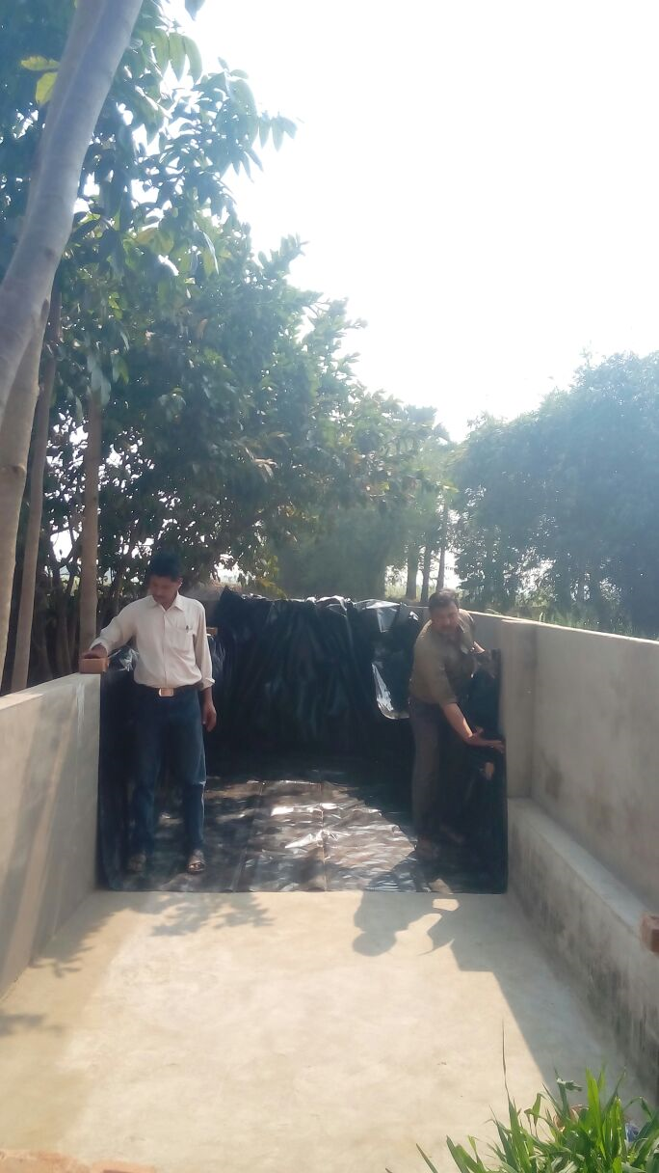
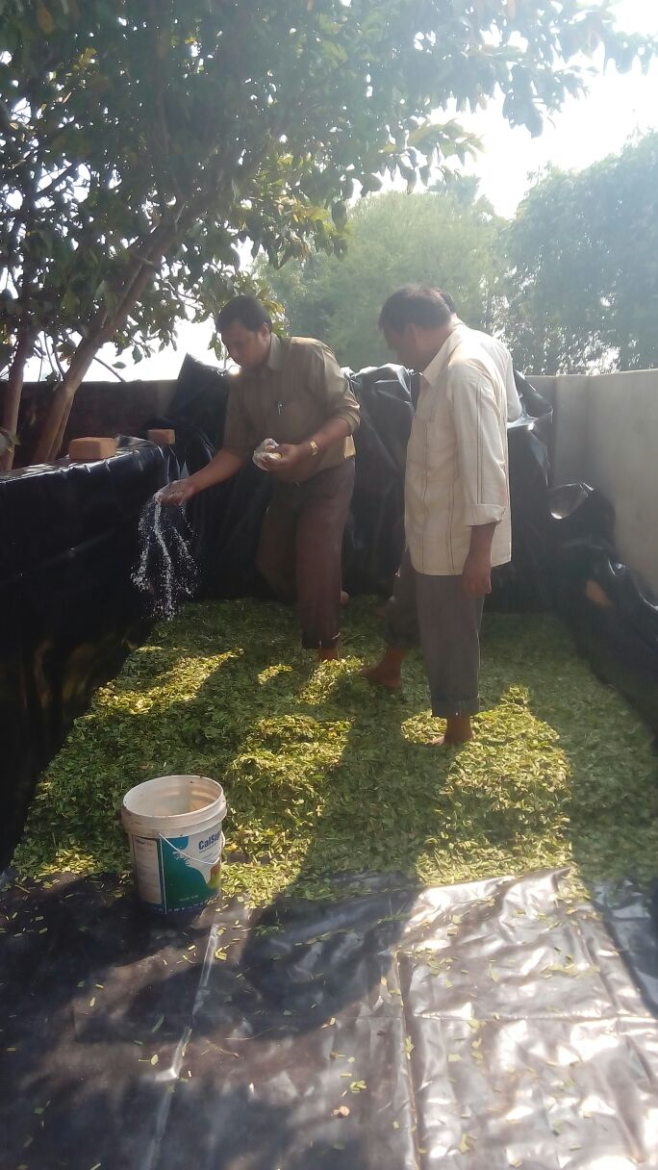
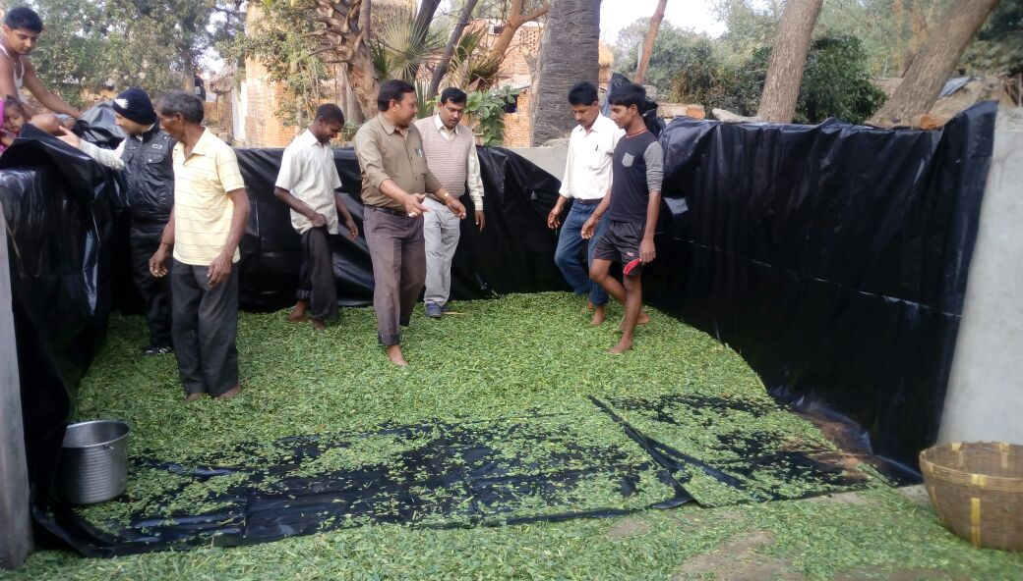
Site for construction of silo
• Silo should be elevated from other places.
• Place must be free from water logging
• Walls of silo pit must be leak proof
• Should be at least six feet away from animal shed
• Silo size is determined by a herd size,
amount of daily feed intake, and
packed density of the raw materials.
10m*3m*1.5m= 35 T Green fodder

Slide 15
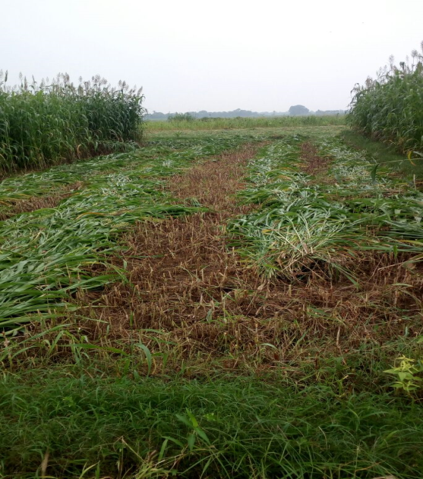
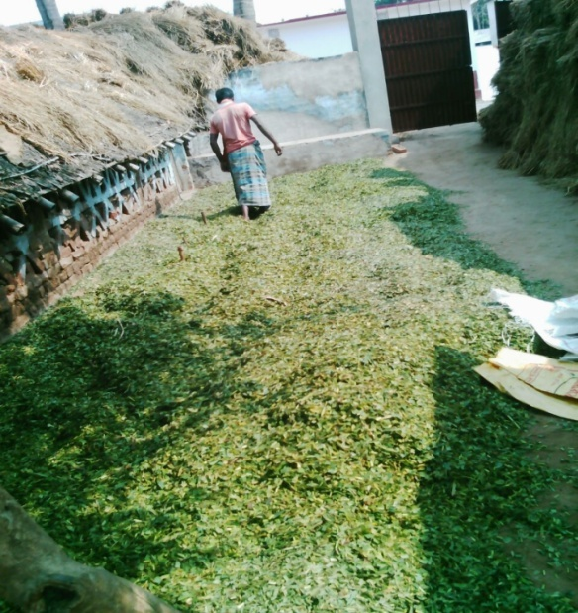
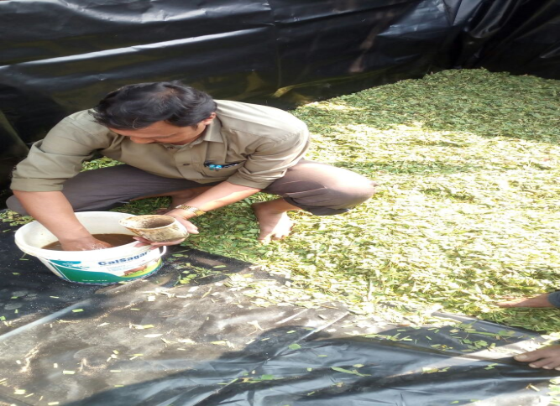
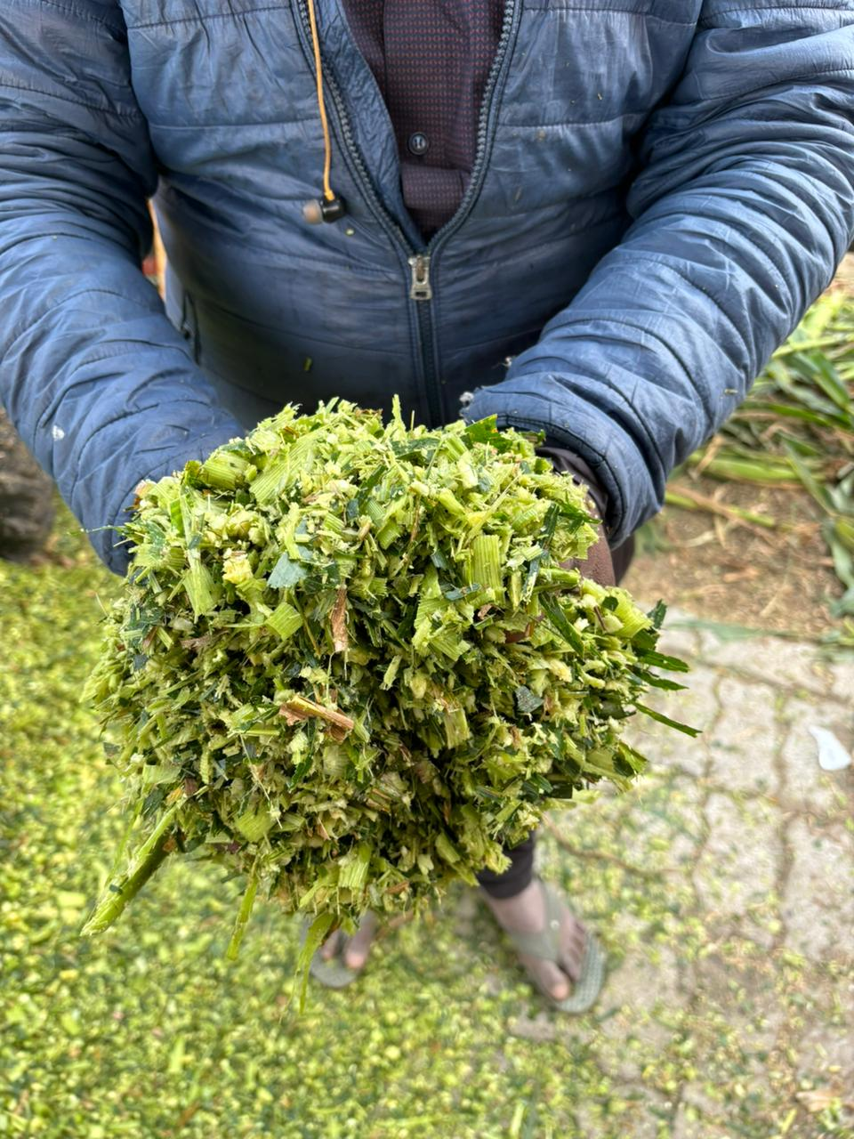


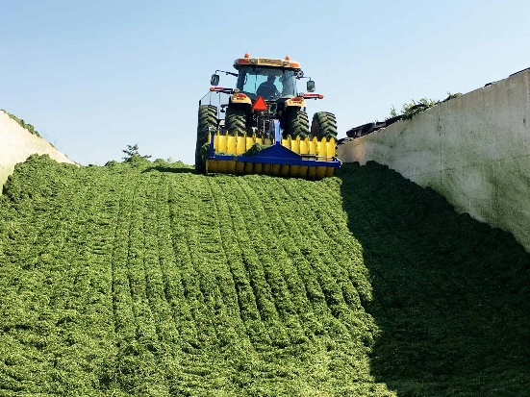
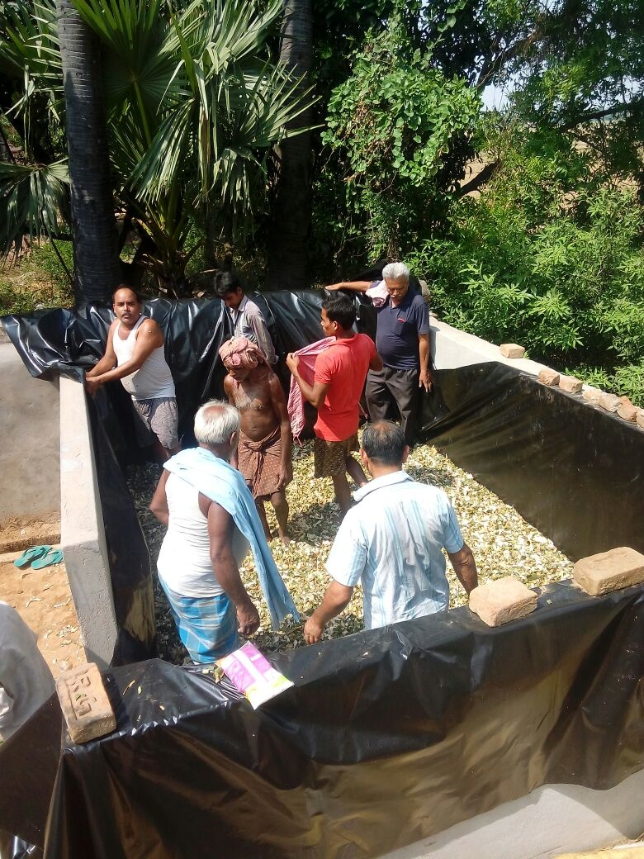
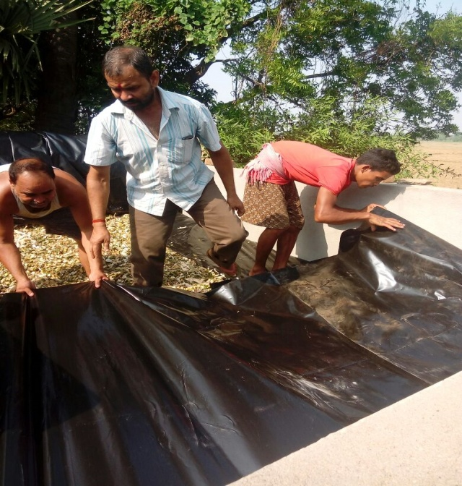
Ensiling

Slide 16
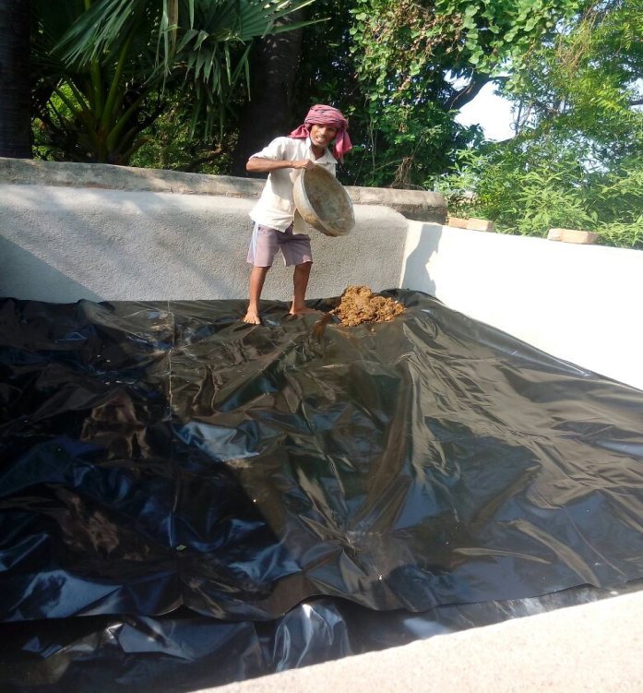
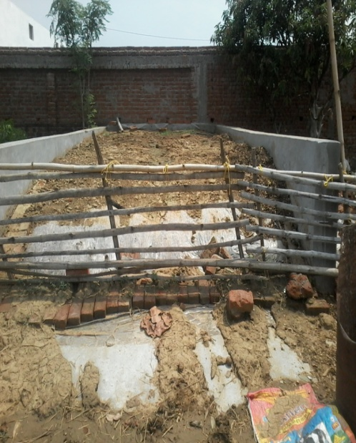
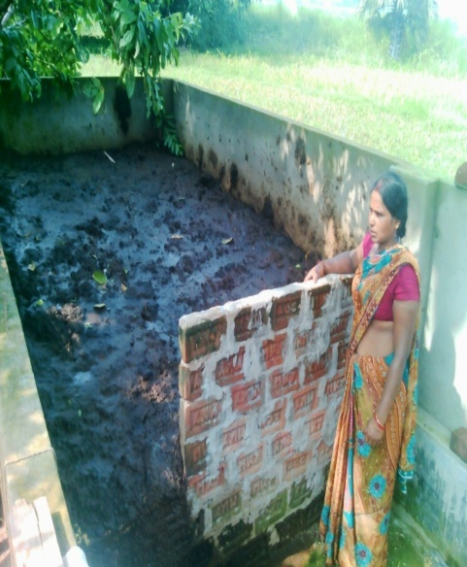
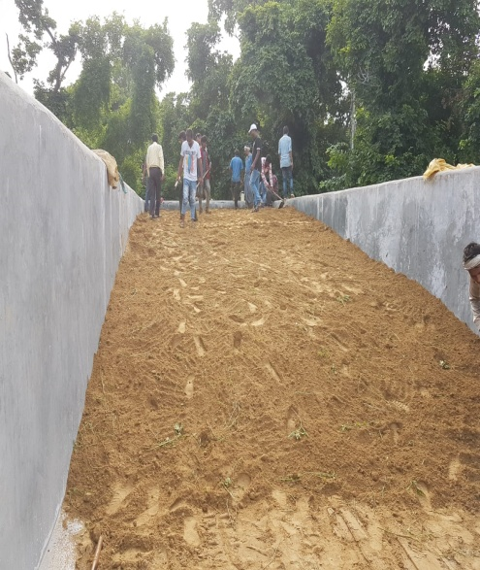
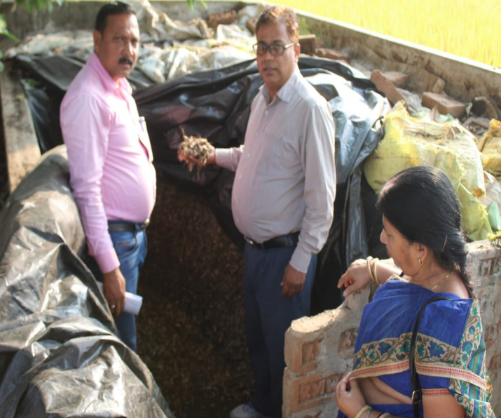

Slide 17
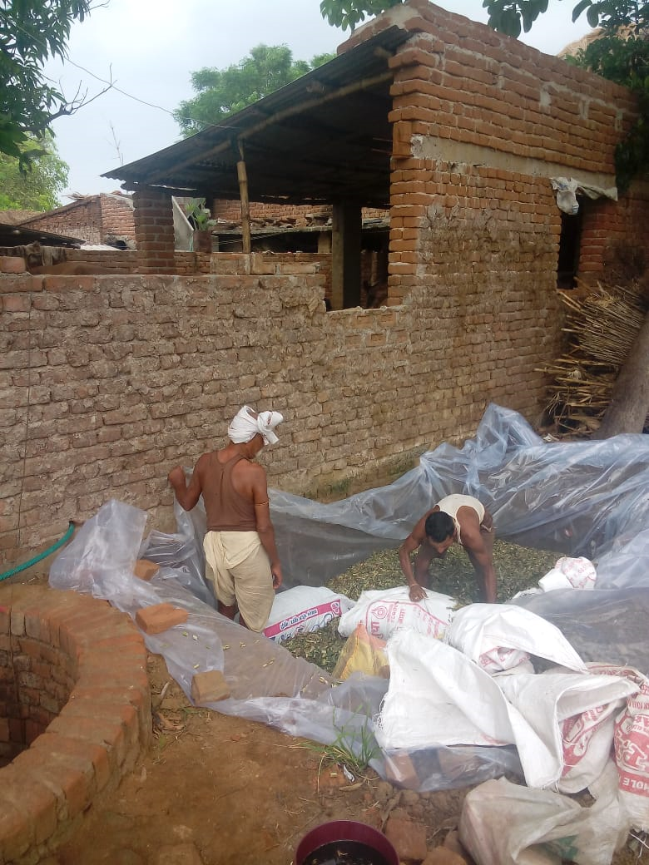
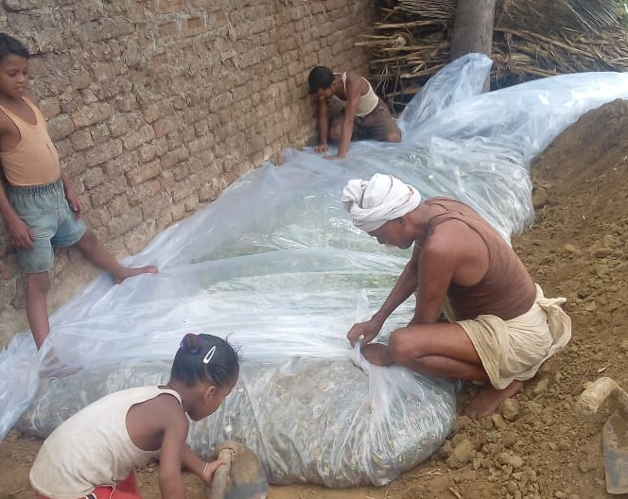


Slide 18






Slide 19
Making of Silage ?
• i) Harvesting of Pasture grasses: Flowering stage
• Corn: Yellow ripening stage
• Sorghum: Milking stage
• 65-70 % moisture level is ideal for silage making
•ii) Chopping of forage to short length (1-3 cm),
so, that the packing density is kept higher, lactic acid fermentation takes.
iii) Chopped fodder filled in silo
iv) Compact forage as tightly as possible with help of tractor or hand roller
• Sprinkle Molasses solution over it @ 1% of the material weight
If the moisture content is high, molasses addition may have no effect.
High moisture content leads to poor fermentation
if moisture level is high wilting is required.
When the moisture content is 80% or higher, brans are evenly sprayed @10% of material weight

Slide 20
v) Seal the pit airtight with plastic cover & should be pressed with heavy objects like
bricks or tire
Maintain sealing for 45 days
• Once silo-pit will be open, it should be finished within 15-20 days to avoid
fungal contamination.

Slide 21
Fermentation process of silage
First stage (respiratory stage)
• The packed raw materials are still respiring immediately after chopped and consumes oxygen
• The temperature will rise to about 32ºC around 4 days after packing
Second stage (early fermentation)
• Production of acetic acid, formic acid and other organic acids as a result of the growth of facultative aerobic bacteria such as Enterobacteria
• The silage pH slowly changes from about 6.0 to 4.0
Third stage (Lactic acid fermentation)
• Lactic acid fermentation begins by lactic acid bacteria which are strictly anaerobic about 3 days
after packing chopped materials and acetic acid production decline.
Fourth Stage (Lactic acid fermentation)
• Lactic acid production continues for about 2 weeks
• The temperature goes down slowly to about the normal atmospheric temperature
and pH is maintained at 4.0
Fifth stage: Stabilization phase
• Due to the presence of lactic acid, further degradation is inhibited, as bacterial
and fungal growths are checked
• The lactic acid fermentation completes in about 20 days
“If the lactic acid production is insufficient, butyric acid fermentation begins and quality deterioration occurs”.

Slide 22
Chemical changes during fermentation
• Sugars are fermented into volatile fatty acids (VFA) like lactic,
acetic, propionic & butyric) acids by anaerobic microorganisms
• The formation of the acids reduces the pH (target = 4)
• Protein is degraded into ammonia & NPN (target =<100g Ammonia / kg total N)

Slide 23
Silage Quality by Shephered et al. (1948)
1. very good silage: Acidic taste and odour,
being free from butyric acid & Moulds
pH range of 3.5-4.2 and
NH3 nitrogen less than 10% of total nitrogen.
Lactic acid content is 1-2%.
2. Good silage: Acidic taste and odour,
traces of butyric acid (<0.2%)
pH range of 4.2-4.5 and
NH3 nitrogen less than 10-15 % of total nitrogen.
Lactic acid content is 1-2%.
3. Fair silage: Some butyric acid, a slight proteolysis, some moulds,
pH 4.8 and above
NH3 nitrogen less than 20 % of total nitrogen

Slide 24
Nutrient losses during silage making
Field losses: DM losses- up to 6%
Nutrient losses- Water soluble CHO, and Proteins hydrolyzed to AAs.
Oxidation losses: Action of plant and microbial enzyme such as sugar in +se of O2.
DM losses-1%
Loss of Carotene & Vit C by oxidation
Fermentation losses: DM losses < 5%, GE losses due to formation of ethanol.
In clostridial and enterobacterial fermentation higher nutrient losses due to evolution of CO2, H2 and NH3
Soluble CHO to Lactic acid, VFA and other organic acid.
Effluent losses: Free drainage occurs and the liquid or effluent, carries with it soluble nutrients.
Soluble minerals
.Protein converted to aminoacids

Slide 25

• Application of Silage additives
1. Fermentation stimulant: encourage the development of lactic acid bacteria
Molasses (water soluble CHO 70%) : 1%, Provide substrates for fermentation
increase the DM and lactic acid content and reduce the pH and ammonia level
Inoculant: Homofermentative Lactic acid bacteria-10⁶ cfu/ g fresh crop.
Enzyme: speed-up fermentation e.g. cellulase, hemicellulase- in young herbage at
low DM content
2. Fermentation inhibitor: Inhibit the microbial growth.
• AIV process- (HCl and H2SO4)- to lower the pH below 4.0
Formic acid- less corrosive- 2.5-5 liters/ T fresh crop.
Formalin: less corrosive than mineral acid, 4.6 liter/ T Feed.
Formaldehyde combine with protein, protecting from hydrolysis by plant
enzymes and microorganisms in silo.
Now banned due to carcinogenic nature.
• Improve animal performance
• Decrease heating & molding during storage
• Fermentation inhibitors that Immediately decreases pH (e.g. formaldehyde, sorbic acid salts)
Mixture of lactic acid-producing bacteria : Lactobacillus plantarum, Lactobacillus acidophilus and Lactobacillus bulgaricus
Silage Savor: several organic acids
Notes:
CFU- colony forming unit

Slide 26
Types of fermentation during Silage formation
Homolactic fermentation (homofermentative pathway)
• Very desirable, common in high sugar grasses
• Sugars fermented to lactic acid, low pH nutrient loss
• Mediated by Lactobacillus plantarum, L acidilacti etc.
Heterolactic fermentations (heterofermentative pathway)
• Less desirable, occurs when limited sugars are available
• Mediated by Lactobacillus brevis, L. buchneri
• Sugars mainly fermented to acetic acid, & alcohols
• Less efficient than Homolactic fermentation

Slide 27



Slide 28
Judging the quality of silage
The quality of silage can be judged by its color, smell, taste and touch
Color:
• In general, pale yellow indicates good quality
• If the color is from dark brown to dark green, the silage underwent bad
fermentation and is of bad quality
Smell:
• Acidic or a sweet-sour pleasant smell indicates good quality
• On the other hand, if there is a manure smell or putrid smell & it is so
repugnant that one can’t put the silage near one's nose, the quality is poor

Slide 29
Taste:
• If the silage tastes sour and there is no problem in putting it in one's mouth, the quality is good.
• On the other hand, if the silage tastes bitter and one cannot put it in one's mouth, the quality is poor.
Touch:
• When squeezing the silage tightly in a hand and then opening the hand, if
the silage breaks slowly into two, that silage is of good quality
• If the silage breaks into small pieces separately, the silage is deficient in
moisture content
• If water is dripping, the moisture content of the silage is too high.

Slide 30

Feeding of silage
• 2 - 3 year old cattle 11-13 kg
• 3 - 8 year old cattle 13-22 kg
• sheep 1-1.5 kg per 45 kg live wt.
• goats 1-1.5 kg per 45 kg live wt.

Slide 31


Slide 32


Slide 33


