Slide 1


Proximate Analysis of Feeds and Its
Importance and limitation
Dr. Dharmendra Kumar
Associate Professor
Department of Animal Nutrition,
Bihar Veterinary College,
Bihar Animal Sciences University, Patna, Bihar, India
Email: drdharmendravet2310@gmail.com

Slide 2
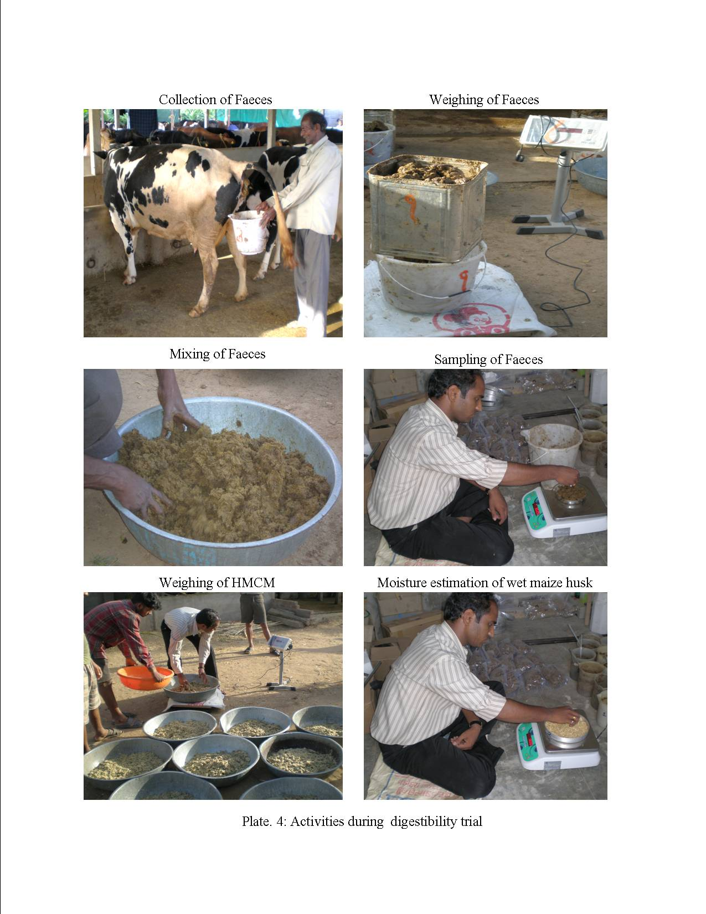
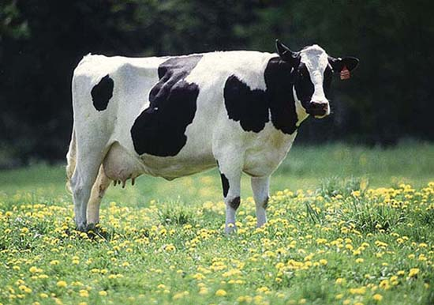

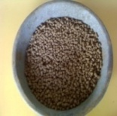
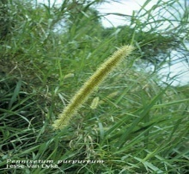
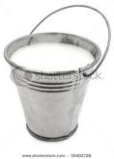
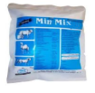
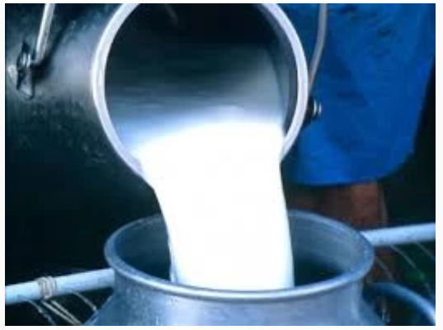
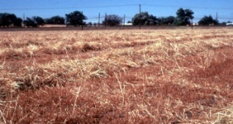
Feeding of Animal as per requirement
i) Water
ii) Energy
iii) Protein
iv) Mineral
v) Vitamin
Water, Energy, Protein, Mineral, Vitamin
i) Water
ii) Energy
iii) Protein
iv) Mineral
v) Vitamin

Slide 3
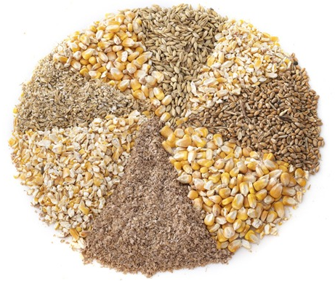
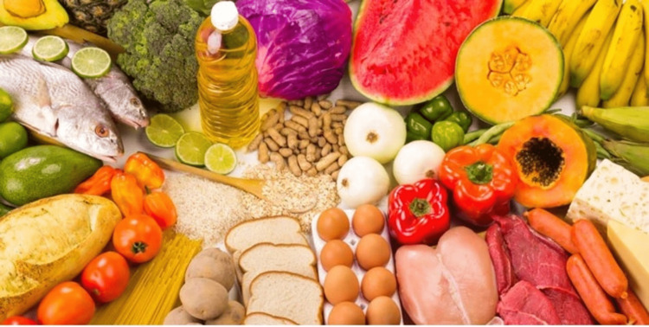
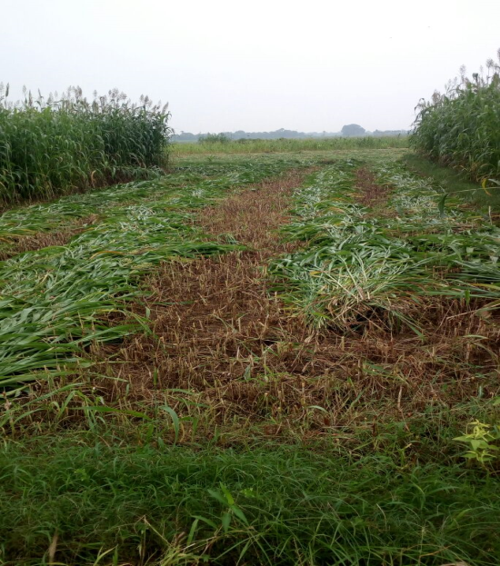
Nutrient
Any food constituent or group of food constituents of the same general chemical composition that aids in the support of animal life.
Order of priority:
i) water,
ii) energy,
iii) protein,
iv) mineral and
v) vitamins.

Slide 4
Proximate analysis is a system of approximating the nutritive value of a feed stuffs without actually going to feeding/ digestion trial.
Aim:
To compare chemical composition of feeds.
To determine proximate composition of feedstuff or any biological matter
To estimate nutritive values of feeds and fodder viz. digestibility, DCP%,
TDN% through digestion trials.
To identify unknown feed samples.

Slide 5
Wilhelm Henneberg and Friedrich Stohmann
Proximate principles analysis system in 1865 at Weende Experimental Station,
A village near the University of Goettingen in Germany.
The system consists of determinations of
water (moisture),
ash
crude fat (ether extract),
crude protein and
crude fiber.
vi. NFE- Nitrogen-free extract

Slide 6
Importance of proximate analysis
It is the basis for the description of feeds.
It is a common basis for feed purchasing and for ration formulation.
It is the starting point for more detailed analysis.

Slide 7
Moisture:
Expression of nutritive value of feedstuff or used for feeding of animals
(As-such Basis/ As-fed Basis/ As-is Basis/ As-received Basis).
The chemical composition and nutritive value are always expressed on a dry matter
(DM) basis.
2. Determination of moisture is essential in bulk purchasing of feed ingredients,
The cost of feed is also calculated on dry matter basis, so water/moisture content is the first step to be estimated in the any feed sample
3. Storage of feed:
when the new rain crop is harvested; normally the moisture content is high.
The safe limit for storage is 10-15 % moisture.
Feeding stuffs containing more than 15 % moisture should it may develop the undesirable moulds and fungus or may even catch fire due to hot fermentation.
4. Feeds with high moisture content may restrict the intake of other nutrients.

Slide 8
5. while ensiling, the moisture of forages has to be brought nearer to 70%.
Moisture content is usually determined by losses of sample weight in a hot air oven at 100°C for constant weight.

Slide 9
DM is calculated by weighing after drying to constant weight in an oven at 100-105ºC.
Grasses and silages are usually pre-dried at 60-70ºC and roots in small cut samples at 70ºC-80ºC, while starchy feeds can stand 120-140ºC.
Generally molasses, milk or feeds with high moisture content is preferably dried by increasing from 50ºC to 105ºC after 24hrs.
Moisture in molasses by “ Dairy search” method based on release of bound water by treatment with HCl and then extraction it with xylol.( Krishna et al., 1972)
Silage suffer losses of volatile components in oven drying.
So followed by Toluene distillation methods.

Slide 10
General methods of drying
1. High temperature drying
Using oven at Temp. 100ºC
This type of drying will losses of volatile labile compounds.

Slide 11
General methods of drying
2. Low temperature drying
Low temperature drying using vaccum drying oven (Temp. 30ºC, 16mm mercury pressure)
This type of drying will reduce losses of volatile labile compounds, losses due to prolonged enzymatic activity are likely to be large.

Slide 12
General methods of drying
3. Toluene distillation
For silage
The DM in silage is calculated from the volume of water removed by distillation in the presence of toluene.
A titrimetric determination of the total acidity of the distillate is used to correct the measured volume of the distillate for the volume.

Slide 13
General methods of drying
4. Dairy search method
“Dairy search” for moisture determination in molasses.
Developed at NDRI, Karnal
disintegrating the carbohydrate moiety with the help of HCl and completely extracting thereby bound water with the help of xylol.
Recovery of 95-98% of added distilled water in the molasses.

Slide 14
Classification of feed
Succulent (Moisture > 18%) and Non-Succulent (Moisture < 18%)
High moisture feeds
 | DM%
Green fodder | 15-30
Silage | 25-45
Haylage | 45-60
Wet byproducts | 10-25

Slide 15
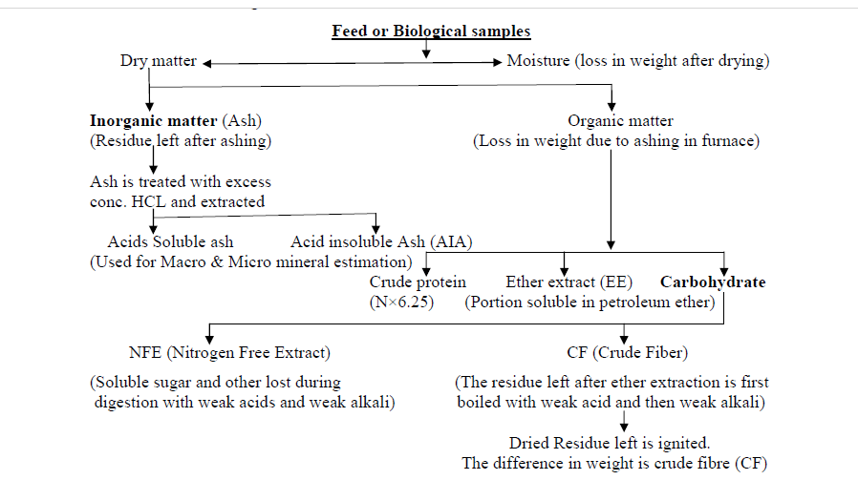

Slide 16
2. Ether extract (EE):
Crude fat is known as ether extract
Consists of glycerides of fatty acids, free F.A, chlorophyll, fat soluble, vitamins sterols, phospholipids,, volatile substances, waxes, resins,, etc.
(Organic acid , Alcohol and pigments)
Fat is estimated by extraction with petroleum ether ( boiling point 40-60ºC) by soxhlet extractor.

Slide 17
Significance of EE
1. Source of energy
2. EFA and fat soluble vitamins
3. EE component is not stable and makes the storage of high fat feeds difficult due to
rancidity.
4. True fats are esters of glycerol with 3 moles of FA,
while crude fat contains other
substances also which are less digestible and do not provide energy. Hence
overestimation of energy content.

Slide 18
3. Crude Fibre (CF):
In Weende’s system of analysis Carbohydrates could be grouped into the
Soluble Carbohydrate (starches and the sugars) and a coarse fibrous fraction (CF).
CF = Cellulose, hemicellulose and lignin
2. Estimated by treating the moisture and fat free sample with 1.25% acid and alkali.
3. Mostly undigested by monogastrics
Acid stomach digestion and the subsequent alkaline intestinal digestion.
Insoluble organic residue called CF.
4. Gives bulk and is laxative
5. Normal peristaltic movements of intestine dependent on CF
6. It decreases the digestibility of other nutrients also by increasing the passage rate and
acting as barrier to enzymes over soluble nutrients.

Slide 19
Classification of Feeds
Physical and chemical characteristic (NRC, International feed classes):
Dry forage and roughage
Succulent forage and pasture
Silage
Energy feed
Protein supplement
Mineral supplement
Vitamin supplement
Additives
Basis of CF content:
1. Roughage (CF > 18%) | 2. Concentrate (CF <18%)
a. Succulent (Moisture > 18%) and Non-Succulent (Moisture < 18%) | Based on Energy and DCP i. Carbaneous- Rich in energy- Cereal grains
b. Leguminous and Non- leguminous | ii. Proteinous- Oil seed cakes, Animal Protein
c. Green and Dry | iii. Intermediary-Brans,husks, chunies
Roughage on the basis of nutritive value
1. Maintenance type (3-5%) DCP | Non legume cereal fodders and grasses
2. Productive type (>DCP-5%) | Legume fodders & Hay
3. Non maintenance type (< DCP 3%) | Straws & Stovers

Slide 20
Protein Analysis
Crude protein estimated by Kjeldahl digestion procedure, where organic matter is digested by heating in concentrated sulfuric acid.
Nitrogen containing organic molecule form ammonium sulfate.
(except nitrate and nitrite)
Ammonia liberated by adding 40% NaOH.
Amount of ammonia is estimated by distillation and titration with standard solution (N/10 H2SO4 or N/10 HCl).
Crude protein (True protein + NPN) = N*6.25 (N in %)
Nitrogen portion of food divided into True protein nitrogen and non-poteinous nitrogen (NPN).
NPN: urea nitrogen, nucleic acid, ammonia nitrogen, uric acid nitrogen, free amino acids. Amines etc.

Slide 21
Significance of protein
CP is a quality control parameter
Protein as energy source- not recommended as 20% loss is there
NPN not utilized by poultry beyond 0.15%
Feeds used in poultry ration generally do not contain significant amount of NPN.
Concentrates : CF < 18%, TDN > 60%
i) Energy feeds | ii) Protein feeds
CP < 20% | CP > 20%
Cereal grains, Mill byproducts, Fruits | Animal Protein: CP > 47%
 | Plant protein- CP < 47 %
 | Ingredients | CP %
Green fodder | Non legume green fodder | 8-10
 | Legume green fodder | 18-20
Dry | Straws | 3-4
 | Legume straws | 6-8
Grains | Cereal grains | 8-12
 | Legume seeds | 18-24
By products | Brans | 12-14
 | Oil cakes | Less than 47

Slide 22
Ash
Inorganic constituent of food
Inorganic residue after complete ignition of sample at 550-650º C.
The residue after burning any biological material in furnace at 550ºC
Organic material:
DM-Ash
Main component is Silica
minerals (acid soluble) and acid insoluble ash (AIA)
AIA includes sand and silica.
Maximum permissible level 3%
Index of feed quality -reduces digestibility
Used as internal marker in feed quality evaluation as it is not digested.

Slide 23
NFE- Nitrogen Free Extract
Difference between the wt. of sample – (Moisture+EE+CP+CF+Ash)
Mixture of starches and sugars + some hemicellulose and lignin
Indicate non cellulose portion of feed CHO
Source of easily available energy

Slide 24
Limitation
Crude protein:
It over estimates feed protein values because:
Some nitrogen in inorganic ( nitrates, ammonium salts and urea- which have 46% nitrogen.
Assumes all N comes from protein but it is not always true (DNA, RNA, ammonia,
amino acids, NPN compounds)
In this method we use 6.25 (16% N) conversion factor for protein calculation but oilseed proteins contain 18.5% N and for Milk we use a conversion factor of 6.38.

Slide 25
Limitation
CF:
It does not give a true estimate of the least digestible part of fibre in many feedstuffs- particularly straw.
The fibrous fraction lignin is partly dissolved in NaOH solution and
hemicellulose is dissolved by both acids as well as alkali solution.
Thus, CF may be underestimated.
NFE may be overestimated
There is no direct method for estimation of nitrogen-free extract.
NFE contains accumulated errors from CP, CF, EE and ash.
Normally loss of volatile fractions is added in NFE.
The assumption about high digestibility of NFE and low digestibility of CF is always not true and the reverse is frequently observed.

Slide 26
Total Ash:
It is not truly representative of minerals levels in either quantitative or qualitative terms.
Ash may contain material of organic origin such as S and P from protein.
Some loss of volatile material in the form of sodium, Potassium, chlorine, phosphorus and sulphur occurs during ignition.
It does not partition biological material into well defined chemical constituents.
It cannot determine the amount of minerals, vitamins, or other micronutrients that will be present in the sample

Slide 27
Fractions of food/feed as per Weende’s system of analysis
 | Fraction | Components
1 | Moisture | Water and volatile materials and bases, if present in samples
2 | Ash | Essential elements Major: Ca, P, Mg, Na, K, S, Cl Trace: Fe, Cu, Co, I, Zn, Mn, Mo, Se, F, V, Cr, Sn, As, Si, Ni Non essential elements: Al, B, Pb, Ti Silica
3 | Crude Protein | Proteins, amino acids, amines, nitrates, nitrogenous glycosides, glycoproteins, B-vitamins and nucleic acids
4 | Ether Extract | Fats, oils, organic acids, pigments, sterols, waxes and vitamin A, D, E and K
5 | Crude Fibre | Cellulose, hemicellulose and lignin
6 | Nitrogen Free Extract | Part of hemicellulose, lignin, sugars, fructans, starch, organic acids, pectins, tannins, resins, pigments and water soluble vitamins

Slide 28


